Slide 1
Steven J. Weisman, MD Jane B. Pettit Chair in Pain Management Children’s Hospital of Wisconsin Professor of Anesthesiology and Pediatrics Medical College of Wisconsin Milwaukee, WI
Developing the Framework for a Comprehensive and Evidence-Based ACTTION-APS-AAPM Pain Taxonomy (AAAPT) for Acute Pain
Pediatrics, Geriatrics, Special Populations

Slide 2
Disclosures: 2014-2016
Luitpold: DSMB
Pfizer: Pediatric Advisory Committee for Lyrica
Depomed: Clinical Trial
Cadence: Clinical Trial
Gruenenthal: Clinical Trial

Slide 3
Objectives
Define Special needs populations for the AAAPT for Acute Pain
Are there unique situations/differences in these populations?
Considerations in the AAAPT 5 dimensions

Slide 4
Possible Special Populations
Neonates/Infants
Children/Adolescents
Patients with developmental delay/
cognitive impairment
Geriatrics
Pregnancy/Breast feeding women

Slide 5
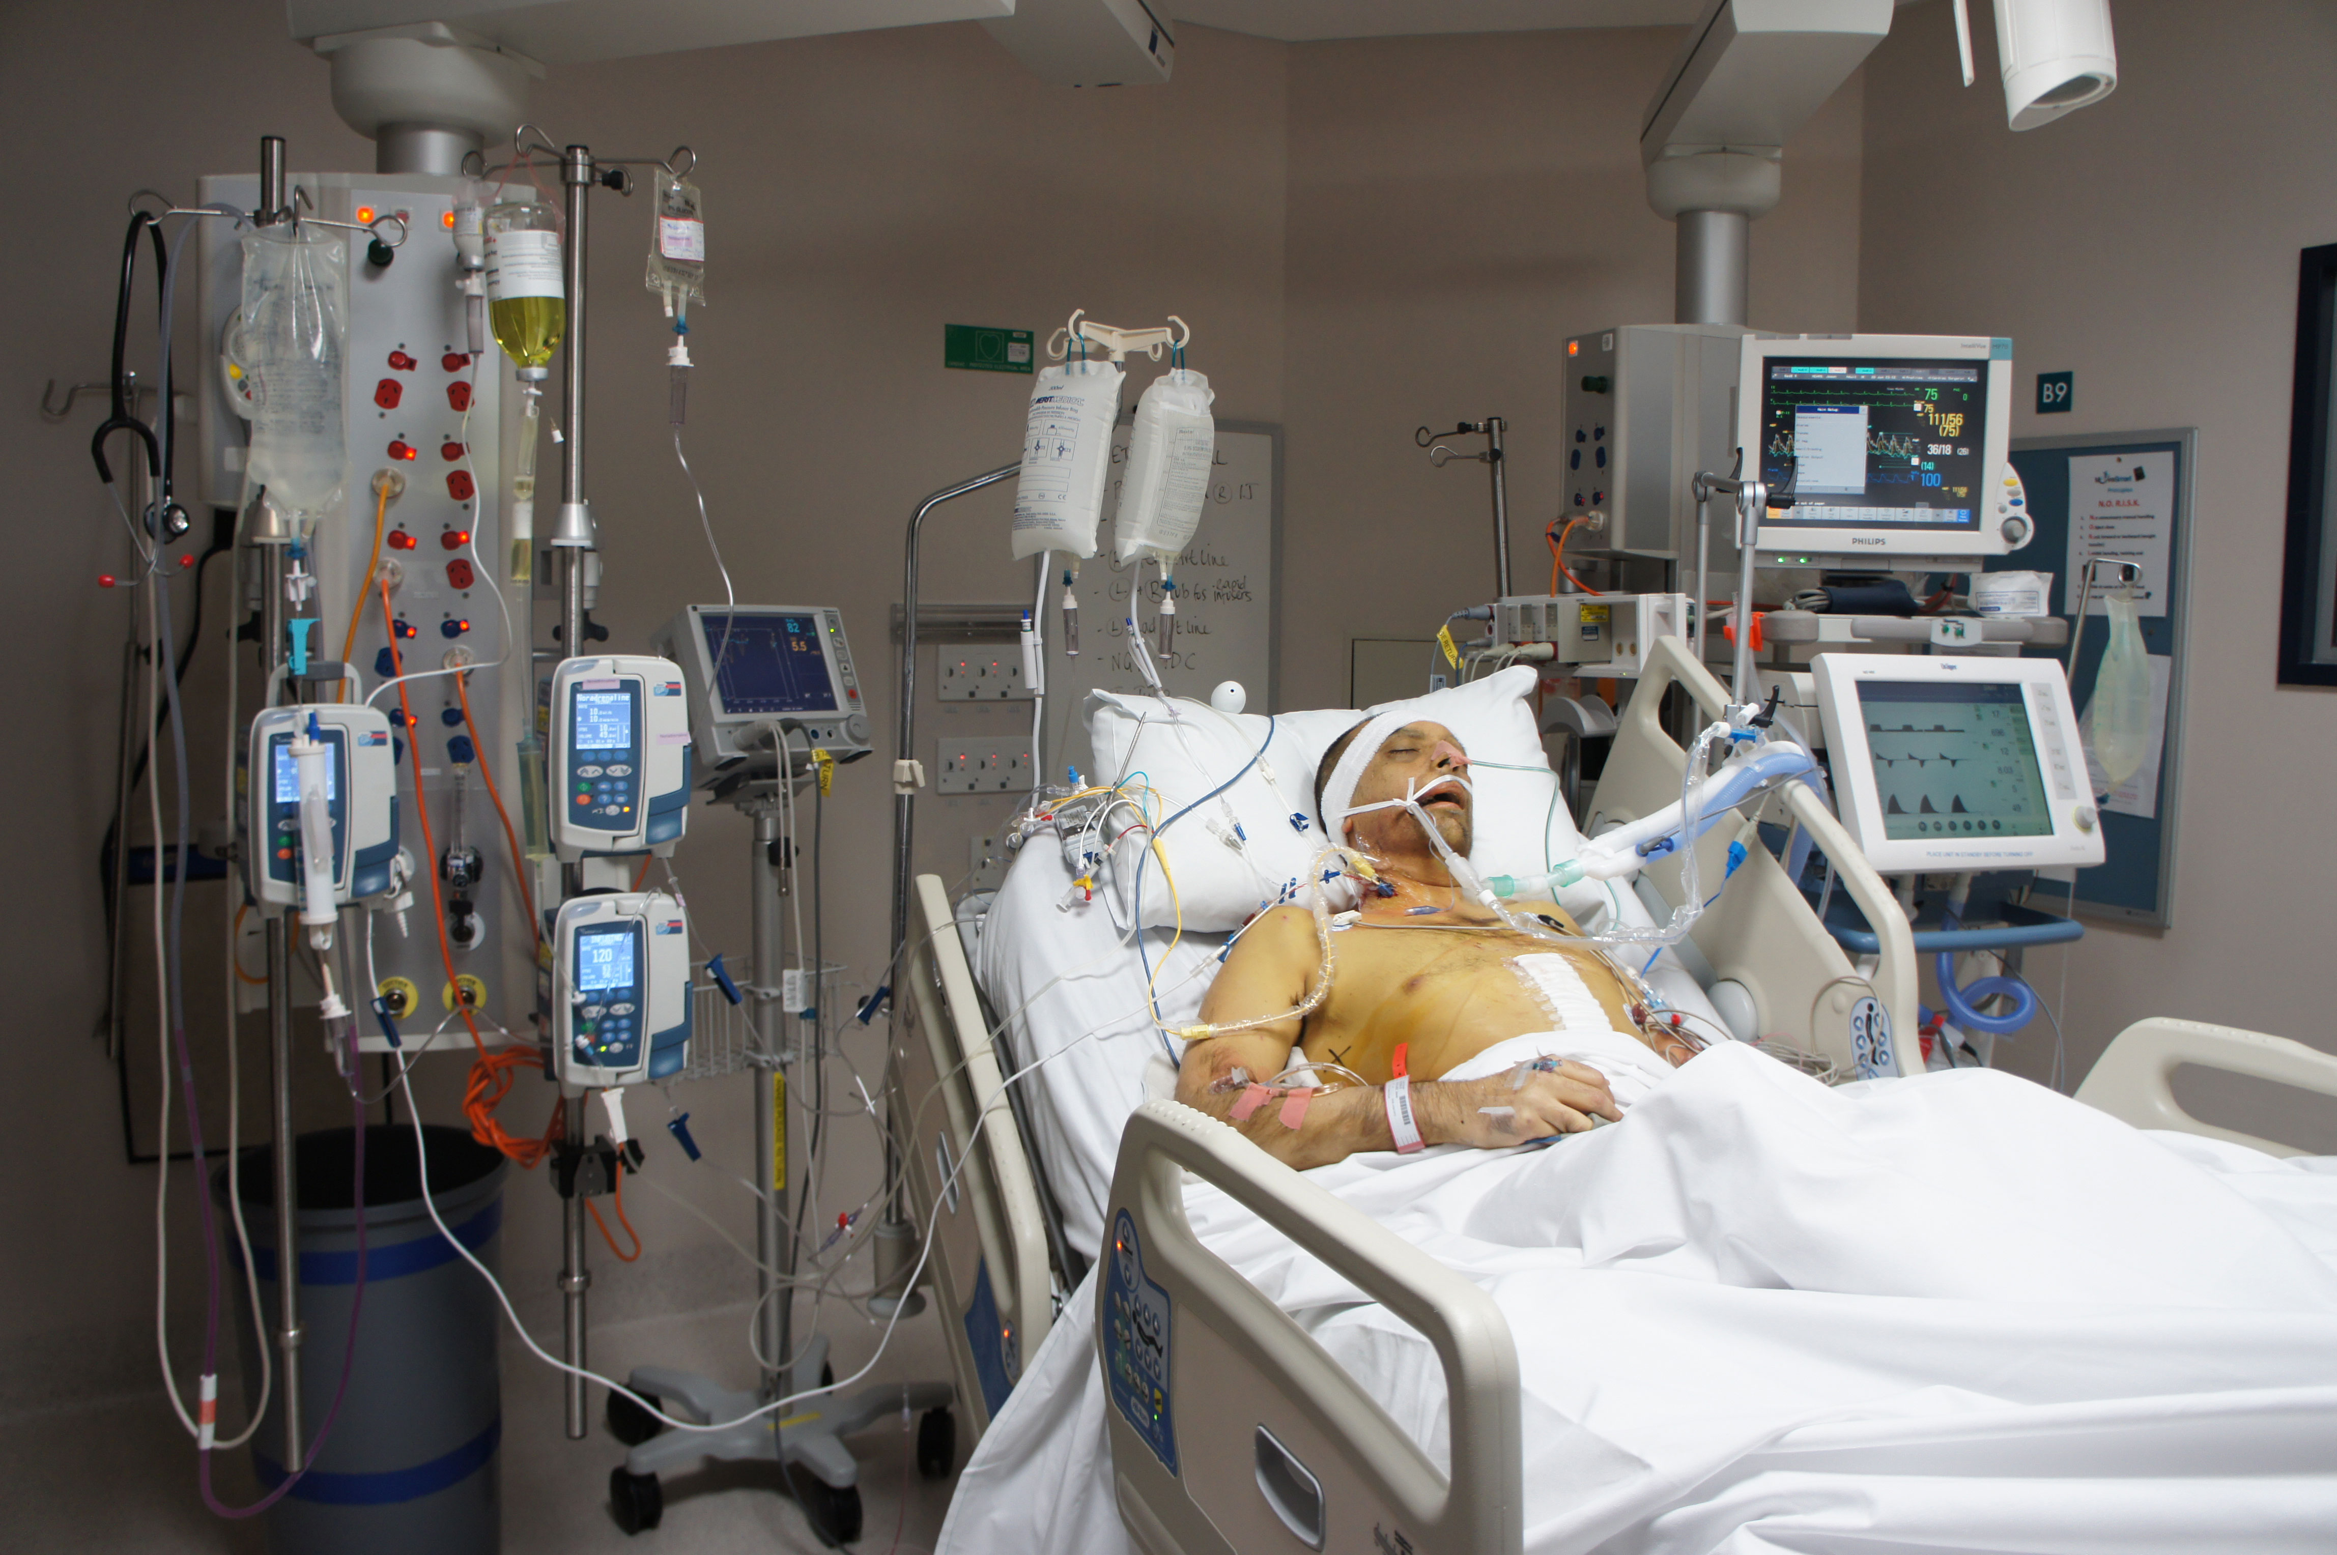
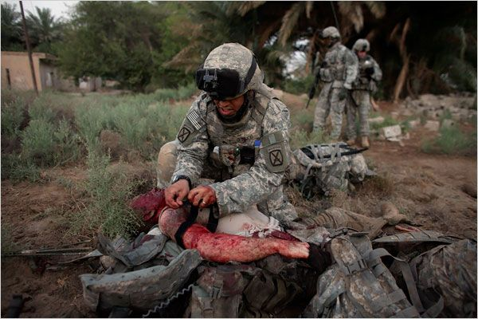
Possible Special Populations
Critically ill patients
Substance abusing patients
War injured
Immigrants/non-native speaking patients

Slide 6
Proposed Dimensions
1: Event or Core Criteria
2: Host/Risk Factors
3: Pain quality incl. temporal and spatial features
4: Environmental context (milieu)
5: Pathophysiology incl. pain and putative mechanisms
6: Impact (functional interference)

Slide 7
Dimension 1: Event/Core Criteria
Some of these populations cannot offer self-report as means to define pain type
Consideration should be given to a taxonomy that is therefore event/etiology defined
There may be considerable variability in the significance of a diagnostic category across special populations (ie needle pain)
Pain defining characteristics may have to be assumed in some of these populations

Slide 8
Event-based Taxonomy: Dimension 1
Acute illness (appendicitis, strep throat)
Trauma (penetrating, burn, fracture)
Surgery
Procedures (needles, biopsy, I&D, cryotherapy)
Disease (Cancer, infection, arthritis, Sickle Cell)
Treatment-related (ChemoTx, RadiationTx, Mab therapy)
Ischemic pain (Compartment syndromes, vascular insufficiency [abdomen/heart])

Slide 9
Dimension 1: Challenges
Pain assessment is a challenge in these populations
Altered perceptions of pain may not be describable
Extremes of age may alter significance of individual pain conditions
Cultural differences may affect report of criteria

Slide 10
Dimension 2: Host/Risk Factors
Susceptible populations may have altered acute pain responses (neonates/premies)
Co-morbidities in elderly
Prior pain experience
Multitude of underlying diseases and experiences
Neuorpsychobiology

Slide 11
Dimension 3: Pain Quality
In children, this is not considered an acute pain domain (PedIMMPACT J of Pain, 2008)
Impossible to characterize in many of these special populations (language, old, ICU)

Slide 12
Dimension 4: Environmental Context
These may play an important role in the need to treat acute pain
Acute pain of labor
Acute pain with war injuries
Immigrant/refugee population with acute injuries

Slide 13
Dimension 5: Pathophysiology
Largely similar across populations
Physiologic impact of acute pain may have variable outcomes in some of these populations
Neonates (Anand and Hickey, NEJM, 1992)
Elderly Hip Fractures (Morrison, et al Pain, 2003)

Slide 14
Dimension 6: Impact (Function)
These populations have quite variable baseline functional levels
Sleep cycles quite different in infants
Emotional responses may be immeasurable in the extremes of age, in the ICU and may vary by culture and milieu (ie delivery of healthy baby)

Slide 15
Cognitively Different Populations
Dimension 1: May be extremely challenging to define in terms of time, descriptors; epidemiology and specific tissue injury could be defined
Dimension 3: May be near impossible to frame quality and temporal features
Dimension 4: likely definable
Dimension 5: similar
Dimension 6: May be much harder to define and needs to be tailored to baseline

Slide 16
Conclusions
Special populations will challenge the application of the taxonomy
Challenges in pain assessment may make definition of dimension 1 and 6 difficult
Language (lack of or linguistic communication challenges) may make use of the taxonomy difficult

