Slide 1
Taxonomy for Acute Cancer Pain
Developing the Framework for a Comprehensive and Evidence-Based ACTTION-APS-AAPM Pain Taxonomy (AAAPT) for Acute Pain, April 29, 2016
Knox H. Todd, MD, MPH
Director, EMLine.org
Founding Chair, Department of Emergency Medicine
The University of Texas MD Anderson Cancer Center

Slide 2
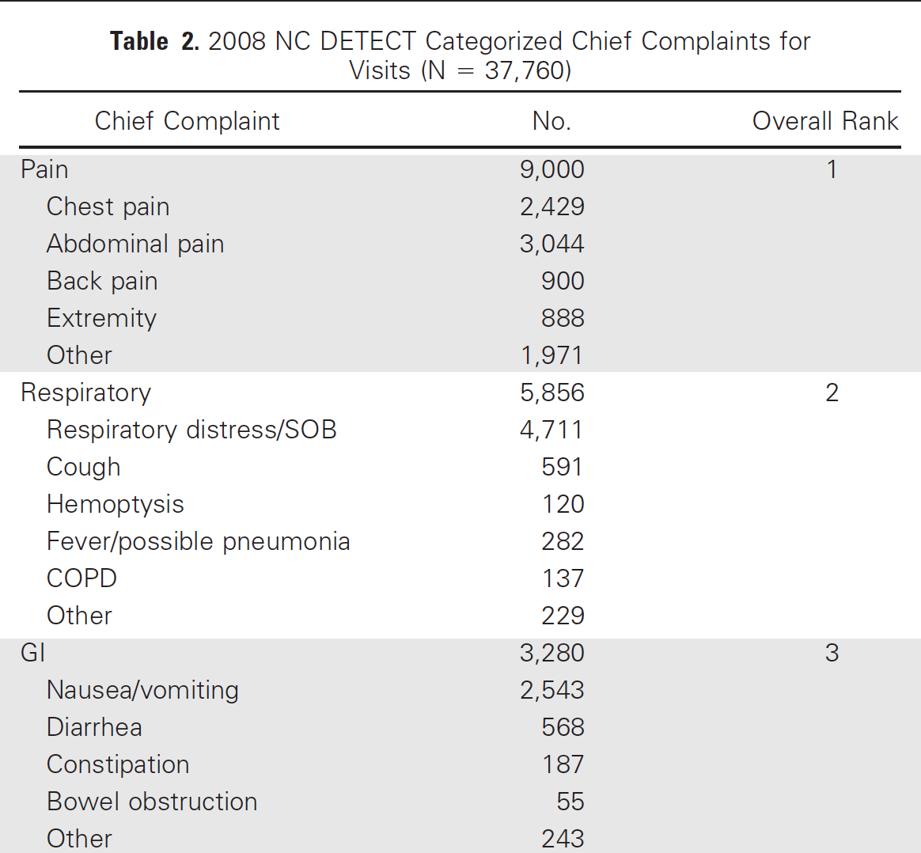
Emergency Department Cancer-related Visits
Why do patients with cancer visit emergency departments? Results of a 2008 population study in North Carolina
First study to provide a population-based snapshot of ED visits by patients with cancer
Pain #1 reason for visit
Visit may be index presentation leading to cancer diagnosis
Pain resulting from cancer progression, treatment toxicities, or complications of surgery
ED visits weigh heavy on our patients and often portend a worsening prognosis

Slide 3
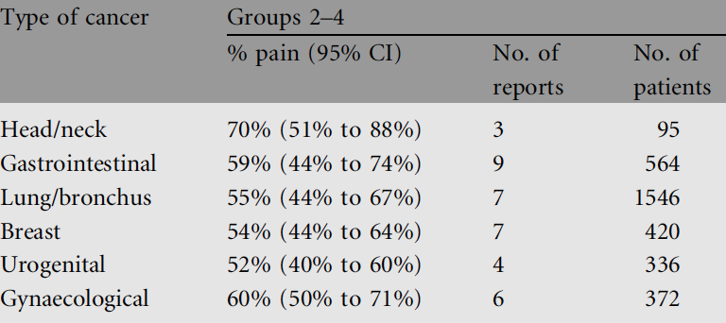
Cancer Pain Prevalence

Slide 4
Cancer Pain Societal Context
“Pain is a bio-psycho-social phenomenon. Nociception reflects anatomy and physiology, but cultural and social factors are the foundation for the expression and treatment of pain.” (Rey 1993)
“[T]he golden rule in cancer not amenable to cure by surgical eradication, is to initiate at the earliest moment the administration of opium or morphia in small, continued, gradually-increased doses. … Making certain local exceptions, the patient with an incurable malignant tumour should thus become permanently subject to the morphine habit, purposely induced.” (Snow 1893)
“The use of narcotics in the terminal cancer [patient] is to be condemned… Morphine usage is an unpleasant experience to the majority of human subjects because of undesirable side-effects. Dominant in the list of these unfortunate effects is addiction.” (Lee 1941)

Slide 5
Assessment of Acute Cancer Pain
Accurate, thorough, and systematic assessment of acute cancer pain may help to:
Identify underlying etiology and mechanisms
Determine prognosis
Develop treatment plans
Assessment tools for cancer pain, treatment plans, related symptom clusters
Edmonton Classification System for Cancer Pain (ESC-CP)
Cancer Pain Prognostic Scale (CPPS)
Pain Management Index (PMI)
Classification of Chronic Pain (IASP)
Opioid Escalation Index (OEI)
Brief Pain Inventory (BPI)
MD Anderson Symptom Inventory (MDASI)
Rotterdam Symptom Checklist (RSC)
Memorial Symptom Assessment Scale (MSAS)
History of past approaches to cancer pain taxonomy
Limitations, face and content validity, consensus-based development, need for additional validation studies, publication standards

Slide 6
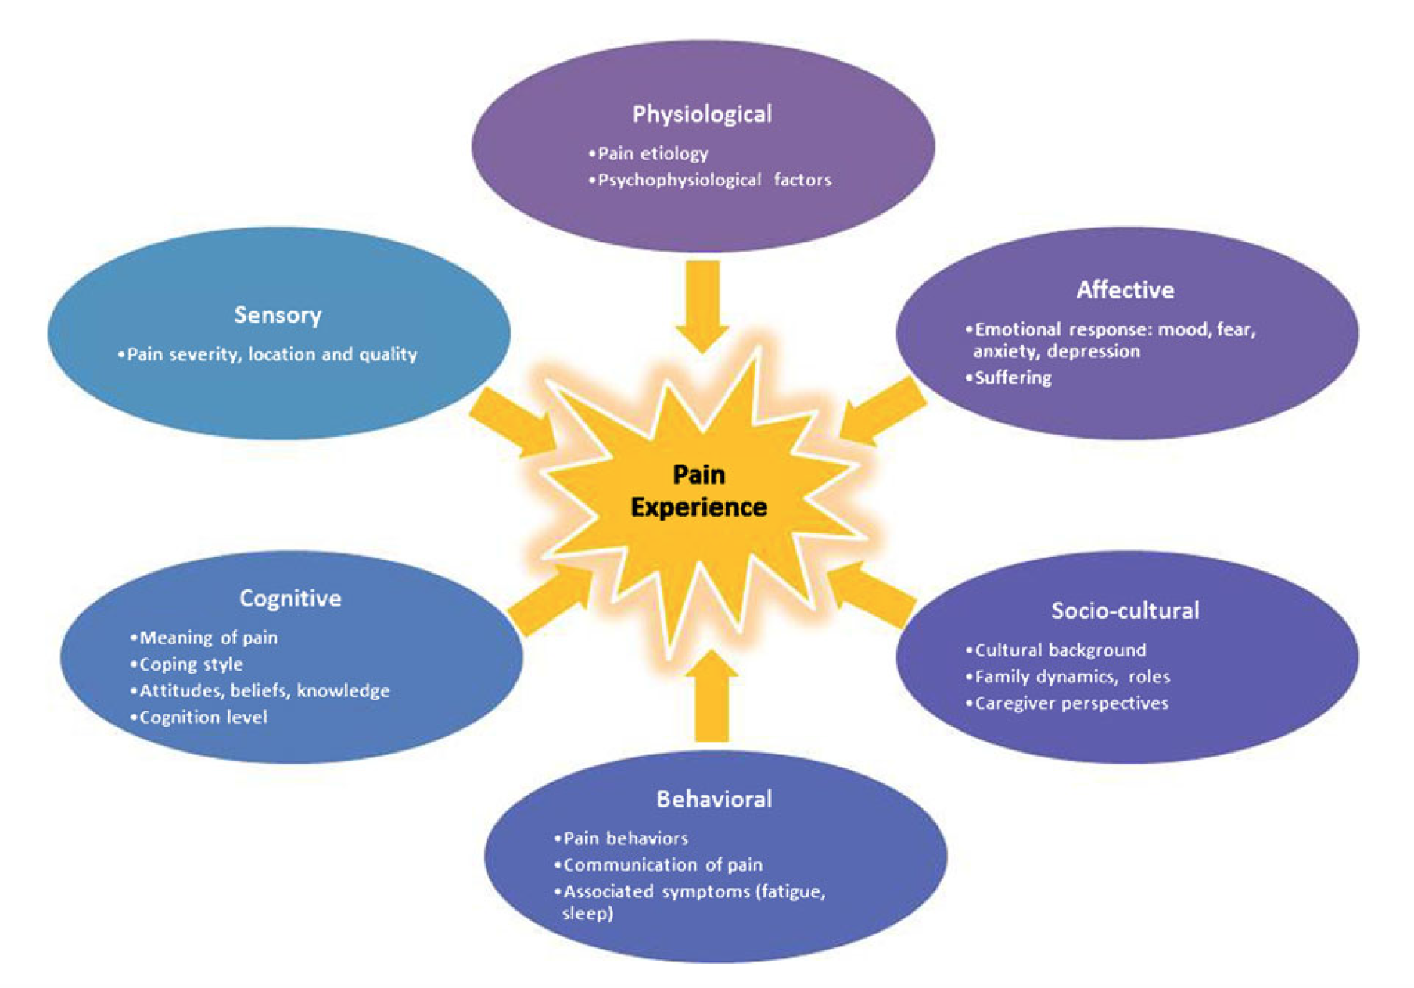
Multidimensional Assessment of Chronic (or Acute) Cancer Pain

Slide 7
Cancer Pain Classification
Acute or Chronic
Cancer Pain
Neuropathic
Mixed
Nociceptive
Tumor invasion or effects of treatment (eg, malignant plexopathy, leptomeningeal disease, chemoneuropathy)
Somatic
Visceral
Inflammation or tumor invasion of bone, joints, or soft tissue (eg, bony metastases, vertebral compression fractures)
Tumor infiltration, stretching, distention, or ischemia of viscera (eg, hepatic capsule distention, bowel obstruction, peritoneal carcinomatosis, constipation)
Notes:
-Pain has historically been classified as acute (such as pain following injury), chronic, or as headache.
-Chronic pain had been arbitrarily defined as pain lasting greater than 6 months.
-Since changes in the nervous system leading to chronic pain have been found to occur within 24 hours after injury, chronic pain is said to occur when symptoms last longer than the typical timeframe expected for resolution. This can be found even after only a few weeks.
-Subcategories of pain:
-Neuropathic-involves known damage to the nervous system
-Mixed- Cancer often will cause both nociceptive pain as well neuropathic pain if there is invasion of neural structures.
-Nociceptive- Can be divided into somatic and visceral pain
-Somatic- involves ongoing pathology of bone, muscle, fascia, skin.
-Visceral- Internal organs can be a source of pain due to distension, inflammation, or compression. Chronic visceral pain includes conditions such as irritable bowel syndrome, pancreatitis, and bladder pain.
- It should be noted that most of these chronic conditions may have superimposed neuropathic changes of the nervous system, which provides the rationale of anticonvulsant adjunct therapy for many chronic pain conditions.

Slide 8
Acute Cancer Pain Etiology
Tumor
Non-Cancer Pain
Treatment
Bone
Viscera
Nerves
Surgery
Chemotherapy
Radiotherapy
Vessels
75%
25%

Slide 9
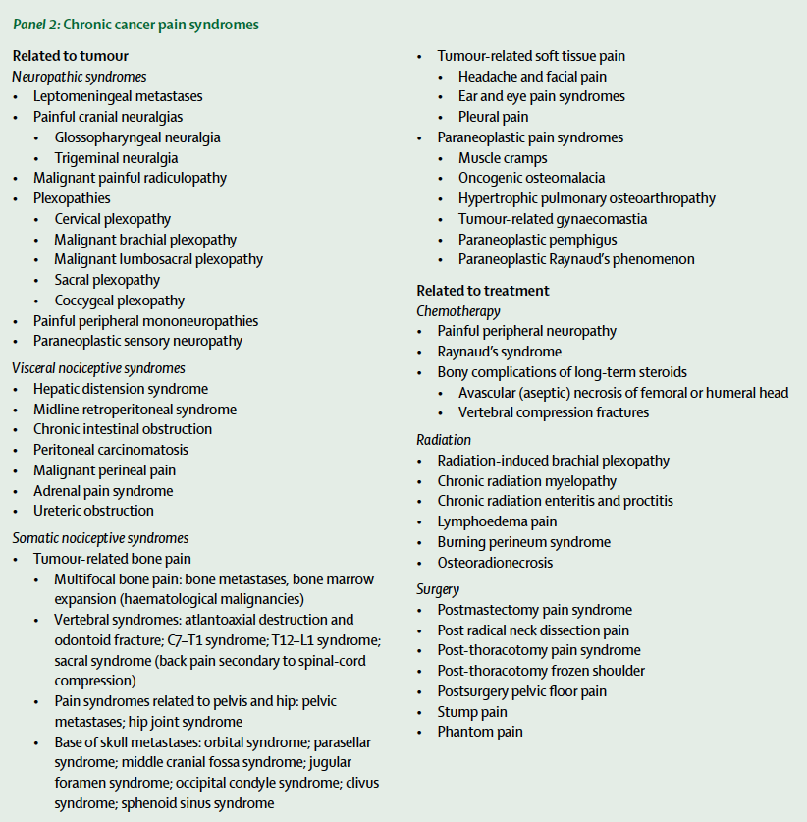
Dimensions 1 & 2
Generally, sufficient information at this point to formulate an understanding of pain etiology.
Additional laboratory testing and imaging to diagnose:
Cause of pain
Pain syndrome
Inferred pathophysiology

Slide 10
Approach
Apply five dimensions from the chronic pain AAAPT to “Acute Cancer Pain”
Dimension 1: Core diagnostic criteria
Dimension 2: Common features
Dimension 3: Common medical comorbidities
Dimension 4: Neurobiological, psychosocial and functional consequences
Dimension 5: Putative neurobiological and psychosocial mechanisms, risk factors, and protective factors
Propose candidate acute cancer pain models for study
Prevalence/severity
Specificity
Proposed mechanisms
Animal models
Therapeutic opportunity

Slide 11
Dimension 1
Core diagnostic criteria of acute cancer pain
Symptoms, signs, and diagnostic test findings required for the diagnosis.
IASP pain definition: “Pain is an unpleasant sensory and emotional experience associated with actual or potential tissue damage or described in terms of such damage.”
Is cancer present?
Pain (acute, subacute, chronic) is often the presenting feature of previously undiagnosed cancer.
Is a tissue diagnosis required or is clinical evidence sufficient?
Is pain cancer-related?
Cancer and multiple comorbidities involving pain commonly coexist.
Is radiation or chemotherapy-related pain considered cancer pain? (probably so)
Is post-procedural or post-surgical pain considered cancer pain? (perhaps so, depending on differences in pain features or course between cancer and non-cancer pain)
Is pain acute?
Given multiple etiologies for pain during cancer history, how do we differentiate acute, recurrent, chronic pain?
Acute-on-chronic pain?
Given that it is often due to disease progression, can some breakthrough pain be considered acute?
Multiple overlapping etiologies for pain, with multiple overlapping patterns.
Is chronic pain an exclusion criterion for acute pain trials?

Slide 12
Dimension 2
Common features of acute cancer pain
Intensity
Temporal features (onset, course, daily fluctuation, and breakthrough pain)
Location and radiation
Quality of pain
Provoking or relieving factors
Differences in features for pediatric populations or the cognitively impaired (proxy assessment)
Wide variation in pain features across a multitude of cancer pain syndromes
Non-pain features: symptom clusters (fatigue, wasting, depression, etc.) commonly present

Slide 13
Dimension 3
Common medical comorbidities of acute cancer pain
Cancer disproportionately afflicts older patients with multiple medical comorbidities
Multiple overlapping (cancer or non-cancer) pain conditions often co-exist
Comorbidities predict prognosis and approach to pain and cancer treatment
Comorbidities associated with toxicity and influence both cancer and pain treatments
Common psychiatric comorbidities of acute cancer pain
Depression and anxiety disorders
Personality disorders
Substance-use history (cancer does not vaccinate against substance abuse)

Slide 14
Dimension 4
Neurobiologic, psychosocial and functional consequences of acute cancer pain
Effect on physical function and well-being
Effect on mood, coping, and related aspects of psychological well-being
Effect on role functioning and social and familial relationships
Effect on sleep, mood, vitality, and sexual function
Distress related to psychosocial or spiritual concerns
Existential crises
Caregiver burden and concrete needs
Problems in communication, care coordination, and goal setting
Given potential for negative functional trajectory, may require enhanced attention to prevention of functional deterioration, rather than restoration of function

Slide 15
Dimension 5
Putative neurobiological and psychosocial mechanisms, risk factors and protective factors for acute cancer pain
Many cancer types characterized by systemic inflammation; higher rates of acute-to-chronic pain transition
Acute cancer pain conditions may be sensitive models for studying mediators of the acute-to-chronic pain transition
Increasingly, genetic and biomarker data are available for those with cancer; opportunities for concurrent pharmacogenetic analgesic research
Multiple putative biomarkers of pain treatment response among cancer patients
The promise of personalized cancer care and personalized pain treatment
It seems likely that psychological factors (depression, anxiety, catastrophizing) and pain/cancer beliefs would tend to be stronger mediators of pain chronification in a condition as fraught with meaning as cancer-related pain
Do beliefs regarding opioid addiction risks impact provision of optimal analgesic therapy?
The more specific the acute pain model, the greater likelihood that it will inform pain science
Is pain an independent predictor of cancer survival? What might be the mechanism?
Mu-opioid receptor promotion of epithelial mesenchymal transition (EMT) in lung cancer?

Slide 16
Additional issues
How do we capture the extent of neoplastic disease, planned treatment, and prognosis?
Impact of pain therapy (antioxidants, opioids) on cancer prognosis?
Treatment before diagnosis (common in EM), potential hazards (SCC/steroids/lymphoma)
Can we better clarify the nature and quality of previous testing and past treatments?
Consistency with NCI Common Toxicity Criteria?
Acute pain syndromes and biomarkers that might prompt cancer screening evaluation
Risk factors for analgesic adverse effects beyond the patient
Considerations of respondent burden for both clinician, patient and investigator?
How can (national and international) editorial consensus be reached?
International acceptance, cultural robustness of instruments?

Slide 17
Candidate Models for Acute Cancer Pain
Criteria
Prevalence/severity
Specificity
Proposed mechanisms
Animal models
Therapeutic opportunities
Candidates
Head and neck cancer pain
Bony metastasis pain
Paclitaxel acute pain syndrome
Mucositis pain
Post-mastectomy pain
Others:
Post-thoracotomy, post-radical neck dissection pain?
Procedural pain?
Stump pain, phantom limb pain?
Radiation-induced plexopathy?
Hepatic capsule distention?

Slide 18
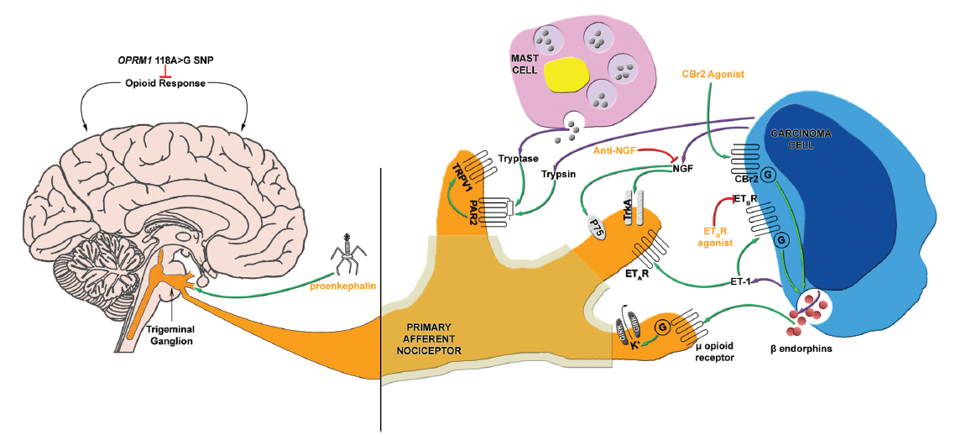
Candidate Model: Head and Neck Cancer Pain
Head and Neck Cancer
Highest pain prevalence
Early localized pain
Dense trigeminal innervation
Incident pain and prognosis
High functional consequences (speech, chewing, swallowing, interpersonal relations)
Pain an independent predictor of survival in head and neck cancer
Chemo/radiotherapy-induced pain
Opportunities to prevent acute-to-chronic transition
Murine model with putative nociceptive mediators (endothelin-1, proteases, NGF)

Slide 19
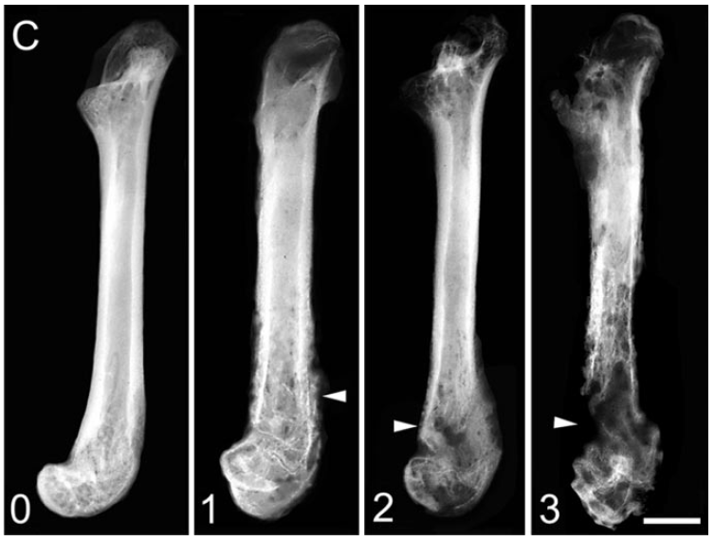
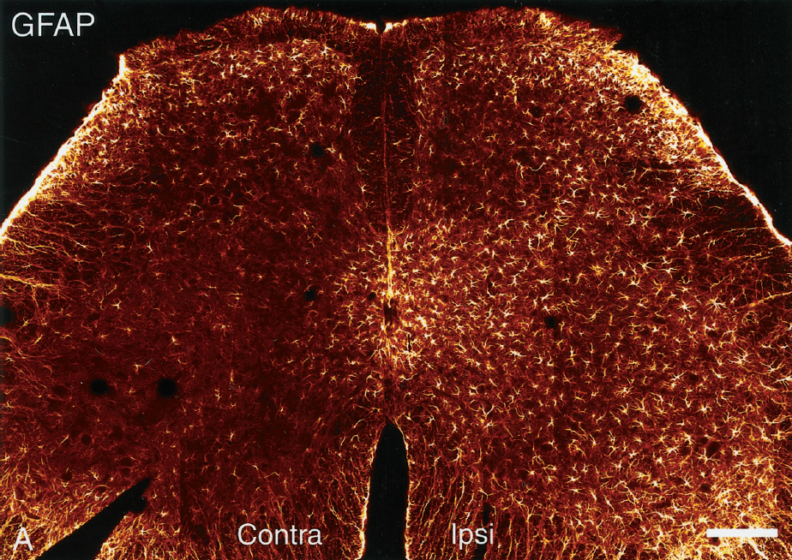
Candidate Model: Bony Metastasis Pain
Bony metastasis
Breast, prostrate and lung cancer most common
Pain may be early symptom
Severe functional consequences
No pain in primary location, but severe pain in metastatic site
Why do some bone metastases cause pain and others do not?
Do specific pain phenotypes predict response to analgesic therapy?
Proposed mediators (neurotrophins, ASIC1, TRPV1, cytokines, oxidative stress, CGRP)
Sarcoma femur murine model

Slide 20
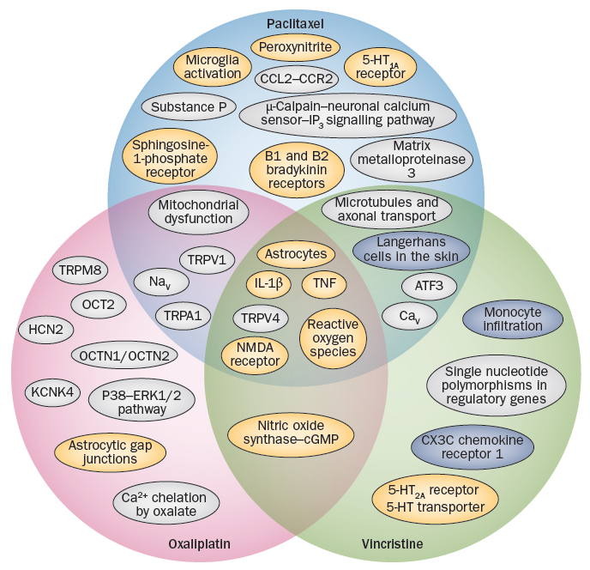
Candidate Model: Chemotherapy Associated Pain
Up to 80% of patients during chemotherapy
Severe adverse effect that can limit choice and dose of therapy
Acute to chronic transition
Many analgesics approved for neuropathic pain fail in CIPNP trials
Murine models
Distinct (and overlapping) mechanisms involved in CIPNP
Blue: periphery
Grey: dorsal root ganglia
Yellow: spinal cord
Potential for mechanism-based treatment
Duloxetine for oxaliplatin?
Neuroprotective and anti-inflammatory agents for paclitaxel or vincristine?

Slide 21
Candidate Model: Mucositis Pain
Oral/GI mucositis
Chemotherapy for solid tumors/lymphoma: 50%
Radiotherapy for H&N cancer: 66%
High dose chemotherapy for BMT: 75%
Single most debilitating complication of BMT
Common cause of ED visits for pain control, poor oral intake, infection
Requirements for fluid replacement, TPN, gastrostomy, hospitalization
Increases cost by 2-3 times
Dose-limiting effect of therapy, impacting survival
WHO, NCI/CTCAE, ECOG, Oral Mucositis Assessment Scale
Topical cryotherapy, NSAIDs, lidocaine, glutamine, antioxidants, N-acetylcysteine and sucralfate; opioids; keratinocyte/fibrocyte growth factors, low level laser therapy
Putative mechanisms and animal models

Slide 22
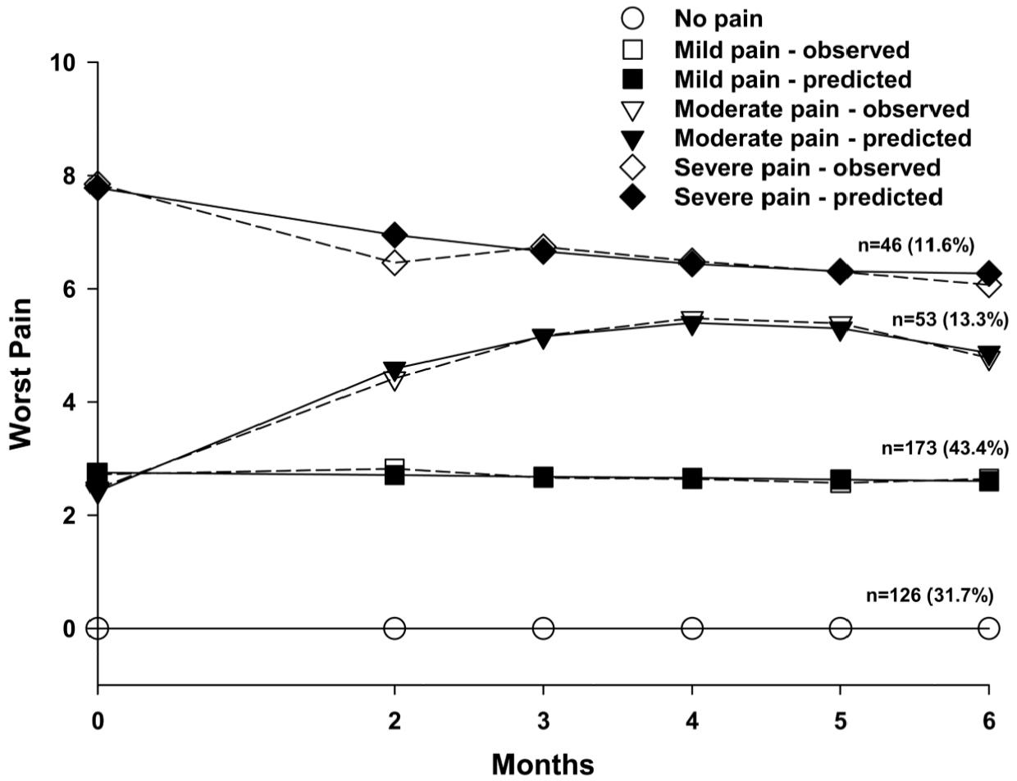
Candidate Model: Post-Mastectomy Pain
25% mod/severe persistent pain with precise definition
Risk factors
Younger, non-white, low SES
Pre-op symptom severity
Peri-operative pain, breast symptoms, radiation therapy
Ongoing efforts to determine phenotypic and genomic risk factors
Cancer vs. non-cancer surgery?

Slide 23
Additional Candidate Models
Post-thoracotomy, post-radical neck dissection pain?
Procedural pain?
Stump pain, phantom limb pain?
Radiation-induced plexopathy?
Hepatic capsule distention?

Slide 24
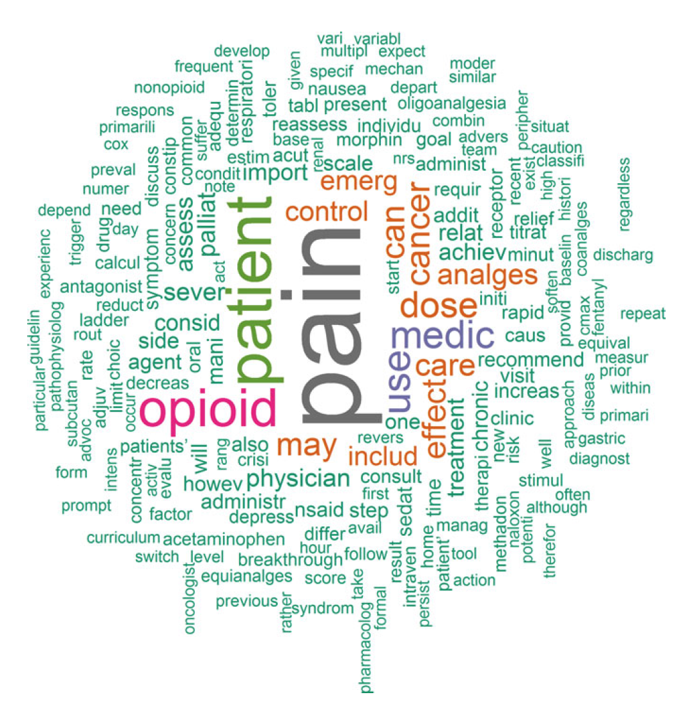
Opportunities and Sustainability
Wealth of data, computational power, existing organizational infrastructures, promise of personalized medicine, pharma support
NCI budget larger than NHLBI and NINDS combined
NIH Research, Condition and Disease Categorizations Tool (FY17 estimates)
Cancer: $6.3 billion (#4 of 265)
Pain: $481 million (#63 of 265)
260 US nonprofit organizations (budgets $2.2 billion) target cancer, exceeding the number devoted to heart disease, AIDS, Alzheimer’s disease and stroke combined.
NCI/Office of Emergency Care Research recently launched Comprehensive Oncologic Emergencies Research Network (CONCERN)

