Slide 1
Acute musculoskeletal pain, including soft tissue conditions
Steven Stanos, DO
Medical Director
Swedish Pain Services
Swedish Health Systems
Seattle, WA

Slide 2
Disclosures
Consultant:
Astra Zeneca, Collegium, Daiichi Sankyo, Endo, MyMatrixx, Pfizer, Scilex
Research:
Grunenthal

Slide 3
AAPT Diagnostic Criteria: Dimensions₁
1: Core diagnostic criteria
2: Common features
3: Common medical comorbidities
4: Neurobiological, psychosocial and functional consequences
5: Putative neurobiological and psychosocial mechanisms, risk factors, and protective factors
Biologically Plausible, Exhaustive, Mutually exclusive, Reliable, Clinically useful, Simple₂
1. Dworkin RH et al. J Pain (Suppl.) 2016; 1-9.
2. Fillingim RB et al. J Pain 2014;15:241-249.
Notes:
Intentional to leave off vascular

Slide 4
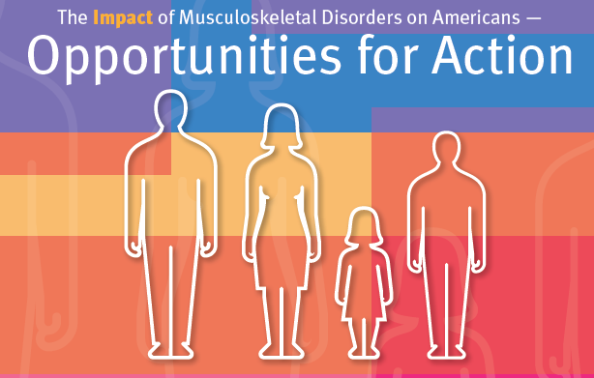
Burden of MSK Diseases in US, Prevalence, Societal and Economic Cost, 3rd Ed.
Notes:
2012 1 in 2 adults dx with MSK condition
US Bone and Joint Initiative 2016
Bone and Joint Initiative
Bone and Joint Decade 2010-2020
BoneandJointburden.org

Slide 5

Impact of MSK Disease
Burden of MSK Diseases in US, prevalence, Societal and Economic Cost, 3rd Ed.

Slide 6
Musculoskeletal related pain
Most common reasons for self-medication and entry into the health care system
MSK pain affects 1 in 4 and is leading cause of serious long-term pain and physical disability
In US, cost increased by 18% in 5 yrs, total cost of $254 billion
MSK injuries place burden on military service and is leading reason for medical care for nonbattle injuries and leading cause for disability discharge from service
Walsh NE, et al. Arch Phys Med Rehabil 2008; 89:1830-45.
Notes:
Cameron and Owens

Slide 7
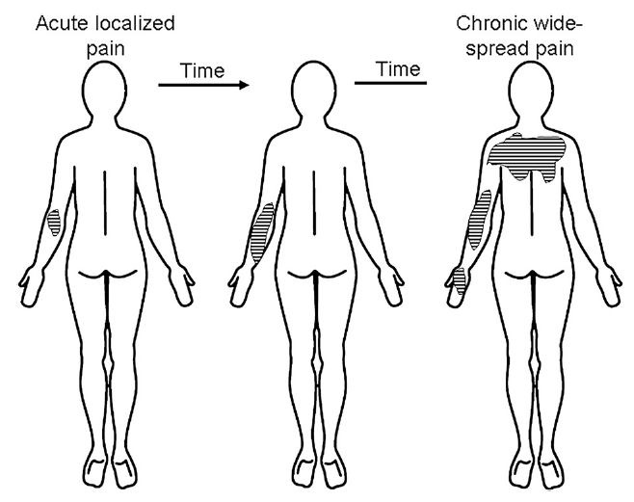
Arendt-Nielsen, Graven-Nielsen. Best Pract & Res Clin Rheum. 2011;25:209-226.

Slide 8
Major Categories of Musculoskeletal Conditions
Joint conditions
Osteoporosis
Spinal disorders
MSK injuries
Childhood disorders
ACTTION-APS Taxonomy for Chronic Pain
Musculoskeletal Pain System
  1. Fibromyalgia, myofascial, widespread pain
  2. Gout
  3. Osteoarthritis
  4. Rheumatoid arthritis
  5. Spondyloarthropathies
Notes:
Joint conditions: RA, OA
Osteoporosis: fragility fractures
Spinal disorders
MSK injuries: high-energy limb fractures, strains, sprains, occupational, sports related
Childhood disorders
Medial Diagnostic approaches (ICD-10) prioritize identification of pathophysiological mechanisms, vs Syndromal approaches (DSM-V classify condions based on clusters of symptoms. AAPT is a hybrid
AAPT different from hisotrical biomedical view of pathophys of pain, emphasizing peripheral markers of structural pathology. These pathophysiologic measures generally corresponded poorly to chronic pain severity and fail to account for interindividual variability

Slide 9
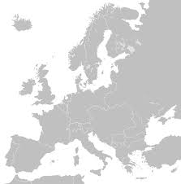
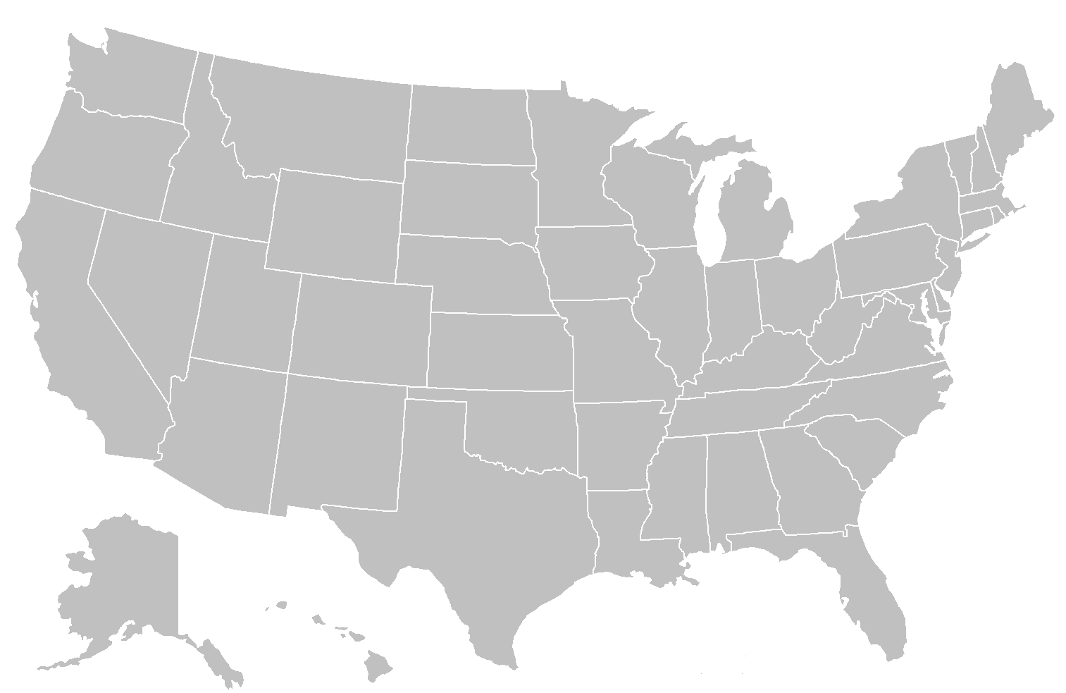


“Musculoskeletal”?
Depends whom and where you ask.
Notes:
Insert Europe and USA Map

Slide 10
Consider 3 common “MSK” conditions
1. Acute Low Back Pain
2. Sprains & Strains
3. Knee Pain

Slide 11
1. Acute Low Back Pain: Traditional Approach
Anatomical
Discogenic
Compressive
Soft tissue
  sprain/strain
Facet
Sacroiliac
APS/ACP 2007₁
1. “Nonspecific” LBP
2. Radiculopathy or spinal stenosis
3. “Other”, i.e. spine or organ related
1. Chou R et a. Ann Intern Med. 2007;147:478-491.
Notes:
Clinicians should conduct a focused history and physical examination to help place patients with low back pain into one of three broad categories:
1. non-specific low back pain,
3.back pain potentially associated with radiculopathy (nerve disorders) or spinal stenosis (narrowing), or
3. back pain associated with another specific cause. The history should include assessment of psychosocial risk factors, which predict risk for chronic disabling back pain.
(strong recommendation, moderate-quality evidence)
Classification based on simple clinical criteria including signs and symptoms (pain and neurologic exam), imaging results, and response to treatment:
1 – Pain without radiation
2 – Pain with proximal radiation above the knee
3 – Pain with distal radiation below the knee
4 – Pain with distal radiation and neurologic signs
5 – Presumptive compression of a spinal nerve root on simple roentgenogram
6 – Compression of a spinal nerve root confirmed by specific imaging techniques
7 – Spinal stenosis
8 – Post-surgical 1 to 6 months after intervention
9 – Post-surgical >6 months after intervention
10 – Chronic pain syndrome, treatable active disease has been ruled out
11 – Other diagnoses (eg, metastases, visceral disease, compression fracture, spondylitis)
For categories 1-4:
a – <7 days
b – 7 days to 7 weeks
c – >7 weeks
For categories 1-4, 10 and 11:
w – working
i – idle (not working)
Spitzer 1987

Slide 12
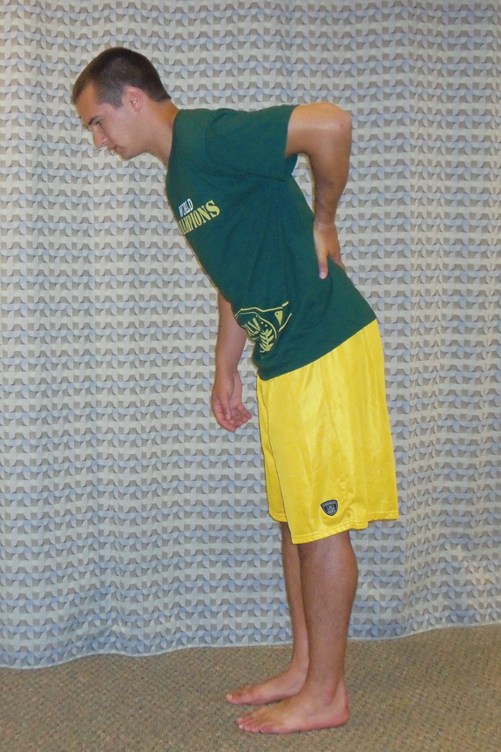
How specific is “nonspecific” low back pain?
Disc
Bone/ Stress
Facet
Ligamentous
Organ
Muscle
Sacroiliac Joint

Slide 13
Non-specific Low Back Pain
Risk Factors:
Smoking, BMI₁
Tumor necrosis factor-α (TNFα) in non-specific LBP₂
Genetic factors₃, twin studies heritability estimates from 30%-40% of variance
Interleukin-1 gene cluster polymorphisms assoc w/ Modic changes₄
Shiri R, at al Am J Med 2010;123:87 e7-35.
Wang H. Clin J Pain 2008;24:273-278.
Battie MC, et al. Pain 2007;131:272-280.
Karppinen J. et al. Eur Spine J 2009;18:1963-1970.
Notes:
TNF: prospective case controlled study, 6 mo observation, TNF alpha positive individuals higher in low back pain group vs controls.
Increased TNF alpha in discs/NP, ppromotes axonal growth and induces substance P production

Slide 14
A shift in low back pain assessment
To improve treatment outcomes better identify prognostic factors indicating increased risk of poor outcome
Target treatments toward factors that are modifiable
Physical prognostics:
  Leg pain
  Widespread symptoms
Psychosocial factors
  Pain-related fear
  Catastrophizing
  Depression
  Self-efficacy
Fritz JM, et al Phys Ther. 2011;91:722-732.

Slide 15
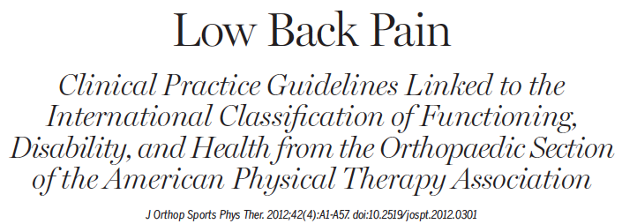
“Classifying patients into groups based on clinical characteristics and matching these patient subgroups to management strategies likely to benefit them will improve outcome of physical therapy interventions.”
Delitto A, et al. J Orthop Sports Phys Ther. 2012;42(4):A1-A57.
Notes:
Best available evidence supports a classification approach that de-emphasizes importance of identifying specific anatomical lesions after ref flag screening done.
No long one size fits all
A variety of classificaitons systems described in literature

Slide 16
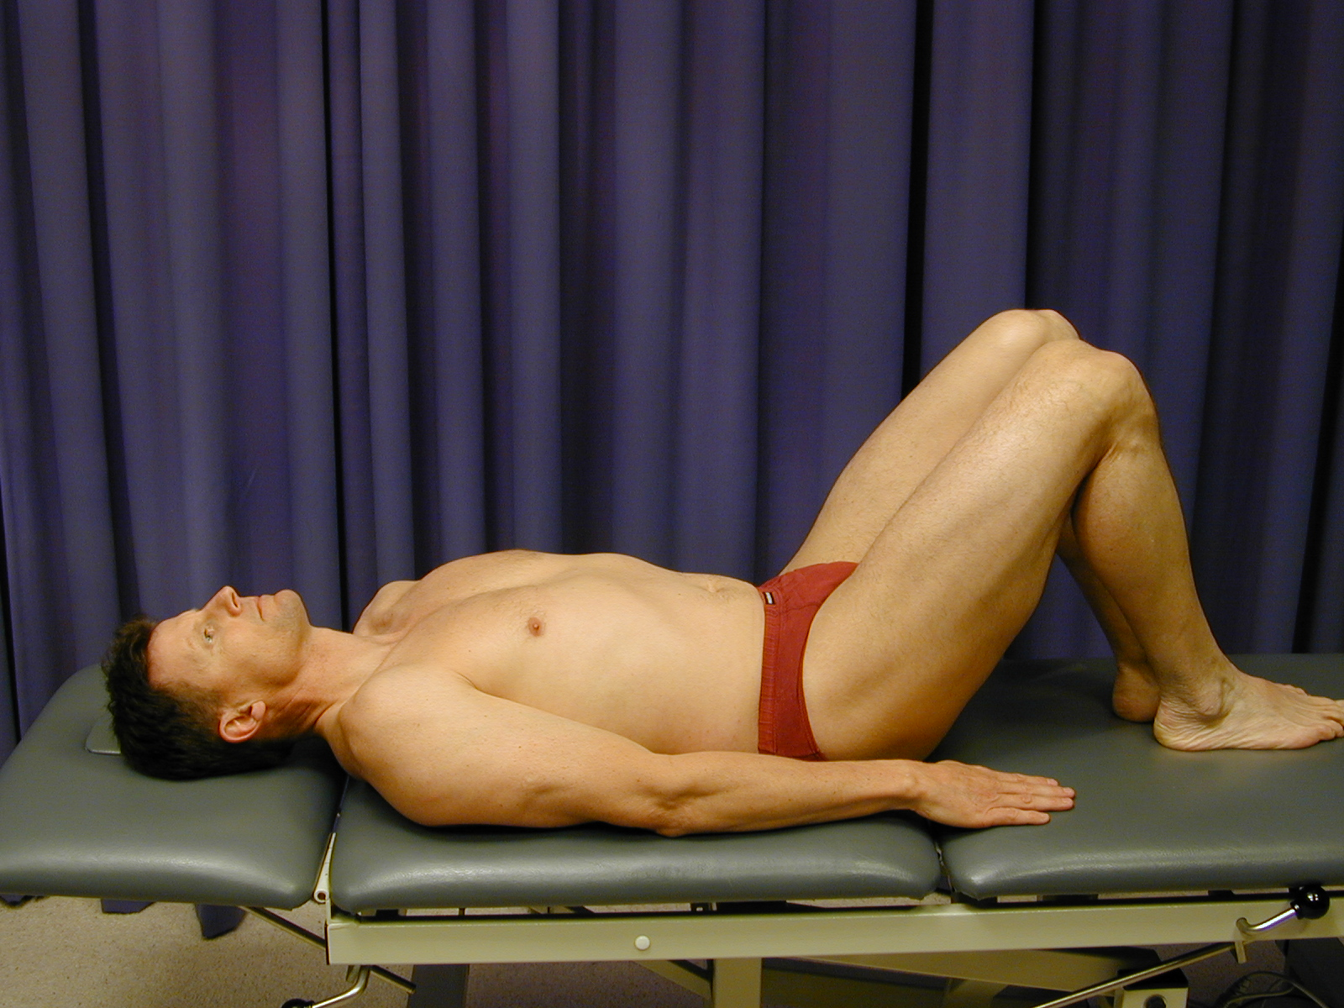
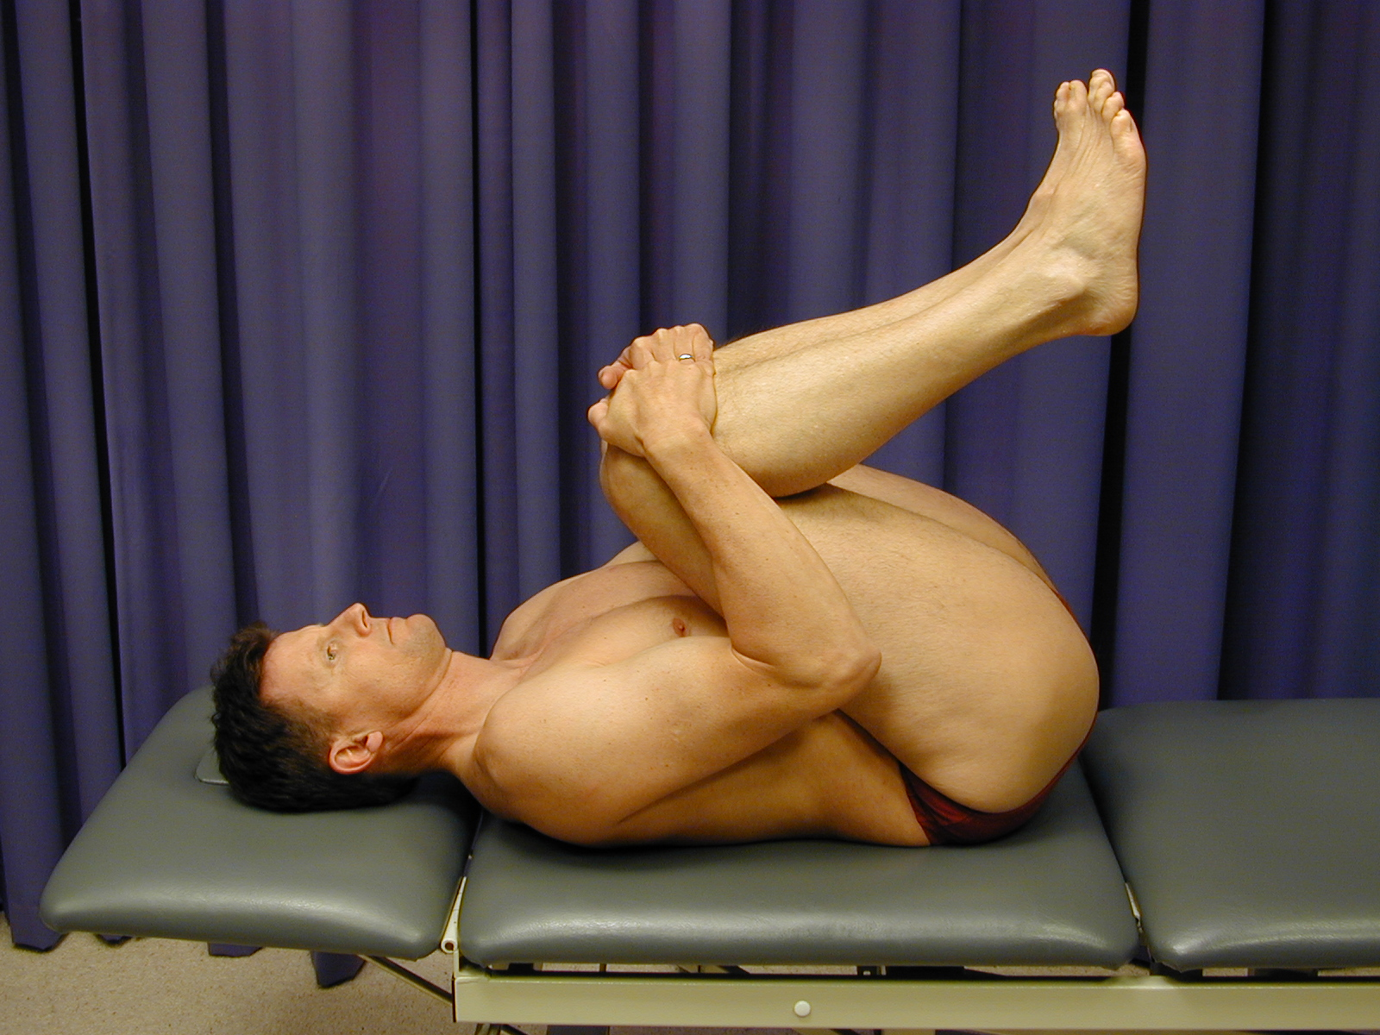
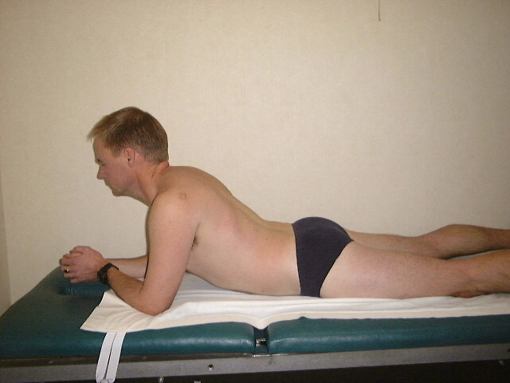
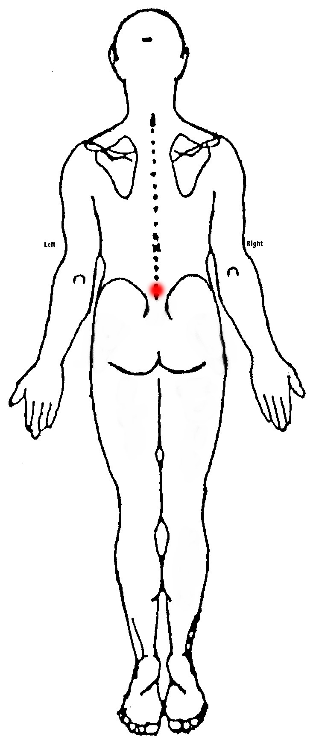
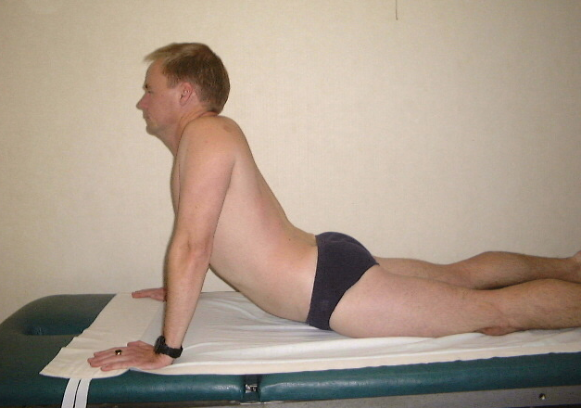


Peripheralization
Centralization
Structural pathology is responsible for the symptomatic presentation
Damage can be reversed with certain exercises and postures
Mark Laslett, 2006.
Notes:
Mechanical bias optimal pain relief for
positioning
healing or repair
Postural, dysfunction, derangement syndromes
Pain is progressively abolished in distal to proximal direction with each progressive abolition being retained over time until all symptoms abolished
McKenzie hypothesized movement of internal contents of IVD is mech for central or peripheralization
Directional preference: with intact anulus and hydrostatic disc mech, an offest load on the disc I lesion specific direction will help move material back to its original cntral disc location.
If can’t centralized: disc is incompetant

Slide 17
ICD-10 Codes: LBP
ICD-10 | Code
Acute and Subacute Low Back Pain with Mobility Deficits | M99.0
Acute, Subacute, & Chronic Low Back Pain with Movement Coordination Impairments | M53.2
Acute Low Back Pain with Referred Lower Extremity Pain | M40.3
Acute, Subacute, and Chronic Low Back Pain with Radiating Pain | M54.1
Acute, Subacute Low Back Pain with Related Cognitive or Affective Tendencies | M54.5
Chronic Low Back Pain with Related Generalized Pain | M54.5

Slide 18
ICF Classification and Treatment
ICF-Based Category | Symptoms | Impairments of Body Function | Primary Intervention
Acute Low Back pain with Referred Lower Limb Pain | LBP associated with referred buttock, thigh, or leg Symptoms worse with flexion and sitting | Low back and lower extremity pain that can be centralized and diminished with specific exercises Limited lumbar extension | Therapeutic exercises, traction Repeated centralization Patient education to promote centralization
Acute Low Back Pain with Radiating Pain | LBP with radicular pain LE paresthesias, weakness | Reproduced leg pain with dural tension, straight leg, slum | Nerve glides Traction Patient Education to reduce compression
Notes:
Impairment based

Slide 19
Acute Low Back Pain: Focus on “Subgroups”
Treatment- Based Classification₁
Likely to respond to neuromobilization₂
1. Mobilization
  Sacroiliac pattern
  Lumbar pattern
2. Specific exercises
  Flexion pattern
  Extension pattern
3. Immobilization
4. Traction
Neuropathic Sensitization(NS)
Denervation (D)
Peripheral Nerve Sensitization (PNS)
Musculoskeletal (M)
1. Fritz J, et al. Spine 2003;28:1363-1372.
2. Schafer A et al. J Back Musculoskel Rehab 2014;27:409-418.
Notes:
Capture the primary focus of the PT intervention
Brennan GP, Fritz JM, Hunter SJ, et al: Identifying subgroups of patients with acute/subacute “nonspecific” low back pain: Results of a randomized clinical trial. Spine 31(6):623–631, 2006.
In this prospective, randomized study the authors studied the impact of classifying 123 patients with LBP of less than 90 days’ duration into one of three subgroups based on the type of treatment believed most likely to benefit the patient (manipulation, stabilization exercise, or specific exercise). Patients who received matched treatments experienced greater reductions in disability after 4 weeks and after 1 year than those who received unmatched treatments. This suggests that nonspecific LBP should not be viewed as a homogenous condition and that outcomes with nonspecific LBP can be improved when subgrouping is used to guide treatment decision making.

Slide 20
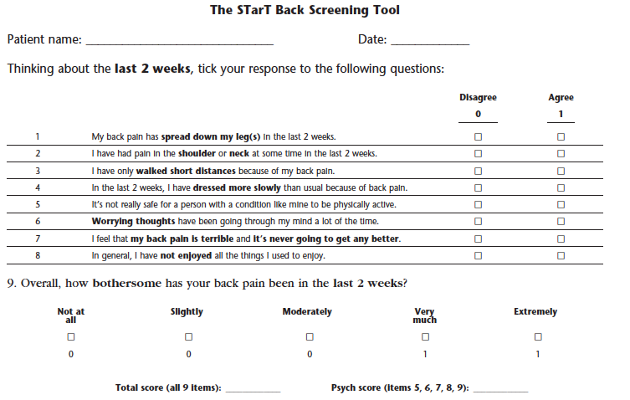
STarT Back Screening Tool
Keele STarT Back Screening Tool – Matched Treatments.
Available at: http://www.keele.ac.uk/sbst/matchedtreatments
Notes:
Delitto A, George S, Van Dillen L, Whitman J, Sowa G, Shekelle P, Denninger T, Godges J. Low back pain clinical practice guidelines linked to the international classification of functioning, disability, and health from the orthopedic section of the American Physical Therapy Association. J Orthop Sports Phys Ther. 2012;42(4):A1-A57.
Keele STarT Back Screening Tool – Matched Treatments. Available at: http://www.keele.ac.uk/sbst/matchedtreatments/

Slide 21
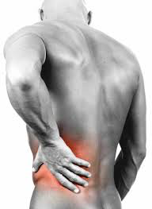
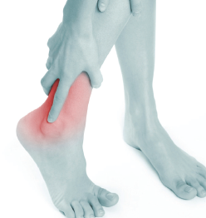
Acute Musculoskeletal Pain
2. Sprains and Strains
Myofascial Pain
Delayed Onset Muscle Soreness (DOMS)
Notes:
Group III and IV polymodal muscle nociceptors
Elements of central sensitization

Slide 22
Dimension 1: Core diagnostic criteria
Sprain: supporting structures of joint, a stretching or tearing of a ligament or joint capsule
  Signs: tenderness, swelling, pain with weight bearing, passive ROM
  Symptoms: pain with weight-bearing
Strain: stretching or partial tear of a muscle
  Signs: focal muscle tenderness, hematoma, common mid-belly
Rupture: complete tear of a muscle or tendon
  Signs: focal defect, weakness, minimal to no pain

Slide 23
Dimension 2: Common Features
Sprain: Injury to a ligament as a result of an excessive load
Sprain: more common in older adolescents, young adults, middle aged adults
Children: physis is the weak link, may result in fracture of growth plate
Older adults: bone again is weak link and similar injuries cause fracture
Cause by sudden trauma, inversion stress to ankle with “snapping”, pain, welling, stiffness, ecchymosis
Diagnostics: (-) X-ray, (+) US, MRI findings
Essentials of Musculoskeletal Care, AAOS,

Slide 24
AMA Ligament Injury Classification: Sprains
GRADE | DESCRIPTION
I | Mild, minor tearing of ligament fibers and no demonstrable increase in translation on examination
II | Moderate, partial tear of the ligament without complete disruption, with a slight to moderate increased translation upon examination
III | Severe, complete tear of the ligament, with a marked increase in translation upon examination

Slide 25
Dimension 2: Common features
Strain: “Injury to a muscle-tendon unit as a result of an excessive contractile or stretching load”
Strains: occur in any age
With aging, collagen in muscle-tendon unit changes
Muscles have decreased elasticity, more susceptible
Result from sudden stretch on muscle actively contracting, pain and swelling with mild strain may be delayed
Essentials of Musculoskeletal Care, AAOS,

Slide 26
Classification of muscle strains
Injury Type | Swelling/ Ecchymosis | Defect
Interstitial strain | Absent | Absent
Intramuscular strain | Present | Absent
Partial rupture | Present | Present incomplete
Complete rupture | Present | Present, complete loss of continuity
Notes:
No good classification exists for muscle strain injuries. Different from ligament injuries, partial disruption of a muscle tendon unit is difficult to assess with mechanical testing, use of a asca similar to ligament injury classification is not exact
Injury and recovery correlated with the inflammatory, fibroblastic and maturation phases of injury. Maturation phase, collagen fibers aligned and strength is regained. Repeated stress to tendons assoc with degen intratendinous changes and not inflammatory. “Tendinopathy”
Glutamate receptor changes and Kainate receptor changes in tendons
Immune competent cells found in chronic achilles tendinopathy

Slide 27
Dimension 3: Common medical comorbidities of sprains and strains
High exposure to game conditions, low back dysfunction, poor endurance of core muscles as predictors for sprains and strains in football players₁
Reduced trunk extensor muscle endurance may be risk factor for “nonspecific” LBP
Lack of adequate trunk muscle endurance may lead to loading of passive low-back structures increasing risk for lumbar muscle sprain₂
Wilkerson GB, J Athl Train. 2015;50:643-650.
Biering-Sorensen F. Spine. 1984;9:106-119.

Slide 28

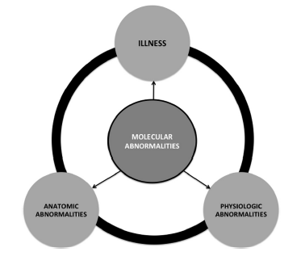
Osteoarthritis Classification
“Disease” vs “Illness”
Early on as silent disease process prior to “injury” or “accident”
“Disease” does not coincide with illness
Kraus VB, et al. Osteoarthritis and Cartilage 2015;23:1233-1241.

Slide 29
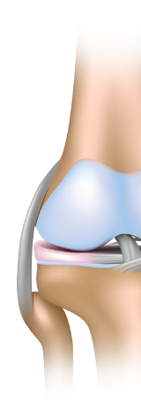
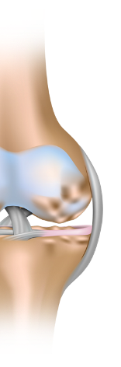


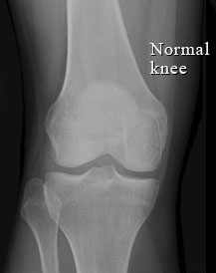

Osteoarthritis
Cartilage to the Whole Joint
Normal
Osteoarthritis
Normal
Osteoarthritis
Cartilage
Fibrillated/
Destroyed
Synovium
Episodically
inflamed
Bone
Bony
outgrowths
Wieland HA, et al. Nat Rev Drug Discov. 2005;4:331-344.
Notes:
Knee most common
40% of > 60 yrs old have severe radiographic changes
12% with symptoms related to knee OA
Biomechanical an proinflammatory changes
Synovium, bone, and cartilage reorganized as main structures being destroyed during progression
But further research, OA simply not biomechanical process
Catabolic cytokines cascades
Production of inflammatory mediators

Slide 30
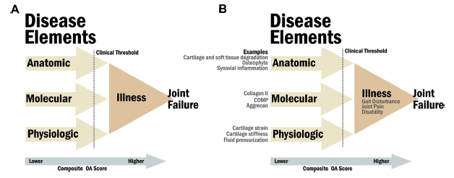
OARSI: Proposed Taxonomy of OA
Kraus VB, et al. Osteoarthritis and Cartilage 2015;23:1233-1241.
Notes:
New Taxonomy of OA
OA disease involving movable joints characterized by cell stress and extracellular matrix degradation initiated by micro and macro injury that activates maladaptive repair responses including pro-inflammmatory pathways of innate immunity.
Disease manifests
1st: molecular derangement (abnormal metabolism)
anatomic and/or physiologic derangements (cartilage degradation, bone remodeling, osteophyte formation, joint inflammation and loss of normal joint function. Culminates into “illness”
Use biomarkers to identify disease before “pain”

Slide 31
Dimension 4: Neurobiological, psychosocial and functional consequences
Ongoing cellular distress, molecular, anatomical, and physiological disease progression
Disturbed sleep
“Kinetic” chain consideration
Lost work days, activity limitation and participation restrictions
Ascending/descending stairs, mobility in community
Notes:
Distinction between causes and consequences will be challenge
Bi-directional relationship between depression and chronic pain

Slide 32
Dimension 5: Putative neurobiological and psychosocial mechanisms, risk factors, and protective factors
Risk factors for knee OA: obesity (increased risk in FM after menopause), knee trauma, meniscectomy₂
Healing of damaged cartilage poor, focus on “healing” tissue has emerged with development of “regenerative” biological therapies (i.e. PRP)₁
Psychological factors: catastrophizing, anxiety, depression
Protective factors: strong social and work environment, coping mechanisms, joint phenotypes
Kon E, et al. Knee Surg Sports Traumatol Arthrosc 2012;20:436-439.
Englund M, et al. Arthritis Rheum 2004;50:2811-9.
Fransen M, et al. Best Pract Res Clin Rheum 2011;25:81-101.
Notes:
Great variability in natural recovery of “MSK” conditions making temporal assessment challenging

Slide 33
Dimension 5: Putative neurobiological and psychosocial mechanisms, risk factors, and protective factors
Workplace
Conditions
Occupational factors: floor layers, lifting with kneel squat may be associated with greater risk₁
Anger, perceived injustice after trauma as predictor of greater pain and disability_{2,3}
Work related “blue” and “black” flags
Individual
Perceptions
Workplace
Factors
Fransen M, et al. Best Pract Res Clin Rheum 2011;25:81-101.
Sullivan JJ, et al. Clin J Pain 2012;28:484-488.
Trost Z, et al. Pain 2012;153:515-517.
.Shaw W, et al. J Occup Rehabil 2009;19:64-80.
Notes:
Great variability in natural recovery of “MSK” conditions making temporal assessment challenging
Red
Yellow: concerns about symptoms
Black:Insurance system and employer, poor support, unsafe
Blue: stressful workplace, work history/ work is harmful, job is too heavy

Slide 34
Conclusions: MSK Taxonomy
Acute MSK pain taxonomy may need to shift back towards mechanism based approach while not ignoring biopsychosocial context and syndromal approach
Low back pain: consider acute taxonomy based on treatment-based classification or subclasses vs underlying mechanism, ICD-10?
How do we assess underlying “disease” with presenting “acute pain”? Kinetic chain?
Are classic risk factors for chronicity present earlier but just ignored or under-appreciated?
“Tipping” point from acute to chronic?

Slide 35

Thanks
steven.stanos@swedish.org

