Slide 1
The AAPT Framework
Roger B. Fillingim, PhD
Distinguished Professor, College of Dentistry
Director, Pain Research & Intervention
Center of Excellence (PRICE)
University of Florida, Gainesville, FL

Slide 2
Overview of Presentation
Brief history of AAPT
Conceptual considerations
Current framework
Future activities

Slide 3
Timeline
DATE | ACTIVITY
September, 2012 | Initial email from ACTTION to APS proposing partnership
October, 2012 | Initial approval from APS Board (formal approval 1/13); Announcement of AAPT in ACTTION Newsletter
October, 2012 – April, 2013 | Planning for AAPT Launch Meeting
April, 2013 | Article on AAPT posted on Pain Research Forum
May, 2013 | AAPT Launch Meeting
May – October, 2013 | Working group Chairs identified and working groups formed
November, 2013 | AAPT Framework article submitted to J Pain
January, 2014 | Manuscript accepted
January – July, 2014 | Working groups meeting and beginning their work
July, 2014 | Second AAPT Meeting
July, 2014-present | Working groups developing diagnostic criteria
September, 2016 | JOP Supplement of foundational articles to be published

Slide 4
Initial eMail from Bob
Among the activities that ACTTION is undertaking to advance understanding and treatment of acute and chronic pain is the development of a comprehensive, coordinated, evidence-based, and up-to-date pain taxonomy – classification scheme. A comprehensive pain taxonomy is essential so that consistent and accurate diagnoses are used for clinical research, clinical trials, and to facilitate comparisons across studies for systematic reviews and meta-analyses. A standardized classification system is also critical for regulatory reviews of new drug applications. At present, there is no consensus on pain classification. This shortcoming has impeded the development of improved treatments by the lack of clear diagnostic criteria being available.

Slide 5
AAPT launch meeting May 17-18, 2013
AAPT

Slide 6
Goal
To develop a framework that all working groups could apply in developing diagnostic criteria for chronic pain conditions.

Slide 7
Agenda
Person(s) | Topic
Chuck O’Brien | Evolution of DSM
Pat Mantyh & Frank Porreca | How Can Chronic Pain Mechanisms Inform the Classification of Chronic Pain Conditions?
Sam Dworkin | Developing Research and Clinical Diagnostic Criteria for Temporomandibular Disorders and Facial Pain
Eva Widerstrom-Noga | Developing Diagnostic Criteria for Spinal Cord Injury Pain
Steve Bruehl | Developing Diagnostic Criteria for Complex Regional Pain Syndrome
Roger Fillingim | Proposals for a Multi-axial Framework for a Chronic Pain Taxonomy
All Attendees | Group Discussion: Toward Consensus on an Evidence-based Classification of Chronic Pain
All Attendees | Working Groups, Deliverables, Deadlines

Slide 8
Upcoming JOP Supplement
Multidimensional diagnostic criteria for chronic pain: Introduction to the ACTTION-American Pain Society Pain Taxonomy (AAPT) - Bob Dworkin, Steve Bruehl, Roger Fillingim, John Loeser, Greg Terman, and Dennis Turk
Assessment of pain-related symptoms and signs - Roger Fillingim, Ralf Baron, John Loeser, Rob Edwards
Assessment of psychosocial and functional impact, including sleep - Dennis Turk, Roger Fillingim, Richard Ohrbach, Kushang Patel
Life span developmental considerations in the diagnosis of chronic pain – Gary Walco, Elliot Krane, Kenneth Schmader, Debra Weiner
Pathophysiologic mechanisms and their identification – Daniel Vardeh, Richard Mannion, Clifford Woolf
Psychosocial mechanisms and their identification - Rob Edwards, Mark Sullivan, Dennis Turk, Ajay Wasan
Overlapping chronic pain conditions and their implications for diagnosis and classification - William Maixner, Roger Fillingim, David Williams, Shad Smith, Gary Slade
Approaches to developing the evidence base for a multi-dimensional pain taxonomy - Steve Bruehl, Richard Ohrbach, Sonia Sharma, Eva Widerstrom-Noga, Bob Dworkin, Roger Fillingim, Dennis Turk

Slide 9
Overview of Presentation
Brief history of AAPT
Conceptual considerations
Current framework
Future activities

Slide 10
Disorder, Disease, and Diagnosis
 | Description | Comments
Disorder | A medical concern in a patient, an abnormality, injury, or aberration. | Generally used when the pathological process is unknown.
Disease | A known pathological process that leads to one or more disorders. | A disorder may reflect multiple diseases, and vice versa.
Diagnosis | A procedure used to decide whether or not a certain disorder or disease is present is a patient. | A disorder or disease is a characteristic of the patient; a diagnosis is an opinion that the disorder or disease is present.
Kraemer, et al., 2007, Soc Psychiatry Psychiatr Epidemiology, 42: 259-67

Slide 11
What is the Purpose of Diagnosis?
TO GUIDE TREATMENT & PROGNOSE
Secondary purposes
Satisfy patient curiosity/legitimate symptoms
Research purposes
Billing

Slide 12
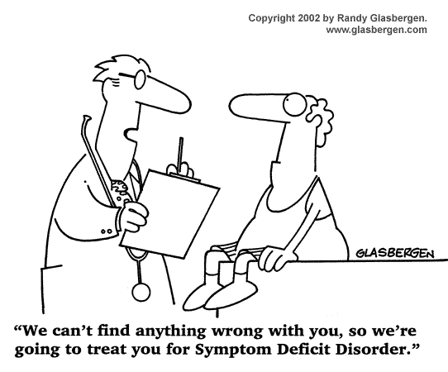
Treatment is Based on Diagnosis

Slide 13
Lumping vs. Splitting
“The open question is whether different diagnostic manifestations of a basic pathological process have been divided into multiple diagnostic silos, creating artifactual comorbidity in certain circumstances.”
Stephen E. Hyman (2011). Diagnosis of Mental Disorders in Light of Modern Genetics. In (Regier, et al., Eds). The Conceptual Evolution of DSM-5. Amer Psychiatric Publishing: Arlington, VA.

Slide 14
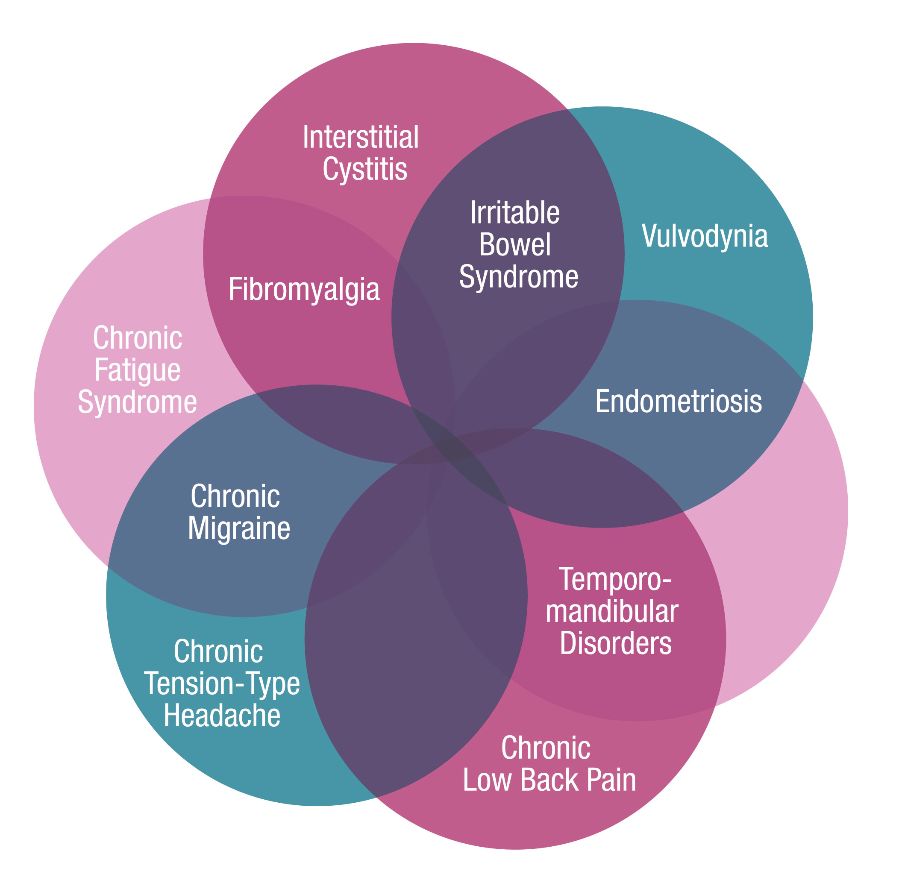
Chronic Overlapping Pain Conditions (COPCs)
www.chronicpainresearch.org

Slide 15
Characteristics of an Ideal Diagnostic System
Biological plausibility
Exhaustive
Mutually exclusive
Reliable
Clinically Useful
Simple

Slide 16
Pre-AAPT State of Pain Classification
Multiple diagnostic systems proposed by different groups with no uniformity of structure or approach
Most have limited evidence supporting reliability or validity
Based primarily on signs and symptoms, which can overlap considerably
Diagnostic studies usually emphasize tissue damage, which has at best a modest association with pain
Pain diagnoses typically provides limited information regarding the mechanisms underlying the pain experience.

Slide 17
Major Points of Discussion at Launch Meeting
Should AAPT Be Evolutionary or Revolutionary (i.e. How Mechanism-Based Can We Make It)?
How Should Chronic Pain Disorders be Categorized?

Slide 18
Etiology Versus Mechanisms
 | Etiology | General Mechanisms | Specific Mechanisms
Diabetic peripheral neuropathy | Diabetes-induced nerve damage | Peripheral nerve damage, altered central pain processing | TRP channels
Knee Osteoarthritis | Changes in the knee joint | Peripheral inflammation & mechanical nociception, Central sensitization | Specific cytokines, matrix metalloproteinases
Fibromyalgia | Infection, trauma, unknown | Central and/or peripheral sensitization | Altered serotonergic function

Slide 19
Major Points of Discussion at Launch Meeting
Should AAPT Be Evolutionary or Revolutionary (i.e. How Mechanism-Based Can We Make It)?
How Should Chronic Pain Disorders be Categorized?

Slide 20
Peripheral & Central Nervous Systems
Peripheral Neuropathic Pain
Central Neuropathic Pain
Musculoskeletal Pain System
Osteoarthritis
Other Arthritides (e.g. Rheumatoid Arthritis, Gout, Connective Tissue Diseases)
Musculoskeletal Low Back Pain
Myofascial Pain, Chronic Widespread Pain, and Fibromyalgia
Other Predominantly Musculoskeletal Pain
Orofacial & Head Pain System
Headache Disorders*
Temporomandibular Disorders
Other Orofacial Pain
Visceral, Pelvic & Urogenital Pain
Visceral Pain: Abdominal, Pelvic, and Urogenital Pain
Disease-Associated Pains Not Classified Elsewhere
Cancer Pain
Pain Associated with Sickle Cell Disease

Slide 21
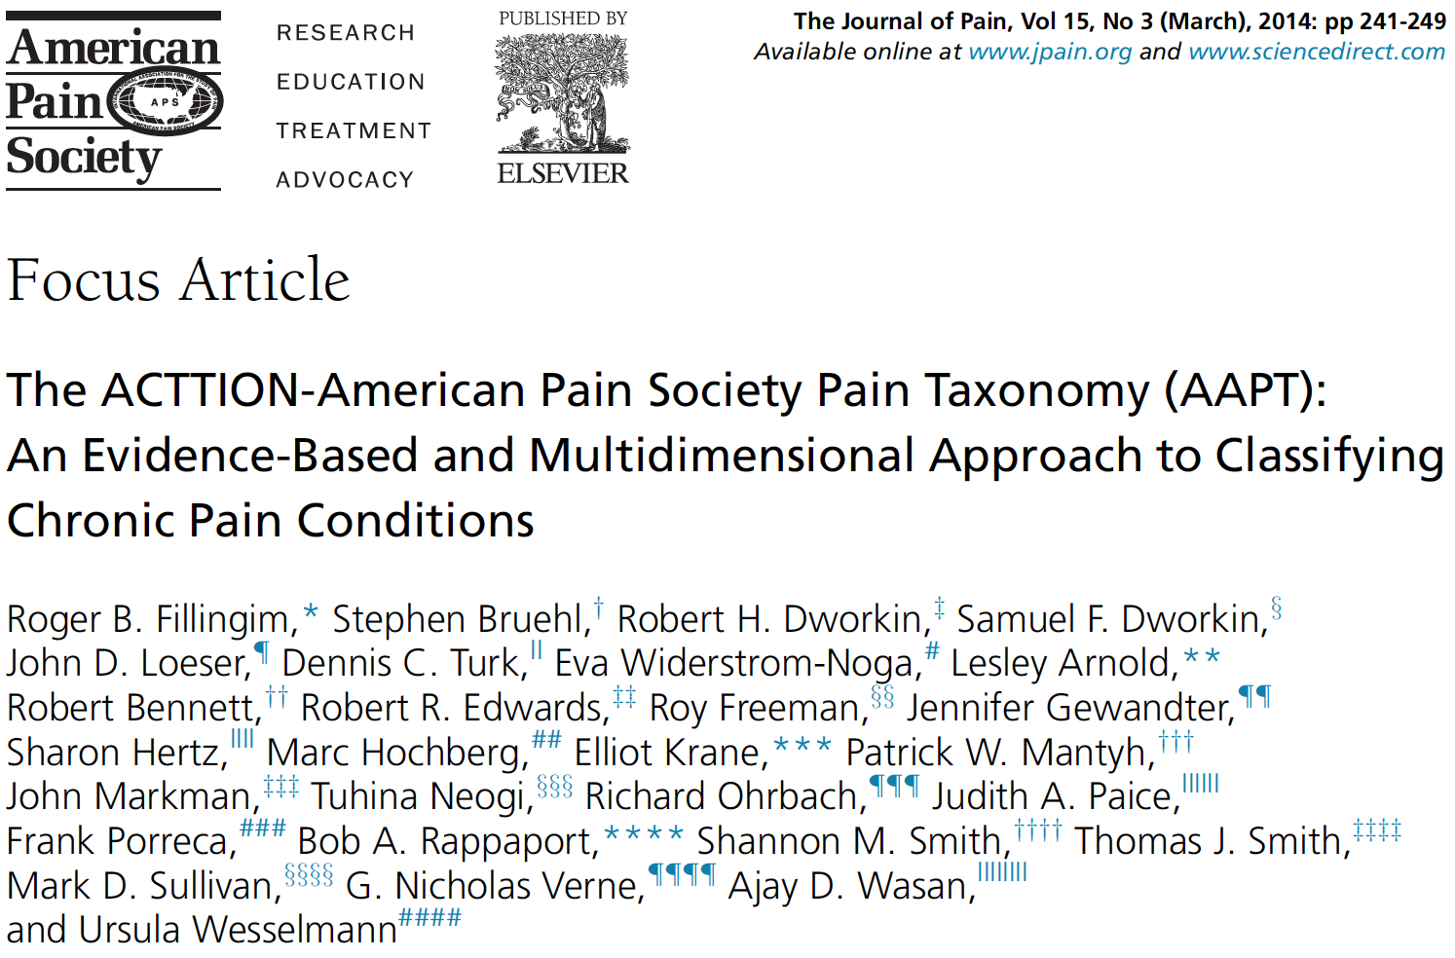

Slide 22
Important Characteristics of AAPT
Evidence-based
Systematically applied across pain conditions
Multidimensional and biopsychosocial
Applicable for both research and clinical use
Should evolve based on new evidence

Slide 23
DIMENSION | DESCRIPTION
Core Diagnostic Criteria | Includes symptoms and signs required for diagnosis of the disorder (e.g. periauricular pain, palpation sensitivity, joint sounds in the case of TMD). Also includes diagnostic tests and differential diagnosis considerations.
Common Features | Provides additional information regarding the disorder, including common pain characteristics (e.g. location, temporal qualities, descriptors), non-pain features (numbness, fatigue), and the epidemiology of the disorder. These features are helpful in describing the disorder but are not used as part of the diagnosis.
Common Medical Comorbidities | Includes medical diagnoses that co-occur with high frequency with the pain disorder. For example, diabetes mellitus is often comorbid with osteoarthritis, and major depression is comorbid with many chronic pain disorders.
Neurobiological, Psychosocial and Functional Consequences | Includes information regarding neurobiological and psychosocial consequences of chronic pain, as well as the functional impact of the pain disorder. Examples include, allostatic load, sleep quality, mood/affect, coping resources, physical function, and pain-related interference with daily activities
Putative Neurobiological and Psychosocial Mechanisms, Risk Factors & Protective Factors | Includes putative neurobiological and psychosocial mechanisms contributing to the pain disorder, including potential risk factors and protective factors.

Slide 24
AAPT Chronic Pain Diagnostic Criteria
(being submitted to Journal of Pain as 9 individual manuscripts)
Peripheral and Central Nervous Systems
Peripheral neuropathic pain (CRPS; PHN; post-traumatic/post-surgical; trigeminal neuralgia; DPN, HIV, and idiopathic polyneuropathies)
Central neuropathic pain (post-stroke, spinal cord injury, MS)
Musculoskeletal System
Spine pain, including radiculopathy and other neuropathic back pain conditions
Fibromyalgia and chronic myofascial and widespread pain
Arthritides/arthropathies (OA, RA, gout, spondyloarthropathies)
Orofacial and Head Pain
Temporomandibular disorders
Visceral, Pelvic, and Urogenital Pain
Abdominal, pelvic, and urogenital pain (IBS, IC, vulvodynia)
Disease-associated Chronic Pain
Cancer pain (including pancreatic cancer pain, cancer-induced bone pain, chemotherapy-induced peripheral neuropathy)
Sickle cell pain

Slide 25
AAPT-I vs. AAPT-II
AAPT-I: Diagnostic criteria based on available evidence from literature reviews, existing criteria, secondary data analyses, and expert consensus
AAPT-II: Evidence-based revision of AAPT-I diagnostic criteria as a result of studies of their reliability and validity

Slide 26
Timeline
DATE | ACTIVITY
mid 2016 – early 2017 | Submission and publication of diagnostic criteria in Journal of Pain: 9 open-access articles published separately
early 2017 | Launch meeting for AAPT-II research studies
mid 2017 | Publication of combined supplement and/or book

Slide 27
What Can Taken from AAPT and Applied to an Acute Pain Taxonomy?
Evidence-based
Systematically applied across pain conditions
Multidimensional and biopsychosocial
Applicable for both research and clinical use
Should evolve based on new evidence

Slide 28
CHRONIC PAIN | ACUTE PAIN??
Core Diagnostic Criteria
Common Features
Common Medical Comorbidities
Neurobiological, Psychosocial and Functional Consequences
Putative Neurobiological and Psychosocial Mechanisms, Risk Factors & Protective Factors

Slide 29
Thank You

