Slide 1
Acute Orofacial Pain
Paul J. Desjardins, D.M.D., Ph.D.
Clinical Professor, Rutgers School of Dental Medicine
Visiting Professor, Tufts University, School of Dental Medicine
AAAPT Acute Pain Taxonomy meeting, April 27-29, 2016
Notes:
Introduction

Slide 2
GOALS
Describe the types of conditions which present as acute orofacial pain
Discuss the characteristics of those disorders – other S & S / comorbidities in context of 5 dimensions
Highlight potential advantages and disadvantages of a new taxonomy in acute pain related to the EENTM and contiguous structures
Reflect on earlier ideas for framing an updated taxonomy
Notes:
Goals of next 2 hours , will also present a few cases illustrating the principles and common clinical questions

Slide 3
How Do We Currently Classify Acute Orofacial Pain?
By anatomical structure affected eg otitis, pulpal pain, conjunctival pain
By association with known diagnosis eg Pharyngitis, abscess, otitis media,
Whether it appears to be primary or referred from some other tissue (eg, maxillary tooth pain secondary to sinusitis)
Within our specialty’s taxonomy (dental pain, toothache, odontalgia, pulpitis)
If all else fails we use Latin, or Greek to impart a sense of a knowledgeable clinician, “Osteitis dolorosa sicca”
Notes:
Goals of next 2 hours , will also present a few cases illustrating the principles and common clinical questions

Slide 4
Why bother? What do I hope for?
Orofacial pain is the great imitator!
Overlapping medical and dental specialties see the pain in their own context
Our hope: that a more specific taxonomy may lead to more accurate diagnosis, more effective treatment and better RCTs of therapies in acute OFP.
Within the regulatory framework, it would be useful to be able to generalize efficacy conclusions across a range of similar disorders - abandon POC
It would be desirable to spot the outliers WRT comorbidities, prognosis and response to treatment

Slide 5
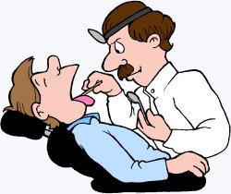
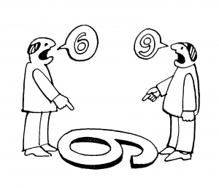
WHICH CLINICIANS TREAT ACUTE OROFACIAL PAIN?
Ophthalmologists
Otolaryngologists
Dentists – Oral surgeons, Endodontists, Oral Medicine specialists
Facial plastic surgeons
Facial Pain, TM Disorder clinics
Primary care physicians
NPs, PAs, Dental hygienists
ED docs
Notes:
What determines who and where care will be delivered?

Slide 6
Thoughts / ideas for discussion
Overall view – Acute pain is but one symptom of EENTM disorders
EENTM conditions often mimic other conditions Ex. Toothache / sinusitis
Key elements in differential diagnosis – other presenting signs and symptoms
Can these disorders/diseases be placed in similar categories? How best to bucket them? Most sensible is by etiological mechanism – how certain are we of the mechanisms? How accurate are our diagnostic tools?
What are the common and differentiating characteristics for different acute OFP conditions?
Do similar disorders – like those characterized as infectious in origin – behave similarly and respond similarly to any given class of analgesics?
Notes:
Goals of next 2 hours , will also present a few cases illustrating the principles and common clinical questions

Slide 7
CURRENT DRIVERS FOR ACUTE PAIN TAXONOMY (Should be easily obtained from CC & HPI)
Anatomic region affected
Duration of the pain / temporal pattern
Severity / intensity
Attenuating factors – what makes it improve or worsen?
From the molecular to the social level
Other presenting signs and symptoms
Notes:
Goals of next 2 hours , will also present a few cases illustrating the principles and common clinical questions

Slide 8
Disorders of the EYE with acute pain as a presenting symptom
Corneal abrasion
Uveitis
Scleritis
Eye pain accompanied with Pink Eye
Conjunctivitis, Blephritis
Dry Eye (Kerato conjunctivitis sicca)
Eye pain caused by neurologic disease–Ocular motor palsy, CN III compression
Accompanied by diploplia, blurred vision,
Occuring after ocular surgery or trauma to the eye
Notes:
Goals of next 2 hours , will also present a few cases illustrating the principles and common clinical questions – illustrate clinical thinking around acute pain

Slide 9
Disorders of the EAR with acute pain as a presenting symptom
Otalgia
If accompanied by otorrhea, bleeding, discharge, itch, edema – Otitis Media
Primary pain in pinna – lacerations, burn, frostbite, sunburn
Infection – Otitis externa (Swimmer’s ear)
Ear pain accompanied with other relevant findings / co-morbidities
GERD, TMD, Mandibular or maxillary molar tooth pain
Referred pain – CN V, IX or X associated with distant infection, inflammation or malignancy
Muscle spasm – sternocleidomastoid or MM of mastication
“God bless those other signs and symptoms”
Notes:
Goals of next 2 hours , will also present a few cases illustrating the principles and common clinical questions – illustrate clinical thinking around acute pain

Slide 10
Disorders of the Nose and Sinuses with acute pain as a presenting symptom
Rhinosinusitis – usually accompanying URTI
Sinusitis
Frequently accompanied by headache
Reportedly can cause excruciating pain
Usually infectious cause – Strep, Staph, Moraxella, H. Influ, E. Coli, Bacteroides, others
Accompanying signs and symptoms – recent URTI, worse when flying or skiing, facial pain / tenderness over the sinuses, purulent discharge, anosmia, dental pain, dental pressure, cough, fever, ear pain
Sore throat pain - pharyngitis
Trauma
Dry Eye (Kerato Conjunctivitis sicca)
Eye pain caused by neurologic disease–Ocular motor palsy, CN III compression
Accompanied by diploplia, blurred vision, ocular surgery, trauma
Notes:
Goals of next 2 hours , will also present a few cases illustrating the principles and common clinical questions – illustrate clinical thinking around acute pain

Slide 11
Disorders with acute tooth or jaw pain as a presenting symptom
Pulpitis – reversible vs non-reversible – similar to acute visceral pain??
Periodontal disease / abscess
Cracked tooth
Caries and secondary pulpal inflammation
Impacted teeth and pericoroniitis
Frequently accompanied by headache, earache, trismus
Reportedly can cause excruciating pain for short duration
Complicated by local infection – Strep, Staph, Mixed infections
Acute TMJ pain – Muscle spasm (masseter and temporalis muscles)
Atypical Odontalgias – Acute periodontal triggers, burning mouth
Myocardial Ischemia or MI
Dry Eye (Kerato Conjunctivitis sicca)
Eye pain caused by neurologic disease–Ocular motor palsy, CN III compression
Accompanied by diploplia, blurred vision, ocular surgery, trauma
Notes:
Finally – a slide where I have some expertise!

Slide 12
Acute Orofacial Pain Dimension 1: Key Pain Aspects
Pain Location and Quality
Pain Duration / Recurrence
Physical, Lab, Radiologic findings
All other items in HPI
All are generally available at presentation or shortly initial presentation
Source of pain frequently from well defined conditions
Notes:
Goals of next 2 hours , will also present a few cases illustrating the principles and common clinical questions

Slide 13
Acute Orofacial Pain Dimension 2 and 3: Common Features and Comorbidities
Infectious etiology (e.g., URTI for ear, throat, & nasal pain)
Inflammatory reaction – common in most forms of acute OFP
Referred Pain to adjacent structures
Psychological / emotional component can be important in select cases (usually not) if significant delay in diagnosis or treatment
Comorbidities: less impact than seen in burns, trauma etc
Notes:
Goals of next 2 hours , will also present a few cases illustrating the principles and common clinical questions

Slide 14
Acute Orofacial Pain - Dimension 4: Neurobiological, psychosocial and functional consequences
Considerable research in some disorders like TMD which can become chronic
These topics are “ripe” for further interdisciplinary and evidence-based research
Several studies in acute OFP models have systematically collected patient outcome data on functional consequence (sore throat, dental impaction pain) - effects on sleep, ability to drive, ability to concentrate
Investigators, sponsors and regulators consider these “secondary” outcomes in efficacy evaluations of analgesics
Notes:
Goals of next 2 hours , will also present a few cases illustrating the principles and common clinical questions

Slide 15
Acute Orofacial Pain - Dimension 5: Putative mechanisms, risk factors and protective factors
Key questions: Can one or two generalizable pain models be developed of acute orofacial pain?
Considerable learning from established post-surgical models (Ex. assay sensitivity to classes of drugs, efficacy of concomitant drugs like corticosteroids, how to assess combination therapy)
Some acute pain studies could be modified to include patient outcome data assessing risk factors and protective factors
Notes:
Goals of next 2 hours , will also present a few cases illustrating the principles and common clinical questions

Slide 16
IMPROVING ACUTE PAIN STUDY DESIGN ACROSS MODELS
Better understanding of baseline pain determinants
Better understanding of natural course of pain
Effect of surgical characteristics (soft tissue vs bony surgery), duration, alternative surgical approaches
Multimodal = concomitant interventions
Are they confounders?
Rescue drug
Concomitant interventions, eg corticosteroid, long acting local anesthetics improved dental post op without a doubt
Notes:
What we have learned over the past 50 years is that there are factors which impact assay sensitivity, these factors are generally incorporated
I believe this is a fair list of factors, discussed at many meetings, which impact
One critical point I would like to make is that there are many sources of variance in RCTs and most of us try to do our best to minimize variance within a trial.
Jim Witter, Ray Dionne and others have asked whether there might be ways to look the variance to give us a more complete picture

Slide 17
NSAID / COX II EFFECT SIZE BY MODEL (Based on SPID-8)
Dental Impaction
Bunionectomy
1.5
1.06
1.10
1
0.76
Effect Size
0.35
0.5
0
Ibuprofen
400 mg PO
Ibuprofen
400 mg PO
Ibuprofen
400 mg PO
Day-0
Ibuprofen
400 mg POI
Day-0

Slide 18
NSAID/COX II Effect Size (Based on SPID-8)
1.5
1
0.763
Effect Size
0.67
0.61
0.53
0.5
0.35
0
Rofecoxib
Rofecoxib
Naproxen
Ibuprofen
Ibuprofen
50mg Bunion¹
50mg
550mg
400mg PO
400mg PO
Orthopedic
Orthopedic
Bunion³
Bunion⁴
Surgery²
Surgery²
Treatments
Notes:
This slide summarizes the effect size reported by three NSAID drugs that have repeatedly shown similar time effect curves over the first 8 hours in either bunionectomy or joint replacement surgery
The effect sizes were calculated by subtracting the mean placebo score from the active treatment group mean and dividing the difference by the pooled standard deviation
As you can see, a pretty reproducible effect size across these different orthopedic pain models for this class of drugs

Slide 19
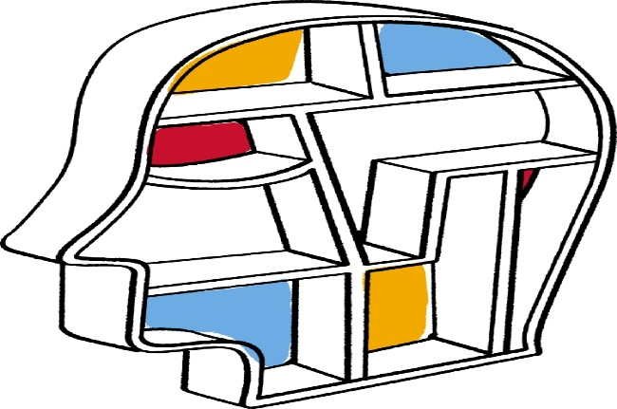
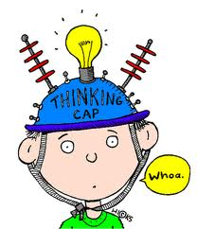
A FEW PARTING THOUGHTS ……
Are we hostage to our own specialties
and disciplines?
How can we help tomorrow’s clinicians & investigators understand these problems?
Can a better taxonomy / ontology make diagnosis and treatment more accurate, more simple, and recovery more predictable ?

Slide 20
Notes:
While the topic of today’s talk is orofacial pain – This little fellow reminds us that this region is also the source of some of our earliest and ongoing forms of pleasure!

Slide 21
Conflict of Interest Disclosure
I was an employee of Wyeth and Pfizer Consumer Healthcare from 2005 - 2011
Over the past 4 years I have consulted with the following companies: AcelRx Pharmaceuticals, Adynxx Pharmaceuticals, Affinety Research Inc., Akron Molecules, Analgesic Solutions, Cadence Pharmaceuticals, Charleston Pharmaceuticals, Clinical Trials NZ, Consumer Health Products Assn, CARA Therapeutics, CRO Analytics, Cytogel Pharmaceuticals, Dental Learning Systems, Grunenthal USA, Grunenthal Gmbh, Iroko Pharmaceuticals, Lotus Clinical Research, McDermott Will & Emery LLP (DepoMed), McNeil Consumer Healthcare, Medtronic, Novartis Consumer Healthcare, Pfizer Consumer Healthcare, Pfizer, PGT Inc, Purdue Pharmaceuticals, Reckitt Benckhiser, Regenesis Biomedical Inc, Science Branding,
I serve on Board of Directors of Coverys (Medical Liability Insurance Co)
Notes:
Self-explanatory

