Slide 1
Developing the Framework for a Comprehensive and Evidence-Based ACTTION-APS-AAPM Pain Taxonomy (AAAPT) for Acute Pain
April 27-29, 2016 Sofitel, Washington DC

Slide 2
Acute Pain: Resurgent Interest (Tighe et al 2015)
Accelerated, enhanced postop recovery increasingly the norm
Reliable, effective multimodal regimens to accomplish above
Improved acute pain control reduces AEs, chronification risk and associated costs
Increased patient satisfaction

Slide 3
Hypotheses
There is an opportunity to advance acute pain research (? + practice) by revisiting the taxonomy of acute pain from an inter- and multidisciplinary perspective
Recent, ongoing experience with taxonomy of chronic pain (AAPT) can guide this process for acute pain
AAPT process, results for chronic pain may require modification for acute pain

Slide 4
5 AAPT Dimensions (Fillingim et al 2014)
Core diagnostic criteria
Symptoms, signs, Dx tests, DDx
Common (i.e., frequent) features
Additional info: characteristics, nonpain features
Common medical comorbidities
Co-occurrence with high frequency
Neuro, psych and functional consequences
Impact, e.g., on sleep
Putative neurobiological and psychosocial mechanisms, risk factors and protective factors

Slide 5
“Working Definition” of Acute Pain (APM SIG 2015)
The physiologic response and experience to noxious stimuli that can become pathologic, is normally sudden in onset, time limited, and motivates behaviors to avoid actual or potential tissue injuries.

Slide 6
The Experience of Acute Pain… (APM SIG 2015)
Has an inciting event
Is of sudden onset
Is time limited
Has potential to develop into a pathologic condition

Slide 7
Evolution or Revolution? (Fillingim et al, AAPT 2014)
A revolutionary approach to chronic pain taxonomy might completely abandon current diagnostic labels and approaches based on anatomical structures and organ systems in favor of an approach that prioritizes the neurobiological mechanisms underlying chronic pain. However, prevented by:
inadequate knowledge of mechanisms
clinicians’ and scientists’ comfort with classical systems, reluctance to change

Slide 8
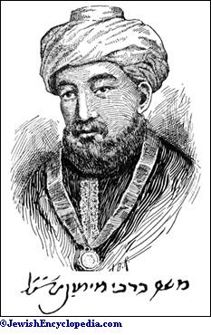
Maimonides (1135-1204)
Two scholars who dislike each other are forbidden to sit together in judgment, for this might lead to the rendering of a perverted judgment. Prompted by hostility, each will be inclined to refute the arguments of the other.
Mishneh Torah, Book 14
(“Judges”), Number 7

Slide 9
Key Distinctions Among Acute, Subacute and Chronic Pain
AAAPT
April 27-29, 2016 Sofitel, Washington DC

Slide 10
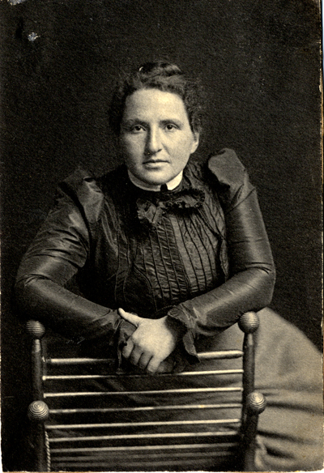
Gertrude Stein (1874-1946)
A difference, to be a difference, must make a difference.

Slide 11
Pain: IASP Definition
“an unpleasant sensory and emotional experience associated with actual or potential tissue damage, or described in terms of such damage”
language, verbalization not required
Why was it framed in this way?

Slide 12
Chronic vs Acute Taxonomies: Contexts (1)
Chronic
Encompasses diagnosis (e.g., criteria for CRPS)
Behavioral dimensions: suffering, trauma, anxiety, fear-avoidance
Presumptive centralization of pain: hyperalgesia…
No opportunity to prevent, modify inciting event
Pain intensity one of several outcome domains
Stable medically (mostly)
? Under-weighted in IASP’s “real-time” definition
Outpatient culture of care

Slide 13
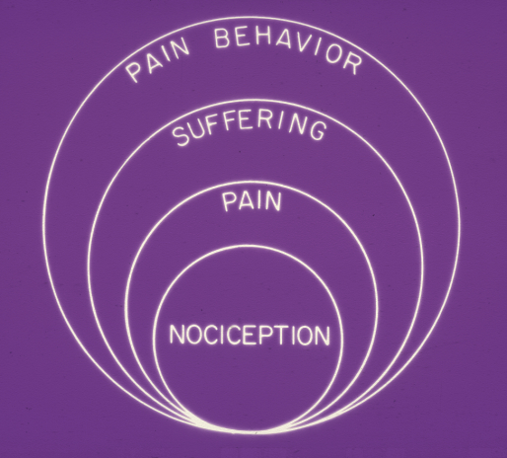

Slide 14
Chronic vs Acute Taxonomies: Contexts (2)
Acute
Diagnosis usually clear-cut, anatomy relevant
Medical-pathophysiological focus emphasizes periphery
Opportunity for early intervention, prevention
Pain intensity the key outcome measure
Pain control integral to clinical efficiency
Objective outcomes relatively easily captured (e.g., LOS, incidence of complications…)
Patients often unstable medically: postop, post-trauma, medically ill [pancreatitis, sickle]
Inpatient culture of acute care [including labor]

Slide 15
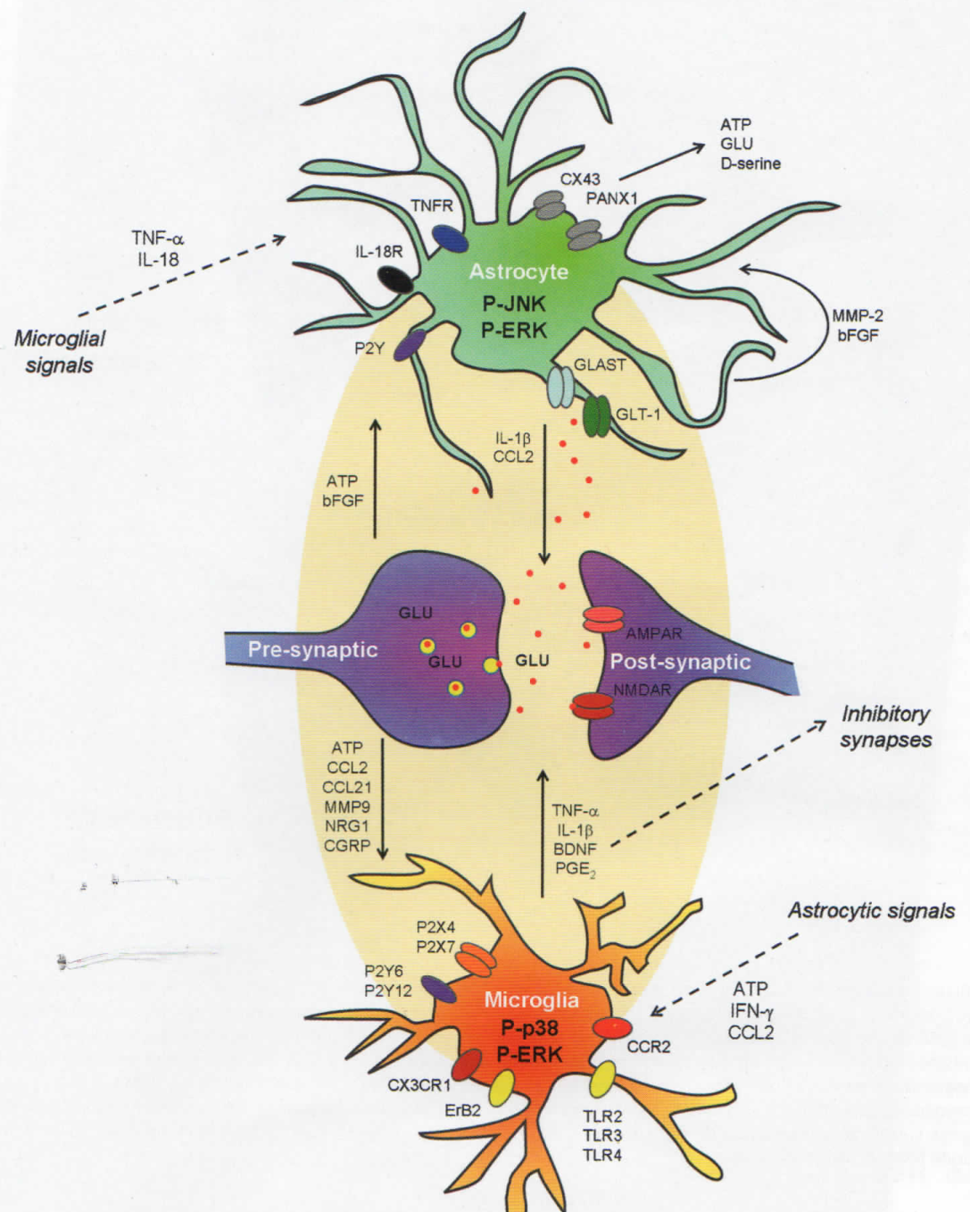
“The Fundamental Unit of Pain is the Cell”
Above is title of 2014 review article in Pain supplement by Reichling, Green and Levine.
However, no figures in that supplement depict individual cells.
Figure from Ji R-R et al, Glia and pain: Is chronic pain a gliopathy? Pain 154 (2013) S10-S28

Slide 16
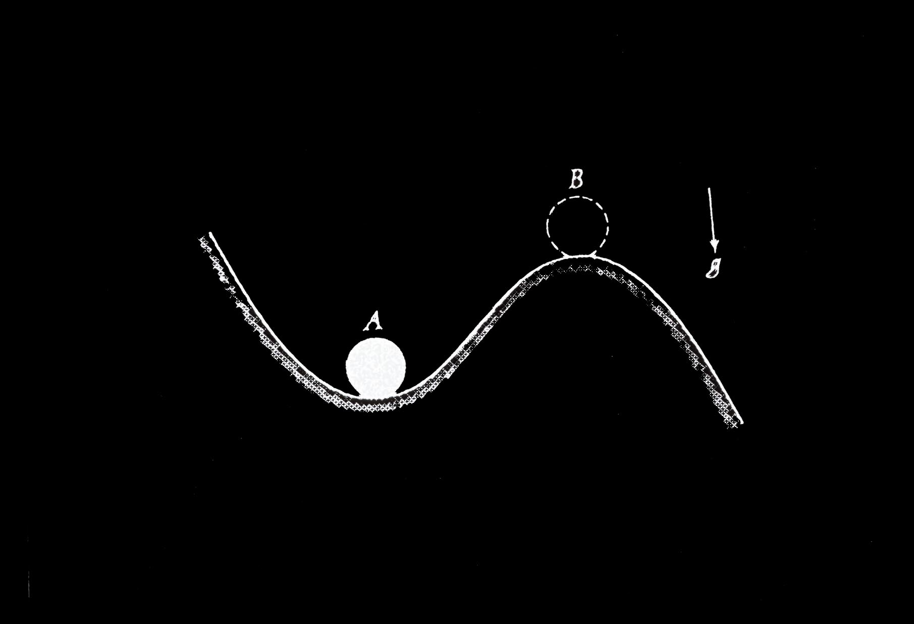

Slide 17
Have We Oversimplified?

Slide 18
The Perfect Analgesic?

Slide 19
Constructing Reality

Slide 20
Pain and Consciousness
Consciousness = an “emergent” neuronal property that requires a developed (layered) forebrain
Pain (classic view): passive registration of nociception
Pain (current view): a network of brain structures employs nociception, other inputs and memories to actively construct a continually evolving internal model of reality

Slide 21
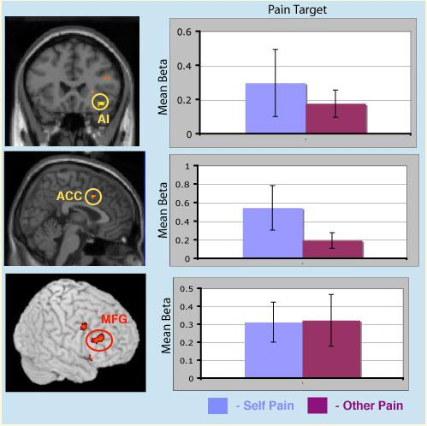
Self Pain & Pain Empathy Activate Common Regions
Ochsner K et al. Social Cognitive & Affective Neurosci (2008)

Slide 22
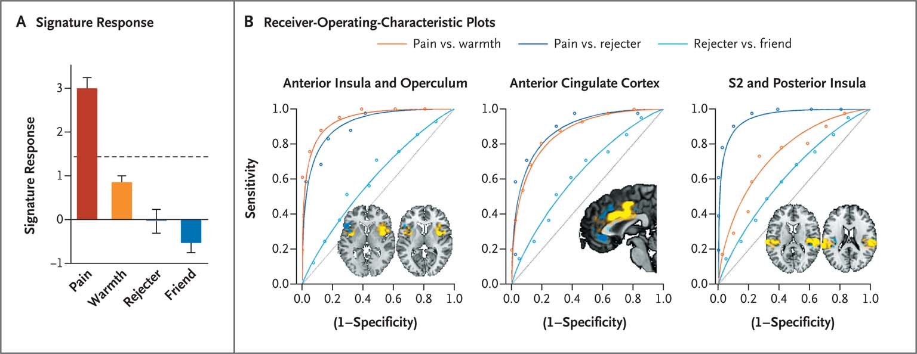
Pain vs Rejection (Wager 2013)
“Comparisons of rejecter versus friend and pain versus warmth yielded similar levels of self-reported negative affect, and overlapping portions of many regions related to pain intensity
were activated (bilateral anterior insula, medial thalamus, secondary somatosensory cortex, and dorsal posterior insula).”

Slide 23
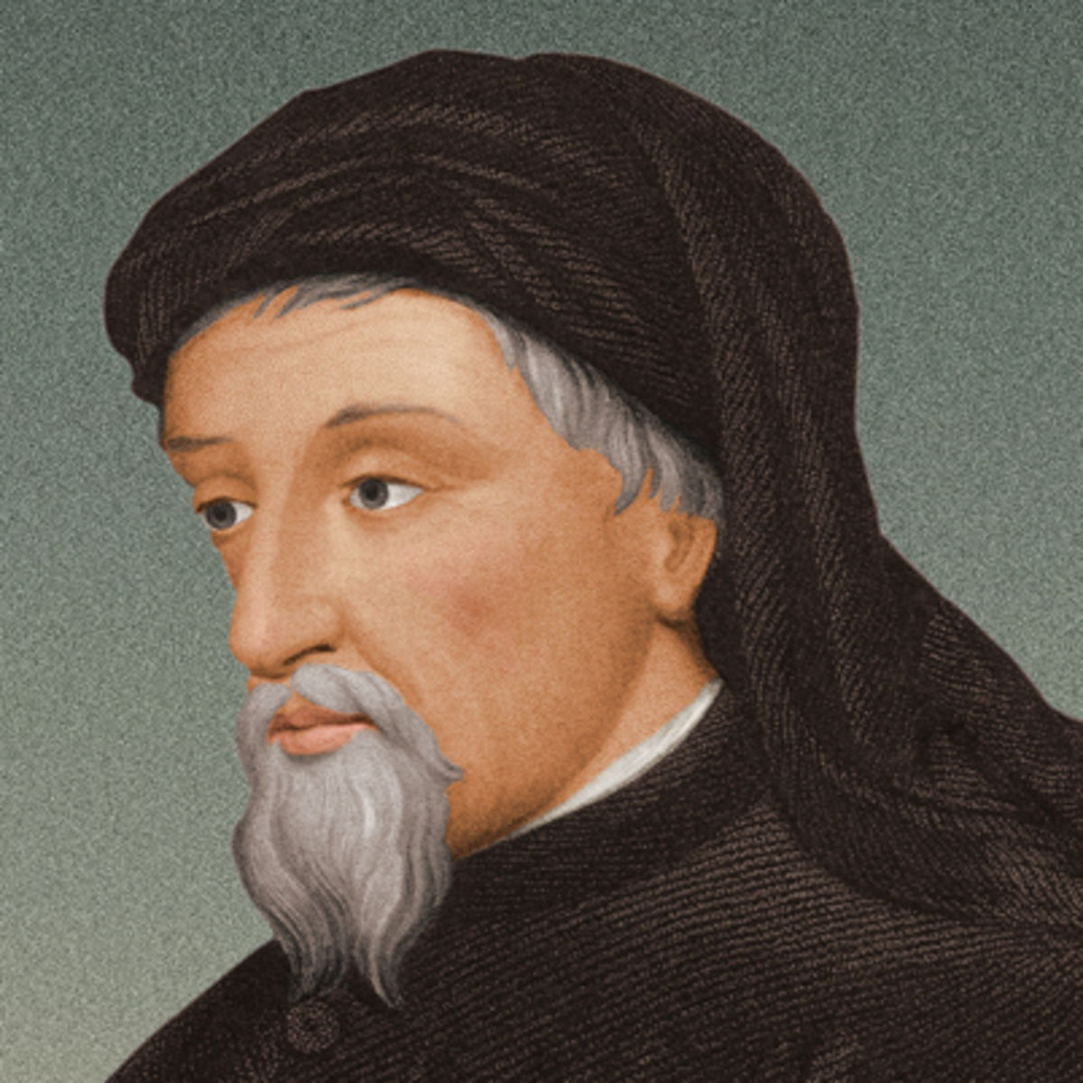
Geoffrey Chaucer (1343-1400)
Out of olde bokes…
cometh all this newe science.
Parliament of Foules (c. 1380)

Slide 24
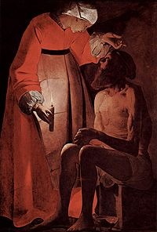
Job 30 (~6th Century BCE)
⁸ They were children of fools, yea, children of base men: they were viler than the earth.
⁹ And now am I their song, yea, I am their byword.
¹⁰ They abhor me, they flee far from me, and spare not to spit in my face.

Slide 25
Greek Etymology
Algos = somatic or psychic pain
From alego = “to care, look after”
Multiple compound forms emphasizing bodily location, e.g., cephalalgia
Poena = penalty
Odyne = strong psychic pain
Deine odyne = fearful, terrible pain
Oxeia odyne = acute, sharp pain
Psychrai odyne = cold pain, i.e., chronic
Thermai odyne = hot pain, i.e., acute

Slide 26
“Pain” as Payback: Origin
Greek poine "retribution, penalty, blood-money”
Proto Indo European "to pay, atone, compensate“
Latin poena "punishment, penalty, retribution, indemnification“ [cf penal, penance…]
English late 13th century : punishment, especially for a crime [survives in “on pain of death”]
Fundamentally social, transactional meaning
Source: Online Etymology Dictionary

Slide 27
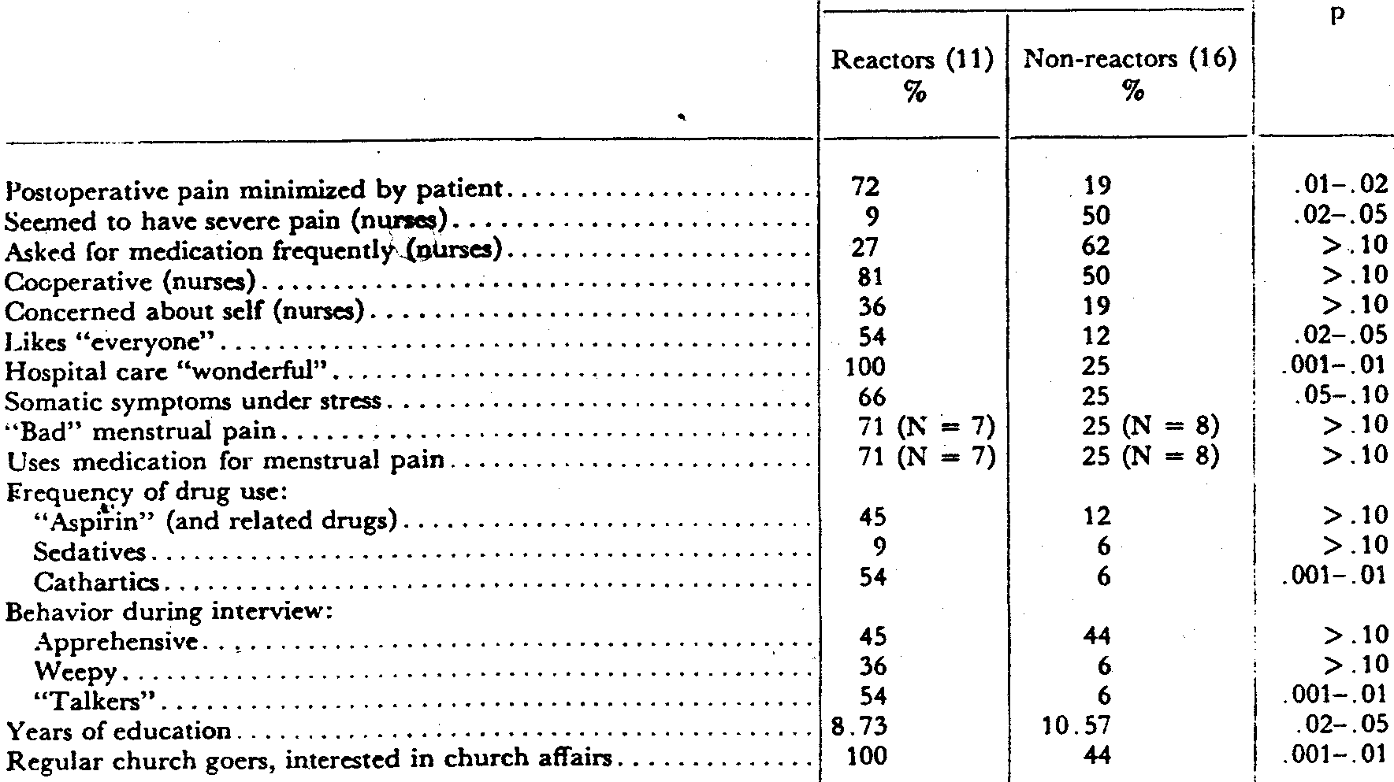

Slide 28
“What 3 Words Should the World Know about Pain?” (Tufts, 2015)

Slide 29
Acute Pain (Carr, Goudas 1999)
Acute vs chronic pain dichotomy is oversimplified
“Chronic pain”, a disease state, may begin within hours (?minutes) of acute injury
Acute pain = initiation phase of an extensive, persistent nociceptive and behavioral cascade triggered by tissue injury
As with other complex dynamic systems, small differences in the initial state of the host and in the intensity, quality, and meaning of the nociceptive stimulus can produce major differences in the detailed manner in which this process unfolds

Slide 30
Acute Pain: Initial Phase of Disease?
Injury triggers a cascade of responses
PNS, CNS promptly adapt, reorganize, remember
“Programmed instability” links pain, memory
Acute and chronic pain = continuum
Increasing documentation of chronic neuropathic pain after surgery (NNH 2-7)
Unclear why NNH isn’t = 1

Slide 31
Chronification of Pain
New Pathology
Muscle atrophy,
weakness
Bone loss
Immunocompromise
-Depression / suicide
-Substance abuse /
overdose
Pathophysiology of Maintenance
Radiculopathy
Neuroma traction
Myofascial sensitization
Brain, SC pathology
(atrophy, reorganization)
Central
Sensitization
Neuroplastic
changes
Psychopathology
of maintenance
Encoded anxiety
dysregulation
- PTSD
- Emotional, mood disorder
Acute injury
and pain
Disability
Less active
Kinesophobia
Decreased
motivation
Social isolation
Role loss
Sleep disorder
Neurogenic
Inflammation
- Glial activation
- Pro-inflammatory
cytokines
- blood-nerve barrier
disruption
Peripheral
Sensitization
New Na+ channels
>> lower threshold
From Gallagher RM, in Krames, Neuromodulation, 2009

Slide 32
Hypotheses
Acute vs chronic pain dichotomy oversimplified
“Chronic pain”, a disease state, may begin within hours (?minutes) of acute injury
Potential clinical techniques, benefits of early intervention inadequately studied thus far
Mechanisms of pain resolution (e.g., resolvins) an intriguing area of study

Slide 33
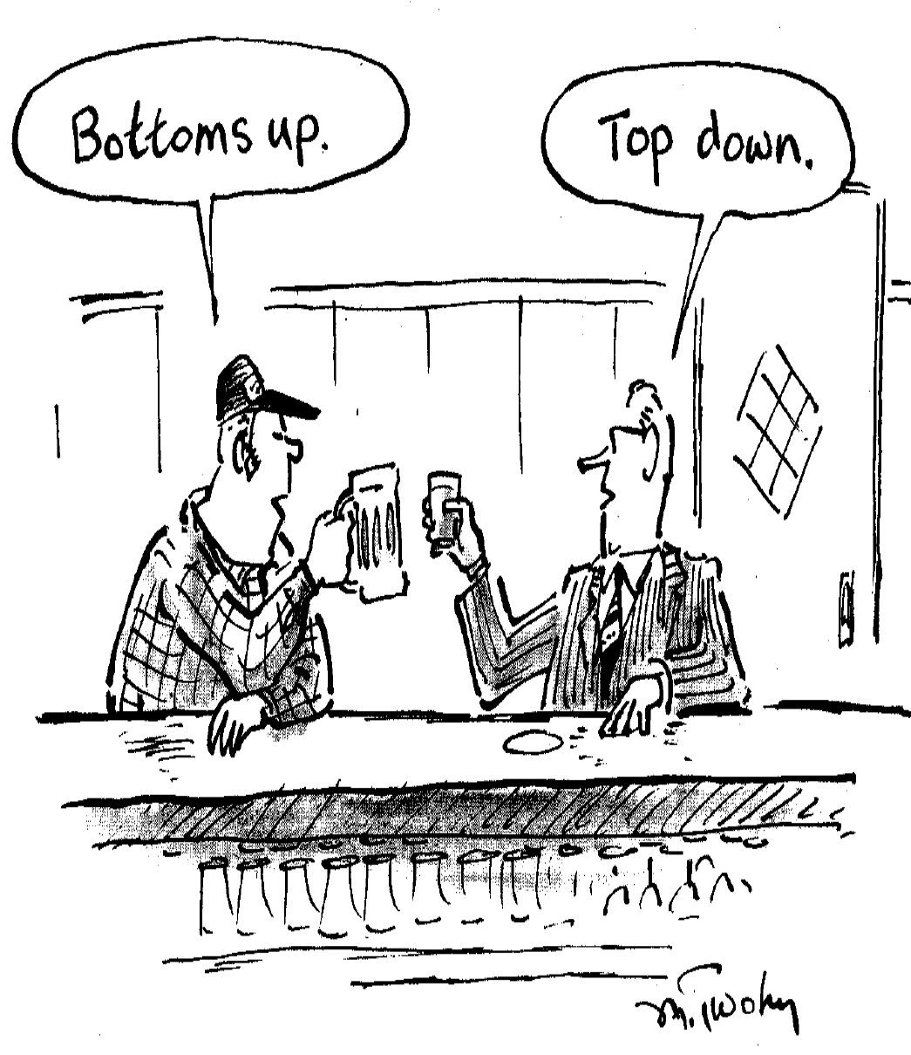

Slide 34
Towards an Answer (1)
To ask “when does acute pain become chronic?” is misleading
Question equates time course, mechanism
Prolonged (labor, arthritis, glaucoma, obstructed viscus, sunburn) or repetitive (ulcer, muscle bruise/ soreness) nociception alone rarely induce chronic pain
[Exception: psychosocial factors]
BUT, acute-to-chronic pain progression is well documented clinically

Slide 35
Towards an Answer (2)
Evidence, logic mandate distinguishing intense nociception (“acute pain”) vs. rapid onset of PNS, CNS reorganization (“chronic”)
Epidemiology of acute-to-chronic pain progression implies concordance of nerve injury (zoster, operation, ischemia…) and intense acute nociception, inflammation
? CPSP risk ~ PNS injury x CNS sensitization
Genetics, epigenetics, cognition influence relative weighting, intensity, inhibition

Slide 36
Marie Kondo (1975-)

Slide 37
Marie Kondo (1975-)
If we can have confidence in our decisions and launch enthusiastically into action without any doubts holding us back, we will be able to achieve much more.
The Life-Changing Magic of Tidying Up (2011/ 2014)

