Slide 1
Can Pathophysiologic Mechanisms of Acute Pain Inform the Classification of Acute Pain Conditions?
Timothy J Brennan, MD, PhD

Slide 2
Conclusion
Not very easily

Slide 3
Alternative Conclusion
We are part way there and we need more information.

Slide 4
Pain Mechanisms
Procedural Pain
Acute pain
Pain mechanisms
  Nociceptive, neuropathic, inflammatory…
Sensitization
  Peripheral vs Central sensitization.
Mediator
  Factor Z is generated in condition A but not in condition B.
Treatment
  Drug A is effective in condition A but ineffective in condition B.
Tissue injured
  Acute joint injury has a different clinical profile vs ischemic leg pain.
Notes:
Temporal

Slide 5
Procedural Pain
Immediate Procedural Pain: Nociceptive Pain
Treatment is local
Peripheral nociceptor activation and central nervous system nociceptive pathway activation occurs
Time: minutes
Examples:
Freezing or burn lesion
Any injection
Distension during a gastrointestinal procedure

Slide 6
Procedural Pain
Nociceptive transduction of heat, cold, mechanical stimuli.
Nociceptive transmission through central nervous system pain-transmitting pathways.
Not pathophysiologic

Slide 7
Pathophysiologic Mechanisms
Pain mechanisms
  Nociceptive, neuropathic, inflammatory…
Sensitization
  Peripheral vs Central sensitization.
Mediator
  Factor Z is generated in condition A but not in condition B.
Treatment
  Drug A is effective in condition A but ineffective in condition B.
Tissue injured
  Acute joint injury has a different clinical profile vs ischemic leg pain.
Notes:
Temporal

Slide 8
Pathophysiologic Mechanisms
Pain mechanisms
  Nociceptive (mechanical, heat, cold, chemical): transduced acute stimuli
  Neuropathic: caused by nerve injury
  Inflammatory: immune mediated
Notes:
Temporal
Anatomic location
Tissue type

Slide 9
Categorize acute pain mechanisms
Nociceptive: swelling after sprain, ischemia
Neuropathic: acute nerve injury (cut, stretch, inflamed)
Inflammatory: acute joint infection
Most of these mechanisms are components of all acute pain conditions.

Slide 10
Categorize acute pain mechanisms
Nociceptive/Mechanical:
  Swelling after sprain
    Relief with ice and elevation.
  Stretch with respiration after abdominal surgery
    Thoracic and abdominal muscles relax with deep inspiration
  Stretch with coughing after abdominal surgery
    Thoracic and abdominal muscles contract during cough
Any evoked pain with activities has a mechanical nociceptive component.
Most acute pain has evoked components to its clinical scenario.
Neuropathic: acute nerve injury
Inflammatory: acute joint infection

Slide 11
Categorize acute pain mechanisms
Chemical (ischemia): hypoxic, lactic acidosis for example.
  compartment syndrome after trauma
  Fracture with bone remodeling
  Wounding and loss of blood flow/coagulation.
  Osteoarthritis
Neuropathic: acute nerve injury
Inflammatory: acute joint infection
  All injuries have some component

Slide 12
Categorize acute pain mechanisms
Nociceptive/Mechanical:
  Swelling, Stretch and Strain.
Neuropathic: surgical and traumatic nerve injury and others
  Thoracotomy: Can chronic neuropathic pain following thoracic surgery be predicted during the postoperative period. Interactive Cardiovascular and Thoracic Surgery 9 (2009) 999–1002
  Acute Herpes Zoster: Patient perspective on herpes zoster and its complications…. Pain 153:342-349, 2012
  Other examples: amputation/phantom, inguinal hernia, Iliac bone harvest.
  All trauma has nerve injury to some degree, its role in acute pain is noted. Acute neuropathic pain is present based on neuropathic pain scoring in acute scenarios.
Inflammatory: acute joint infection
  All injuries have some component

Slide 13
Categorize acute pain mechanisms
Inflammatory: markers of inflammation, leukocytes, TNF
  Any trauma or surgery is associated with inflammation.
    Perioperative single dose systemic dexamethasone for postoperative pain: a meta-analysis of randomized controlled trials. Anesthesiology 2011:115 :575 -588. mixed effect
    Analgesic effect of NSAIDs and COX-2 inhibitors
A Multicenter, Randomized, Double-Blind, Placebo-Controlled Trial of Intravenous Ibuprofen in the Management of Postoperative Pain Following Abdominal Hysterectomy Pain Practice, Volume 11: 2011 23–32. weak effect
    Evaluation of the opioid-sparing effectiveness of parecoxib sodium….Total hip arthroplasty J. Pain. 2:38, 2001 moderate to strong effect
  A comparison of the analgesic efficacy of flurbiprofen, diclofenac, dihydrocodeine/paracetamol and placebo following oral surgery. Br. J Clin. Pract. 1986. 40:463-7. strong effect
  TNF inhibitors have high utility in autoimmune acute pain conditions.
  Acute joint infection
  Acute zoster

Slide 14
Conclusion
Pain mechanisms to classify acute pain
  Nociceptive (mechanical, chemical heat, cold): mechanical stimuli are part of all evoked pain. Chemical mediators are a common mechanism in various conditions
  Neuropathic: nerve injury occurs in any tissue trauma, acute neuropathic pain exists, is assessed by neuropathic pain surveys but is not consistently diagnosed.
  Inflammatory: immune mediated responses are common and may be separated to some extent from autoimmune conditions.
Notes:
Temporal
Anatomic location
Tissue type

Slide 15
Pathophysiologic Mechanisms
Pain mechanisms
  Nociceptive, neuropathic, inflammatory…
Sensitization
  Peripheral vs Central sensitization.
Mediator
  Factor Z is generated in condition A but not in condition B.
Treatment
  Drug A is effective in condition A but ineffective in condition B.
Tissue injured
  Acute joint injury has a different clinical profile vs ischemic leg pain.
Notes:
Temporal

Slide 16
Sensitization of the Nociceptive Pathway -
Peripheral Sensitization
Increased responsiveness and reduced threshold of nociceptors to stimulation of their receptive fields.
Central sensitization
Increased responsiveness of nociceptive neurons in the central nervous system to their normal or subthreshold afferent input.
Pain 137 (2008) 473–477

Slide 17
Acute Pain
Time: minutes to weeks
Early acute pain has high local amounts of pain mediators and/or sensitizing agents
Peripheral/nociceptor activation and sensitization.
Central sensitization occurs using the very broad definition of central sensitization
  Spinal cord, thalamus, cortex…
  Excitation, disinhibition, reorganization…

Slide 18
Acute vs Chronic Pain
Less local mediators in chronic pain
  Can be peripherally maintained (myofascial pain)
  Structural rather than predominantly mediator transmitted (neuroma, tendonopathy).
  Central sensitization may be more prominent in chronic rather than acute pain (phantom pain)
Birbaumer, N. et al. Effects of regional anesthesia on phantom limb pain are mirrored in changes in cortical reorganization. J. Neurosci. 17, 5503–5508 (1997).
Baron, R. & Maier, C. Phantom limb pain: are cutaneous nociceptors and spinothalamic neurons involved in the signaling and maintenance of spontaneous and touch-evoked pain? A case report. Pain 60, 223–228.
Schmidt, A. P., Takahashi, M. E. & de Paula Posso, I. Phantom limb pain induced by spinal anesthesia.Clinics 60, 263–264 (2005)
JAY P. SHAH, MD, and JULIANA HEIMUR, BA NEW FRONTIERS IN THE PATHOPHYSIOLOGY OF MYOFASCIAL PAIN THE PA IN P R AC T I T IONE R 22: 26-33

Slide 19
Acute Pain
Central sensitization in acute pain
  Area of secondary hyperalgesia-limited clinical relevance.
  The engagement of affective/emotional/cognitive components of acute pain
  Acute phantom pain may have a strong component of central sensitization.

Slide 20
Conclusion
Sensitization to classify acute pain
Most acute pain is driven strongly by peripheral sensitization.
The importance of peripheral sensitization even in chronic pain prevents using sensitization to categorize acute pain.
The role of central sensitization in chronic pain remains under active study and much less so in acute pain.

Slide 21
Pathophysiologic Mechanisms
Pain mechanisms
  Nociceptive, neuropathic, inflammatory…
Sensitization
  Peripheral vs Central sensitization.
Mediator
  Factor Z is generated in condition A but not in condition B.
Treatment
  Drug A is effective in condition A but ineffective in condition B.
Tissue injured
  Acute joint injury has a different clinical profile vs ischemic leg pain.
Notes:
Temporal

Slide 22
Hypothesized mediators are redundant in various acute pain states:
PGE2
Histamine
CGRP
NGF
Cytokines
NO
Bradykinin
PAF
TNF-alpha
Substance P
Serotonin
ATP
Acid
Lactate

Slide 23
Clinically evident mediators are redundant in various acute pain states:
PGE2
Histamine
NGF
Cytokines
NO
Bradykinin
PAF
TNF-alpha
Substance P
Serotonin
CGRP
ATP
Acid
Lactate

Slide 24
Classification based on pain mediators
pH/lactate Incisions, compartment syndromes but also OA and cancer pain
NGF Incisions, OA, burns and bone cancer
PGs OA, incisions, acute soft tissue (sprain or strain), dental

Slide 25
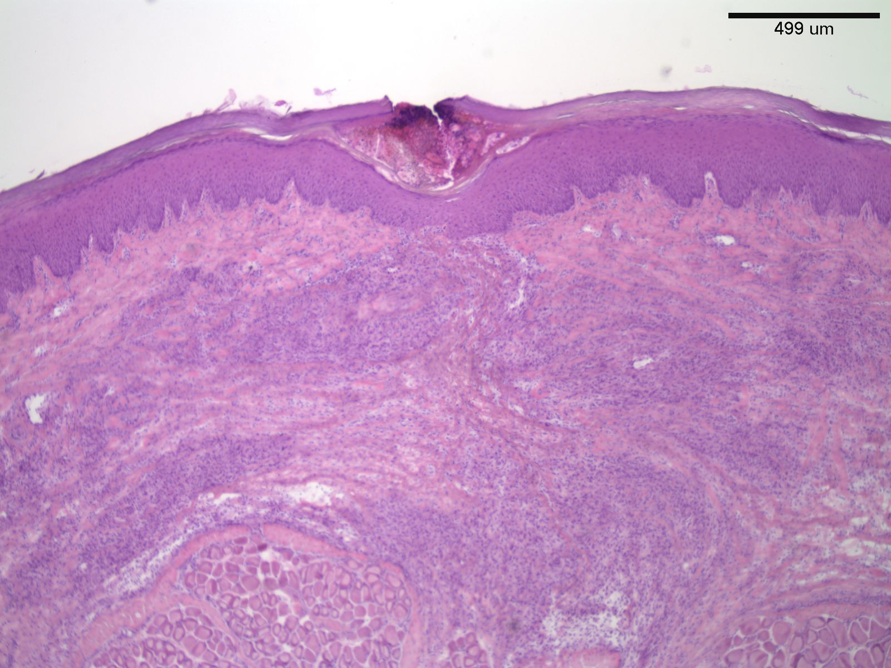
Incision
H+ Lactate
Hypoxia NGF
Notes:
HE stained cross section image of rat hindpaw with skin incision. It was taken 4hr after the incision. The depth around 0.4. It broke through epi , and stopped before reaching fascia. We also can see some acute inflammatory cell surrounding the incision site.

Slide 26
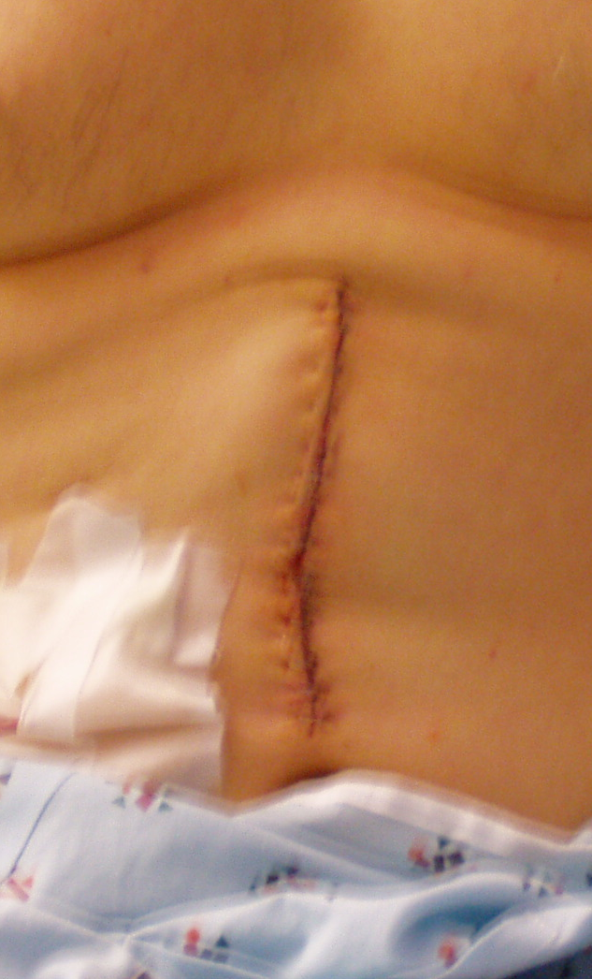
Postoperative Day 1
PO₂
H+
Lactate
NGF

Slide 27
Conclusion
Many acute and chronic diseases states share the same mediators
Trauma, coagulation and monocyte activation produce a local environment for revascularization and reinnervation that should be redundant in injury.
That local repair environment can contribute to pain.

Slide 28
Pathophysiologic Mechanisms
Pain mechanisms
  Nociceptive, neuropathic, inflammatory…
Sensitization
  Peripheral vs Central sensitization.
Mediator
  Factor Z is generated in condition A but not in condition B.
Treatment
  Drug A is effective in condition A but ineffective in condition B.
Tissue injured
  Acute joint injury has a different clinical profile vs ischemic leg pain.
Notes:
Temporal

Slide 29
Acute and Chronic Pain and Mechanisms and Treatments
Both acute and chronic pain share treatments:
  Gabapentin: total joint replacements, breast surgery, spine surgery.
  COX-2 inhibitors: orthopedic surgery and urologic surgery. Less remarkable in thoracic surgery and gynecologic surgery.
  Glucocorticoids: laparoscopic cholecystectomy and laparoscopic hysterectomy. Less effective in major gynecologic surgery.
  Bisphosponates: bone related pain

Slide 30
Acute Autoimmune Treatments
The inflammatory cascade-autoimmune responses do not appear to be useful in many acute pain conditions.
  TNF inhibitors
  IL-1 inhibitors
  IL-6 inhibitors
  Immune-mediated inflammatory conditions vs autoinflammatory diseases.

Slide 31
Conclusion
Many acute and chronic diseases states share the same treatments
COX-2 inhibitors seem to have broad efficacy in orthopedic related acute pain conditions.
TNF inhibitors and acute autoimmune pain conditions.

Slide 32
Pathophysiologic Mechanisms
Pain mechanisms
  Nociceptive, neuropathic, inflammatory…
Sensitization
  Peripheral vs Central sensitization.
Mediator
  Factor Z is generated in condition A but not in condition B.
Treatment
  Drug A is effective in condition A but ineffective in condition B.
Tissue injured
  Acute joint injury has a different clinical profile vs ischemic leg pain.
Notes:
Temporal

Slide 33
Tissue specific responses to acute injury
Skin
Muscle tendon ligament
Bone
Vascular
Joint
Viscera
Mucosa
Nerve
Dental

Slide 34
Characteristic Mechanisms of Acute Pain
Tissue specificity/Procedure specific
  Cutaneous procedure skin injury
  Plantar fascia release skin and fascia injury
  Total hip replacement skin, fascia, muscle, ligament, bone…
  Pancreatectomy skin, fascia, muscle, peritoneum, viscera.

Slide 35
Tissue transduction has some specificity
A greater proportion of visceral afferents compared with cutaneous afferents were trkA-immunoreactive (75% and 43%, respectively).
The percentage of TrkA-IR, binding neurons in the subchondral bone afferents is 65%.
Nociceptive markers that are associated with tissue signatures but maybe not causal (TRPV1)

Slide 36
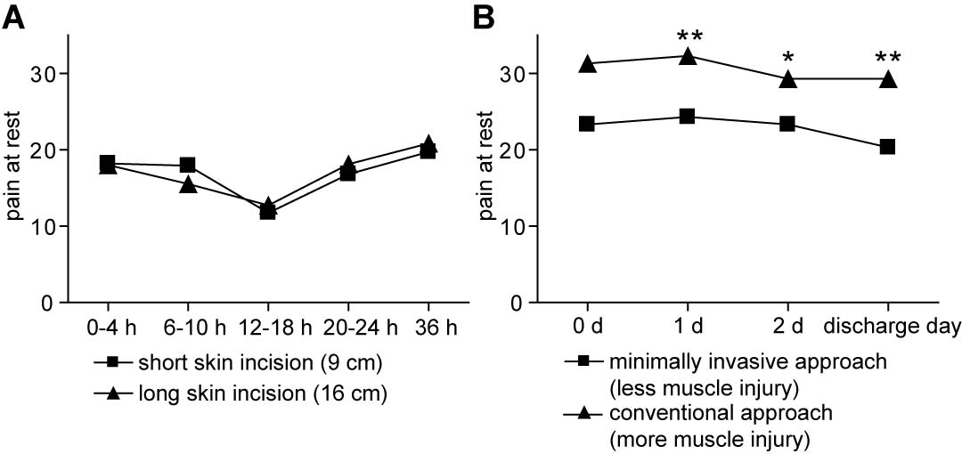
Surgical approaches for a unilateral total hip replacement on spontaneous pain
**
*
**
Opioid consumption =
Opioid consumption less
Opioid consumption =
Opioid consumption less
J Bone Joint Surg Am 87:701-10, 2005
J Bone Joint Surg Am 89:1153-60, 2007
Notes:
36

Slide 37
Acute pain mechanisms and classification of acute pain
There is evidence for tissue specific mediators, receptors and responses.
For example: acute ischemic pain appears to be muscular pain rather than cutaneous or skeletal.
Changing the degree of cutaneous injury has not effect on postoperative pain after hip replacement

Slide 38
Acute Pain and repair
Linked to repair, neovascularization
Repair mechanisms likely vary with tissue.
Redundancy: TRPA1: joint, viscera, muscle, skin

Slide 39
Can Pathophysiologic Mechanisms of Acute Pain Inform the Classification of Acute Pain Conditions?
Not easily
We do not have sufficient information
The best opportunity for pathophysiologic classification is in the type(s) of tissue injured.

