Slide 1
Craving as an outcome measure in OUD trials
Tanya Ramey MD, PhD
NIDA DTMC
ACTTION meeting Nov 29 2018

Slide 2
Craving in SUD diagnosis
Craving - a key symptom, added into DSM-5 (Criterion 4)- an intense desire or urge for the drug that may occur at any time but is more likely when in environment where the drug previously was obtained or used.
Pathophysiology of craving – long term present neuroplacticity signature,and not only in SUDs...

Slide 3
Near-term Goals
-Available craving measures/scales currently used in OUD clinical trials reviewed today.
-Best measure to be identified and validated.
-Craving Clinical Outcome Assessment (COA) for OUD should go through the qualification process for Drug Development Tool (DDT). This step is needed for:
the FDA regulatory acceptability as an endpoint.
Label claim?
Indication?
Notes:
NIDA is very interested in following FDA Guidances and supporting the development of PROs FDA approved, such as craving.

Slide 4
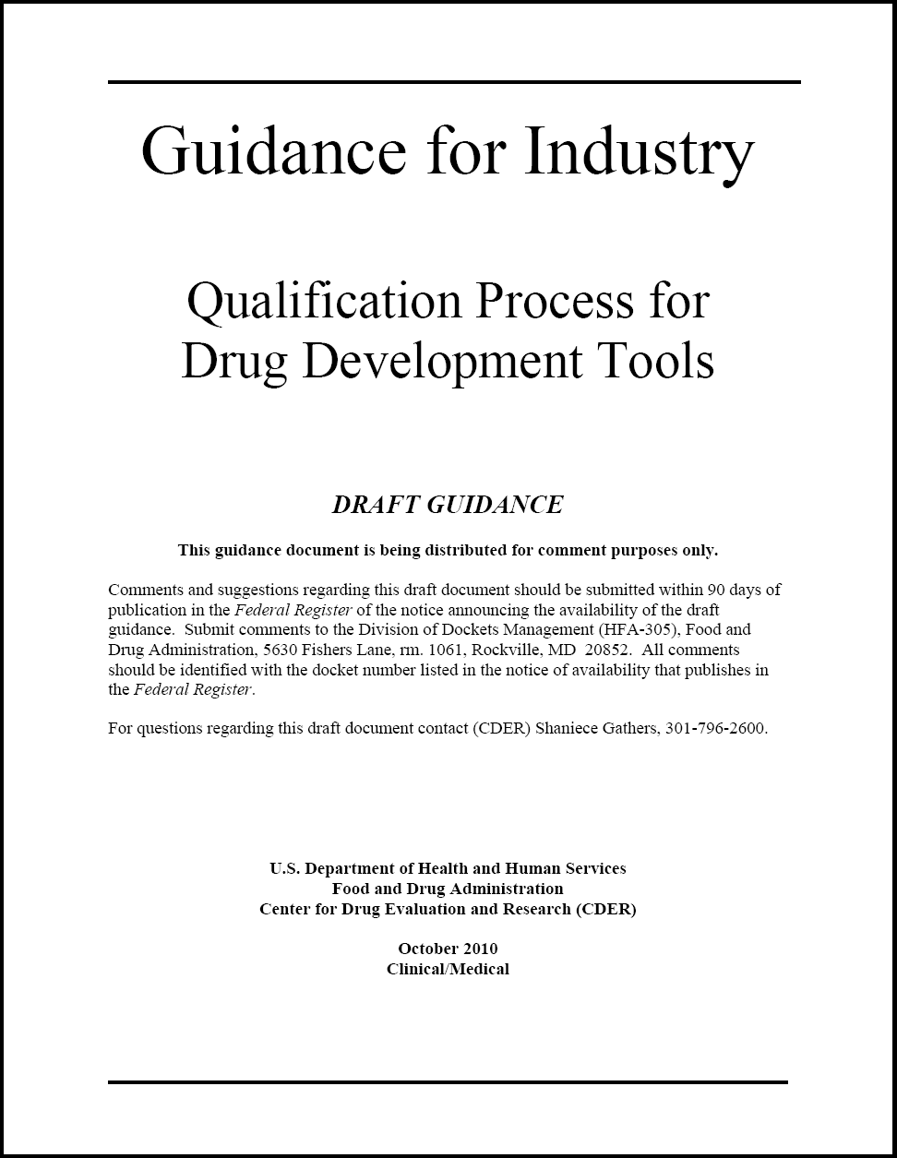
Biomarkers
Animal Models
Clinical Outcome Assessments (COA)
Craving
Notes:
NIDA is interested in following FDA Guidance.
4

Slide 5
What is Clinical Outcome Assessment?
A measure that produces a score
Has clearly defined methods and instruction for administration
Has clearly defined methods for assessing responses
A standard format for data collection
Well-documented methods of scoring, analysis, interpretation of results in targeted patient population

Slide 6
Long term Goals
Strive to link Craving COA measure
To proximal biological markers, e.g., neurocircuitry
To more distal clinical outcomes along the line of how patient feels, functions or survives
Use Craving as an intermediate phenotype of incentive salience with the brain function measures biomarkers & behavioral task(s) for efficient go/no-go decisions in drug candidates early clinical evaluation

Slide 7
Clinical Endpoints
Endpoints
Symptoms
State - Trait
COAs – clinical scales, eg craving COA
Behavioral tasks
Human lab
measures
Brain Circuit malfunction
Addictions RDoC
RDoC
Brain functions measures
fMRI, EEG, MEG,…

Slide 8
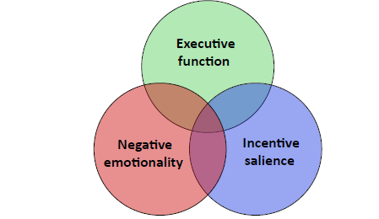
Addictions RDoC & Craving as an intermediate phenotype
Craving,
increased
attention to drug
related cues
(Kwako et al.,2018)

Slide 9
Thank you for your attention

Slide 11
Clinical Outcome Assessments (COA) Types
craving
Clinician Reported Outcome (ClinRO)
Patient Reported Outcome (PRO)
Observer Reported Outcome (ObsRO)
Performance Outcome(PerfO)
Excludes Biomarkers

Slide 12
12

