Slide 1
Does reduction in cocaine use represent psychosocial benefit?
Ivan D. Montoya, M.D., M.P.H.
Deputy Director, NIDA-DPMC

Slide 2
Specific Questions
Are quantitative urine cocaine results associated with psychosocial measures independent of treatment?
Are changes in quantitative urine cocaine results associated with psychosocial changes during treatment?
Is a percent reduction of quantitative cocaine urine associated with psychosocial changes?

Slide 3
What we have…
Data from 7 Phase II, double-blind RCTs of pharmacotherapies for cocaine dependence
Conducted by NIDA
Quantitative urine toxicology analysis thrice weekly
Study medication (n)
Baclofen (n=160)
Ondansetron (n=63)
Selegiline (n=300)
Carbergoline (140)
Modafinil (210)
Reserpine (140)
Tiagabine (140)
Manual-based weekly individual cognitive behavioral therapy
8-week treatment (n=523)
N=1,153
12-week treatment (n=630)

Slide 4
Outcome variables
Addiction Severity Index (ASI)
Clinical Global Impressions (CGI)
Observed
Self-rated
Severity
Improvement
Brief Substance Craving Scale (BSCS)

Slide 5
Q1. Are quantitative urine cocaine results associated with psychosocial scores?
Lower cocaine use associated with better psychosocial function
Independent of treatment time
Linear regression

Slide 6
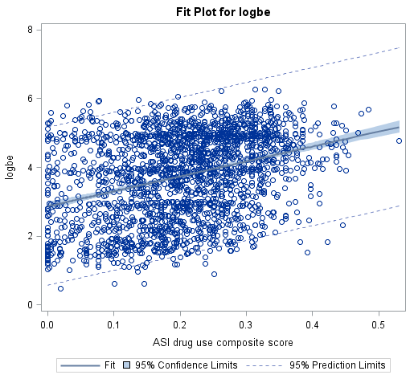
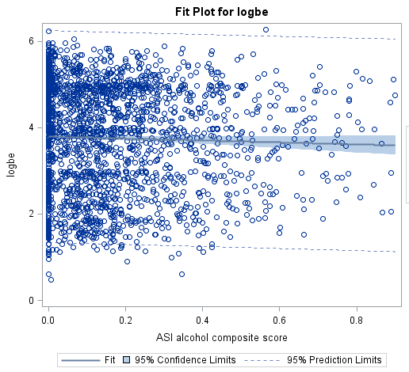
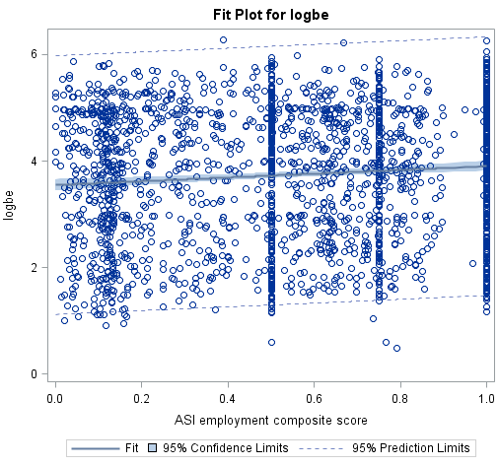
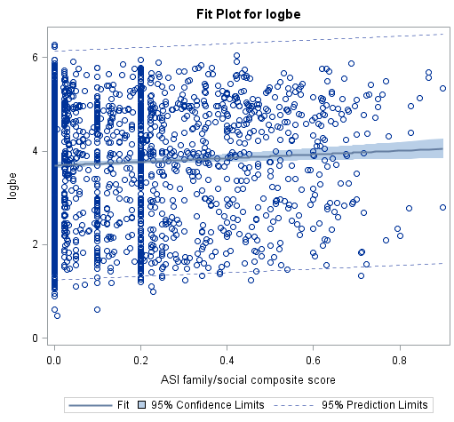
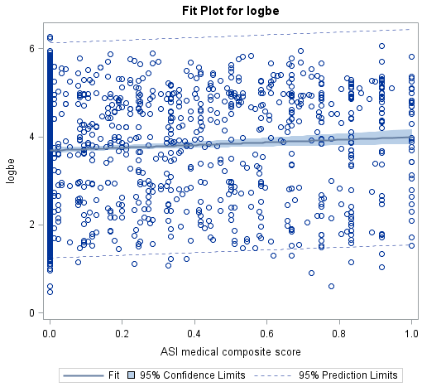
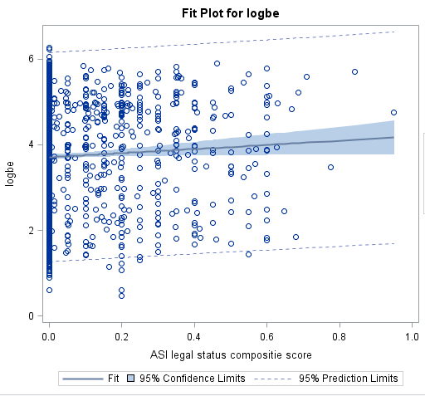
ASI

Slide 7
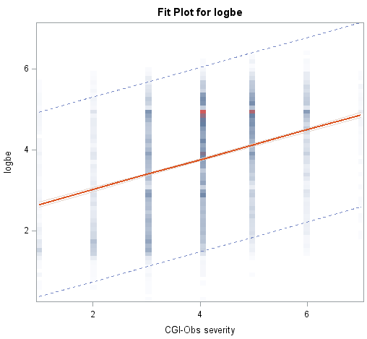
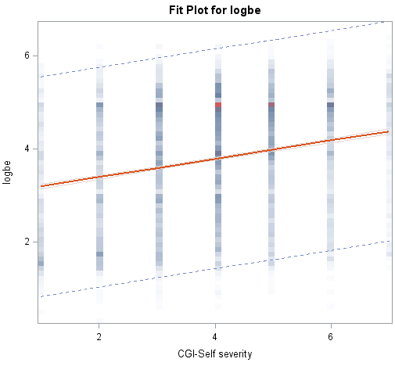
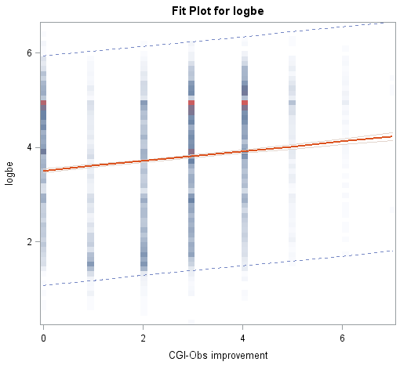
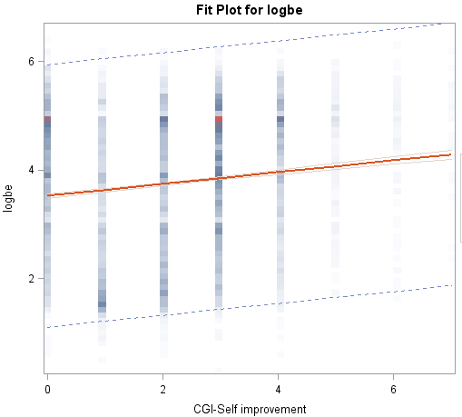
Clinical Global Impression (CGI) Observer & Self-Rated
*
*Adj R-Square: 0.13
P = 0.017

Slide 8
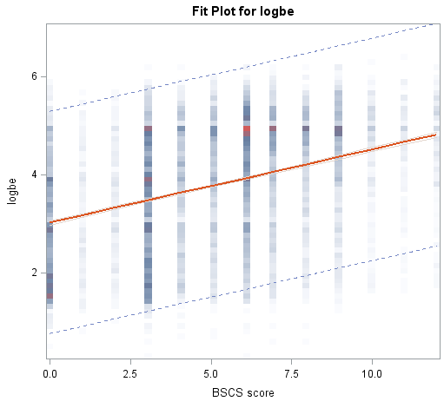
Brief Substance Craving Scale
Adjusted R-Square: 0.14
P=0.016

Slide 9
Q2. Are changes in quantitative urine cocaine results associated with psychosocial changes during treatment?
Cocaine Use
Cocaine Use
Cocaine Use
Psychosocial
Psychosocial
Psychosocial
Treatment Weeks
Treatment Weeks
Treatment Weeks

Slide 10
Data Analysis
For each participant during treatment:
Slope of log-10 BE vs.
Slope of
ASI
CGI scores
Self-reported cocaine use
Treatment Retention
Regression coefficient and p value

Slide 11
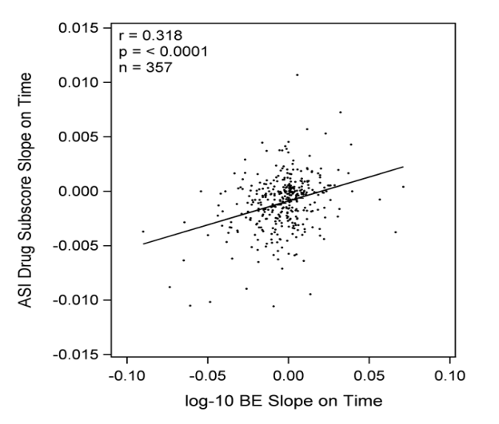
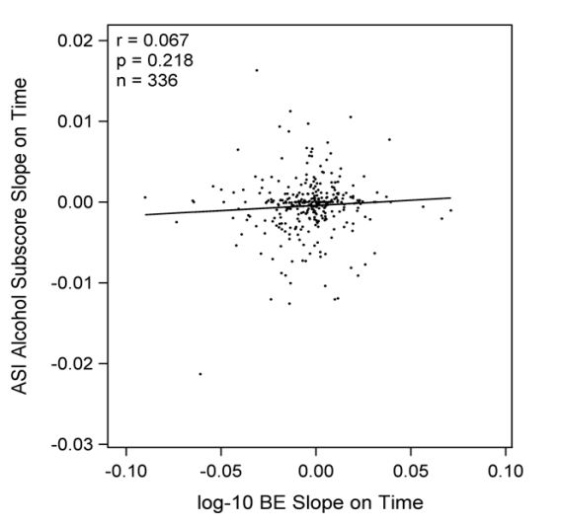
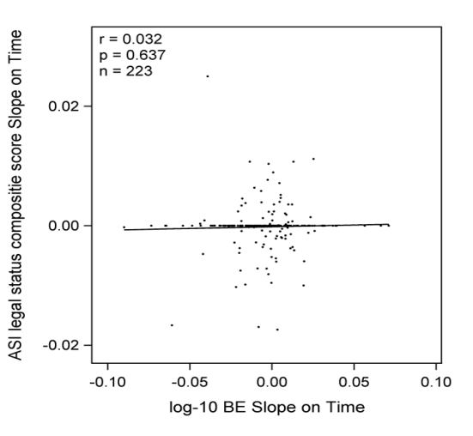
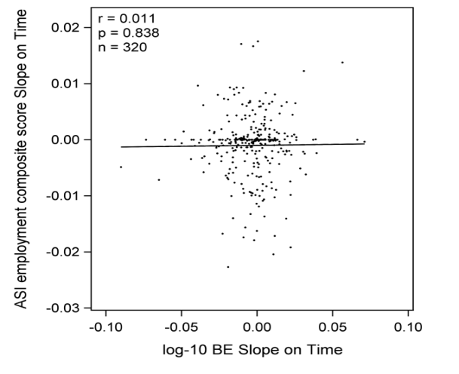
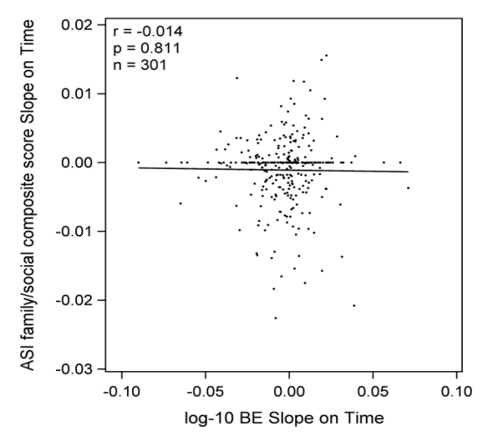
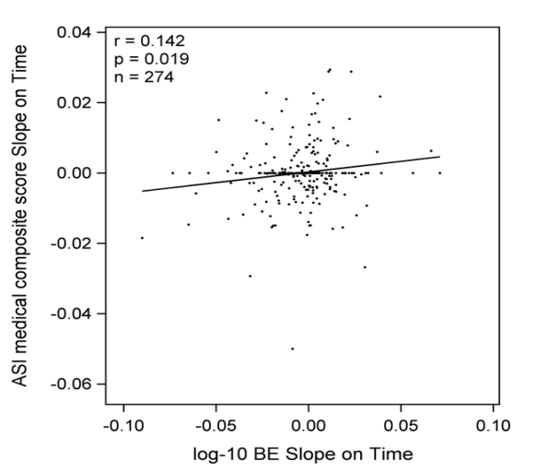
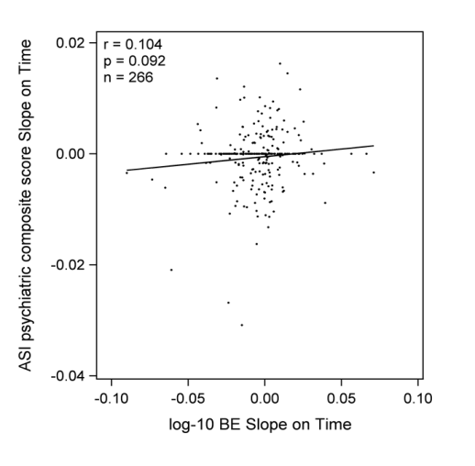
*
ASI

Slide 12
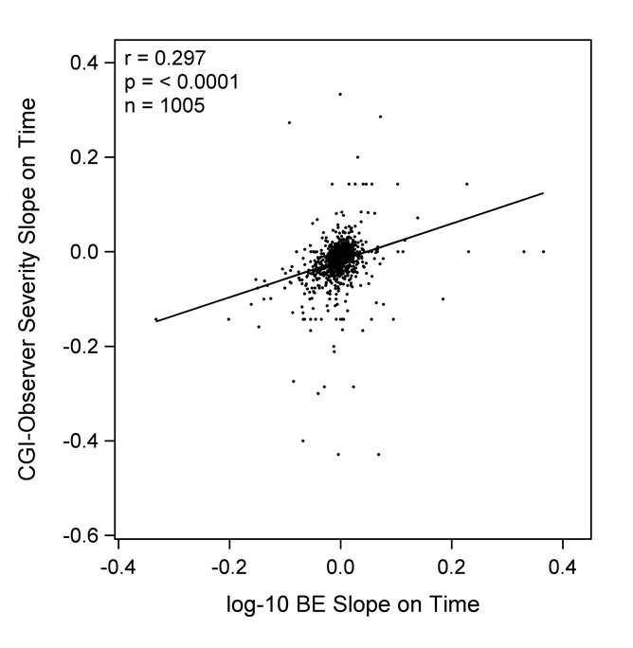
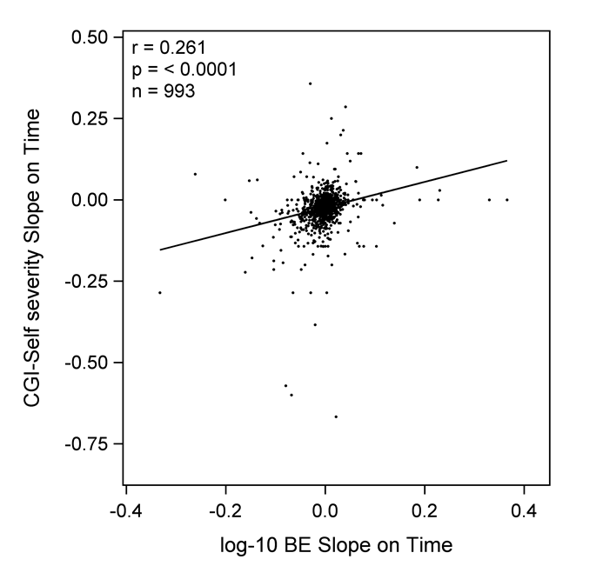
Clinical Global Improvement (CGI) Observer & Self-Rated

Slide 13
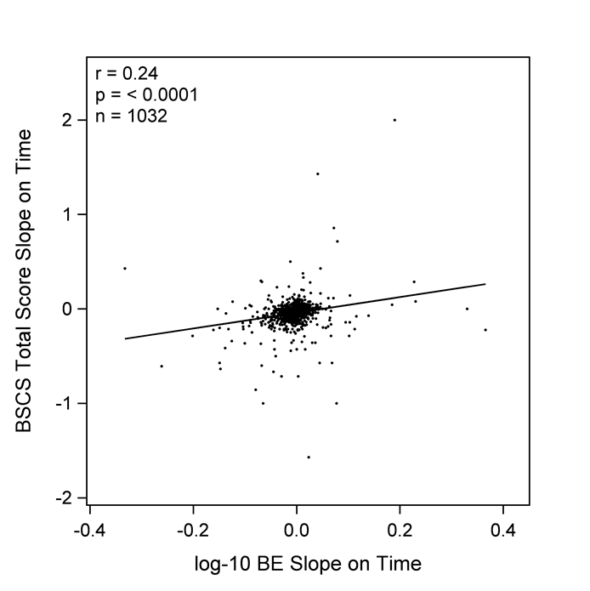
Brief Substance Craving Scale

Slide 14
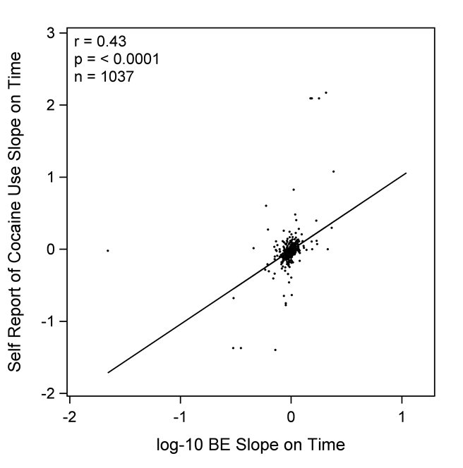
Quantitative Urine BE and Self-Reported Cocaine Use

Slide 15
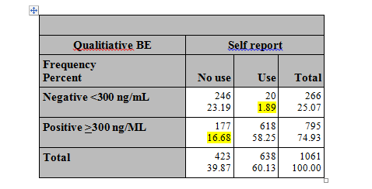
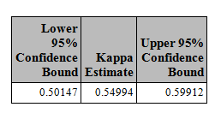
Self-report was coded:
USE: if the use on at least one of three days prior to urine test
NON-USE: no use if the participants reported no use for all three prior days
The simple Kappa coefficient can’t be used because the data are longitudinal and individuals provided multiple self report/BE pairs of observations.
The longitudinal structure required special handling of confidence interval construction using “bootstrap” technique.
Values between 0.40 and 0.75 represent good agreement.

Slide 16
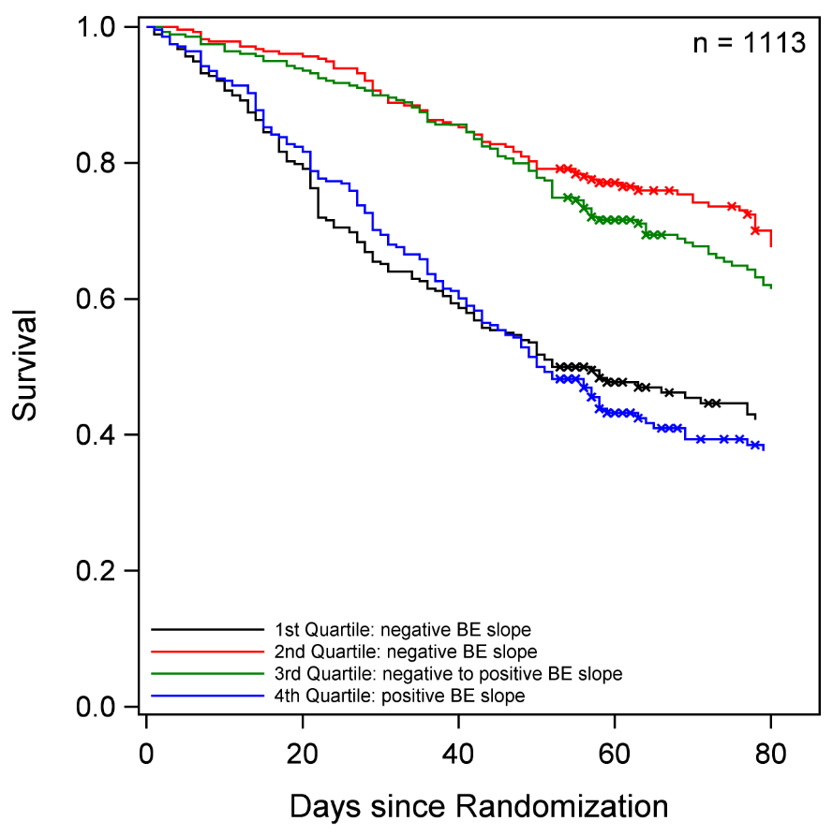
Quantitative Urine Result and Retention in Treatment
Retention was shorter for those who decreased use most rapidly (first quartile)
and those who increased use (fourth quartile)

Slide 17
Q3. Is a percent in reduction of quantitative urine cocaine results associated with psychosocial improvements?
Treatment groups
Success: reduction of 50% or more in urine BE between baseline and end of treatment
Failure: Reduction of less than 50%
Separate analysis for 8- and 12-week studies because of significant differences at baseline and EOT
End of treatment (EOT)*
Weeks 6-8 for 8-week studies
Weeks 9-12, for 12-week studies
Comparison between treatment failure and success groups
Difference in mean scores between baseline and EOT for each outcome variable
Subjects with missing data were excluded from the analysis
Stepdown Bonferroni correction t-tests

Slide 18
Difference in Mean ASI Scores between Treatment Failure and Success (8-week study, n:~130)
Mean ASI Score
______________
ASI Alcohol Score
______________
ASI Drug Score

Slide 19
Difference in Mean ASI Scores between Treatment Failure and Success (8-week study, n:~130)
Mean ASI Score
______________
ASI Family Score
______________
ASI Legal Score
______________
ASI Medical Score
______________
ASI Psychiatric Score

Slide 20
Difference in Mean Brief Substance Craving Score between Treatment Failure and Success 8-week (study, n=399)
*
Mean BSC Score
* p<.01

Slide 21
Difference in Mean Clinical Global Impression Severity Scores between Treatment Failure and Success 8-week (study, n=394)
*
*
Mean CGI Score
_________________
CGI Observed Score
_________________
CGI Self-Rated Score
* p<.01

Slide 22
Difference in Mean ASI Scores between Treatment Failure and Success (12-week study, n=314)
Mean ASI Score
*

Slide 23
Difference in Mean BSCS, CGI-O and CGI-S between Treatment Failure and Success (12-week study, n=405)
*
*
*
Mean
Score
* p<.01

Slide 24
Summary
Are quantitative urine cocaine results associated with psychosocial measures independent of treatment?
ASI: No
CGI Severity: Possibly

Slide 25
Summary
Are quantitative urine cocaine results associated with psychosocial measures?
Are changes in quantitative urine cocaine results associated with psychosocial changes during treatment?
ASI: No
CGI Severity: Possibly
Self-reported cocaine use: yes
Retention: yes

Slide 26
Summary
3. Is a percent reduction of quantitative cocaine urine (success vs. failure) associated with psychosocial changes?
8-week studies:
No significant change in all ASI domains
Treatment success: significant reduction of craving and improvement of CGI Severity Observed and Self-rated
12-week studies:
No significant changes in most ASI domains
Treatment success: significant reduction of craving and improvement of CGI Severity Observed and Self-rated

Slide 27
Conclusions
ASI may not be sensitive to tx change
CGI-O and CGI-S: appear sensitive measures
Self-reported drug use is somewhat reliable
Cocaine use affects retention in treatment
50% reduction in urine quantitative (“treatment success”) is associated with improvement in CGI-O, CGI-S and Craving (in 8- and 12-week tx regimens)

Slide 28
NIDA Funding Opportunities

Slide 29
Clinical Global Impressions (CGI)
Considering your total clinical experience with this particular population, how mentally ill is the patient at this time?
1: Normal
7: The worst
Compared to the patient’s condition at admission, it is:
1: Very much improved
7: Very much worse

Slide 30
Quantitative Urine Result and Retention in Treatment
Estimated the rate of change in use by regressing logarithm-base-10 urine BE on days elapsed since randomization during the active intervention period.
Subjects were then classified into four groups based on the quartiles of these estimates of rate of change in use.
Retention was defined as days elapsed on study and those who reached study end were classified as right censored.
Survival curves for retention were estimated (Kaplan-Meier) separately for each quartile of rate of change in use.

