Slide 1
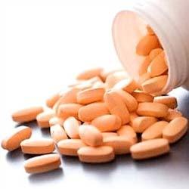
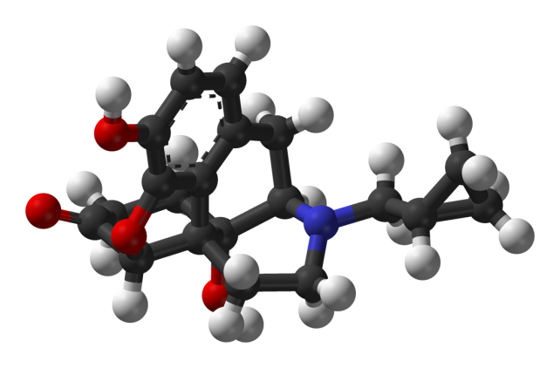
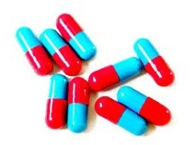


Exploration of Endpoints for Pivotal Clinical Trials to Treat AUD
Raye Z. Litten, Ph.D.
Daniel Falk, Ph.D. (Discussant)
Division of Treatment and Recovery Research
National Institute on Alcohol Abuse and Alcoholism
Presented at the Measures of Outcome for Stimulant Trials (MOST) meeting of the ACTTION Initiative
Rockville, MD, March 25, 2015

Slide 2
Key Organizations
NIAAA
Dan Falk, Joanne Fertig, Megan Ryan
ACTIVE Group
FDA, EMA, pharmaceutical companies, academic researchers, NIAAA, NIDA

Slide 3
FDA Draft Guidance for Industry: Primary Alcohol Drinking Endpoints
Dichotomous Measures
Percent Subjects Abstinent
Percent Subjects with No Heavy Drinking Days (PSNHDD)
  Subjects with no heavy drinking days ÷ total number of subjects
  Heavy drinking day (HDD): 4 or more drinks/ drinking day for women and 5 or more drinks/drinking day for men
  PSNHDD includes abstinence and low-risk drinking

Slide 4

What evidence was provided for consideration of PSNHDD as a primary endpoint?

Slide 5

Evidence of Clinical Benefit (PSNHDD)
Alcohol Clinical Trials
Treatment Settings
Epidemiologic Studies

Slide 6
Evidence of Clinical Benefit (PSNHDD)
Alcohol Clinical Trials
Treatment Settings
Epidemiologic Studies

Slide 7
COMBINE Trial
Duration: 4 months treatment (1 year follow-up)
Participants: alcohol dependent (n=1383)
At Randomization: 3 to 21 days required abstinence
Medications: naltrexone, acamprosate
(alone and in combination)
Behavioral therapies:
  Medical Management (MM)
  Combined Behavioral Intervention (CBI)
Anton et al., JAMA 295: 2003-2017, 2006

Slide 8
Drinker Inventory of Consequences (DRINC)
37-item alcohol-related consequences measure
Four Subscales
  Physical (e.g., “I have been sick and vomited after drinking”)
  Social responsibility (e.g., “I have gotten into trouble because of drinking”)
  Interpersonal (e.g., “I have lost a friend because of my drinking”)
  Impulse control (e.g., “I have had an accident while drinking or intoxicated”)
Miller et al., Project MATCH Monograph Series, 1995

Slide 9
Heavy Drinking increases DRINC Scores at Follow-Up
DRINC Score (37-item) (Mean)
COMBINE Study

Slide 10
Abstainers and Low Risk have similar DRINC Scores during Treatment and Follow-up
DRINC Score (37-item) (Mean)
Treatment Months 3-4
Follow-up Month 2.5
Follow-up Month 9
Follow-up Month 12
COMBINE Study

Slide 11
Abstainers and Low Risk have similar Drinks/Drinking Day during Treatment and Follow-up
Drinks per Drinking Day (Mean)
Treatment Months 3-4
Follow-up Month 2.5
Follow-up Month 9
Follow-up Month 12

Slide 12

Evidence of Clinical Benefit (PSNHDD)
Alcohol Clinical Trials
Treatment Settings
Epidemiologic Studies

Slide 13
Kaiser Permanente Studies
Study Site:
  KP Chemical Dependency Recovery Program (CDRP) in Sacramento, California
Participants:
  N = 995 adult patients (18+) with alcohol dependence/abuse
  Recruited from two randomized studies (Weisner et al., 2000, 2001)
Predictor: Drinking Status (past 30 days) (6 months post-treatment)
  Abstinent
  Low-Risk Drinker: drank but no heavy drinking days (5+ drinks/drinking day)
  Heavy Drinker: 1+ heavy drinking days
Outcomes:
  Addiction Severity Index (12 months post-treatment)
    Medical
    Psychiatric
    Family/Social
    Employment
  Treatment Cost & Utilization (up to 5 years post-treatment)
Notes:
Day Hospital Study (Weisner et al., 2000) and Integrated Care Study (Weisner et al., 2001). Both Studies:
Recruited at treatment
Had excellent recruitment rates (DH – 93%; ICS – 95%)
Had the same Medical Director
Did not differ in patient characteristics, program characteristics or staffing
Weisner C, Mertens J, Parthasarathy S, Moore C, Hunkeler EM, Hu T, Selby JV (2000) The outcome and cost of alcohol and drug treatment in an HMO: day hospital versus traditional outpatient regimens. Health Serv Res 35:791-812.
Weisner C, Mertens J, Parthasarathy S, Moore C, Lu Y (2001) Integrating primary medical care with addiction treatment: a randomized controlled trial. JAMA 286:1715-1723.
Mention that the THIS IS A COMBINED SAMPLE THAT’S BEEN USED FOR SEVERAL OTHER PUBLISHED STUDIES (chi et al. 2011; satre et al. 2007; satre et al. 2004; tsoh et al, 2011; weisner et al.2000 ) ?
We included individuals with alcohol abuse diagnoses because evidence suggests a continuum of alcohol use disorders rather than “abuse” as distinct from “dependence”(Li et al., 2007), and proposed changes to the Diagnostic and Statistical Manual of Mental Disorders - V (DSM-V) combine abuse and dependence into one “alcohol use disorder” diagnosis (American Psychiatric Association, 2010).

Slide 14
Clinical Relevance of Abstinent, Low-Risk, and Heavy Drinking Post-Treatment Outcomes
Compared with Abstinent Group:
 | Low-Risk | Heavy Drinking
Drinking | greater | much greater
Consequences: psychiatric/family/social problems | similar | higher
Treatment Utilization: inpatient/ED | similar | higher
Treatment Costs | similar | higher
Kline-Simons et al. ACER 37(Suppl):E373-E380, 2013 and ACER 38:579-586, 2014

Slide 15

Evidence of Clinical Benefit (PSNHDD)
Alcohol Clinical Trials
Treatment Settings
Epidemiologic Studies

Slide 16
Epidemiologic Evidence:
Clinical Benefit of PSNHDD
National Alcohol Surveys
  Treated or concerned drinkers who restrict alcohol intake to low volume and did not have any heavy drinking days had a low risk of alcohol dependence or abuse (Greenfield, unpublished data)
National Epidemiologic Survey on Alcohol and Related Conditions (NESARC)
  Subjects with no heavy drinking days carried a much lower risk for alcohol dependence and AUD symptoms than those who experienced heavy drinking (Dawson et al. 2007)

Slide 17
Summary
No heavy drinking vs heavy drinking
No heavy drinking decreases risk for relapse to heavy drinking and dependence, consequences, treatment utilization and cost compared to heavy drinking
Abstinence vs low risk drinking vs heavy drinking
Relapse to heavy drinking and dependence: heavy drinking>>low risk>abstinence
Consequences: heavy drinking> low risk=abstinence
Treatment utilization and cost: heavy drinking>low risk=abstinence
N

Slide 18
FDA Guidance:
Clinical Benefit of PSNHDD
“Patients who never exceeded the heavy drinking limits had minimal alcohol-related consequences and were much less likely to have relapsed at follow-up.”
-- FDA Guidance Summary Statement

Slide 19

Is PSNHDD a Sensitive Outcome in Detecting Treatment Effects in Clinical Trials?

Slide 20
PSNHDD a Sensitive Endpoint?
Not as sensitive as continuous outcome measures
Number of heavy drinking days outcome was significant in five alcohol clinical trials
PSNHDD was significant in only two of the trials
Examples: COMBINE (PSNHDD sensitive) and varenicline trials (PSNHDD less sensitive)
PSNHDD vs continuous outcome measures
PSNHDD vs abstinence outcome

Slide 21
PSNHDD as Sensitive as Continuous Measures (COMBINE)
Naltrexone vs. Placebo
Measure Type | Drinking Measure | P | Cohen d or h
continuous | % heavy drinking days | <0.01 | .23
continuous | drinks/day | 0.02 | .19
continuous | drinks/drinking day | 0.01 | .21
continuous | % days abstinent | 0.01 | .21
dichotomous | PSNHDD | <0.01 | .22
dichotomous | % subjects abstinent | 0.06 | .15
Outcomes measured during last two months of treatment

Slide 22
Sensitivity of PSNHDD Depends on Grace Period
Grace period – a period in a trial where outcome is not considered in the analysis because the measured treatment effect is not thought to represent the full potential of the drug and the pattern of drinking is unstable

Slide 23
Percent Subjects with Abstinence (PSA),
Naltrexone vs. Placebo, COMBINE (Missing Data Imputed)
Cumulative Treatment Months - "Grace Periods"
PSA (%)
* p < 0.05

Slide 24
Percent Subjects with No Heavy Drinking Days (PSNHDDs),
Naltrexone vs. Placebo, COMBINE (Missing Data Imputed)

Slide 25
Percent Subjects with No Heavy Drinking Days (PSNHDDs),
Naltrexone vs. Placebo, COMBINE (Missing Data Imputed)

Slide 26
Varenicline Trial
Duration: 3 months treatment
Participants: alcohol dependent (n=198)
At Randomization: no required abstinence
Medications: varenicline vs placebo
Results:
  Varenicline significantly reduced many of continuous drinking measures:
  Did not significantly reduce dichotomous measures
Litten et al. 2013. J Addict Med 7(4):277-86

Slide 27
PSNHDD not as Sensitive as Continuous Measures
Varenicline vs. Placebo
Measure Type | Drinking Measure | P | Cohen d or h
continuous | % heavy drinking days | 0.01 | .33
continuous | drinks/day | 0.02 | .32
continuous | drinks/drinking day | 0.02 | .29
continuous | % days abstinent | 0.20 | .17
dichotomous | PSNHDD | 0.25 | .10
dichotomous | % subjects abstinence | 0.68 | .01

Slide 28
Percent Subjects Abstinent – by Grace Period
h=.01
h=.09
h=.12
PSA

Slide 29
Percent Subjects with No Heavy Drinking Days – by Grace Period
h=.10
h=.10
h=.20
PSNHDD

Slide 30
Percent Subjects with No Heavy Drinking Days – by Grace Period
h=.10
h=.01
h=.10
h=.09
h=.20
h=.12
PSNHDD

Slide 31
Summary
PSNHDD as an Endpoint
Not as sensitive as continuous outcome measures
Appears more sensitive than abstinence
Need a grace period to show significance

Slide 32
Will allowing additional heavy drinking days (HDD) improve treatment effect?

Slide 33

Cumulative Proportion of Responders Analysis

Slide 34
Cumulative Proportion of Responder Analysis
Presents the proportion of responders over the entire range of possible cut-off points on a graph
Takes number of HDDs and creates all possible dichotomizations using different cut-offs (e.g, 0 HDD, <=1 HDD, <=2 HDD, etc)

Slide 35
Treatment Effect Improves with More Lenient Outcomes….
Falk et al., J Stud Alcohol Drugs 75:335-346, 2014

Slide 36
  …yet Alcohol-Related Consequences increase with additional Heavy Drinking Days (more lenient outcomes)
  Falk et al. Alcohol Clin Exp Res 34:2022-2032, 2010

Slide 37
What new analyses are being conducted to expand primary endpoints for Alcohol Clinical Trials?

Slide 38

New Analyses
Develop and validate more sensitive and clinically meaningful outcome measures
Reduction of continuous drinking outcomes
Drinking categories of drinking levels and patterns
Non-drinking outcomes

Slide 39

New Analyses
Data Sets of Different Alcohol Studies
Rehm’s chronic disease
COMBINE, MATCH, NCIG trials
NESARC and other large epidemiological surveys
Kaiser and other HMO Research Networks

Slide 40
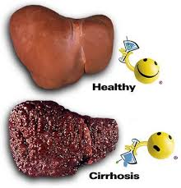
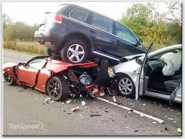

Validation of Clinical Significance of Reduction in Continuous Drinking Outcomes
Validate drinking against:
alcohol-related consequences
treatment utilization
treatment cost

Slide 41
Malignant Neoplasms
Source: Lim et al. 2012

Slide 42
Rehm’s Chronic Disease Data
Drinks per day (DPD): Varenicline = 4.4 vs. Placebo = 5.4 (Litten et al., 2013)
Is this ~ 1 DPD difference clinically meaningful?
Mouth and Oral Cancer
Placebo (RR=4.4)
Varenicline (RR= 3.5)

Slide 43
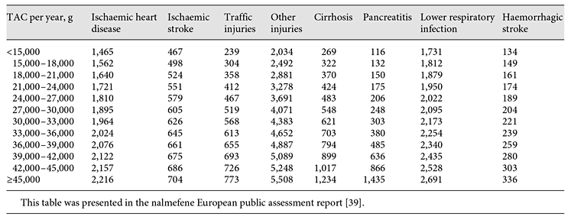
Microsimulation Model to Estimate Clinical Relevance of Reducing Alcohol Consumption
Number of Events per 100,000 Patients by
Total Alcohol Consumption category per year
Francois, Rehm et al, Eur Addict Res 20:269-284, 2014

Slide 44
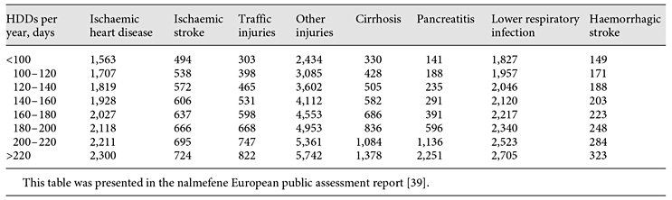
Microsimulation Model to Estimate Clinical Relevance of Reducing Alcohol Consumption
Number of Events per 100,000 Patients by HDDs per year
Francois, Rehm et al, Eur Addict Res 20:269-284, 2014

Slide 45
Applying Microsimulation Model to Nalmafene Trial Outcomes
Difference between nalmefene and placebo groups
~1 drink/day = 692 fewer alcohol-attributable diseases and injuries/1000,000 alcohol dependent patients per year
3 heavy drinking days/month = 941 fewer
Francois, Rehm et al, Eur Addict Res 20:269-284

Slide 46
Development of Risk Categories of Alcohol Intake
Establish categories describing the risks/benefits at different levels and patterns of drinking
Establish categories similar to clinical categories developed for blood pressure, cholesterol, and glycated hemoglobin

Slide 47
Categories for Blood Pressure (BP)
BP Classification | Systolic BP mm Hg | Diastolic BP mm Hg | What to do
Normal | <120 | <80 | Healthy lifestyle
Pre-Hypertension | 120-139 | 80-89 | Healthy lifestyle
Stage 1 Hypertension | 140-159 | 90-99 | Healthy lifestyle and medication
Stage 2 Hypertension | >160 | >99 | Healthy lifestyle and medications

Slide 48
Hypothetical Categories for Alcohol Consumption
Classification: Levels of Drinking | Cut-Off Values (based on risk/benefits associated with non-drinking outcomes)
Abstinence | No drinking
Low-Risk Drinking | Not exceeds weekly limits (< 7/14 drinks/week for females/males) AND No heavy drinking days (HDDs)
Stage 1 (Low) High-Risk Drinking | Exceeds weekly (< 21/28 drinks/week) OR HDDs (up to 3x/month)
Stage 2 (Moderate) High-Risk Drinking | Exceeds weekly (< 49/56 drinks/week) AND HDDs (up to 4x/week)
Stage 3 (Severe) High-Risk Drinking | Exceeds weekly (> 49/56 drinks/week) AND HDDs (daily or near daily/week)
Valuable information to stakeholders: regulatory agencies, pharmaceutical industry, researchers, patients, clinicians, and third-party payers

Slide 49
WHO Risk Level
Who Risk Level | Definition
Abstinence | Men: none Women: none
Low | Men: 1-40g (<2.9 drinks) Women 1-20g (<1.4 drinks)
Medium | Men: 40-60g (2.9-4.3 drinks) Women 20-40g (1.4-2.9 drinks)
High | Men: 60-100g (4.3-7.1 drinks) Women 40-60g (2.9-4.3 drinks)
Very high | Men: 100+g (7.1+ drinks) Women 60+g (4.3+ drinks)
World Health Organization’s gender-specific levels of risk
Standard drink = 14g = 0.6 oz of alcohol

Slide 50
Develop and Validate
Non-Drinking Outcomes
Validate Patient-Reported Outcomes (PRO) under FDA’s Clinical Outcome Assessments (COA):
Alcohol-Related Consequences: Lilly started validation of DRINC, resulting in 15-item measure (IMBIBE)
Craving: not yet started

Slide 51
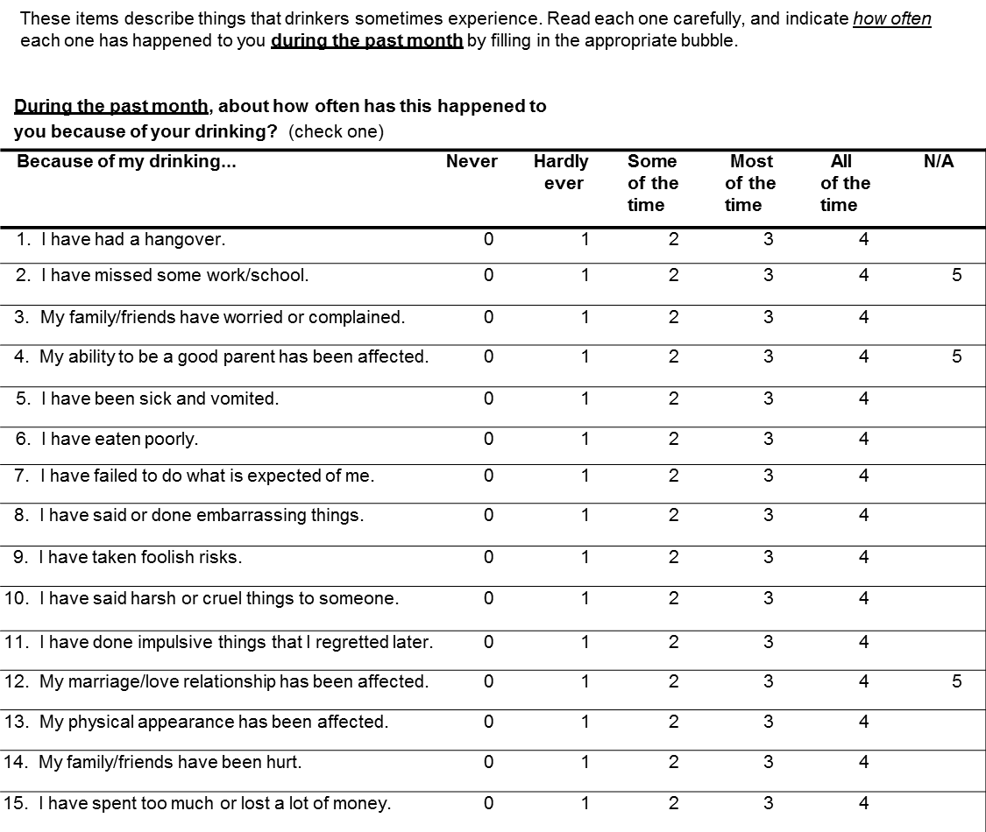
IMBIBE

Slide 52
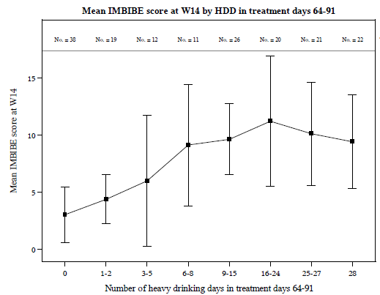
Placebo
12.5 HDD
Varenicline8.5 HDD

Slide 53
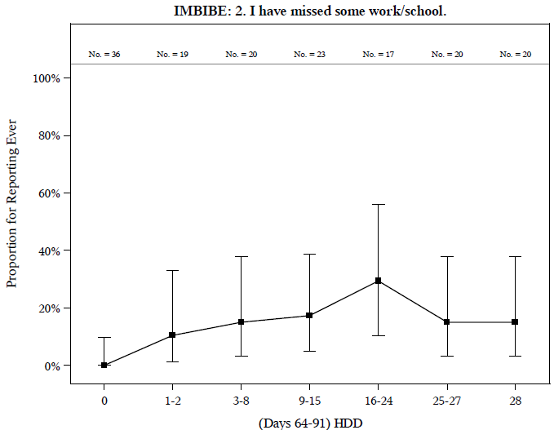
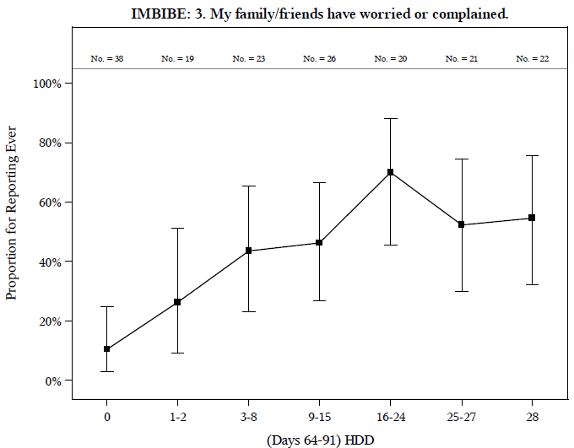
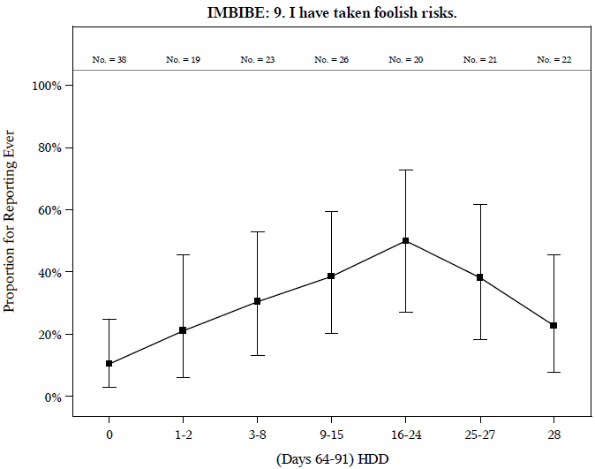
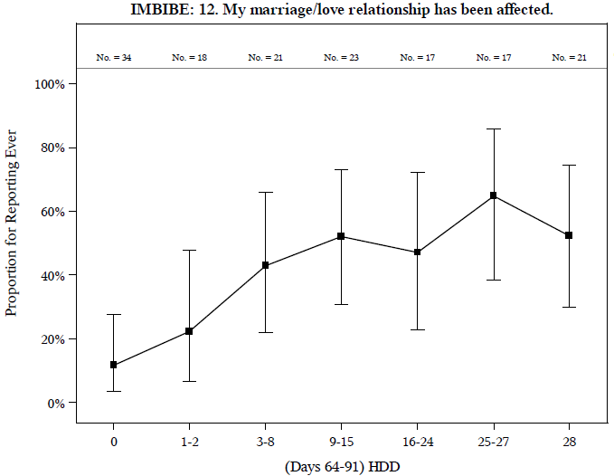
“IMBIBE items sensitive to HDDs”

Slide 54
Summary and Conclusions
Progress in developing and evaluating new sensitive and clinically relevant alcohol outcomes
  reduction in drinking for continuous outcomes
  categories of drinking levels and patterns
  non-drinking outcomes
New approaches during next decade
N

