Slide 1
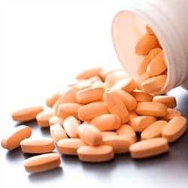
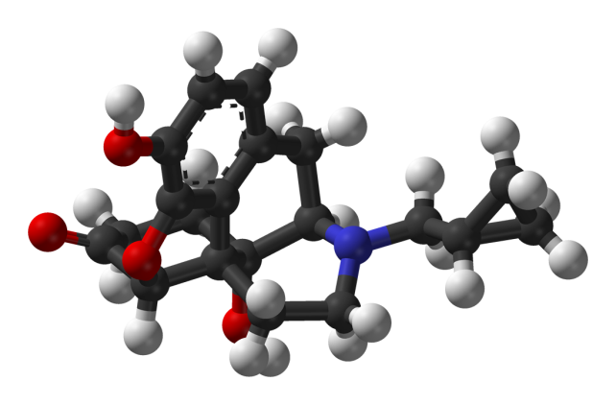
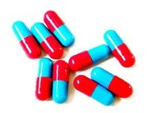
Critical Issues in the Exploration of Endpoints for Pivotal Clinical Trials to Treat AUD
Daniel Falk, Ph.D. (Discussant)
Division of Treatment and Recovery Research
National Institute on Alcohol Abuse and Alcoholism
Presented at the Measures of Outcome for Stimulant Trials (MOST) meeting of the ACTTION Initiative
Rockville, MD, March 25, 2015

Slide 2
Discussion Issues
What makes a good outcome measure?
Sensitivity of alternate drinking & non-drinking outcomes
Issues validating drinking outcomes:
Data issues
What are the most important validation outcomes? How do we decide among them?
How integrate data?
Challenges for stimulant trials

Slide 3
What makes a good outcome measure?
It is clinically meaningful:
e.g., a response variable that sets a threshold by which a clinician might judge a patient to “be well” or to have “gotten better.”
It can be achieved by a sizable proportion of patients.
It is validated against (correlated with) other informative outcomes:
Drinking Consequences (DrInC)
Physical health markers (e.g., blood pressure)
Global indicators of well-being (e.g., SF-12 Quality of Life)
It is sensitive to the effect of medication
It is more sensitive than other outcome measures (or at least no less sensitive).
It has the support of key stakeholders
Consensus of regulatory agencies, researchers, clinicians, patients, policy makers, and payers

Slide 4
Sensitivity of
Alternate Drinking
&
Non-drinking Outcomes
(be careful what you wish for, you might get it)….

Slide 5
Alternative Drinking Outcomes can be LESS Sensitive
Who Risk Level | Definition
Abstinence | Men: none Women: none
Low | Men: 1-40g (<2.9 drinks) Women 1-20g (<1.4 drinks)
Medium | Men: 40-60g (2.9-4.3 drinks) Women 20-40g (1.4-2.9 drinks)
High | Men: 60-100g (4.3-7.1 drinks) Women 40-60g (2.9-4.3 drinks)
Very high | Men: 100+g (7.1+ drinks) Women 60+g (4.3+ drinks)
EMA responder definition:
Reduction in drinking by 2 or more risk levels from baseline to treatment
Very High to Medium risk
(or lower)
High to Low risk
(or Abstinence)
World Health Organization’s gender-specific levels of risk
Standard drink = 14g = 0.6 oz of alcohol

Slide 6
Alternative Drinking Outcomes can be LESS Sensitive (COMBINE)
Measure Type | Drinking Measure | P | Cohen d or h
continuous | % heavy drinking days | <0.01 | .23
continuous | drinks/day | 0.02 | .19
continuous | drinks/drinking day | 0.01 | .21
continuous | % days abstinent | 0.01 | .21
dichotomous | PSNHDD | <0.01 | .22
dichotomous | % subjects abstinent | 0.06 | .15
dichotomous | % subjects reduce by >2 WHO levels | 0.05 | .16

Slide 7
Alternative Drinking Outcomes can be LESS Sensitive
EMA Responder Definition: proportion of subjects with an alcohol reduction of 70%,
50%, 90%, 100% (abstinence)
Falk et al., J Stud Alcohol Drugs 75:335-346, 2014

Slide 8
Alternative Drinking Outcomes can be LESS Sensitive
Falk et al., J Stud Alcohol Drugs 75:335-346, 2014

Slide 9
Non-Drinking Outcomes: Desirable, but Sensitive?
Drinking as a surrogate for non-drinking outcomes:
“The aim of treatment is often expressed as an effort to modify drinking behavior, but the actual desired effect is improvement in physical and psychosocial consequences.”
– FDA Draft Guidance
Limited sensitivity?
Notes:
What makes a good non-drinking outcome?
A mechanism of action (mediator) that also happens to have clinical significance?
E.g., gabapentin may decrease withdrawal symptoms (sleep, mood/anxiety)
Could withdrawal symptoms be primary outcomes?

Slide 10
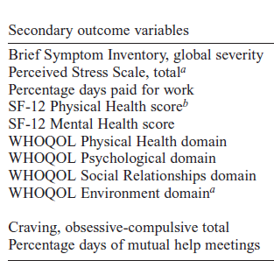
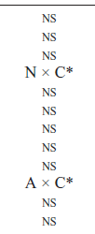
Insensitivity of Non-Drinking Outcomes: (COMBINE)
DrInC score (total) NS, d=.11
Blood Pressure NS
LoCastro et al. 2009. J Stud Alc Drugs, 70:186-191
Falk et al., 2010. Alcohol Clin Exper Res, 34:2022-2034; and unpublished.

Slide 11
Issues Validating Drinking Outcomes

Slide 12
Relative Strengths of Datasets for Validating Drinking vs. Consequences
Measure | Rehm’s Chronic Disease | COMBINE, MATCH, RREP, varenicline | NESARC | Kaiser
Drinking | + | +++ | ++ | ++
Chronic Consequences | ++ |  | ++ | +++
Acute Consequences |  | +++ | ++ | +++
Study Design | + | +++ | +++ | +++
Blank = poor
+ = fair
++ = good
+++ = excellent
Notes:
Drinking: different periods of drinking: poor measure; no TLFB.

Slide 13
Blood Pressure: Which outcomes to validate? Against what consequences?
Outcomes
Systolic BP
Diastolic BP
Consequences
Mortality
Morbidity
Myocardial infarction
Heart failure
Stroke
Revascularization surgery
Renal disease
James et al. 2014. JAMA 311:507-520

Slide 14
Drinking Which outcomes to validate? Against what consequences?
Outcomes
Drinks/day
Drinks/drinking day
Days abstinent
Heavy drinking days (4/5)
Very heavy drinking days (8/10)
Extreme heavy drinking days (10/12)
Biomakers (%CDT, GGT, pETH, etc)
Chonic
Mortality
AUD / other substance
Mental health disorders
Heart
Caridomyopathy
Arrythmia
Stroke
Blood pressure
Liver
Fatty liver
Alcoholic hepatitis
Fibrosis
Cirrhosis
Pancreas
Immune System
HIV/STD infection
Diabetes
Epilepsy
Cancer
Mouth
Espohagus
Liver
Breast
Acute
DrInC (45 items in 5 classes):
Physical
Social responsibility
Interpersonal
Intrapersonal
Impulse control

Slide 15
Challenging question
How integrate data to:
a) validate a given clinical trial result of a continuous outcome
b) create/validate a responder definition,
given the myriad consequences by which to validate them?
Placebo
RR=2.0
Medication
Placebo
Medication
25
50
Alcohol Consumption (g/day)
Alcohol Consumption (g/day)

Slide 16
Endpoints: Challenges for Stimulant Trials
Difficulty obtaining quantity consumed, only frequency (e.g., percent days abstinent) and percent subjects abstinent?
With frequency, need to evaluate clinical relevance
Develop sensitive non-substance intake endpoints (e.g., health, drug-related consequences, treatment utilization, psychosocial function, etc.)
Before the effort of evaluating clinical relevance of new endpoint, test its sensitivity of detecting a treatment effect using various data sets

