Slide 1

Differentiating Problematic Non-medicinal Use From Medicinal Cannabis Use
Ryan Vandrey, PhD
Johns Hopkins University

Slide 2
Importance of Nomenclature
    Cannabis is rare example of a substance moving from illicit to licit status
    Only example where traditional drug development has been circumvented
    Cannabis still cannot be prescribed
    Many pharma examples show us that medicinal use can become problematic and transition to non-medicinal problematic use
    Thus, “medicinal” use does not mean non-problematic

Slide 3
Current State Laws

Slide 4
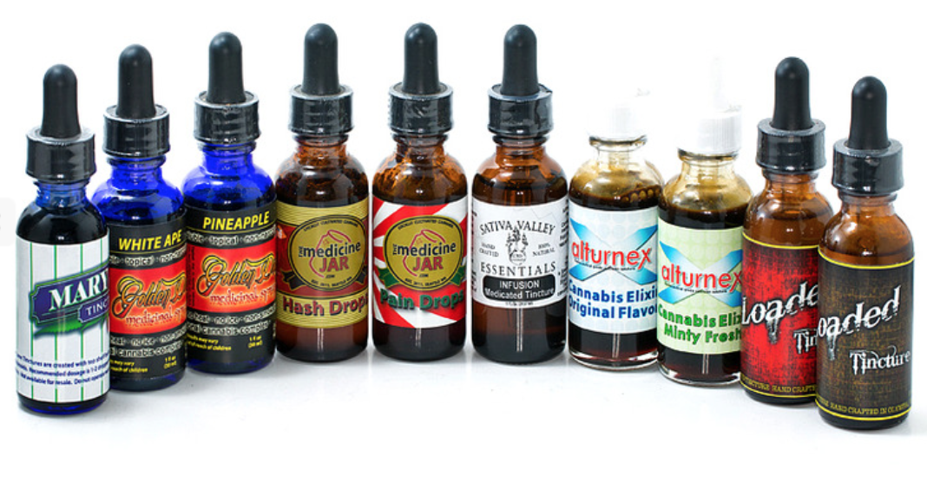
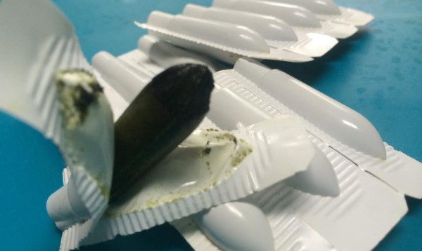
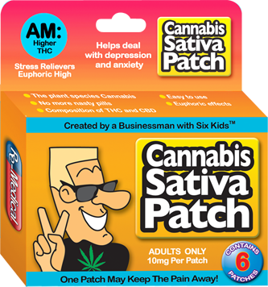
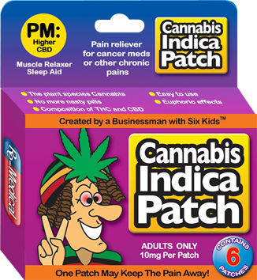
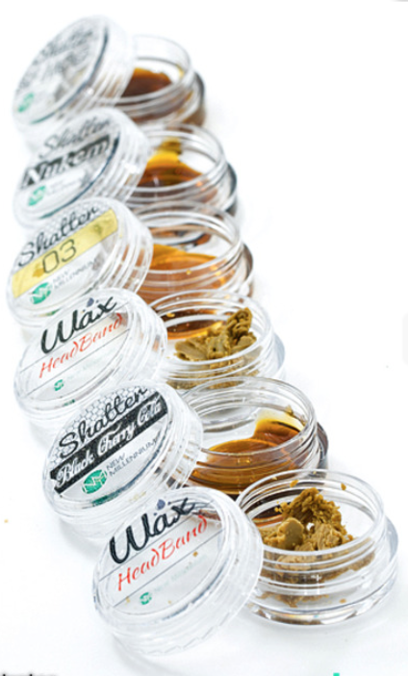
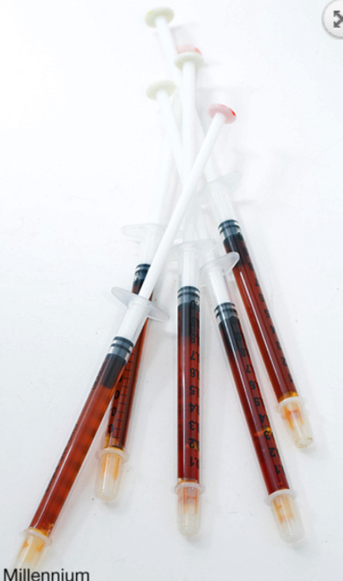
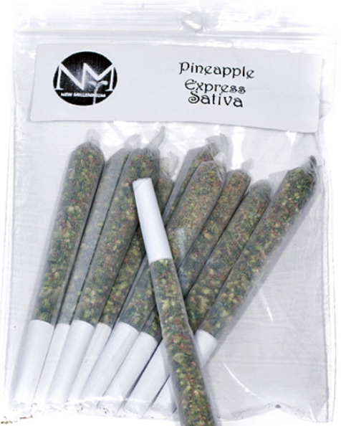
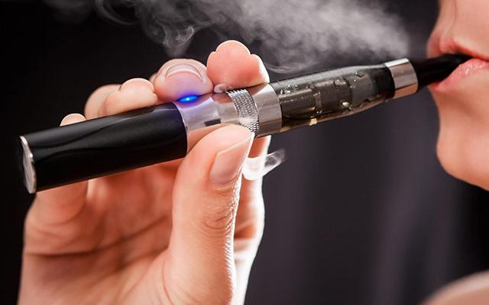
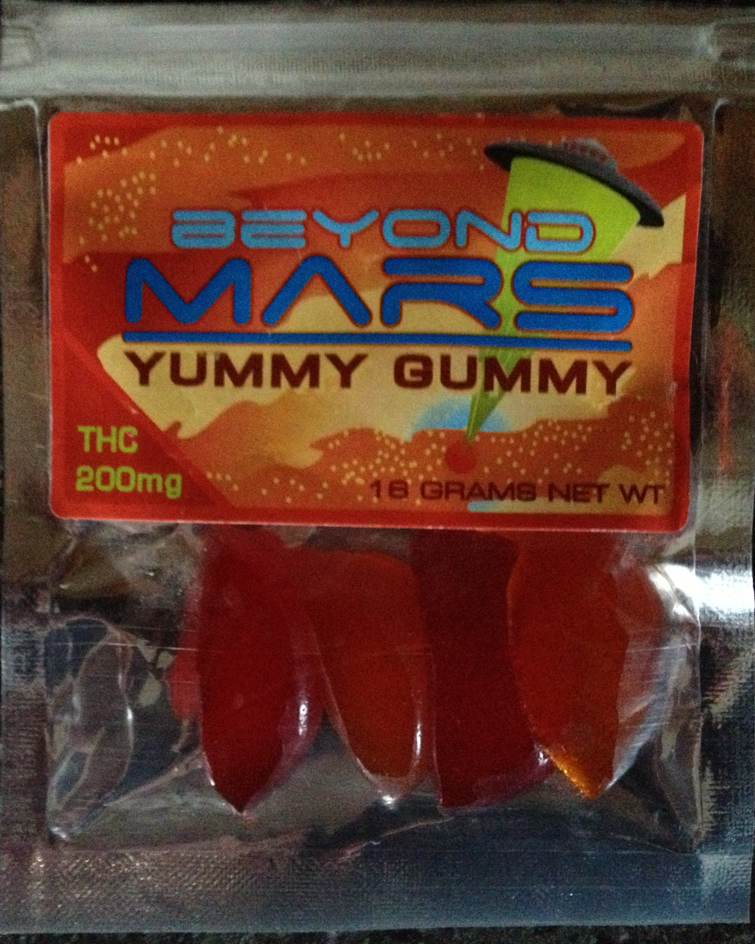
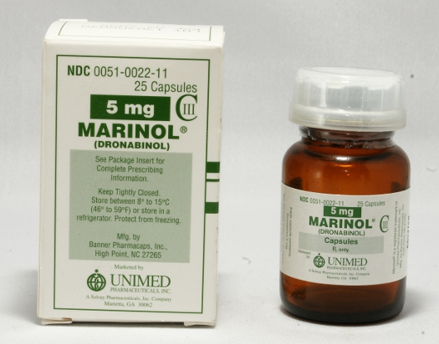
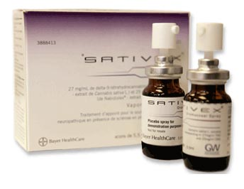
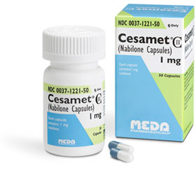
Versus

Slide 5
Legal Cannabis Availability
    62% of current workforce lives in a state where medical use of cannabis is legal
    21% lives in a state where adult non-medical use of cannabis is legal
    Rates of use are higher in states where cannabis is legal vs. those where it is not
    Given the recency of widespread adoption and rapid change in cultural attitudes towards cannabis, it will take years to unravel risk of transitioning from medicinal use to problematic use

Slide 6
Problematic Use Important In:
    Workplace evaluation
    Epidemiological assessment of treatment need and disease burden
    Medical screening and brief intervention
    Criminal justice cases
    Early intervention
    CUD treatment assessment and outcomes

Slide 7
CUD Criteria
    Tolerance
    Withdrawal
    Craving
    Loss of controlled use
    Desire to, or inability to reduce/quit
    Lots of time spent in drug use activities
    Interferes with other important activities
    Use continues despite causing or worsening health/social problems

Slide 8
Measures of Problematic Use
    Addiction Severity Index (ASI)
    Cannabis Problems Questionnaire (CPQ)
    Cannabis and Substance Use Assessment Schedule (CASUAS)
    Cannabis Use Disorder Identification Test (CUDIT)**
    Cannabis Use Problems Identification Test (CUPIT)
    Clinical Global Impression (CGI)
    Drug Abuse Screening Test (DAST)
    Marijuana Dependence Scale (MDS)
    Marijuana Problem Scale (MPS)
    DSM criteria (SCID, CIDI, GAIN, ADI-L, VSDI)
    Severity of Dependence Scale (SDS)

Slide 9
Measure Characteristics
    Frequency/amount of use
    Timing of use
    Adverse consequences
    Desire/attempts to quit
    Psychosocial troubles
    Craving
    Functioning
    Mood
    Cost
    Legal issues
    Health
    Motivation
    Social interaction

Slide 10
Key Issues
    No prescribed medicinal cannabis use guidelines for any health condition
    Medicinal use may be recommended in cases where it is not warranted
    Medicinal use can occur without a physician, in a state without a medicinal cannabis program, and/or with illicit cannabis
    Medicinal users may consume cannabis in circumstances that are for pleasure only
    - Different dose, product type, route

Slide 11
Key Issues
    Tolerance and withdrawal can develop within medicinal use context
    Difference between craving and medicinal need?
    Difficult to disentangle medicinal from non-medicinal use in a single instance
    Both circumstances can exist for the same individual, even at the same time
    Self-attribution for this is not reliable/valid
    Adversity may be policy/culturally driven

Slide 12
Key Issues
Legality may interfere with desire/attempts to quit, or ability to function without
Unbalanced assessment of risk and benefit (only risk)
Variable social context impact (e.g. negative urine needed to get a job in some places and not others)
Reliance on self-report (under reporting)

Slide 13
Key Issues
Frequency of use, timing of use and monetary expenditure are key components in several measures, for which valid medicinal use would artificially inflate scores
Other content not necessarily exclusive to cannabis use included (e.g. depression, self-care/worth)
Factor analyses for the CUDIT-R, validated across several studies, did not hold up in a study of medicinal users (Loflin et al., 2017)
K

Slide 14
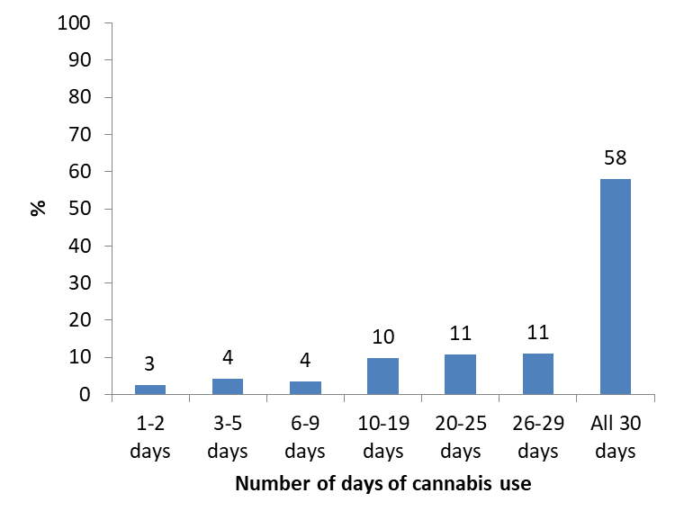
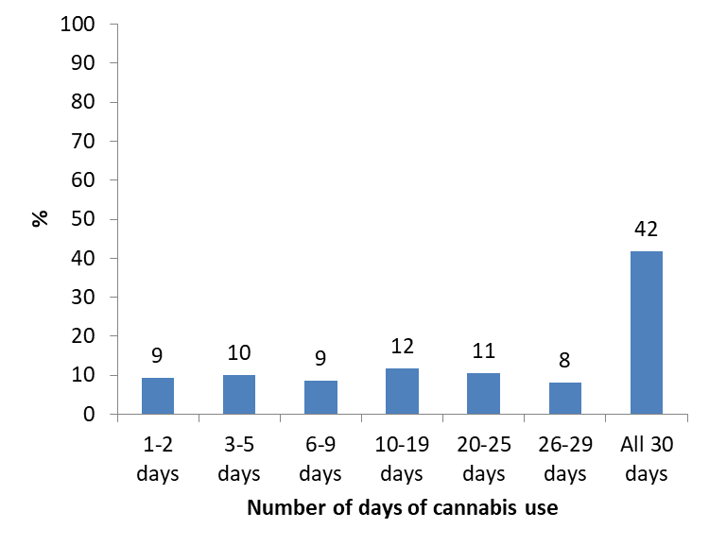
Budney Data Set: Use past 30 daysday
Cannabis Users Medical Only

Slide 15
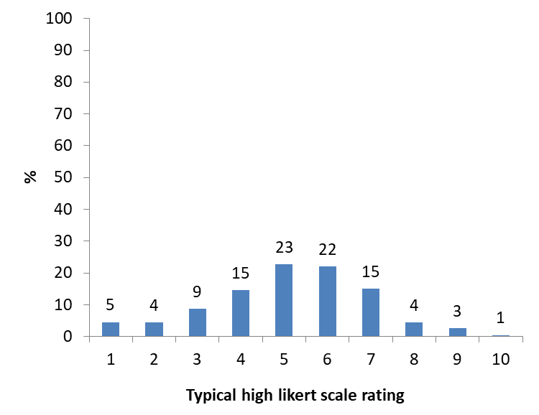
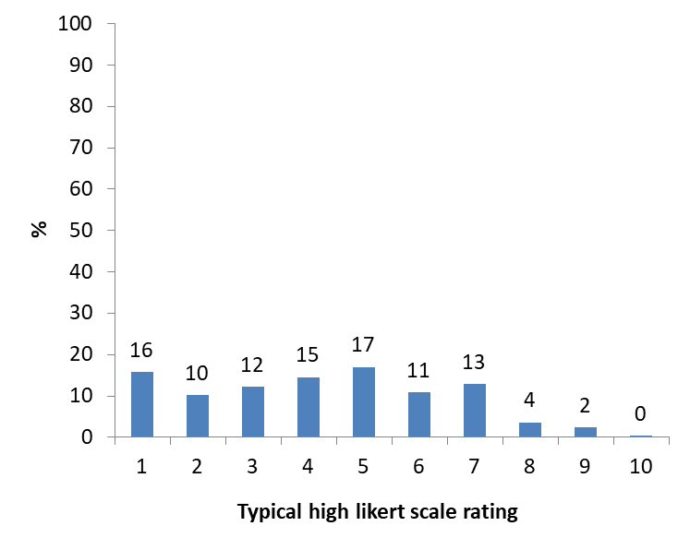
Typical High
Cannabis Users Medical Only

Slide 16
Reconciliation
Dichotomization on medicinal use versus non-medicinal use seems uninformative
Focus on DSM criteria rather than peripheral concerns not necessarily CUD related
Emphasis on adverse consequences rather than frequency/timing of use
Recognition that medicinal use can become problematic
Must account for overall risk/benefit; adverse effects and negative psychosocial impact can occur within overall net gain

Slide 17
Next Steps
Operationalizing “medicinal” use
Evaluation of CUD measures across spectrum of cannabis users
Shift to more global clinical assessments and/or quality of life outcomes
Differential evaluation based on product: Cannabis vs. pharma; THC vs. CBD, etc.
Route and dose specificity?
Health condition specificity?

Slide 18
Open Discussion
This is a quagmire, I don’t have the answers…

