Slide 1
Overview of Secondary Outcome Domains
ACTTION Cannabis Use Outcomes for Clinical Trials (CUOCT)
Erica N. Peters

Slide 2
Secondary Outcome Domains
Cannabis withdrawal
Cannabis craving
Others
Cannabis dependence
Mood
Psychosocial Functioning
Cannabis-related problems
Readiness to change/self-efficacy
Alcohol and other drug use
Quality of life

Slide 3
Cannabis Withdrawal
SYMPTOMS
Irritability | Sleep disturbance
Anxiety | Decreased appetite/weight loss
Restlessness | Other physical symptoms that elicit significant discomfort (i.e. abdominal pain, shakiness/tremors, sweating, fever, chills, headache)
Depressed mood
Notes:
Cessation of cannabis following a prolonged period of heavy use is linked to the onset of a withdrawal syndrome that includes symptoms of …..
Now recognized in DSM
Clinically significant: impairment in function and increased risk for relapse

Slide 4
Cannabis Withdrawal: 9 trials
Measure | # of Trials
Marijuana Withdrawal Checklist | 6
Cannabis Withdrawal Scale | 2
Clinical Institute Withdrawal Assessment Scale | 1
Withdrawal-Related Sleep Disturbance | 4
Pittsburgh Sleep Quality Index
St. Mary’s Hospital Sleep Questionnaire
Combination of sleep diaries and actigraphy
Withdrawal-Related Irritability | 2
Snaith Irritability Scale
Irritability items from the Hopkins Symptom Checklist
Notes:
All 9 were pharmacological interventions
MWC: Budney, first attempt to quantify cannabis withdrawal for research purposes
CWS: Allsop, was adapted from the MWC plus additional items (mood swings, physically tense, yawning, stomach ache, tired, dizzy)
CIWA: Sullivan
BACK POCKET: The CWS measured the intensity of cannabis withdrawal symptoms using a 10-point Likert scale. In addition, the CWS measured the distress or functional impairment caused by each symptom using the same 10- point Likert scale as was used to measure the intensity of the symptom.
Prior to item validity analysis, the CWS consisted of 26 items, 20 of which were adapted from the MWC. An additional six items were included as a result of the literature review (I had mood swings, I felt physically tense, I yawned a lot, I had a stomach ache, I felt tired and I felt dizzy). Several items from the original MWC were omitted on the basis of the literature review showing low endorsement prevalences (e.g., stuffy nose, feverish, muscle spasms, hiccups). An additional six positively framed items (e.g., I felt happy) were embedded within the core 26 items to assess response acquiescence (see analysis section).

Slide 5
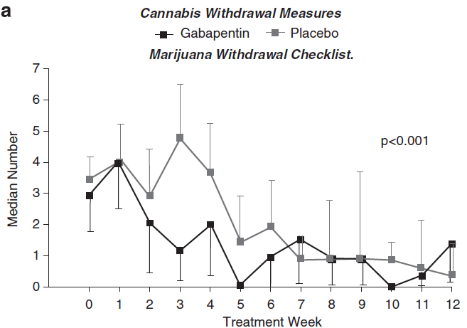
Example of Cannabis Withdrawal: MWC
Mason et al., 2012
Notes:
Phase Iia proof-of-concept pilot study to examine the safety and efficacy of a calcium channel/GABA modulating drug, gabapentin, for the treatment of cannabis dependence. A 12-week, randomized, double-blind, placebo-controlled clinical trial was conducted in 50 unpaid treatment seeking male and female outpatients, aged 18–65 years, diagnosed with current cannabis dependence
MWC contains 10 items and each is scored on a 0-3 scale, and items are summed to create a total withdrawal discomfort score.
In this paper, however, we see the median # of MWC items that were endorsed. According to this measure, gabapentin was superior to placebo in reducing # of withdrawal symptoms.

Slide 6
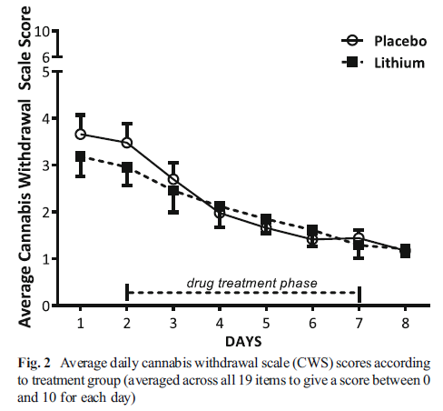
Example of Cannabis Withdrawal Scale: CWS
Johnston et al., 2014
Notes:
Inpatient double-blind randomized controlled trial of lithium carbonate among adults in Australia
Primary outcome measure was the 19-item Cannabis Withdrawal Scale, assessed every day for 8 days
Lithium did not significantly affect total CWS scores relative to placebo.
Rationale: Preclinical studies suggest that lithium carbonate (lithium) can reduce precipitated cannabinoid withdrawal in rats by stimulating release of the neuropeptide oxytocin, while two open-label studies indicate lithium may ameliorate cannabis withdrawal symptoms in humans.

Slide 7
Cannabis Craving
8 trials assessed cannabis craving as an outcome domain
Measures
Marijuana Craving Questionnaire: 7 trials
Visual analog scale that assessed intensity and desire to use cannabis: 1 trial
Single-item measure of craving included in the MWC: 1 trial
Notes:
8 trials, 7 of which were pharmacological trials
MCQ (Heishman) most often used in trials that assessed craving
Othervisual analog scale that assessed intensity and desire to use cannabis (included in 1 PHA trial; Levin et al., 2004), and a single-item measure of craving included in the MWC (included in 1 PHA trial;

Slide 8
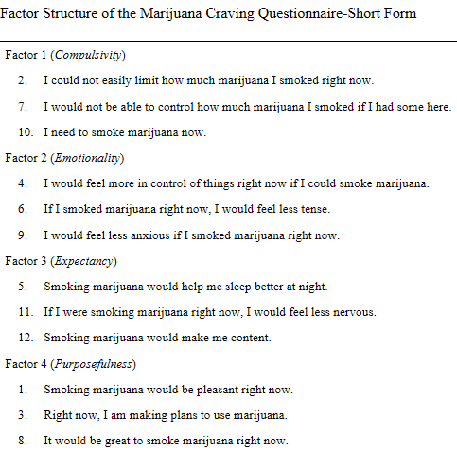
Marijuana Craving Questionnaire
Notes:
Originally developed as 47 item self-report questionnaire but then shortened to 12 items. Short Form was found to be as valid and reliable as 47 item form. Items are rated on a Likert-type scale from 1 (strongly disagree) to 7 (strongly agree). Three items in each factor scale are summed, yielding a score ranging from 3 to 21.

Slide 9
Other Secondary Outcomes
Outcome | # of Trials
Cannabis dependence | 21
Mood | 20
Psychosocial functioning | 17
Cannabis-related problems | 15
Readiness to change/self-efficacy | 11
Alcohol and other drug use | 8
Quality of life | 4
Notes:
Presence or severity of dependence
Mood (depression, anxiety)

Slide 10
Other Secondary Outcomes
Outcome | # of Different Instruments
Cannabis dependence | 10
Mood | 8
Psychosocial functioning | 17
Cannabis-related problems | 3
Readiness to change/self-efficacy | 7
Alcohol and other drug use | 2
Quality of life | 5
Notes:
Instruments used to assess other relevant outcome domains included a heterogeneous mix of self-report questionnaires and clinician-administered interviews.
No self-report instrument emerged as highly prevalent across trials
The most common clinician-administered interviews were the Addiction Severity Index, which was included in 12 trials (9 PSY, 3 PHA) to assess psychosocial functioning, and the TLFB, which was included in eight trials (6 PSY, 2 PHA) to assess alcohol and other drug use.

Slide 11
Conclusions
Agreement on secondary outcome domains, but no clear consensus on the optimal instrument for assessing outcomes in each domain.
Heterogeneity dependent on
target population
associated problems, and
aims of trial
Notes:
heterogeneous depending on the population (i.e. co-occurring mental disorder, adolescent versus adult population), and aims of each trial
E.g., several trials of CUD for individuals with schizophrenia, so secondary outcomes included hospital admissions, psychiatric relapse, and cognitive problems

Slide 12
Future Directions
Which secondary outcome domains are of broad interest for assessment in CUD treatment trials?
What “core” assessments should be used across trials for each secondary outcome domain?
validated “gold standard” assessments
short
freely available
relevant across cultures and translated into multiple languages
PhenX Toolkit
Which assessments should be used for special populations?

