Slide 1
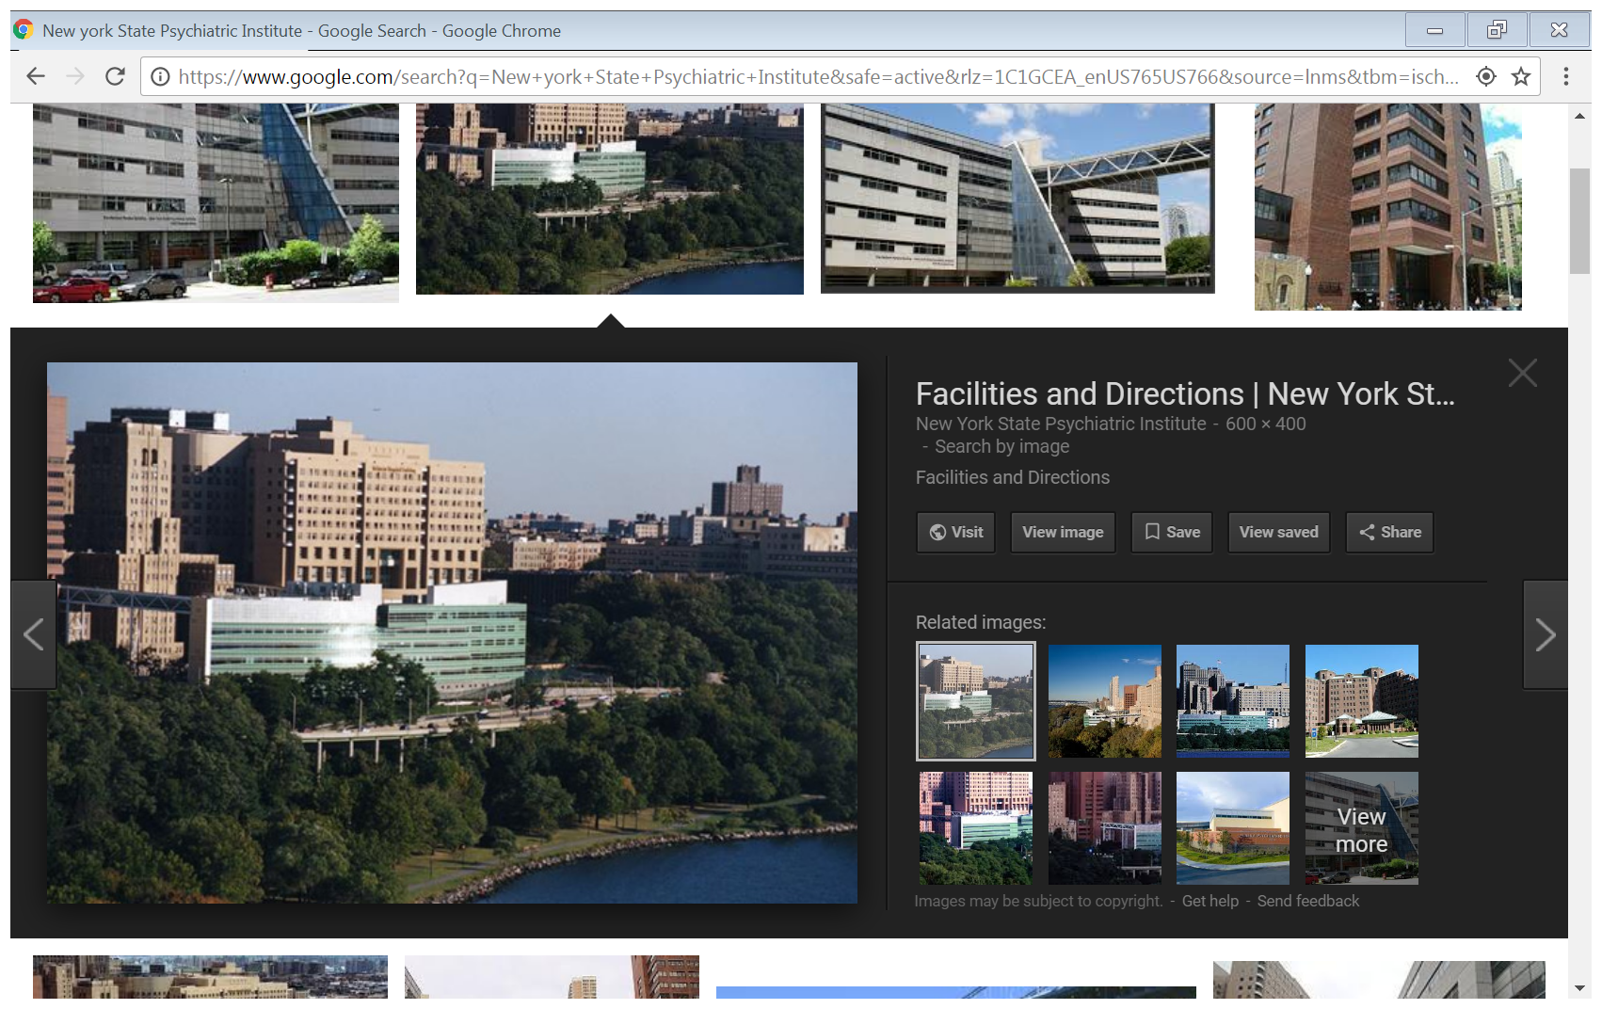


Challenges in Obtaining Accurate Self-Report Assessments of Cannabis Use
Frances R. Levin, MD
Kennedy-Leavy Professor of Psychiatry at CUMC
Chief, Division on Substance Use Disorders
Department of Psychiatry
Columbia University Medical Center/
New York State Psychiatric Institute
Email: FRL2@cumc.columbia.edu
Telephone: 646.774.6137

Slide 2
What are the limitations of self-report
Why Are We So Interested In Self-Reported Use?
Metabolites of marijuana detected in urine for weeks after use has ceased; challenging to capture windows of change on smaller scale
Algorithms using urine toxicology data for no new use have not been well-established for heavy, regular users of cannabis
As a result, cannot easily use common measures found in the cocaine treatment literature (i.e.; proportion of negative urines, weeks of continuous abstinence, as determined by both self-report and urine results)

Slide 3
Before We Talk More About The Challenges Of Self-Reported Marijuana Use- What Are We Measuring?
Substance Use as a behavior can be described by measuring 4 parameters:
  1) Quantity
    Can be further described by 3 separate components: usual, maximum, and minimum quantity
    Tells us how much of a substance used per occasion
  2) Frequency
    Defines how often this happens within a given unit of time
  3) Duration of Use
    Anchors frequency on a time continuum
  4) Context of Use
    Captures hazardous and non-hazardous use
(Day and Robles 1989, Annals NY Acad Science)

Slide 4
What are the limitations of self-report
Some Of The Challenges In Asking Marijuana Users About Their Use?
Before we ask about quantity or frequency, there are other inherent issues/challenges to be dealt with:
1) Understandability of the Questionnaire/Interview
  Most scales about frequency of use ask subjects to partition the proportion of time spent consuming various quantities. This requires sophisticated mathematical thinking to describe behavior that is often poorly remembered.
  When complexity increases, subjects either resort to guessing, or bias their response, and in frustration answer with one set of answers consistently
(Day and Robles 1989, Annals NY Acad Science)

Slide 5
What are the limitations of self-report
Challenges In Asking Marijuana Users About Their Use?
  2) Correct ascertainment of patterns of use
    “Usual” quantity misses most of total marijuana use over a period of time (Underestimates)
  3) Memory
    Questionnaires are retrospective in design. Research literature has repeatedly shown that the longer the time span, the greater the difficulty of recall.
      Use of Ecological Momentary Assessment or Interactive Voice Response
    Investigators have found that when pregnant women are asked about marijuana baseline use at 2 different time periods (at 4 months and delivery), the reported amount was more likely to increase than decrease
      Investigators hypothesized that participants had a greater feeling of safety to report this

Slide 6
Challenges In Asking Marijuana Users About Their Use?
4) Truthfulness
  Context in which the interview takes place is an important component
  Women (and men) are not likely to answer questions honestly in the presence of another person or situation where they feel that their answers are not confidential or their answers could have repercussions
    May be more likely to respond truthfully when answers are anonymous, not face-to-face
    May be impacted by social desirability
      Less censure of marijuana use- this may improve the reliability of self-reported use compared to a decade ago
(Day and Robles 1989)

Slide 7
Challenges In Asking Marijuana Users About Their Use?
4) Truthfulness
  Techniques for dealing with these problems
    Choose a safe and private environment for the interview
    Presentation of the interviewers, the sex of the interviewer may make a difference
    “Bogus pipeline” is a method of convincing our participants that we do have a measure of their use, even when we really do not
      The authors experience with this found that this increased marijuana reporting by 10% and of other illicit drugs by 50%
Day and Robles 1989; Carroll 1995; Johnson and Golub 2007

Slide 8
What Aspects Of Self-Reported Cannabis Use Are Typically Collected And What Are The Challenges?
Quantity
  Amount in weight
  Amount in dollars worth (may be better in attending to concentration assuming that more potent THC would be more expensive)
    The correlation between price and potency can change, not stable
  Number of joints/blunts
    This amount can vary considerable depending on how individual rolls a joint/prepares a blunt
    This can vary depending on how deep the puffs are
    Joints can be a variable mix of tobacco and marijuana products
    One group defined an average joint as .25 grams (Pol et al. 2013) but there does not seem to be a typical sized joint. Others use .5 grams as a typical joint

Slide 9
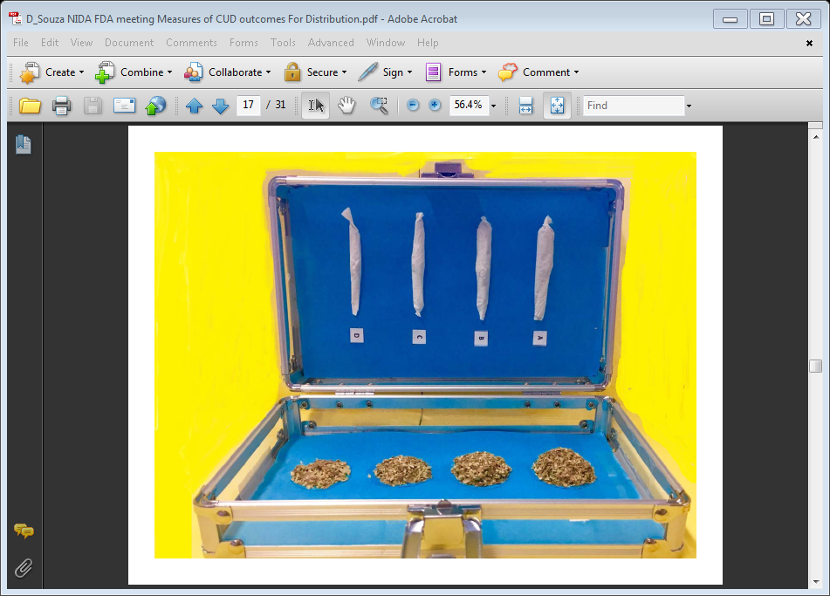

Slide 10
What are the limitations of self-report
What Makes Self-Report So Challenging With Marijuana Users?
Maybe look at the literature with other substances?
Nicotine:
  Have standardized packaging of a legal substance. Patients can simply say they are ½ a pack, a pack or 2 pack/day smokers
Alcohol:
  Similarly, for the alcohol literature, where self-reported use has been the “gold-standard” there is standard quantification for amount of use/concentration of alcohol
  Alcohol is legal for recreational use so individuals may be more forthcoming about use, may not be the case with marijuana

Slide 11
Challenges In Obtaining Accurate Quantities Of Use?
(Zeisser et al. 2012)
Strategies to improve validity of quantity of use, modestly effective
  Pol et al. (2013) Even with a prompt card, in 106 young adults, nontreatment seekers; underestimated their quantity of use (comparing the prompt card to what they actually rolled as a typical joint they used)
  Thus, getting valid measures of quantity is difficult
  Quantity may not be consistent across subjects but percent change within subject might be a reasonable measure to assess change in a treatment trial
    Mariani et al (2012) used oregano method to show amount of use at baseline. Found that 1 blunt, on average, was equivalent to 1.5 joints (not 2-6 as often cited).
    Might expect that dollar amount would be more reliable but what if individuals do not buy their marijuana or share with others?

Slide 12
Challenges In Obtaining Accurate Quantities Of Use?
(Zeisser et al. 2012)
Different means of administration makes it challenging to conceptualize standard consumption
  Joints, Blunts, Pipes, Bowls, Bongs, Vaporizers, Dabbing, Edibles, etc
  Each mode of administration may contain different amounts of cannabis per dose and the potency of THC content can vary greatly (Gray et al. 2009)
Should we be assessing how concentrated their cannabis product is?
  Would patients know this? Would they know constituents of various cannabinoids? Would it even be accurate if they did?
  Patients may alter their inhalation depending on the potency (Pol, 2013, 2014)

Slide 13
The Role Of Quantity In Predicting Cannabis-Related Problems
(Zeisser et al. 2012)
If quantity is so challenging, why should we care about it?
  Research suggests that quantity is an important predictor of cannabis-related problems, including dependence (Chen et al. 1997; Swift et al. 1998); cognitive impairment (Bolla et al. 2002; Walden and Earleywine, 2008) above and beyond frequency
Loobey and Earleywine (2007)
  Examined predictors of cannabis dependence and found that participants who were cannabis-dependent daily users reported smoking a greater number of joints per week and using a larger number of quarter ounces of cannabis per month than non-dependent daily users

Slide 14
Quantity Is Related To Predict Problematic Marijuana Use
Ziesser et al. (2012)
  Quantity of cannabis consumed had an independent and positive effect on the likelihood of cannabis-related problems (Alcohol, Smoking and Substance Involvement Screening Test –ASSIST items 3-7)
  When adjust for frequency, quantity was only associated with one problem measure- failure to do what was expected. Frequency remained a better predictor of cannabis problems than quantity but both contribute

Slide 15
Challenges To Assessing Self-Reported Use: Frequency
As a result of all these complicating issues with assessing quantity, maybe frequency is best?
  But Frequency is not so simple either……..
    Number of days/week
    Hours/day spent using
    How fine-grained should we examine use for each day?
    What constitutes an episode of use?
Frequency has been shown to be fairly reliable (Robinson et al. 2014)

Slide 16
Challenges To Assessing Self-Reported Use: Frequency
If only use frequency, would we consider someone who smokes ½ joint/day the same as someone smoking 10 joints a day?
  May miss associations of use and outcome if depend on frequency of use- or do we?
Is it best to use some combination of amount/frequency?
  Average quantity/day and quantity/week
  Average quantity/on using day

Slide 17
What do we gain by assessing both quantity and frequency of use?
  Asbridge et al 2014
    Another approach is to characterize those as light users, moderate users, and heavy users based on frequency with heavy users being daily or near daily use but where should the cut off for light and moderate users be?
    Q/F topology:
      1) Infrequent light user (use once per week or less, 1 joint per day)
      2) Infrequent heavy users (use once per week or less, 2 or more joints per day)
      3) moderate light users (use 2-4 days per week, 1 joint per day)
      4) moderate heavy users (use 2-4 days per week, 2 or more joints/day
      5) daily light users (use 5-7 days per week, 1 joint per day)
      6) daily heavy users (use 5-7 days per week, 2 or more joints/day

Slide 18
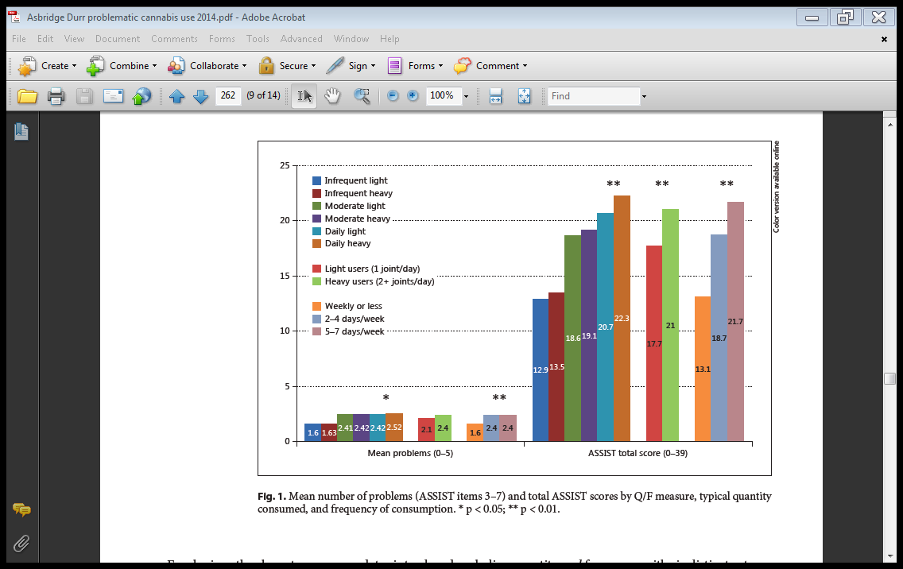
(Alcohol, Smoking and Substance Involvement Screening Test. WHO; Asbridge et al., 2014, Eur Addiction Research)
Notes:
18

Slide 19
Timeline Follow Back Interview: Commonly Use Approach Is Reliable
Robinson et al (2014): Appears we can get reliable measurements of frequency and quantity using timeline followback over time
  Two independent masters level interviewers, met with 63 primary cannabis users approximately 7-14 days apart.
  3 time intervals (30, 90 and 360 days of first interview) assessed by the 2 independent interviewers
  High reliability for percent days abstinent, longest consecutive days abstinent, percent days using 1-3 joints, percent days using > 4 joints.
  This study did not assess the validity of reported use, just reliability

Slide 20
Timeline Follow Back Interview: Commonly Use Approach Is reliable
Norberg et al (2011)
  98 Australian cannabis users. TLFB with marijuanilla, a cannabis substitute
  Interrater reliability (second research assistant watching interview) was excellent while test-retest reliability (same interviewer) was good to excellent
  Test-retest was excellent for frequency of use and good for quantity of cannabis use. Asked about same 3 month period and how much they used on the days they were using
  Quantity of cannabis use significantly added to frequency of use in predicting cannabis problems and dependence severity (using the Severity of Dependence Scale and the Cannabis Problems Questionnaire)
  Cravings to cannabis did not increase as a result of using the cannabis substitute to report their cannabis use

Slide 21
Ultimately: What Are We Looking For?
We want a clinically meaningful, reliable and valid approach/measure for self-report
  Self-reported use, both frequency and quantity is associated with problematic symptoms- so worth looking at both despite the challenges
  Reduction in frequency of use is associated with improved quality of life measures but unclear if quantity is (Brezing et al., 2018; Hser et al. 2017)
  Not clear if using frequency of use as an outcome measure is “enough” but clearly there are greater challenges in assessing quantity of use.

Slide 22
Thank You
NIDA support
  U54 DA037842
  K24 DA029647
STARS Team
  John Mariani, M.D.
  Daniel Brooks, M.A.
  Amy Mahony, M.A.
  Christina Brezing, M.D.
Thoughts?
Questions?

