Slide 1
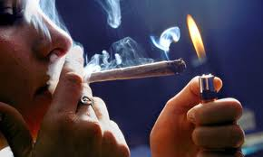
Strengths & Limitations of Biologic Assays for Cannabis Use
Cannabis Use Outcomes for Clinical Trials March 23, 2018
Professor Dr. Dr. (h.c.) Marilyn A. Huestis
Lambert Center for Study of Medicinal Cannabis & Hemp, Institute of Emerging Health Professionals, Thomas Jefferson University, Philadelphia, PA

Slide 2
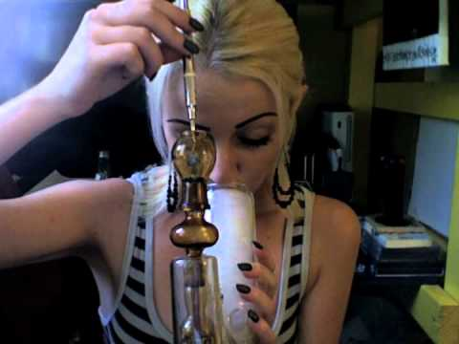
The Problem
With chronic frequent cannabis use,
THC body burden increases due to storage of lipophilic THC in adipose tissue & highly perfused organs including the brain
THC released from body stores into the blood, is metabolized to 11-OH-THC & THCCOOH, & excreted into biological matrices over time
Difficult to differentiate new cannabis use (relapse) from residual cannabis excretion in an easily accessible & cost-effective manner

Slide 3
In the Context of Cannabis Treatment Drug Testing, Which Currently Available Biological Matrix Can Best Identify New Cannabis Use Accurately, Rapidly, Non-invasively, & at an Affordable Price in Cannabis Dependent Individuals

Slide 4
In the Context of Cannabis Treatment Drug Testing, Which Currently Available Biological Matrix Can Best Identify Long Term Cannabis Abstinence Accurately, Rapidly, Non-invasively, & at an Affordable Price in Formerly Cannabis Dependent Individuals

Slide 5
Available Biological Matrices
Breath
Hair
Sweat
Blood
Urine
Oral fluid

Slide 6
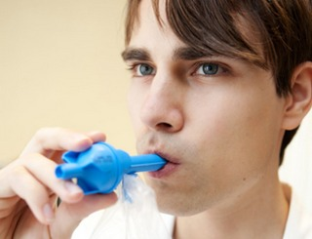
Breath Cannabinoid Concentrations After Acute Cannabis Smoking in Occasional & Chronic Frequent Smokers
Himes et al 2014
Clinical Chemistry
Notes:
Changed to whole blood more relevant to toxicologists

Slide 7
THC-Positive Breath Specimens
Time after smoking (h) | Chronic Users N=13 | Occasional Users N=11
Admission | 15.4% | 0
-1.0 | 0 | 0
0.5 | 100% | 90.9%
1.0 | 76.9% | 63.6%
2.0 | 53.8% | 0
3.0 | 0 | 0
4.0 | 7.7% | 0

Slide 8
Cannabinoids in Breath
THC can be monitored in breath
Multiple companies around the world are attempting to commercialize a device
To date none have data demonstrating sensitivity, specificity & efficiency of THC measurement
If breakthrough comes, window of detection will be short- less than 6 h

Slide 9
Hair

Slide 10
Advantages of Hair Testing
Large window of drug detection
  Documents abstinence
  Brief abstinence does not alter test outcome
Hair is easy to collect, handle & store
Retesting possible
Adulteration more difficult or apparent
Differentiate acute from chronic exposure

Slide 11
Disadvantages of Hair Testing
Color bias (not racial bias) for basic drugs
Neutral & acidic drugs incorporate poorly
Smoked drug environmental contamination
Recent drug use not detected (5-10 days)
Expensive & results are not available immediately
Few controlled drug administration studies to guide interpretation

Slide 12
Hair Testing for Cannabis Dependence
Least sensitive matrix for identifying cannabis use
Wide window of drug detection
No color bias for detecting THCCOOH- not a basic drug
Must measure THCCOOH & not parent THC due to potential for environmental exposure
Useful for long-term follow up of clinical studies & epidemiological studies

Slide 13
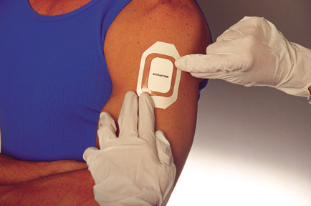
Sweat Testing

Slide 14
Advantages of Sweat Testing
Convenient & less invasive method for monitoring drug use
Provides cumulative record of exposure over the patch wear period (usually 1 week)
Longer detection window than urine
Parent drug is predominate analyte
Difficult to adulterate specimen

Slide 15
Disadvantages of Sweat Testing
Variations in sweat production
Lack of dose/concentration relationships
Lower analyte concentrations
Only 1 commercial laboratory doing testing
Occasional skin irritation & lack of adhesion
Loss of drug from patch through the skin
Potential for contamination of skin with drugs from the environment- must thoroughly clean
Residual THC excretion in chronic frequent cannabis users?

Slide 16
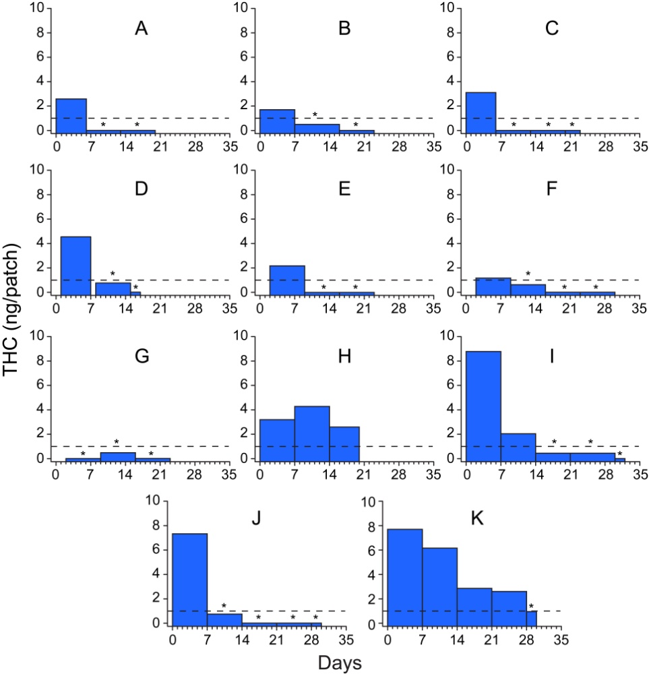
THC sweat excretion in 11 frequent cannabis users during sustained abstinence
Dashed line:
1.0 ng/patch cutoff proposed by SAMHSA
in 2004
* Negative sweat patch: LOQ
0.4 ng/patch

Slide 17
Cannabinoid Sweat Testing
Useful for weekly outpatient treatment visits as entire period covered for drug use
Primarily used for criminal justice/parolee programs
Results are not immediately available
Expensive analyses
Poor dose-concentration relationships

Slide 18
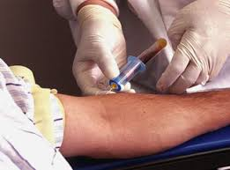
Blood Cannabinoid Testing

Slide 19
Chronic Cannabis Users’ Blood THC Concentrations After Smoked, Inhaled
& Oral Cannabis
C_{max} during
inhalation
Delayed C_{max}
µg/L
N=11, LOQ=0.5 µg/L
Hours
Notes:
First, to orient you, concentrations are presented on a log scale. Note too the x-axes are different, going out to 72 h for frequent smokers and 54 h for occasional smokers. The shaded area is the 10 min inhalation time. First notice that frequent smokers were THC positive on admission and baseline. During inhalation, blood THC concentrations rapidly rose in both groups. Maximum concentrations for the inhaled routes occurred during inhalation, while delayed Cmax occurred after oral dosing. Nearly all frequent smokers were positive at 72 h, while only 1 occasional smoker after oral dosing was positive at 54 h.

Slide 20
Chronic Cannabis Users Blood
THCCOOH-gluc Concentrations After
Smoked, Inhaled & Oral Cannabis
µg/L
N=11, LOQ=0.5 µg/L
Hours
Notes:
Similarly, frequent smokers’ THCCOOH-glucuronide concentrations were minimally increased from baseline, with nearly all frequent smokers positive at 72 h. Similar to THCCOOH, more occasional smokers were positive after oral dosing than after inhaled doses at 54 h.

Slide 21
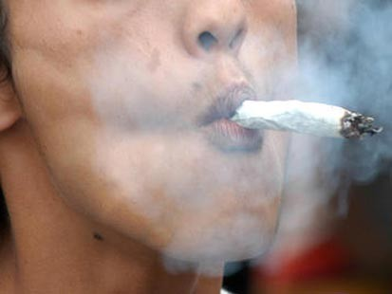
Cannabinoid Excretion in Blood of Chronic Frequent Cannabis Smokers During Sustained Abstinence

Slide 22
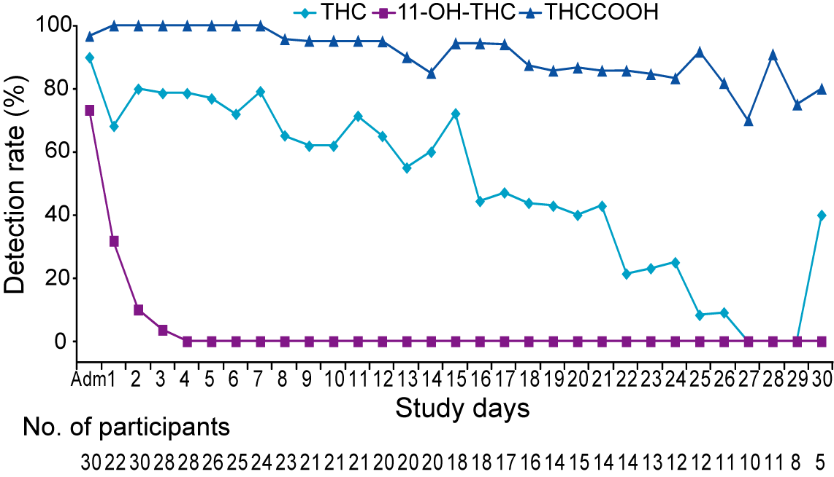
Blood Detection Rates for THC, 11-OH-THC & THCCOOH in Chronic Frequent Cannabis Smokers Over 30 Days Sustained Abstinence
LOQ 0.5 µg/L

Slide 23
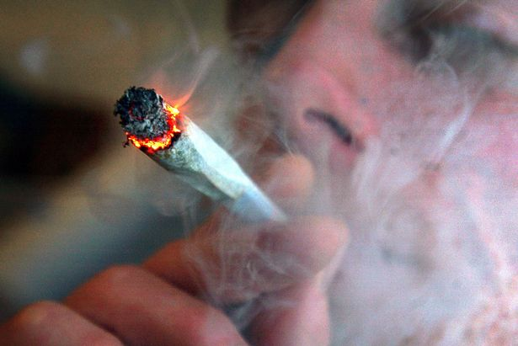
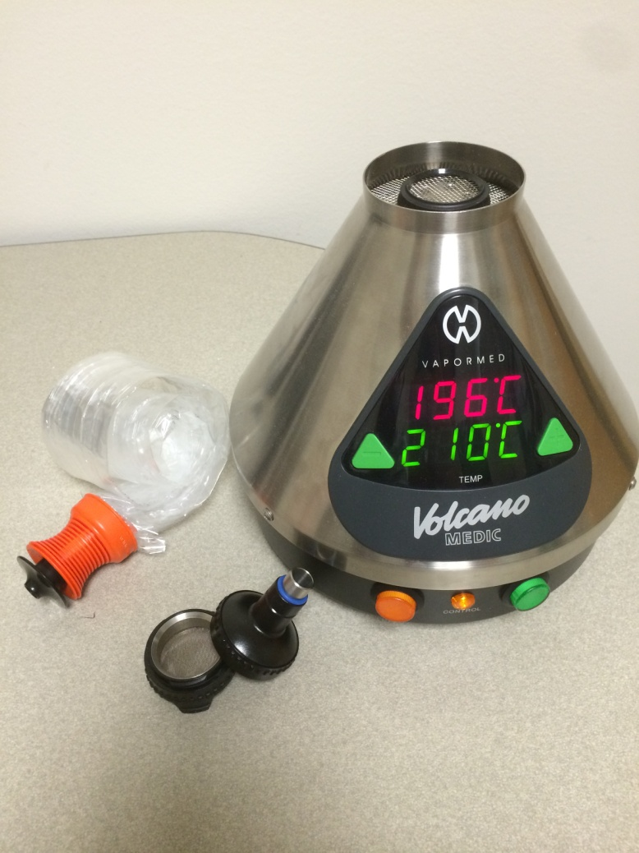

Are There Other Blood Cannabinoid Markers of Recent Cannabinoid Intake?

Slide 24
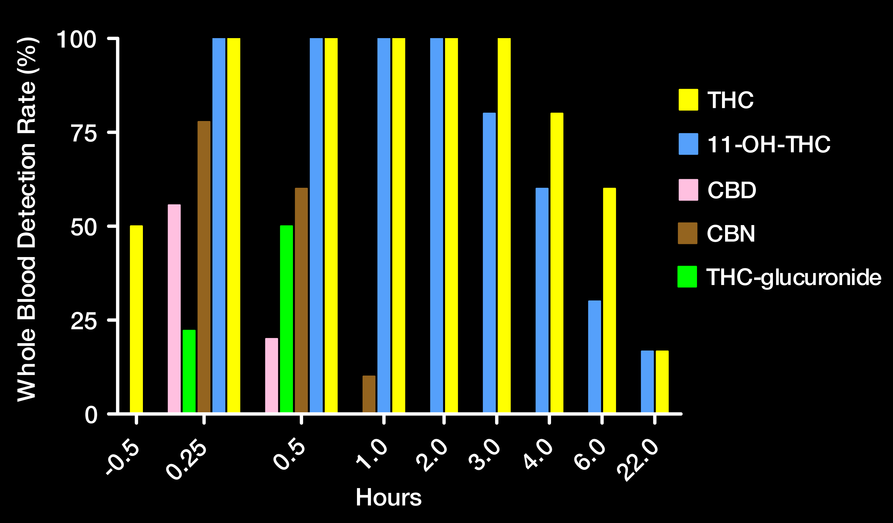
Are There Markers of Recent Cannabis Intake in Blood?
µg/L
Plasma
THCCOOH & THCCOOH-glucuronide present in all samples
CBD
Schwope et al 2011
Clinical Chemistry
CBN
CBN
LOQ
1 µg/L except
0.5 µg/L for
THC-glucuronide
Hours

Slide 25
Monitoring Cannabinoid Concentrations
Identifying recent cannabis intake in blood
Chronic frequent cannabis smoker 6 min into
10 min vaporization ~50 mg THC
THCCOOH, 89.8 µg/L
THCCOOH-gluc,
221 µg/L
THC
78.0 µg/L
11-OH-THC
4.6 µg/L
CBN
6.4 µg/L
CBG
2.3 µg/L
THCV-
COOH,
1.2 µg/L
CBD
2.0 µg/L
Notes:
So switching gears a little bit, I want to talk briefly about how we test for marijuana use. Testing also affected by BMI

Slide 26
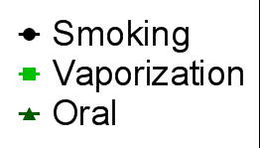
N = 11
µg/L

Slide 27
Recent Blood Cannabis Intake Markers
Analytes not useful recent use markers due to long detection time: THCVCOOH
Analytes maybe useful recent use markers but low detectability: THCV, THC-glucuronide
Analytes with high detectability & short windows of detection: CBG, CBN
  May not be seen after oral dosing
  Minor cannabinoids inclusionary, but not exclusionary markers of intake
  With new CBD rich cannabis strains, CBD can’t be used as a marker of recent use until evaluated

Slide 28
Blood Cannabis Intake Markers
Blood collection is invasive
Blood cannabinoid analysis is expensive
Immediate results are not available
Concentration of THCCOOH may indicate chronic frequent cannabis intake
Markers of recent cannabis intake are available

Slide 29
Urinary THCCOOH Excretion in Chronic Frequent Cannabis Smokers

Slide 30
Urinary THCCOOH Excretion in Chronic Daily Cannabis Smokers
 | N | Age Mean SD | BMI Mean SD | Jts/Day Median | 1st Use Mean SD | Yrs Used Mean SD
M | 12 | 25.1 ± 3.6 | 25.3 ± 3.8 | 6.0 3 - 60 | 16.3 ± 3.3 | 8.6 ± 3.9
F | 10 | 25.3 ± 3.8 | 29.5 ± 6.8 | 7.5 1 - 30 | 16.4 ± 3.4 | 9.4 ± 5.2

Slide 31
Urinary THCCOOH Excretion in Chronic Daily Cannabis Smokers
 | N | Days on Unit | Median THCCOOH µg/g | Ist Neg Days | Last Pos Days | Last Pos µg/g
M | 12 | 26.3 ± 3.9 | 283 31 - 563 | 10.3 3.9 -17.2 | 20.5 ± 6.3 | 6.5 3 - 26
F | 10 | 27.6 ± 3.3 | 171 56 -793 | 9.1 2.2 – 23.1 | 26.3 ± 3.3 | 10.5 5 - 49

Slide 32
Urinary Cannabinoid Excretion in Chronic Cannabis Smokers
50% highest THCCOOH occurred in 1st urine
50% Cmax up to 30 h after admission
No significant BMI difference males & females
Mean ± SD (range) time to last positive urine:
  Males 20.5 ± 6.3 days (12.1 – 30)
  Females 26.3 ± 79.6 days (20.8 – 30)
Significantly longer urinary cannabinoid excretion rate in chronic frequent female cannabis smokers than male chronic cannabis smokers

Slide 33
Mean Detection Rates
After 1st Negative THCCOOH in Urine
100
80
60
Detection Rate (%)
>150 µg/g
40
51 – 150 µg/g
0 – 50 µg/g
20
0
0
5
10
15
20
25
30
Days After 1st Negative 50 µg/L Screen

Slide 34
Does Presence of THC &/or 11-OH-THC
in Urine Suggest Recent Cannabis Use?

Slide 35
Cannabis Urinary Biological Markers
E coli ß glucuronidase hydrolysis of urine enables measurement of THC, 11-OH-THC & THCCOOH in urine
Kemp et al 1995, Manno et al 2001, & Brenneisen et al 2009 suggested urinary THC & 11-OH-THC predicted recent cannabis use

Slide 36
THC & Metabolite Urinary Excretion
After Smoking a 2.74% THC Cigarette
125
THCCOOH
100
11-OH-THC
75
THC
µg/L
50
25
0
0
8
18
28
38
48
58
68
78
88
Hours

Slide 37
Urinary THC in Frequent Cannabis Smokers During Monitored Abstinence
Subj Entry Cmax 1st Neg Last Pos Detection
µg/L µg/L Day Day Rate %
G 8.8 11.5 9.6 12.0 100.0
M 7.3 11.0 1.1 7.5 86.2
O 5.8 8.3 0.3 3.7 64.3
P 5.2 6.3 0.7 3.3 44.2
B 8.1 8.1 1.5 7.2 70.4
F 15.4 15.4 1.1 24.7 79.1
H 0.0 5.7 0 4.6 61.5
Neither THC or 11-OH-THC in urine are markers of recent cannabis use

Slide 38
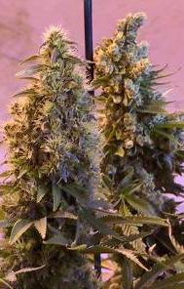
Predicting New Cannabis Use in Chronic Frequent Cannabis Smokers

Slide 39
Model Development & Validation
Develop & validate a model to differentiate new cannabis use from residual urinary drug excretion in chronic frequent cannabis smokers
All urine collected, cannabinoids quantified & normalized to creatinine concentrations

Slide 40
Model Development
48 participants resided on closed research unit throughout sustained abstinence to preclude cannabis use
2,377 urine specimens collected
For each subject, every specimen compared with every other specimen collected ≥ 48 h later
123,513 Specimen 2/Specimen 1 ratios
Ratios sorted into Specimen 1 groups: 6-15, 15-25, 25-50, 50-100, 100-200, 200-400, 400-600, >600 ng/mg

Slide 41
Model Development
Unique model for each Specimen 1 group
Prediction probabilities 80, 90, 95, 99%
Models developed for creatinine-normalized concentration ratios
Non-normalized ratio models abandoned
  Large variability
  Less accurate predictions than creatinine-normalized models

Slide 42
Model Development
√
Upper PI Limit = Ae^{-kt} + Z_{1-α/2} S²_{Model} + RMS
Single Specimen 1 Group
99% PI
Ratio
95% PI
90% PI
80% PI
0
360
ΔT (≥48 H)
720

Slide 43
Decision Rule 1
Increasing THCCOOH after admission
  Peak concentrations up to 40 h after admission
  Represents cannabis use close to admission
  Occurred in 6 participants (9%)
  Ratios expected to be high
Rule 1: Cannabis re-use predicted from 1st & 2nd specimens = do not use 1st specimen for predictions

Slide 44
Decision Rule 2
Admission specimen >800 ng/mg, remaining >200 ng/mg for up to 14 days
Occurred in 4 participants (6%)
Rule 2: If 1st specimen ≥800 µg/g, & ≥200 µg/g on day 5, false re-use predictions may occur up to 14 days

Slide 45

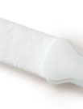
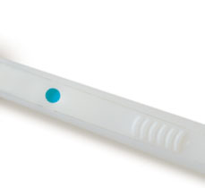
Is There A Better Biological Matrix for Identifying Recent Cannabis Intake?

Slide 46
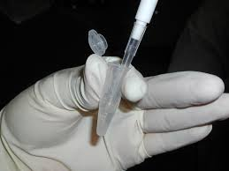
Oral Fluid Testing
Advantages:
  Less invasive, observed collection
  More difficult to adulterate
  No bathroom requirement
  Gender neutral specimen collection
  Basic drugs concentrate in lower pH of oral fluid
  as compared to blood
  After time, OF correlates with blood concentrations
  Can reflect recent drug use

Slide 47
Oral Fluid Drug Testing
Limitations:
  Specimen volume
    Generally low, especially after stimulant use
    Variability in volume collected (SAMHSA requires ±10%)
  Drug absorption to collection device
  Elution buffer
    Differential drug recovery & drug stabilization
    Dilutes oral fluid reducing sensitivity
    May interfere with LCMS techniques
  Oral mucosa contamination from smoked, insufflated & oral drugs
  Potential for environmental contamination

Slide 48
OF Cannabinoids Following Smoking of a 6.8% Cannabis Cigarette

Slide 49
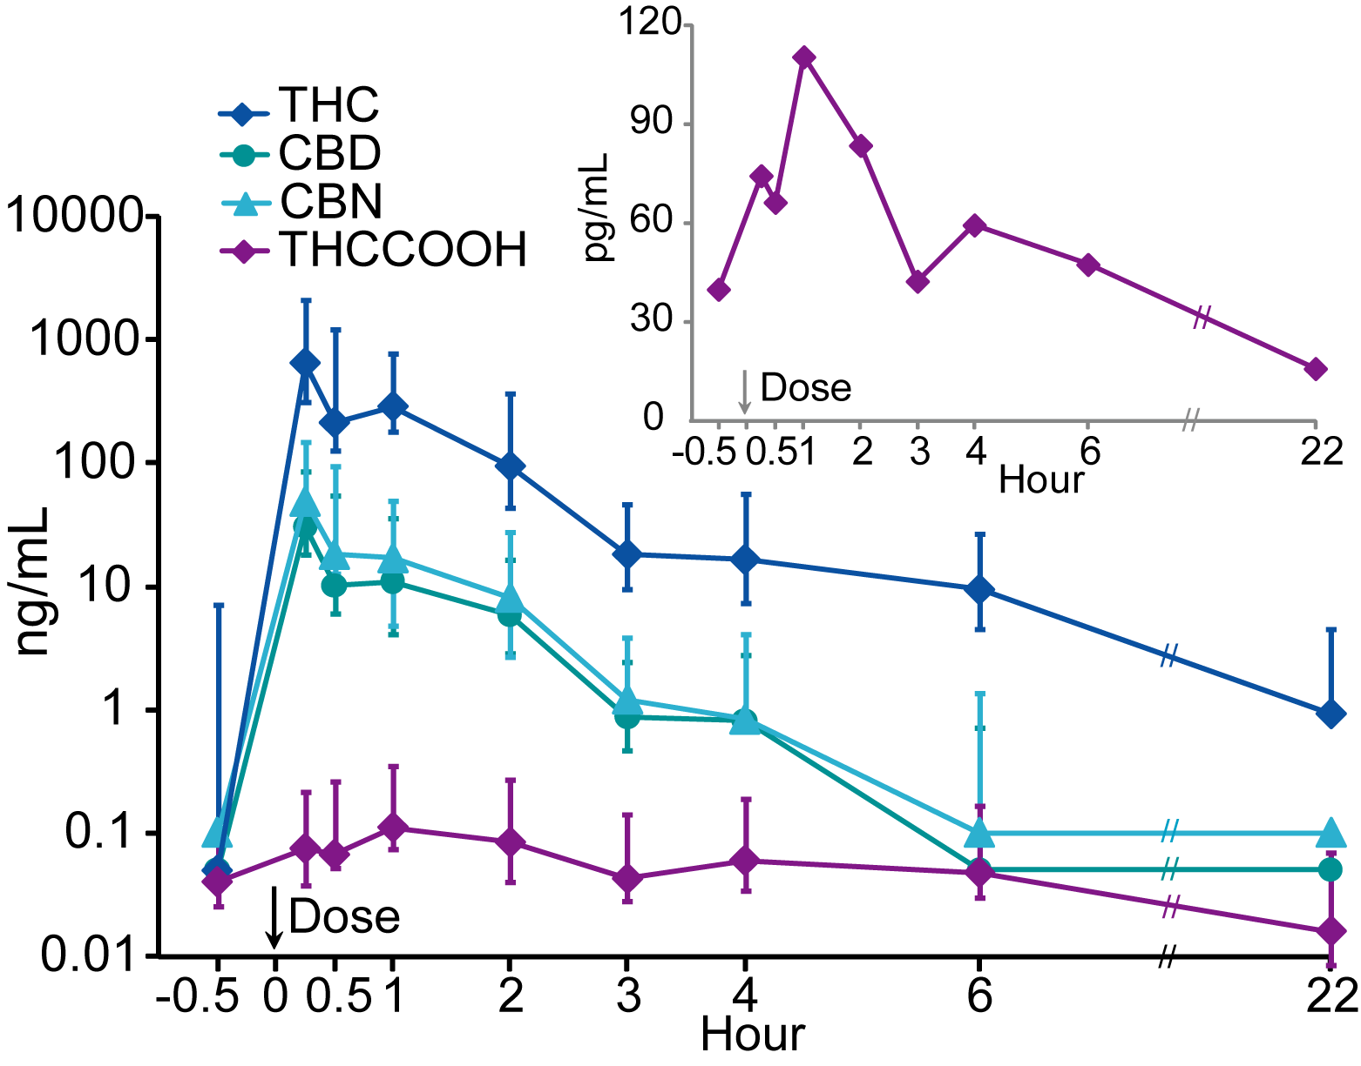
Median Cannabinoid OF Concentrations after Smoking One 6.8% THC Cigarette
N = 10

Slide 50
OF Cannabinoids in Occasional & Chronic Frequent Cannabis Smokers

Slide 51
Median OF Cannabinoids in Occasional & Chronic Frequent Cannabis Users After Smoking 6.8% THC Cigarette
Frequent users, n=14
Occasional users, n=10
StatSure Device Collection
Notes:
Median and interquartile ranges for tetrahydrocannabinol (THC), cannabidiol (CBD), cannabinol (CBN) and 11-nor-9-carboxy-tetrahydrocannabinol (THCCOOH) oral fluid concentrations for 30h following smoking of one 6.8% THC cigarette in chronic frequent (Red) and occasional (Blue) cannabis smokers. Error bars indicate interquartile ranges.

Slide 52
Oral Fluid Cannabinoids’ Pharmacokinetics in Chronic Frequent & Occasional Cannabis Smokers after 50.6 mg (6.9% THC) Smoked, Inhaled & Edible Cannabis
Swortwood MJ, Newmeyer MN, Andersson M, Abulseoud OA, Scheidweiler KB, Huestis MA.

Slide 53
THC Oral Fluid Pharmacokinetics
Frequent Smokers
Occasional Smokers
μg/L
Time (h)

Slide 54
CBG Detection, 0.3 μg/L
Frequent Smokers
Occasional Smokers
Detection Rate (%)
Time (h)
All participants negative by 26h post-inhaled doses
All participants negative by 10h post-oral dose

Slide 55
THCV Pharmacokinetics
Frequent Smokers
Occasional Smokers
μg/L
Time (h)
No significant difference in t_{max} (0.17h)

Slide 56
Detection Windows
0.3 μg/L THCV & CBG in oral fluid indicative of recent cannabis intake regardless of smoking frequency or administration route
OF pharmacokinetics after high potency CBD cannabis not available, precludes use as marker of recent use

Slide 57
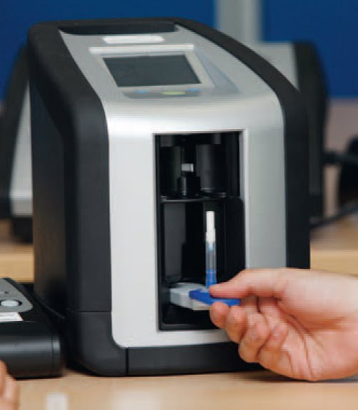
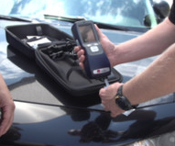
Onsite OF Screening
Draeger DrugTest 5000 Alere DDS2

Slide 58
Overall Device Performance
THC µg/L | TP | TN | FP | FN | SN% | SP% | EFF%
DT5000 (N = 551)
THC ≥ 5 | 116 | 373 | 33 | 29 | 80.0 | 91.9 | 88.7
THC ≥ 2 | 138 | 332 | 11 | 70 | 66.3 | 96.8 | 85.3
DDS2 (N = 545)
THC ≥ 25 | 70 | 398 | 76 | 1 | 98.5 | 84.0 | 85.9
THC ≥ 5 | 124 | 376 | 22 | 23 | 84.4 | 94.5 | 91.7
THC ≥ 2 | 138 | 325 | 8 | 74 | 65.1 | 97.6 | 85.0

Slide 59
Device Performance for Frequent Smokers
THC µg/L | TP | TN | FP | FN | SN% | SP% | EFF%
DT5000 (N = 300)
THC ≥ 5 | 87 | 170 | 20 | 23 | 79.1 | 89.5 | 85.7
THC ≥ 2 | 104 | 137 | 3 | 56 | 65.0 | 97.9 | 80.3
DDS2 (N = 345)
THC ≥ 25 | 49 | 244 | 51 | 1 | 98.0 | 82.7 | 84.9
THC ≥ 5 | 83 | 231 | 17 | 14 | 85.6 | 93.1 | 91.0
THC ≥ 2 | 96 | 191 | 4 | 54 | 64.0 | 97.9 | 83.2

Slide 60
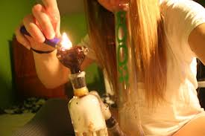
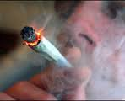
Onsite Oral Fluid Cannabinoids Test
Draeger DrugTest 5000 & Alere DDS2 performed well at detecting recent cannabis intake
Non-invasive collection, preferred by patients & collectors over urine due to privacy issues
Immediate results
Shorter window of drug detection than urine improves identification
of relapse

Slide 61
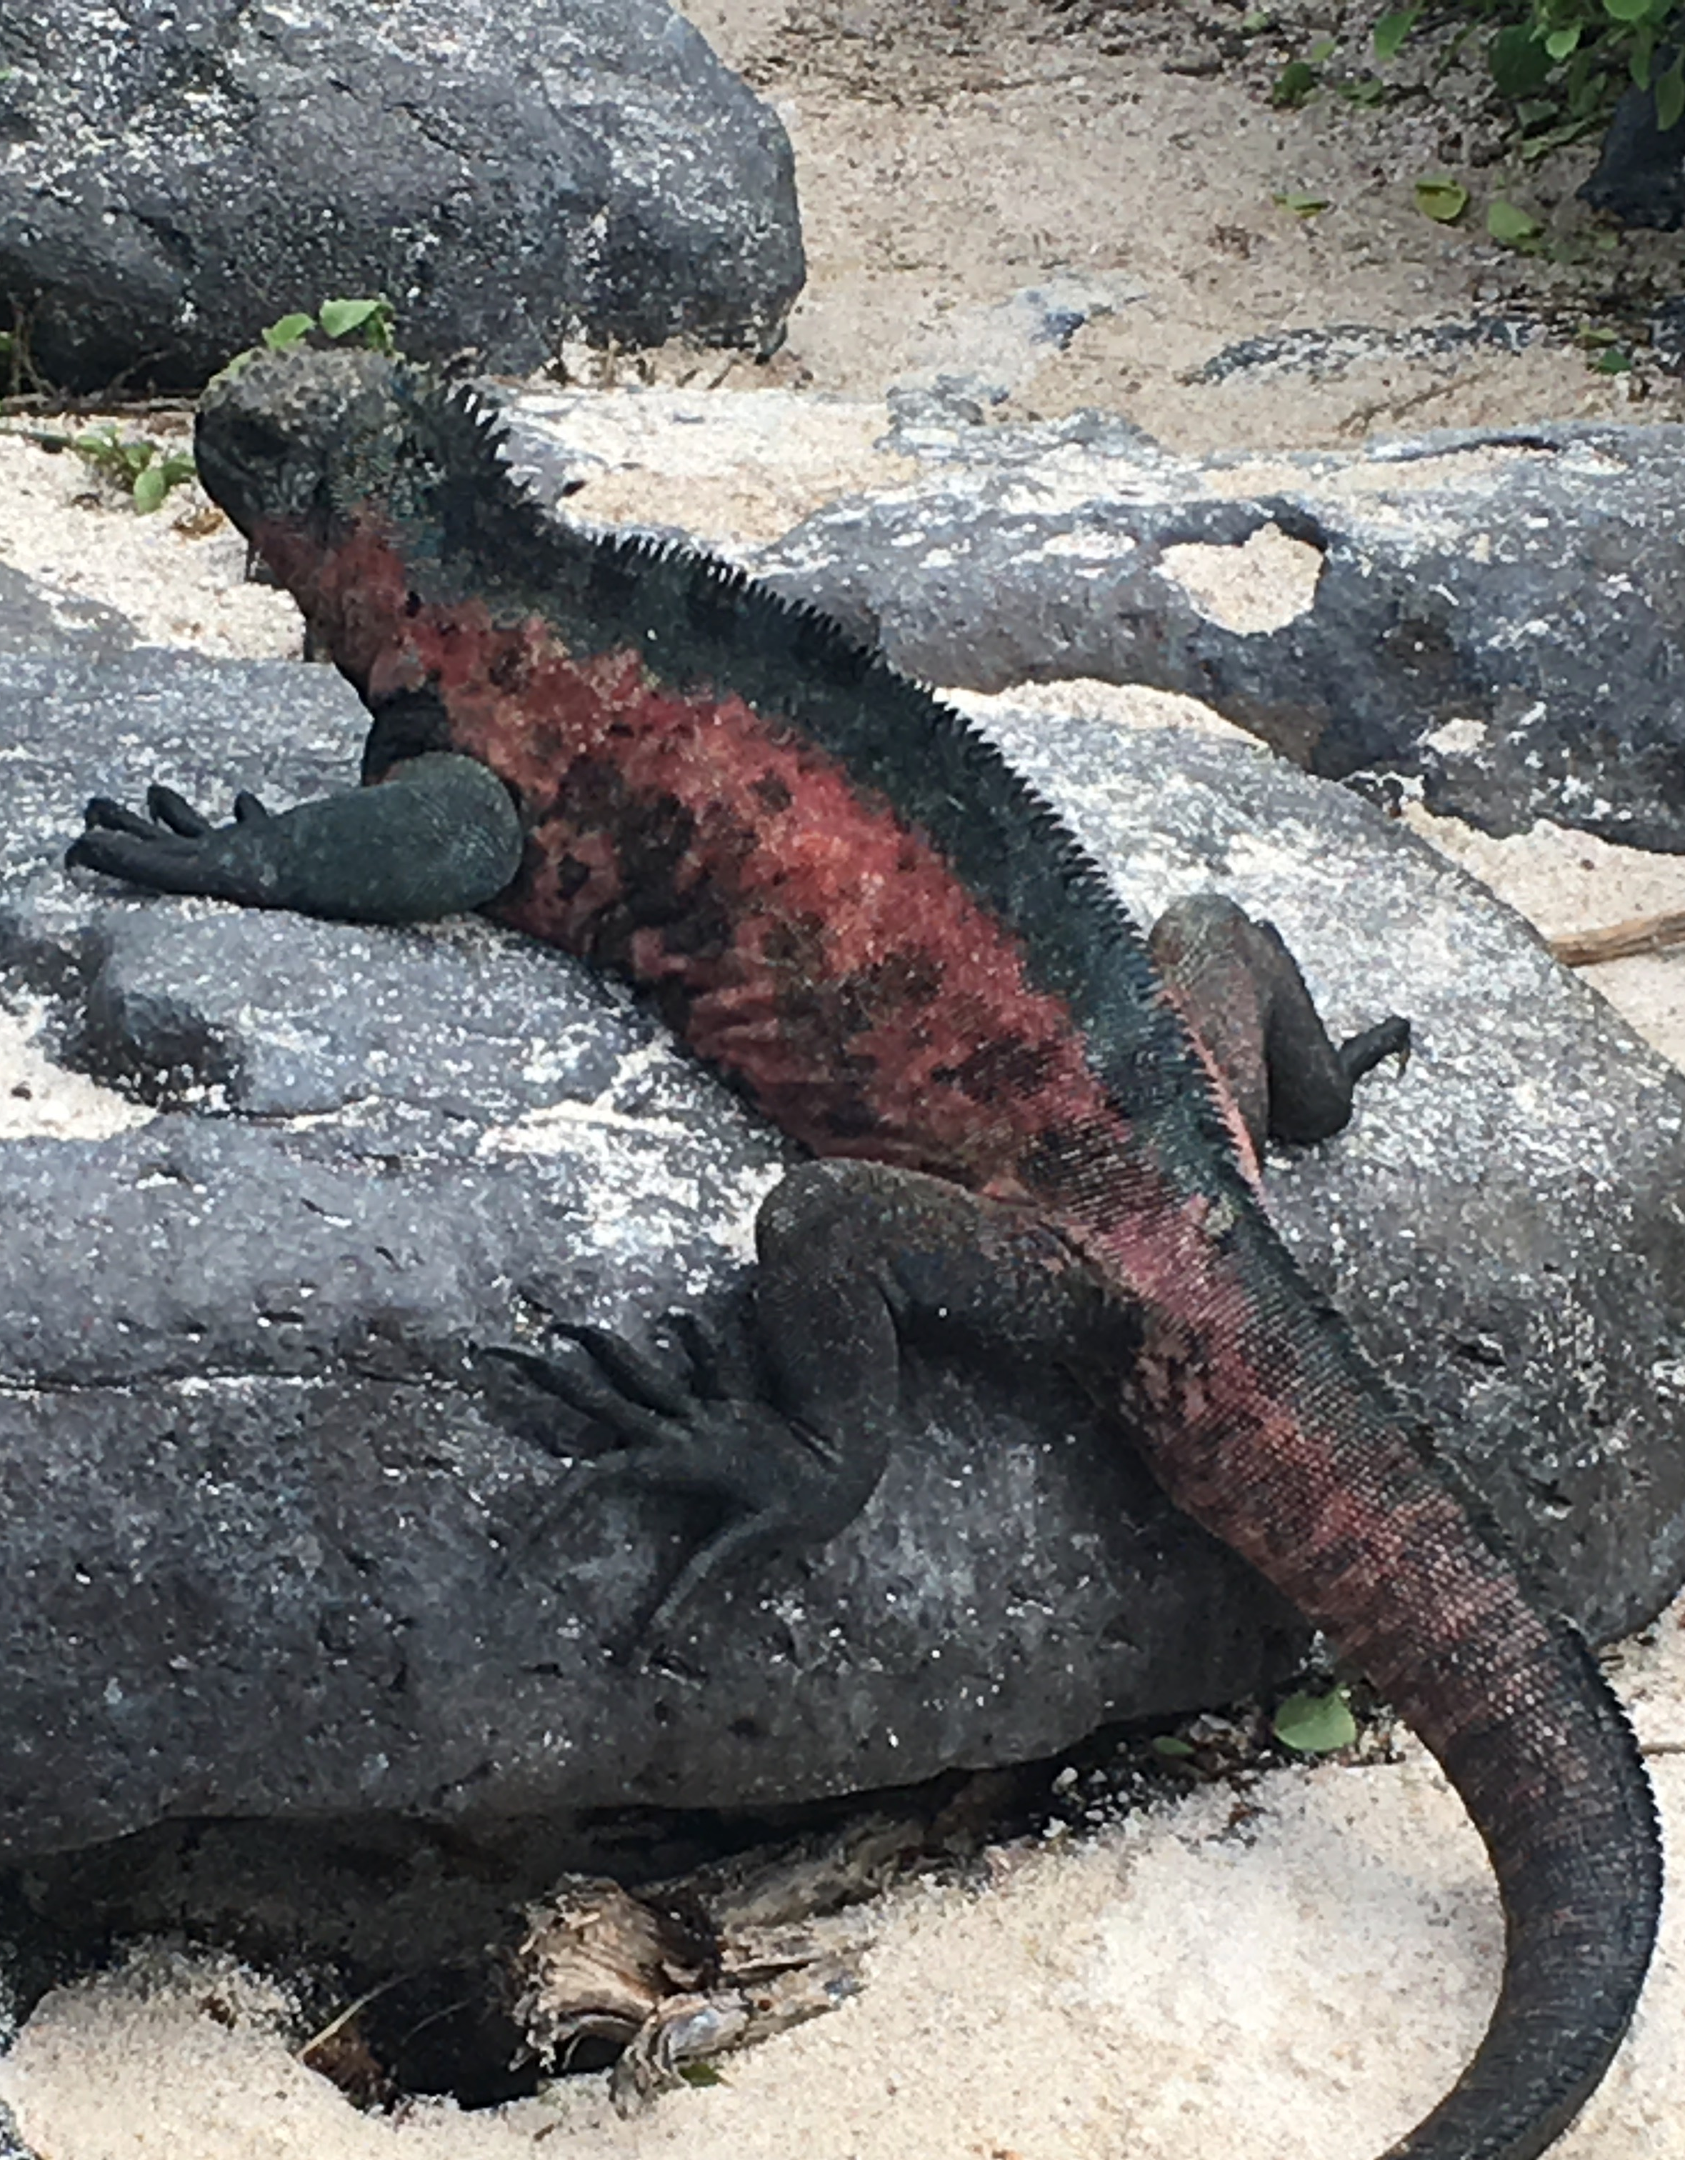
Thank You!
Cristina
Sempio, MS
Megan
Taylor, BS
Caitlin
House, BS

