Slide 1
Measuring Cannabis Severity Cannabis Use Outcomes for Clinical Trials (CUOCT) March 23, 2018
Deborah Hasin, Ph.D.
Columbia University
New York State Psychiatric Institute

Slide 2
Acknowledgements
Christina Aivadyan, Eliana Greenstein, Bridget Grant, Dvora Shmulewitz, Melanie Wall
Financial support
R01DA018652
R01DA034244
Campbell Alliance (now Seneos Health; NCT02660619) Westat/NIAAA (HHSN275200900007C)
New York State Psychiatric Institute

Slide 3
Outline
Outcomes: improvement in how patients feel and function
Context: increasing U.S. rates of cannabis use, Cannabis Use Disorder (CUD)
2 studies from other (non-US) groups using TLFB
Study designs: providing reliability, validity results
Results
Cannabis Use: Test-retest reliability, procedural validity
DSM-5 (CUD): Test-retest reliability, procedural validity
Unidimensionality: DSM-5 CUD criteria
DSM-5 (CUD) dimensional measures: test-retest reliability, procedural validity

Slide 4
Substance use is actually a surrogate endpoint for how patients feel and function
According to the FDA, desired effect of a treatment is clinical benefit, i.e., improving how patients feel and function
This makes makes use a surrogate endpoint, not a direct measure of outcome
Substance Use Disorder (SUD) criteria include tolerance, withdrawal, and other important functional consequences of use indicating how patients feel and function
Thus, CUD and reduction in its severity could be seen as an indicator of treatment outcome

Slide 5
Outline
Outcomes: improvement in how patients feel and function
Context: increasing U.S. rates of cannabis use, Cannabis Use Disorder (CUD)
2 studies from other (non-US) groups using TLFB
Study designs: providing reliability, validity results
Results
Cannabis Use: Test-retest reliability, procedural validity
DSM-5 (CUD): Test-retest reliability, procedural validity
Unidimensionality: DSM-5 CUD criteria
DSM-5 (CUD) dimensional measures: test-retest reliability, procedural validity

Slide 6
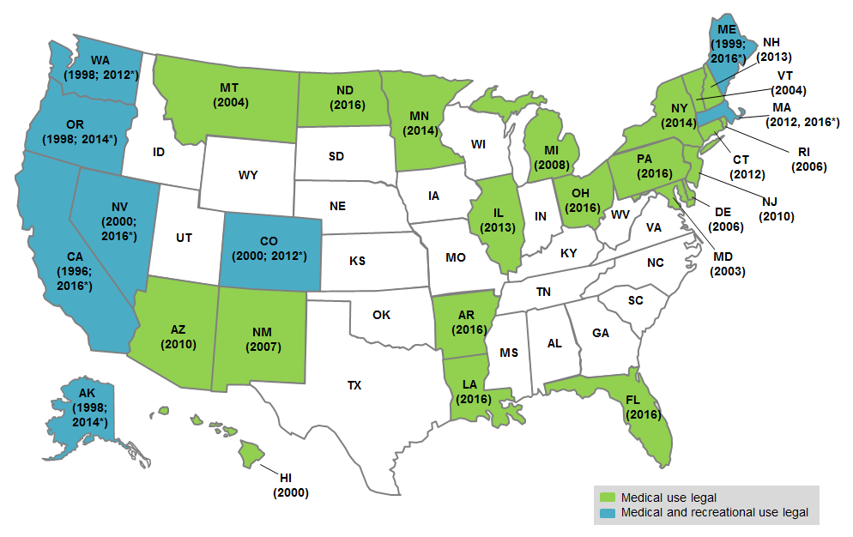
Context: States with medical marijuana laws (MML) and recreational marijuana laws (RML)
* Denotes the year recreational use became legal.

Slide 7
Context: Decreasing adult perceived risk of regular marijuana use, NSDUH 2002-2013
Shmulewitz, Hasin, unpublished

Slide 8
Context: Adults perceiving no risk in using marijuana,
NSDUH 2002-2014
15.1%
Increase: 270%
5.6%
Compton et al., Lancet Psychiatry 2016

Slide 9
Adult Prevalence of Cannabis Use, NESARC 2001-2002 and NESARC-III 2012-2013
Increase: 232%
9.5%
4.1%
Hasin et al., JAMA Psychiatry 2015
Notes:
4.1% in NESARC, 9.5% in NESARC-III

Slide 10
Adult Prevalence of DSM-IV Cannabis Use Disorder, NESARC 2001-2002 and NESARC-III 2012-2013
Increase: 187%
2.8%
1.5%
Hasin et al., JAMA Psychiatry 2015
Notes:
1.5% in NESARC, 2.8% in NESARC-III

Slide 11
U.S. National Estimates of Cannabis-Related Emergency Room Visits
Increase: 62%
Substance Abuse and Mental Health Services Administration, Drug Abuse Warning Network, 2011: National Estimates of Drug-Related Emergency Department Visits
Zhu H & Wu LT, J Addict Med. 2016

Slide 12
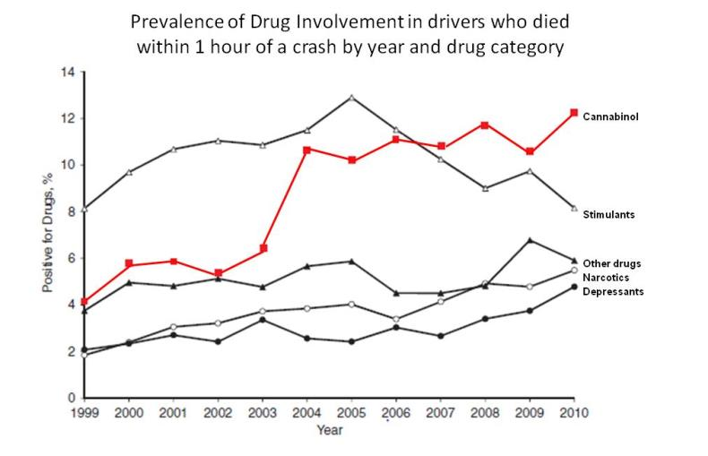
Cannabis Involvement in Fatal Vehicle Crashes 1999 - 2010
Increase: 320%
Brady & Li, Am J Epidemiol, 2014

Slide 13
Increased Prevalence of ICD-9-CM Cannabis Use Disorder: Massachusetts Gasterenterology Clinic Medical Records of 190,303 patients
Gubatan J et al., Digestive Diseases and Sciences, 2016

Slide 14
% of adult inpatient hospitalizations involving
patients with ICD-9-CM Cannabis Use Disorders:
2002-2011
1.34%
Increase: 258%
.52%
Charilaou et al., Am J Medicine, 2017

Slide 15
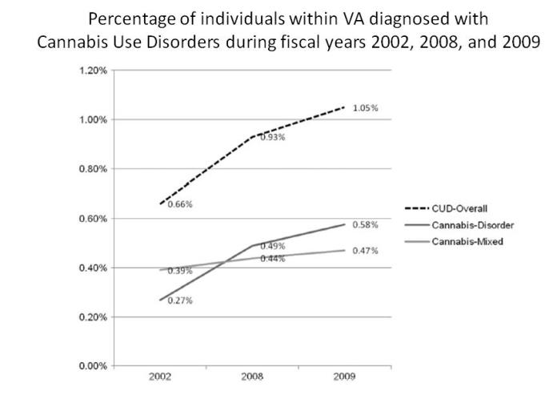
Prevalence of ICD-9-CM Cannabis Use Disorder: Veterans Administration Medical Records, 2002-2009
Increase: 59%
Bonn-Miller, Harris, & Trafton, Psychological Services, 2012

Slide 16
Prevalence of ICD-9-CM Cannabis Use Disorder: Veterans Administration Medical Records, 2010-2015
1.8%
Increase: 50%
1.2%
Hasin, Browne, Malte, Saxon, unpublished

Slide 17
Current DSM-5 Cannabis Use Disorder
Impaired Functioning, NESARC-III, 2012-2013
Impaired functioning: ≥ 0.5 S.D. below norm, SF-12v2 functioning scale
From data published in Hasin et al., Am J Psychiatry 2016

Slide 18
Summary, national trends
Laws are changing
Attitudes are changing
Cannabis Use Disorder is impairing
Rates of cannabis use are increasing
Based on the concept of triangulation (Munafo & Smith, Nature 2018), multiple sources indicate increasing US adult rates of CUD
DSM-5 CUD is seldom treated (Hasin et al., Am J Psychiatry 2016)
Need for effective treatments is increasing

Slide 19
Outline
Outcomes: improvement in how patients feel and function
Context: increasing U.S. rates of cannabis use, Cannabis Use Disorder (CUD)
2 studies from other (non-US) groups using TLFB
Study designs: providing reliability, validity results
Results
Cannabis Use: Test-retest reliability, procedural validity
DSM-5 (CUD): Test-retest reliability, procedural validity
Unidimensionality: DSM-5 CUD criteria
DSM-5 (CUD) dimensional measures: test-retest reliability, procedural validity

Slide 20
Timeline Followback for Cannabis Use
Robinson SM et al., Psychol Addict Beh 2014
63 Canadian patients and advertisment respondents
Different interviewers each time, average interval 9.1 days
 | Intraclass Correlation Coefficient (ICC)
 | 30 days | 90 days | 360 days
Cannabis measure
% days abstinent | .92 | .89 | .96
Longest consecutive days abstinent | .81 | .80 | .81
Longest consecutive days using | .94 | .92 | .91
Largest # joints/day | .69 | .83 | .91
Total # joints/day | .82 | .78 | .94
# joints per using day | .69 | .79 | .93
% days used 1-3 joints | .81 | .80 | .81
% days used ≥4 joints | .86 | .82 | .86
Notes:
20
20

Slide 21
Timeline Followback for Cannabis Use
Norberg et al., DAD 2012
Convenience sample: 63 Australian patients and ad respondents,
Same interviewer each time, mean interval 14.1 days
 | Intraclass Correlation Coefficient (ICC)
 | Last 30 days | Last 90 days
Cannabis measure
Average quantity | .87 | .82
Frequency | .95 | .97
Notes:
21
21

Slide 22
TLFB and simpler assessment method
Agreement overall excellent (ICC=0.80)
Mean days used: 10.1 in A-CASI, 8.7 in TLFB
Results did not vary by primary drug, race, education, differences were greater in younger, women, non-Hispanics
Simpler assessments may be acceptable

Slide 23
Outline
Outcomes: improvement in how patients feel and function
Context: increasing U.S. rates of cannabis use, Cannabis Use Disorder (CUD)
2 studies from other (non-US) groups using TLFB
Study designs: providing reliability, validity results
Results
Cannabis Use: Test-retest reliability, procedural validity
DSM-5 (CUD): Test-retest reliability, procedural validity
Unidimensionality: DSM-5 CUD criteria
DSM-5 (CUD) dimensional measures: test-retest reliability, procedural validity

Slide 24
Assessment interviews
AUDADIS-5 (Grant et al, DAD 2015)
Alcohol Use Disorders and Associated Disabilities Interview Schedule for DSM-5
Fully structured
Non-clinician interviewers
PRISM-5 (Hasin et al, DAD 2015)
Psychiatric Research Interview for Substance and Mental Disorders, DSM-5 version
Semi-structured
Clinician interviewers
PRISM-5-OP (Hasin et al, in preparation)
Opioid section expanded for chronic pain patients
Assessment of other substances same as PRISM-5

Slide 25
National Epidemiologic Survey on Alcohol and Related Conditions (NESARC-III) 2012-2013
N=36,309
Not a follow-up of a previous sample
Household and group residents
Response rate ~60%
Oversampling of Blacks, Hispanic, and Young Adults
DSM-5 diagnoses
AUDADIS-5
Grant BF et al., JAMA Psychiatry 2015
Notes:
25

Slide 26
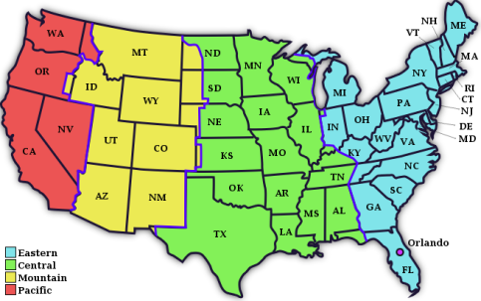
NESARC-III Test-Retest Reliability Study 2012-2013 Grant et al., DAD 2015
N = 1,006
57% female
65% white
$≥$86% high school
Around the U.S.
Alcohol Use Disorders and Associated Disabilities Interview Schedule – AUDADIS for DSM-5 criteria
Face-to-face household interviews
AUDADIS-5 test & AUDADIS-5 re-test
2nd interviewer always blind to 1st interview results
Re-test interval mean, 2.9 weeks; range 1-10 weeks
Notes:
26

Slide 27
NESARC-III Procedural Validity Study 2012-2013 Hasin et al., DAD 2015
Validation through re-evaluation with semi-structured clinician-administered procedures
N = 712
55% female
68% white
$≥$86% high school
Lived in Eastern time zone
1st interview: Face-to-face AUDADIS-5
2nd interview: Phone PRISM-5
2nd interviewer: master’s level clinician, always blind to AUDADIS-5 results
Re-test interval, mean 10.5 days
Notes:
27

Slide 28
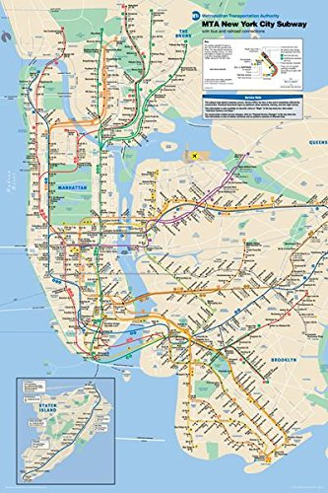
DSM-5 Test-Retest Study
Ongoing study, NIDA-funded
N = 321, New York City treated and untreated participants
Low-income, 75% minority urban sample
Face-to-face and phone interviews
PRISM-5 test, PRISM-5 re-test interviews
Master’s level clinician interviewers
2nd interviewer always blind to initial results
Re-test interval mean, 5.9 days (range 1-20)
Notes:
28

Slide 29
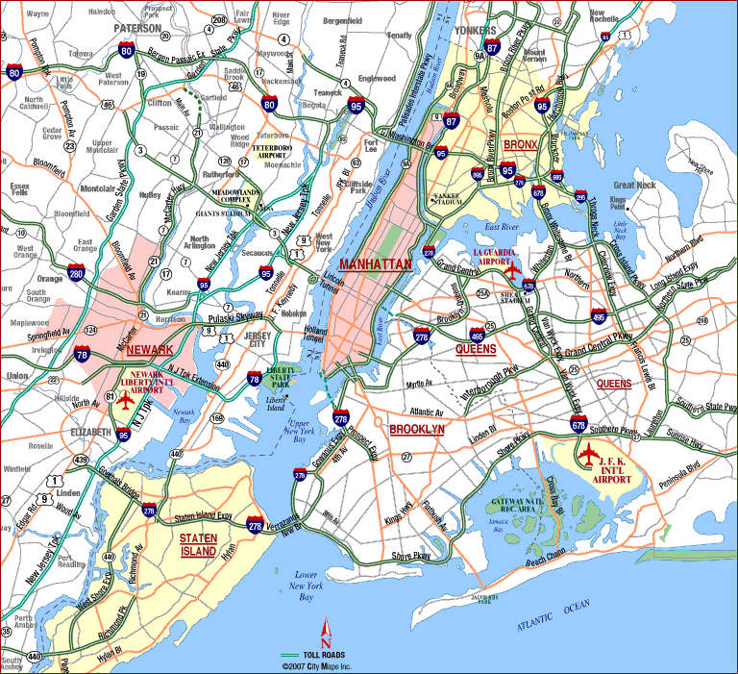
PMR Opioid Study
Completed study, funded by consortium of 8 pharmaceutical manufacturers
Total N = 606 patients from New York City, Long Island, & New Jersey
All had current or past opioid prescriptions ≥30 days for chronic pain
Mixed urban and suburban, largely white
”High-risk” patients: inpatient rehabilitation, N = 258
“Low-risk” patients: university-affiliated pain clinics, N = 348
Face-to-face or telephone interviews
PRISM-5-OP test and PRISM-5-OP retest interviews
Conducted by master’s level clinician interviewers
Test-re-test sample: N = 206
High-risk N = 97
Low-risk N = 109
2nd interviewer always blind to initial results
Re-test interval mean, 6.8 days; range 1-19 days
Notes:
29

Slide 30
Outline
Outcomes: improvement in how patients feel and function
Context: increasing U.S. rates of cannabis use, Cannabis Use Disorder (CUD)
2 studies from other (non-US) groups using TLFB
Study designs: providing reliability, validity results
Results
Cannabis Use: Test-retest reliability, procedural validity
DSM-5 (CUD): Test-retest reliability, procedural validity
Unidimensionality: DSM-5 CUD criteria
DSM-5 (CUD) dimensional measures: test-retest reliability, procedural validity

Slide 31
Cannabis use variables
test-retest reliability & procedural validity studies
Hasin et al., in preparation
Last 12 months | Study, participants 𝚱 (chance-corrected agreement)
 | Opioid, high risk N = 97 | DSM-5 N = 352 | NESARC-III procedural validity N = 712
Any use | .71 | .80 | .84
Use $≥$ 3 times/week | - | - | .73
Used $≥$6 times | .76 | .79 | -
Used $≥$ 4 days/week at least a month | .29 | .53 | -
Used $≥$ 3 days consecutively | .34 | .58 | -
Notes:
31
31

Slide 32
DSM-5 Cannabis use disorder
test-retest reliability & procedural validity
Hasin et al., in preparation
Last 12 months | Study, participants 𝚱 (chance-corrected agreement)
 | Opioid, high risk N = 97 | DSM-5 N = 352 | NESARC-III test-retest reliability N = 1,006 | NESARC-III procedural validity N = 712
DSM-5 Cannabis Use Disorder | .71 | .80 | .41 | .84
Notes:
32
32

Slide 33
DSM-5 Cannabis use disorder criteria
test-retest reliability & procedural validity
Hasin et al., in preparation
Last 12 months | Study, participants 𝚱 (chance-corrected agreement)
 | Opioid, high risk N = 97 | DSM-5 N = 352 | NESARC-III procedural validity N = 712
Used more/longer than expected | .61 | .65 | .41
Desire/repeated attempts to cut down/quit | .61 | .64 | .50
Much time spent using/getting over effects | - | .36 | -
Activities given up to use | .19 | .61 | -
Tolerance | .46 | .63 | .54
Withdrawal | .59 | .50 | .36
Continued use despite phys/psych probs | .49 | .41 | .23
Hazardous use | .53 | .52 | .64
Social/interpersonal probs due to use | .48 | .38 | -
Neglected major roles to use | .44 | .40 | -
Craving | .57 | .72 | .57
Legal probs due to use | - | .60 | -
Notes:
33
33

Slide 34
Binary measures and dimensional measures of SUD
If the severity of conditions is inherently dimensional, dichotomizing into yes/no risks losing information and can create artefactual results due to selected cut-point
Prior to DSM-5, many factor analyses showed abuse and dependence criteria formed 1 factor, or 2 very highly correlated factors
Item Response Theory analysis extends factor analysis, providing more information on the relationship of the criteria to each other
Item characteristic curves (ICC; graphed) show relationship of criteria to each other

Slide 35
Up to DSM-5 (2013), IRT/latent variable modeling of SUD showed unidimensionality in >200,000 participants Hasin et al., Am J Psychiatry 2013
Sample | # Studies | Ns | Locations
Adult general population | 17 | 722 - 43,093 | Australia, Israel, US
Adult emergency room | 2 | 5,195 | Argentina, Mexico, Poland, US
Adult substance abuse treatment | 5 | 372 - 1,511 | Australia, US
Adult genetic studies | 4 | 496 - 9,313 | US
Adolescent general population | 4 | 353 - 3,641 | France, US
Adolescent substance abuse treatment | 2 | 279 - 472 | US
Adolescent mixed | 2 | 5,587 | US

Slide 36
NESARC=III DSM-5 Cannabis Use Disorder Criteria Item Characteristic Curves Past-year frequent users, N = 1,527
Shmulewitz, Hasin, unpublished

Slide 37
DSM-5 Cannabis Use Disorder Criteria Item Characteristic Curves, past-year cannabis users Opioid Study, N = 113
Shmulewitz, Hasin, unpublished

Slide 38
DSM-5 Study Cannabis Use Disorder Criteria Item Characteristic Curves Frequent cannabis users, N = 233
Shmulewitz, Hasin, unpublished

Slide 39
DSM-5 Cannabis use disorder
test-retest reliability & procedural validity
Binary vs. Dimensional measures
Hasin et al., in preparation
Last 12 months | Study, participants Dichotomous: 𝚱 (chance-corrected agreement)
 | Opioid, high risk N = 97 | DSM-5 N = 352 | NESARC-III test-retest reliability N = 1,006 | NESARC-III procedural validity N = 712
DSM-5 Cannabis Use Disorder | .71 | .80 | .41 | .60
Notes:
39
39

Slide 40
DSM-5 Cannabis use disorder
test-retest reliability & procedural validity
Binary vs. Dimensional measures
Hasin et al., in preparation
Last 12 months | Study, participants Dichotomous: 𝚱 (chance-corrected agreement)
 | Opioid, high risk N = 97 | DSM-5 N = 352 | NESARC-III test-retest reliability N = 1,006 | NESARC-III procedural validity N = 712
DSM-5 Cannabis Use Disorder | .71 | .80 | .41 | .60
 | Dimensional: intraclass correlation coefficient (ICC)
DSM-5 Cannabis Use Disorder | .82 | .89 | .70 | .79
Notes:
40
40

Slide 41
Summary of reliability and procedural validity results
Measures of use appear are reliable as long as they don’t require computations or reporting complex patterns
Existing studies do not address vaping, edibles, dabbing
Use per se may not reflect how patients feel, function
Cannabis Use Disorder (or dependence) is often an inclusion criterion for RTCs, but improvement in its severity not used as an outcome
Change in DSM-5 CUD dimensional measures (highly reliable, procedural validity) could be used as outcomes indicating how patients feel and function

Slide 42
Thank you!

