Slide 1
Abstinence vs. Reduction Primary Treatment Outcomes for Cannabis Use Disorder
Alan J. Budney
Center for Technology and Behavioral Health
Department of Psychiatry
Geisel School of Medicine at Dartmouth
ACTTION Meeting: Cannabis Use Outcomes for Clinical Trials
Bethesda, MD
March 23, 2018
Notes:
Hi everyone, thank you for coming
My name is jake borodovsky
I am a phd student at the dartmouth institute for health policy and clinical practice
I conduct my research at the center for technology and behavioral health
Today I am going to try and give you a sense of the research I have been working as a phd student focused on using social media to study the effects of cannabis legalization
how that work has informed the concept and design of for my dissertation project

Slide 2
Disclosures
- supported by NIH-NIDA for over 25 yrs
- currently on DSMB for a clinical trial supported by Tilray, Inc
- consulted with GW Pharmaceuticals / Otsuka regarding abuse liability of Sativex (THC/CBD oromucosal spray)
Copy of Slides, Articles, or Other:
alan.j.budney@dartmouth.edu

Slide 3
Plan
Identify and “Operationalize” the Issues
Examples of the End Game
Explore What Types of Data are Needed

Slide 4
Operationalize the Terms
Abstinence is Reduction? or Are they Qualitatively Different?
Conceptual and Empirical Questions
Conceptualization of SUDs / Addiction?
Traditions in the Field (FDA, Alcohol, Tobacco, Opiates)
Abstinence vs. Reduction?
Primary vs. Secondary Outcomes

Slide 5
Reduction Implies “Harm Reduction”
There is some amount of reduction in use (or in the way a drug is used) that has important positive implications for one’s life.
- how important, how much reduction, how to measure it?
How much does a person need to reduce?
- # of days, # times used per day, the amount used per episode/total dose ingested, time of use, context of use?
- Vaping or eating rather than smoking?

Slide 6
Reduction Implies “Harm Reduction” (2)
Can such reduction be standardized?
- targeted safe amount
- percentage reduction: use variables (improvement)
(days, times, amount?)
- improvement in clinical functioning – what variable(s)
- large individual differences in how CUD relates to “functioning”
- need to validate global functioning measures

Slide 7
Abstinence complete/prolonged or some discrete period
(1) “Days of Use” or “Days of Abstinence”
(2) Traditional Meaning:
Once you develop a CUD:
- You need to discontinue all use? or else what?
- You will “relapse” / Go back to problem levels.
- You cannot learn to use at a non-harmful level.
- Is this true of all persons with CUD, or are there identifiable subsets that it applies to or not?

Slide 8
Abstinence (complete) as the Primary Outcome does not seem Logical, Practical or Realistic - at least not for all cases of CUD

Slide 9
% of Participants Abstinent
(MTPRG 2004)
Notes:
Here are the 90-day abstinence rates at each follow-up of the same study and we can generally see the same pattern. Differences were statistically significant at 4 months and 15 months but not at 9.
Note that even those receiving 2 sessions show greater abstinence rates than those in the Delayed Treatement Control group, suggesting that some individuals only need very brief intervention.
However, its also clear that abstinence rates are roughly 20-25% at best, and examining individuals who were still using cannabisbut were not experiencing dependence or abuse symptoms only added 4-9% onto these rates, leaving plenty of room for improvement.

Slide 10
(Budney et al. 2006)

Slide 11
Kadden et al. (2007)
% Participants Abstinent

Slide 12
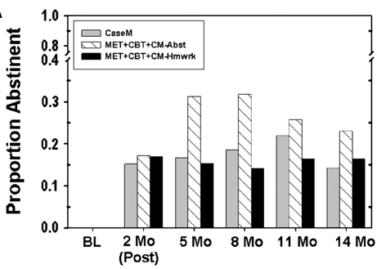
Marijuana Abstinence
Litt et al. (2013)

Slide 13
CUD Treatment Seekers who Smoke Tobacco (Lee, Walker, Budney et al., in preparation)
End of Treatment Outcome | N = 65
Cannabis Abstinence
Any Documented Abstinence | 27.7%
> 2 wks | 20.0%

Slide 14
Abstinence Outcomes Across Multiple Studies
% Abstinent
Notes:
Adult Studies: Slide combines data across a number of studies

Slide 15
Reduction in Days of MJ Use Marijuana Treatment Project (2004)
Notes:
N= 400 Adults seeking treatment…

Slide 16
Days of Use Past 30
# days past Month
(Budney et al. 2006)

Slide 17
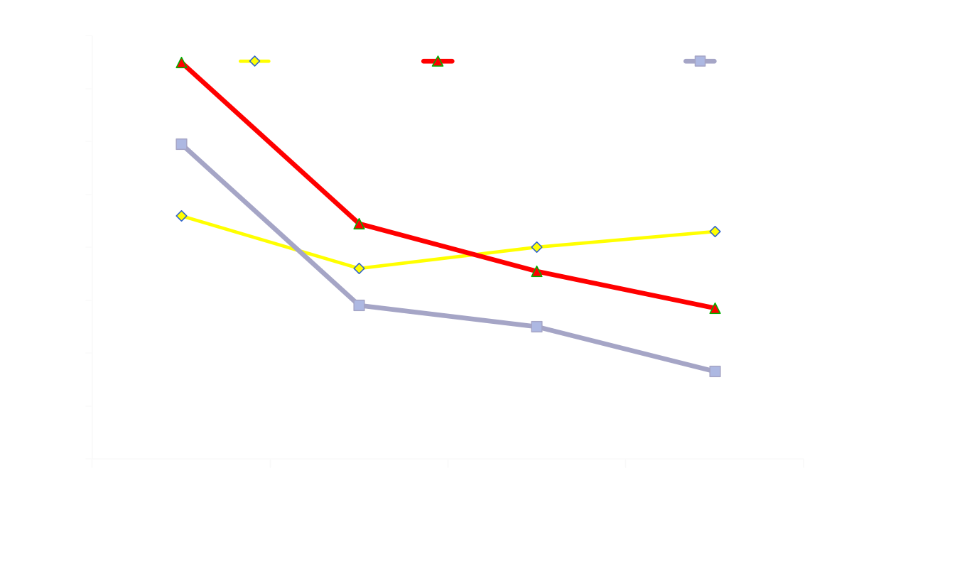
Cannabis Use Days Past Month
Kay-Lambkin et al. (2009)
Mean Cannabis Use / Day
Notes:
This shows the percentage of participants within the condition that were abstinent at etx, 3mo and 6mo post treatment. As you can see we found a greater percentage of abstinent participants in the computerized condition at all time points although significant only at 6 mo. when we analyzed the 3 gps together

Slide 18
Abstinence vs. Reduction Outcomes
Abstinence: Participant Level (% cases)
Reduction: Group mean amount of reduction

Slide 19
OTHER REDUCTION MEASURES
Frequency
- # Times (episodes) Used Per Day
- # of Time Periods Used Per Day
Quantity (over time or single episode)
- # Joints Used
- Grams Used
?? bowls, blunts, dabs, concentrates, oils, edibles
Notes:
Adult Studies: Slide combines data across a number of studies

Slide 20
Current (past 30 day) Cannabis users
Mean: 5.4
SD: 1.8
N=4177

Slide 21
Intoxication Ratings How high do you typically get? 1= slightly buzzed; 10 = so stoned I might vomit
Typical Intox Level
(1-10) Daily Users (n = 2185)
1-3 14%
4-6 57.5%
> 7 28%
Notes:
First adult study, vape typology study, HC study, and RTC study and AS study combined (excluded youth study) total #s vary b/c of missing data/variations in item response options

Slide 22
Reduction or Abstinence: How do you Define Success (Improved)?
Predictive Validity
1) Define Outcome During Treatment
2) Define the Long Term Outcomes
Notes:
Adult Studies: Slide combines data across a number of studies

Slide 23
Abstinence / Reduction
Data suggest
Period of continuous abstinence during treatment predicts longer term outcomes; how robust is this finding?
Does reduction (days) in use during treatment predict positive longer term outcomes?
Days = yes; Amount?? Times per day??
Person’s with abstinence goals show superior outcomes (Lozano, et al.). Person’s with moderation goals can be successful, but more likely to fail. Replications needed.

Slide 24
Other Things to Consider
Physical Health Effects? (OD, cancer, liver, cardio)
Behavioral Impairment / Consequences
Type of Treatment (CM-abstinence; CBT)
Diversity of the Clinical Population
- high functioning, disadvantaged, co-occurring issues, medical users
Legal or Illegal

Slide 25
Clinical and General Population Data
More carefully examine and document use patterns?
Should there be different outcomes / goals for different profiles of use and other co-morbidities?
- CUD is generally less severe
- Reduction or non-problematic use would seem to be a goal for a substantial proportion of those with CUD
Notes:
First adult study, vape typology study, HC study, and RTC study and AS study combined (excluded youth study) total #s vary b/c of missing data/variations in item response options

Slide 26
That’s It!

Slide 27
How Do People Use Cannabis? Clinical and General Population Samples
Social Media Sample of Recent Cannabis Users
(N=4378)
Days of Use
1-19 days 35%
20-29 days 26%
All 30 days 39%
Notes:
First adult study, vape typology study, HC study, and RTC study and AS study combined (excluded youth study) total #s vary b/c of missing data/variations in item response options

Slide 28
Social Media Sample Frequency of Use
% All Ss % Daily Users
(n=4378) (n=2145)
1x per day 24% 7%
2-3x per day 46% 46%
4-5x per day 17% 25%
> 6x per day 13% 22%
Notes:
First adult study, vape typology study, HC study, and RTC study and AS study combined (excluded youth study) total #s vary b/c of missing data/variations in item response options

Slide 29
Other Uses: Develop Cannabis Risk Index
Large, diverse samples of cannabis users; provide detailed information about their use and consequences.
e.g., frequent daily use with low level intoxication may be a profile for true therapeutic use, or evening stress reduction pattern (low risk?)
frequent daily use with high levels of intoxication (high risk) would seem high risk

Slide 30
Natural History of Quitting: Daily Cannabis Users (n=193)
3 month daily monitoring (Usual Use, Abstinence, Reduction)
Rapid & Multiple Transitions: Median = 22 changes (12, 31)
Quit Attempts: - 46% made at least one attempt
- Median attempts = 3 (1, 2)
- Median duration = 2 days (1, 6)
Reduction Attempts: - 85% attempted to reduce
- Only 5% lasted longer than 1 week
- Days of reduction predict quit attempt
End of Period: 10% abstinent prior 7 days; 5% prior month
Hughes et al (2016)

Slide 31
Medical Cannabis Approvals vs. Medical Use (States with MMLs only)
Yes No
Have Approval
Why do you use Cannabis?
-- Medical Reasons Only 17% 3%
-- Recreat. Reasons Only 2% 25%
-- Medical and Recreational 81% 71%

Slide 32
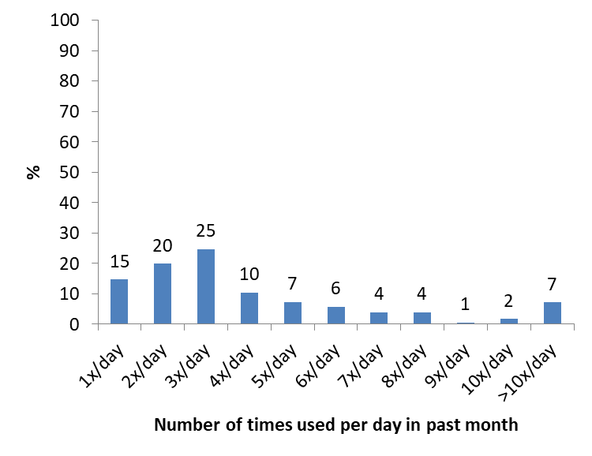
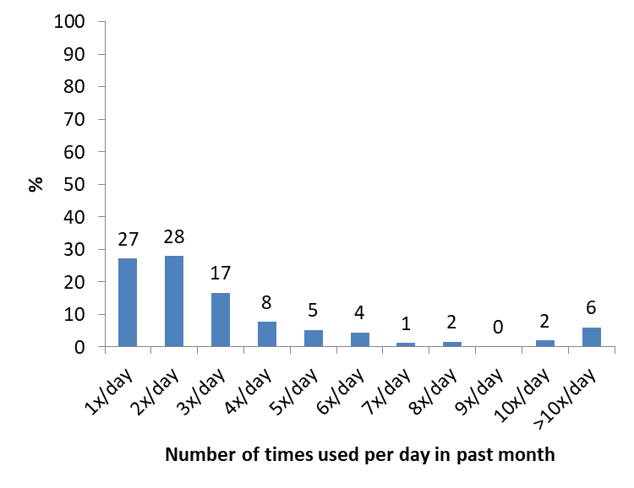
# of Times used per day - past-30 day users
medical cannabis card holders only for medical reasons

Slide 33
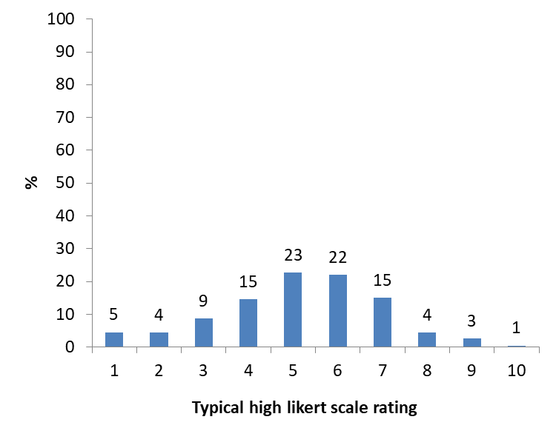
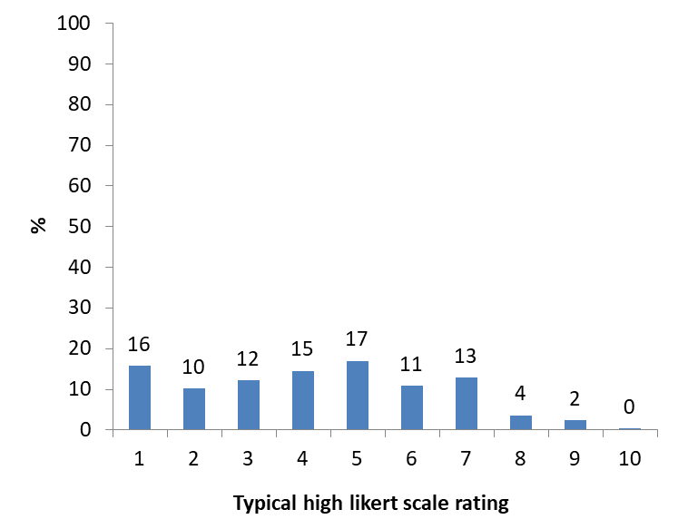
Typical High
medical cannabis card holders only for medical reasons

Slide 34
Typical high rating among past-30 day users who are medical cannabis card holders (N=587)
1=light buzz
10=vomiting

Slide 35
Typical high rating among past-30 day users who report using only for medical reasons (N=247)
1=light buzz
10=vomiting
Notes:
Analogous to DIVERSION issue

Slide 36
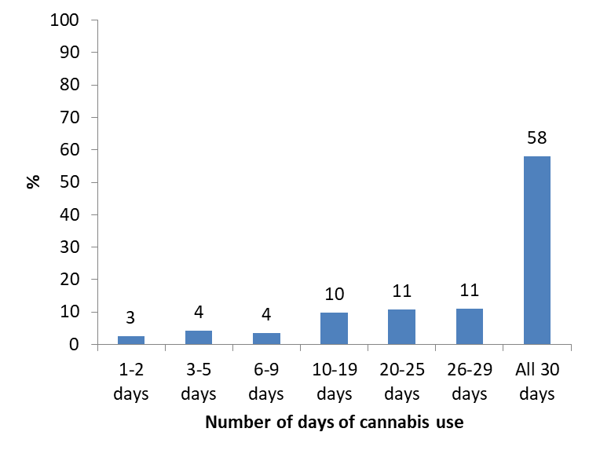
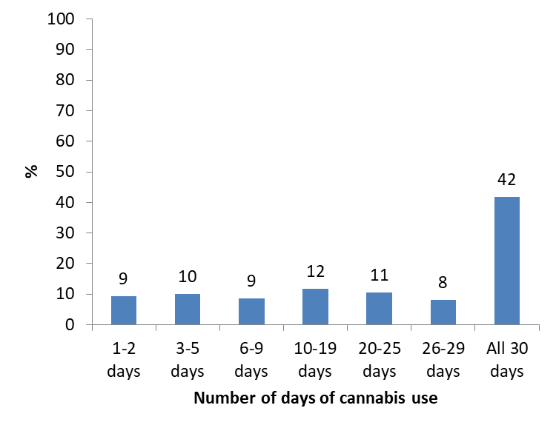
Days of cannabis use among past-30 day
medical cannabis card holders only for medical reasons

Slide 37
Cannabis Youth Treatment Study Abstinence at Discharge
(Dennis et al. 2004)

Slide 38
Youth Cannabis Abstinence Outcomes
Stanger et al. 2015

Slide 39
Cannabis Youth Treatment Study
(Dennis et al., 2004)

Slide 40
Cannabis Youth Treatment Study Treatments Reduce Marijuana Use
Notes:
N=

Slide 41
Improvement Outcomes Across Multiple Studies
% Abstinent
Notes:
Adult Studies: Slide combines data across a number of studies

