Slide 1


Epidemiology of small fiber neuropathy
J. Rob Singleton
Professor and Vice Chair
University of Utah Neurology
Director, Clinical Trials services Foundation
Utah Center for Clinical and Translational Science
Chief, Neurology
SLC VA Medical Center
ADA, NIH NINDS, NIDDK, DP3, NCATS CTSA 1ULTR001067
Notes:
To discuss:
Evidence for metabolic syndrome dyslipidemia in neuropathy, espeicially to small diameter nerves
Tools we are using to evaluate early neuropathy and nerve regenerative capacity in humans
Two analogies
Achingly familiar statistics
Some cartoons

Slide 2
Epidemiological questions
What fraction of all neuropathies can be considered “small fiber”?
What are the most common causes of small fiber neuropathy?
Up to half of SFN remains idiopathic- do these patients have a distinct prognosis?
How does the prognosis of small fiber neuropathy differ from that of large or mixed fiber sensory neuropathy?

Slide 3
Definitions of small fiber neuropathy
Systemic, generally length dependent injury to peripheral nerve
Small fiber predominant” neuropathy- sensory neuropathy in which small fiber clinical features are frequently encountered (i.e. = painful)
“Pure” small fiber neuropathy- exam shows only spinothalamic sensory features, and confirmatory tests show SFN but not large fiber sensory involvement
Notes:
Important because some common causes of neuropathic pain are not PNS (MS, fibromyalgia, cancer pain), or not really neuropathies
(e.g zoster, trigeminal neuralgia)

Slide 4
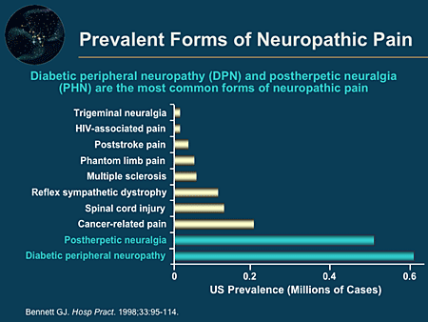
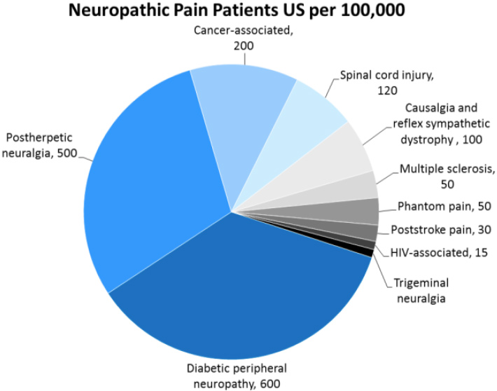
Neuropathic pain
Not all neuropathic pain is neuropathy
Bennett G, Hosp Practice, 1998

Slide 5
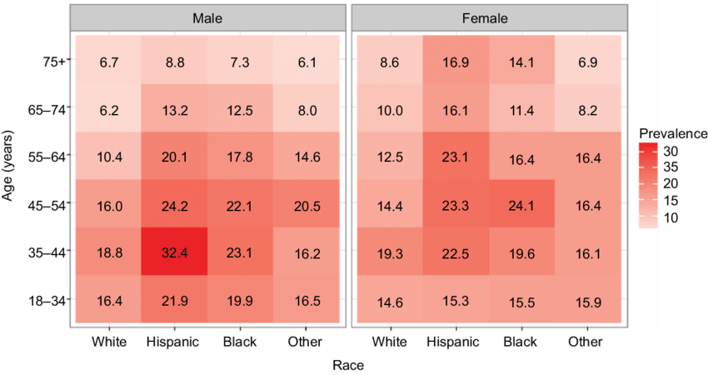
Neuropathic pain
Racial diversity of all cause neuropathic pain
Corresponds to diabetic neuropathy risk.

Slide 6
SFN differential diagnosis
Metabolic
  Diabetes 1 and 2
  Prediabetic metabolic syndrome
  Treatment induced diabetic neuropathy (TIND)
Toxic/ drug induced
  Ethanol
  Pyridoxine
  Arsenic
  Chemotherapy agents, especially taxanes, platinum agents
  Anti-retrovirals, especially Didanosine, Stavudine
  Metronidazole /gold /disulfram /isoniazid /thalidomide /perhexilene
  Organic solvents, especially n-hexane
Infectious
  HIV
  Hepatitis B, C
  Leprosy
Autoimmune
  Sarcoidosis
  Sjogren syndrome
  Systemic lupus
  Celiac disease
  Paraneoplastic
  Monoclonal gammopathy
Inherited
  Na channelopathies
  HSANs
  Familial amyloidosis
  Fabry disease
  Metachromatic leukodystrophy

Slide 7
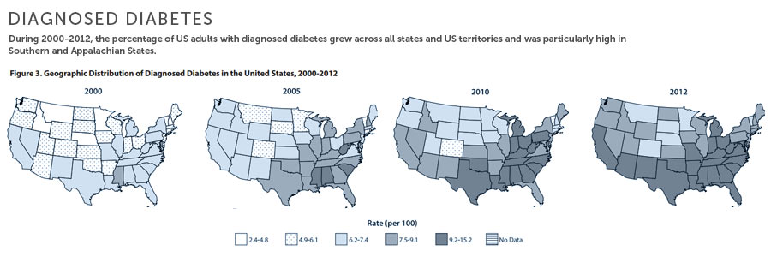
Type 2 diabetic neuropathy
Estimated overall US adult DM2 prevalence of 14%, or 31.5 million
25% have clinical SFN phenotype
DM2 SFN burden in US ~7.9 million
Notes:
Total US population 303 M
76% of population is over 18 years old

Slide 8
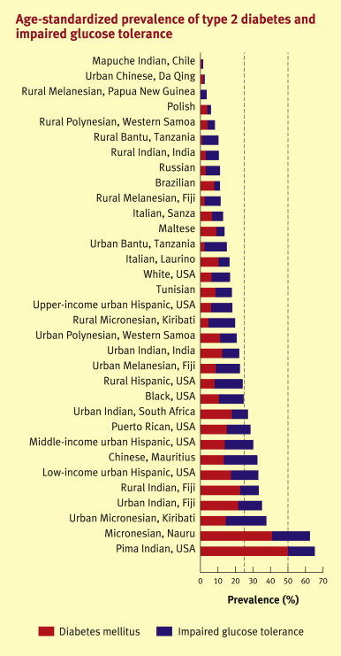
DM2 neuropathy
Prevalence varies dramatically by ethnicity, across US and world
Notes:
Dramatic variation in ethnic prevalence of type 2 diabetes.

Slide 9
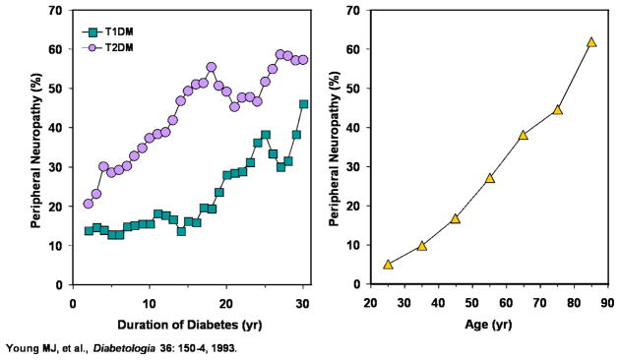
Type 2 diabetic neuropathy
Prevalence of neuropathy in DM2- 25-60%
Age, duration of diabetes, ethnicity contribute risk

Slide 10
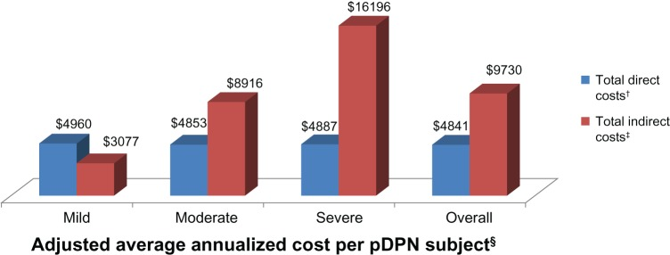
Diabetic neuropathy is expensive
112 US patients with DM2 and painful neuropathy
Comprehensive assessment of health and social impact, including direct medical costs and indirect costs due to lost work
Sadosky A Schaefer C et al, Diab Met Syn Obes 2013

Slide 11
Neuropathy in prediabetes
Multiple lines of epidemiological evidence suggest a causative association between prediabetic metabolic syndrome and peripheral neuropathy
Notes:
Dramatic variation in ethnic prevalence of type 2 diabetes.

Slide 12
P<0.001
Metabolic syndrome is
prevalent in otherwise
idiopathic neuropathy
Percent with MS
n=709
n=249
n=95
P<0.001
P<0.01
From- Visser NA, Vrancken AF, van der Schouw YT, van den Berg LH, Notermans NC. Chronic Idiopathic Axonal Polyneuropathy Is Associated With the Metabolic Syndrome. Diabetes Care. 2012.
Notes:
Notermans (female) University of Utrecht
Discuss reverse study- neuropathy more common in prediabetes
Make this slide

Slide 13
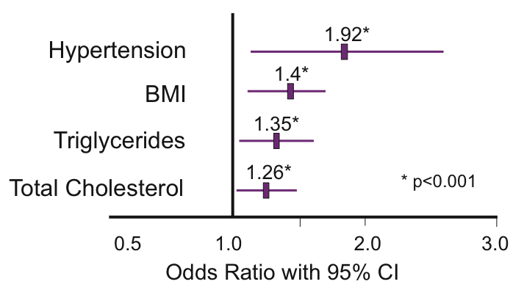
Neuropathy associated with metabolic syndrome
Solomon Tesfaye, M.D., Nish Chaturvedi, M.D., Simon E.M. Eaton, D.M., John D. Ward, M.D., Christos Manes, M.D., Constantin Ionescu-Tirgoviste, M.D., Daniel R. Witte, Ph.D., and John H. Fuller, M.A. for the EURODIAB Prospective Complications Study Group. N Engl J Med 2005
Notes:
Mention the DCCT here- showed the importance of glucose control on prevention of diabetes.
Look up DCCT
EURODIAB 1127 type 1 patients, followed for 7.3 years. 23% developed neuropathy over follow-up.
Multifactorial analysis controlling for age, glucose to examine contributors.

Slide 14
Obesity, hypertriglyceridemia and metabolic syndrome associated with increased neuropathy prevalence
p < 0.02
p < 0.02
p < 0.02
Smith, Singleton J Diab Comp, 2013
Notes:
In CMND cohort, examined relative risk of each MS feature for neuropathy in the setting of diabetes.

Slide 15
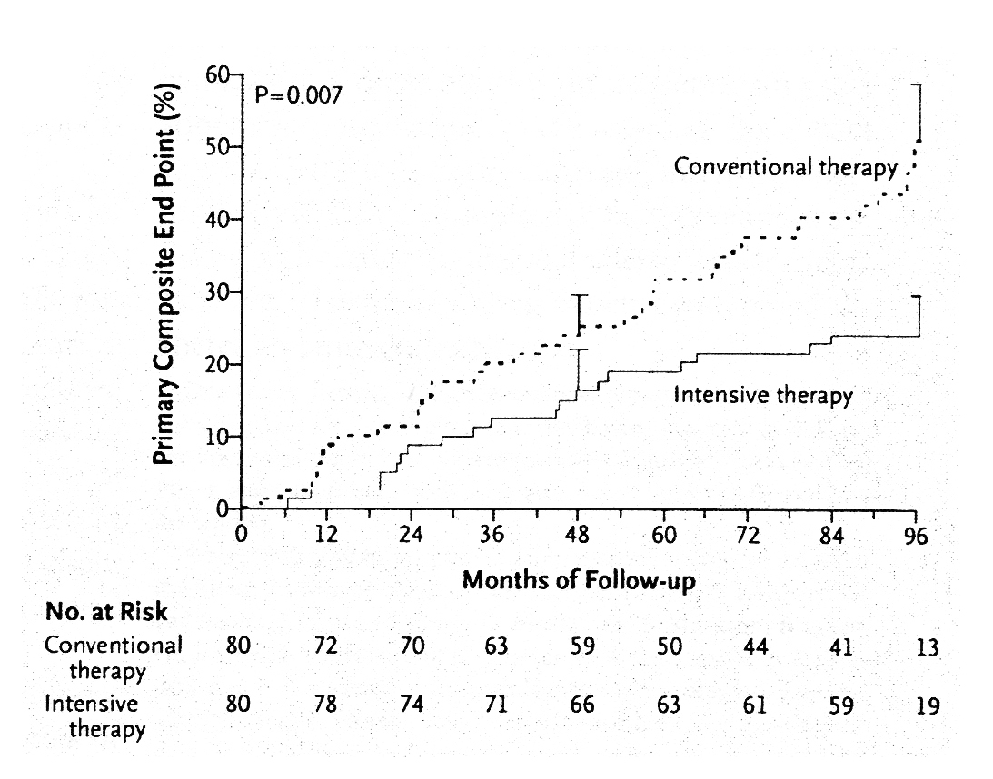
Targeted metabolic syndrome therapy reduces diabetic complications in Steno 2
Gaede, P, et al. NEJM 2003;348:383-393.
Notes:
Carrying this a step further, the Steno 2 trial demonstrated that- treatment of each component of metabolic syndrome improves outcomes of macrovascular complications in type2 diabetics. Although the Steno trial’s primary endpoints were macrovascular complications, the study did also showed secondary endpoints of microvascular complications that demonstrated a significant improvement with intervention.

Slide 16
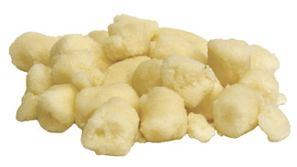
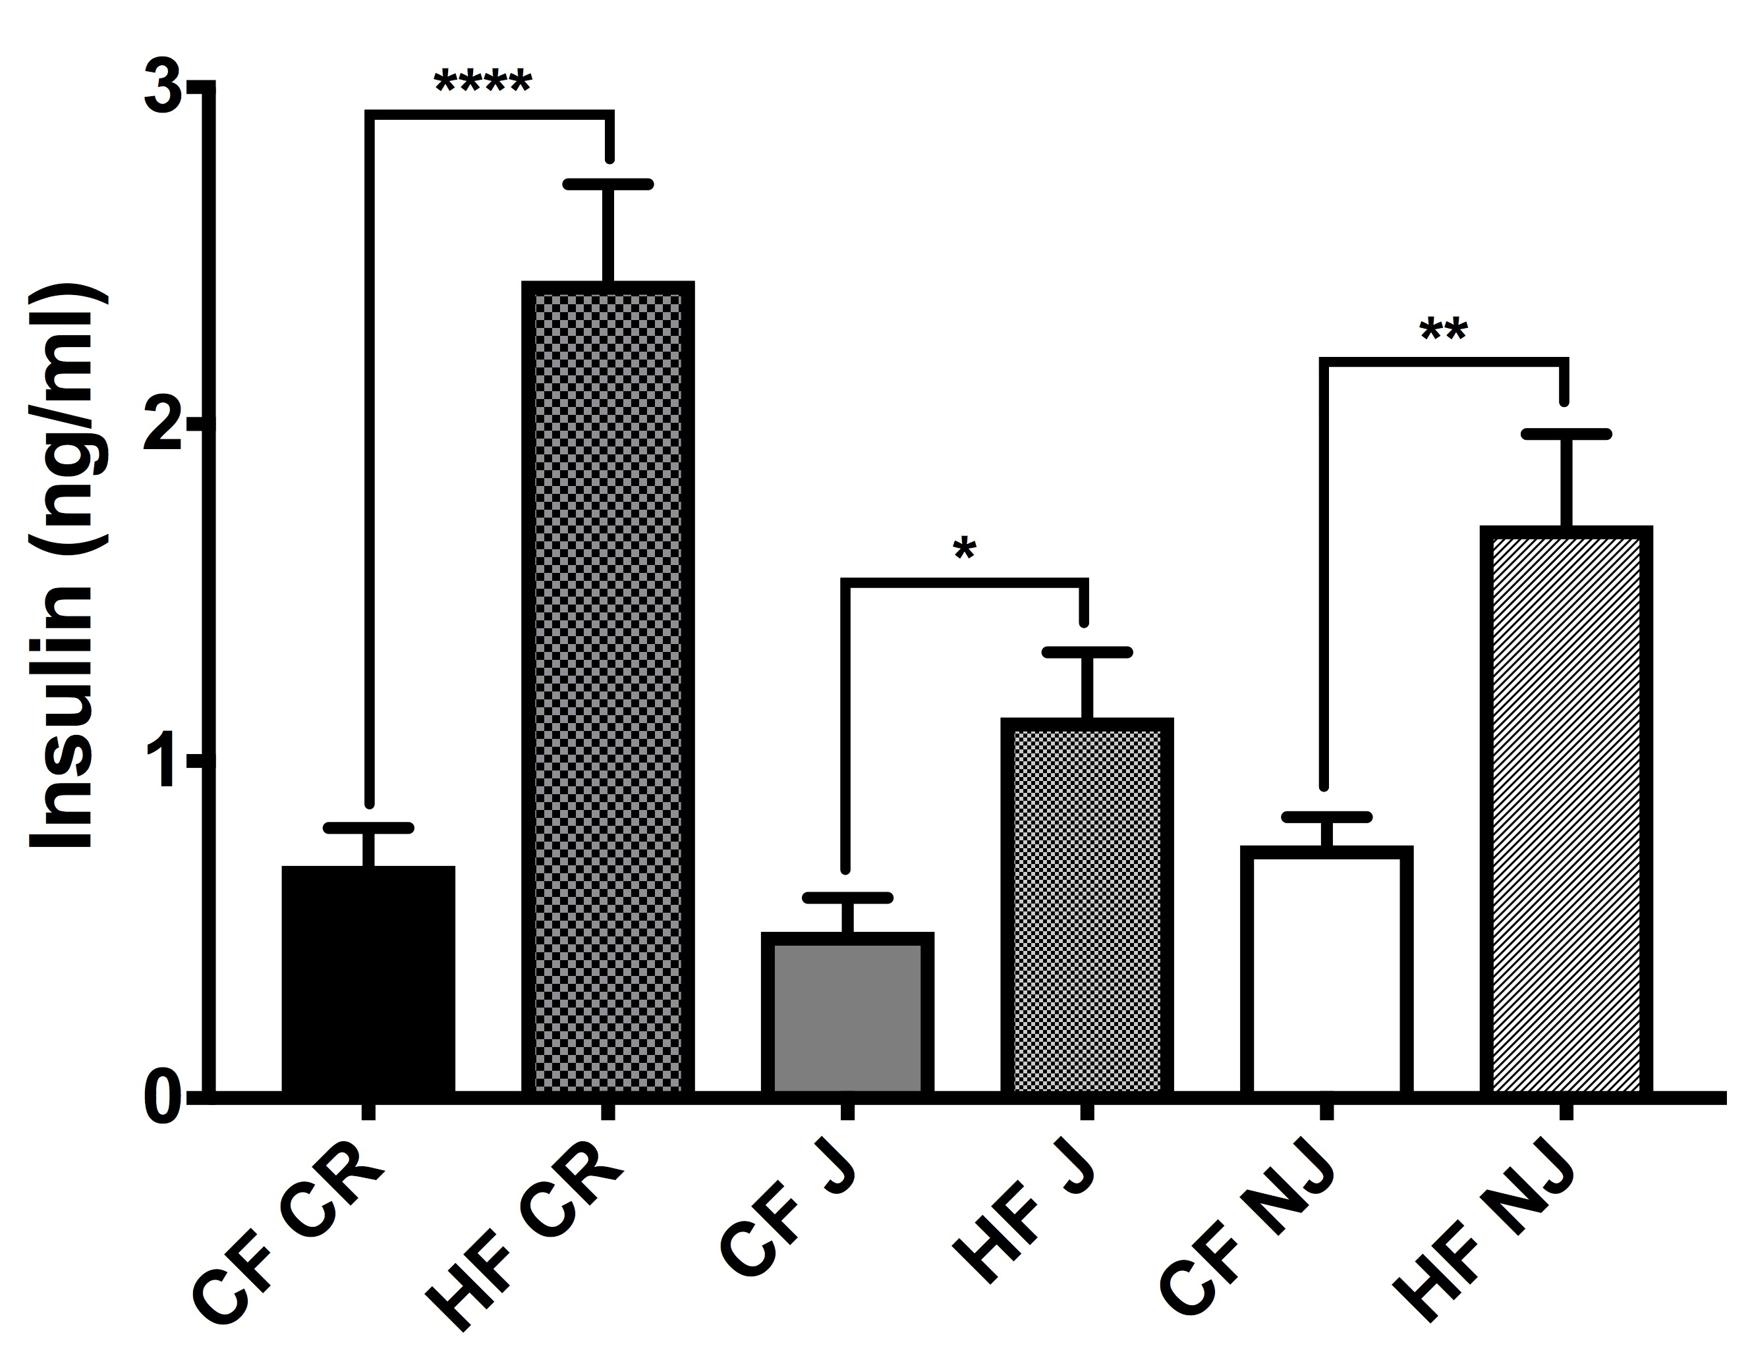
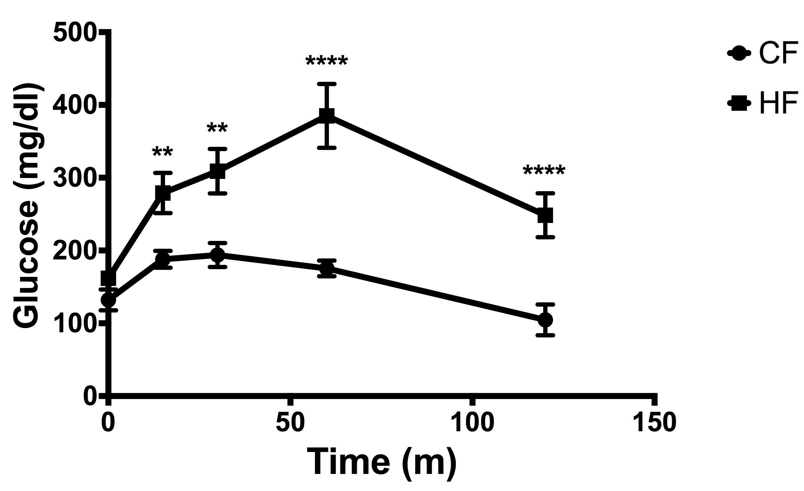
Rodent Models of Prediabetes
Metabolic Abnormalities
  Increased body weight
  Mild hyperglycemia
  Increased serum insulin
  Impaired glucose tolerance
  Insulin resistance
  Increased cholesterol
Approaches:
  Western diets (45% fat, high sucrose)
  High Fat diets (50—60% fat; lard)
  Standard American Diet (flour, sucrose)

Slide 17
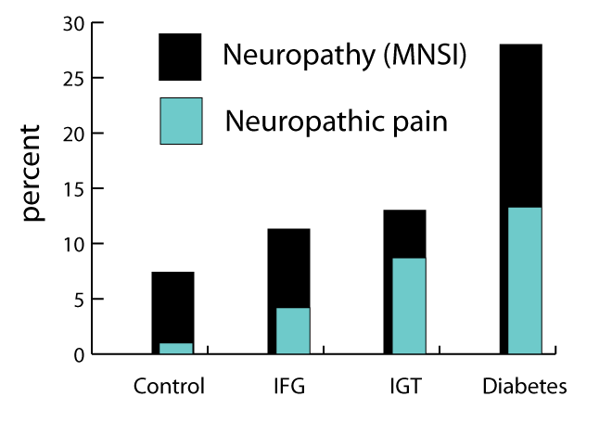
Neuropathy and neuropathic pain are more common in prediabetic patients than controls
Adapted from Ziegler et al. Diabetes Care, 2008
Ziegler et al. Pain Med, 2009
Notes:
Dan Ziegler performed a case/control study of 195 diabetic patients and 198 controls in various states along the glycemic continuum
Augsburg region of Germany- the MONICA/KORA Augsburg surveys S2 and S3
Slight increase in neuropathy MNSI >2
Similar results in a larger Chinese study

Slide 18
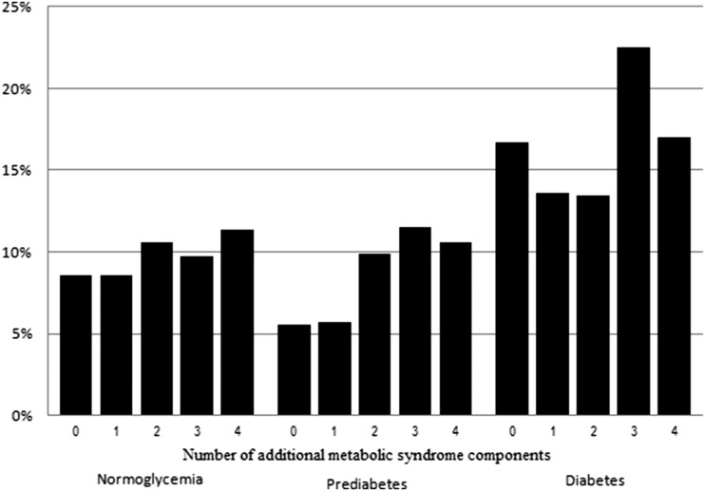
Neuropathy is associated with metabolic syndrome features
2382 Health ABC study participants
“Neuropathy” if + to 1 of 2 questions and had abnormality of 10g monofilament
1.1% increase in neuropathy for each MS component
Waist circumference and HDL associated with DSP secondary measures
Callaghan et al Diabetes Care, 2016
Notes:
No increase in prevalence in neuropathy in prediabetes compared to normoglycemia
No small fiber measure of neuropathy on exam, NCS
Suggests that if you have diabetes, additional metabolic features add risk for neuropathy

Slide 19
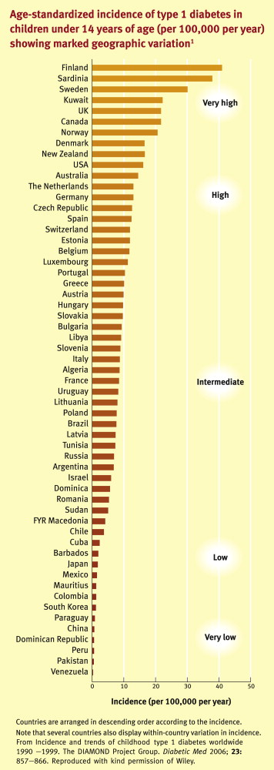
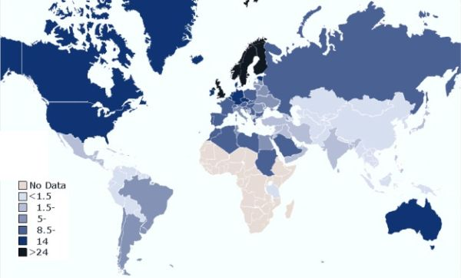
Type 1 diabetes
T1D USA prevalence ~410/100,000
USA incidence 16/100,000/year
Total US burden 1.2 million
SFNeuropathy in 30%
T1D SFN in 360,000

Slide 20
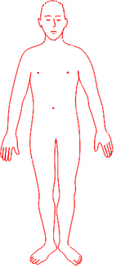
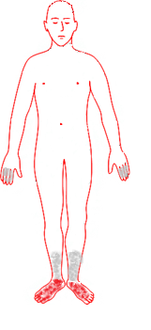
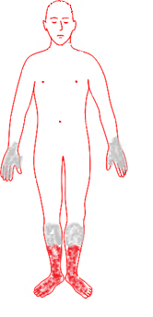
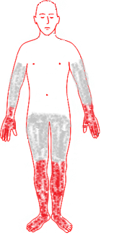
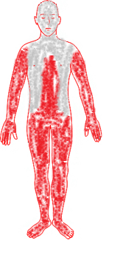
Treatment induced neuropathy of diabetes
76 individuals with type 1 diabetes
  Age 25.0±6.7 years (60 female)
  Medications: Insulin (100%)
29 individuals with type 2 diabetes
  Age 50.9±6.8 years, (12 female)
  Medications: Insulin (41%), oral hypoglycemic (90%)
DISTRIBUTION OF NEUROPATHIC PAIN
SEVERITY OF NEUROPATHIC PAIN
Gibbons, Freeman et al Brain, 2015

Slide 21
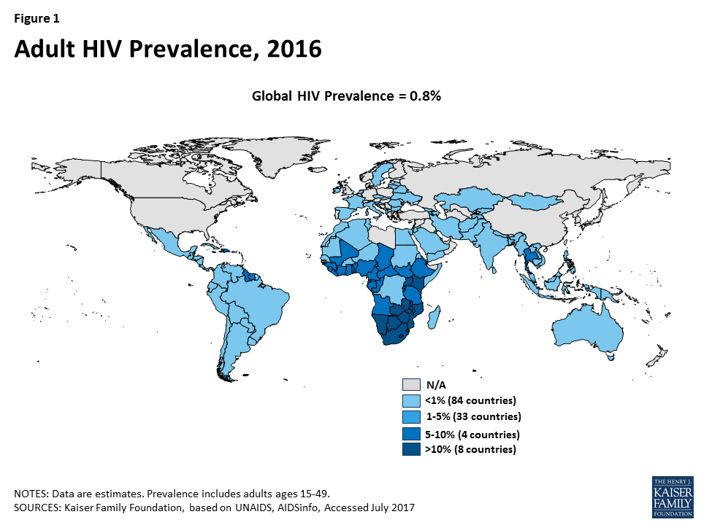
HIV neuropathy
Prevalence of neuropathy in HIV+ patients 9-63% depending on series
Risk Factors- older age, HIV severity, duration, other neuropathy, retroviral agents
Notes:
Very different worldwide distribution of disease prevalence than type 1 diabetes

Slide 22
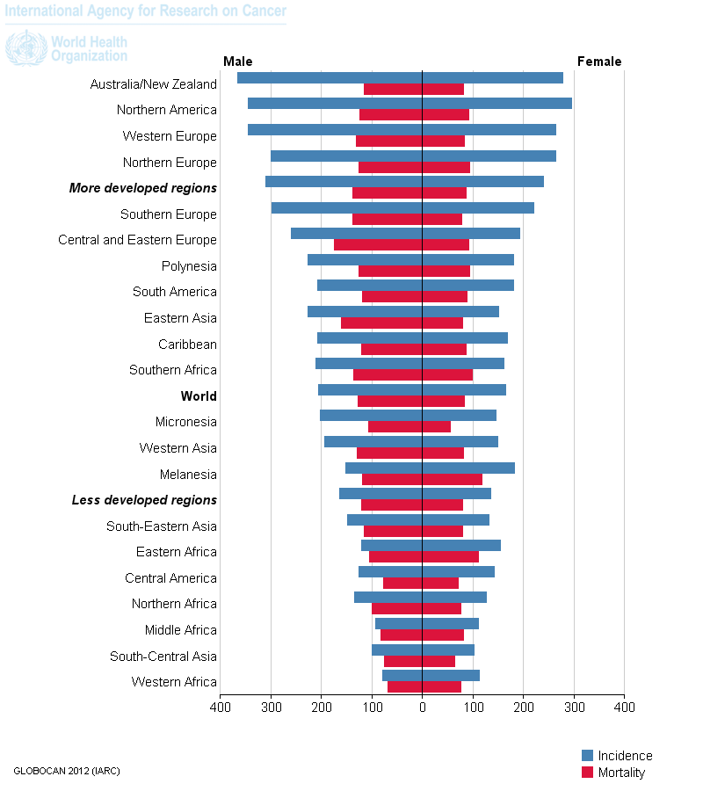
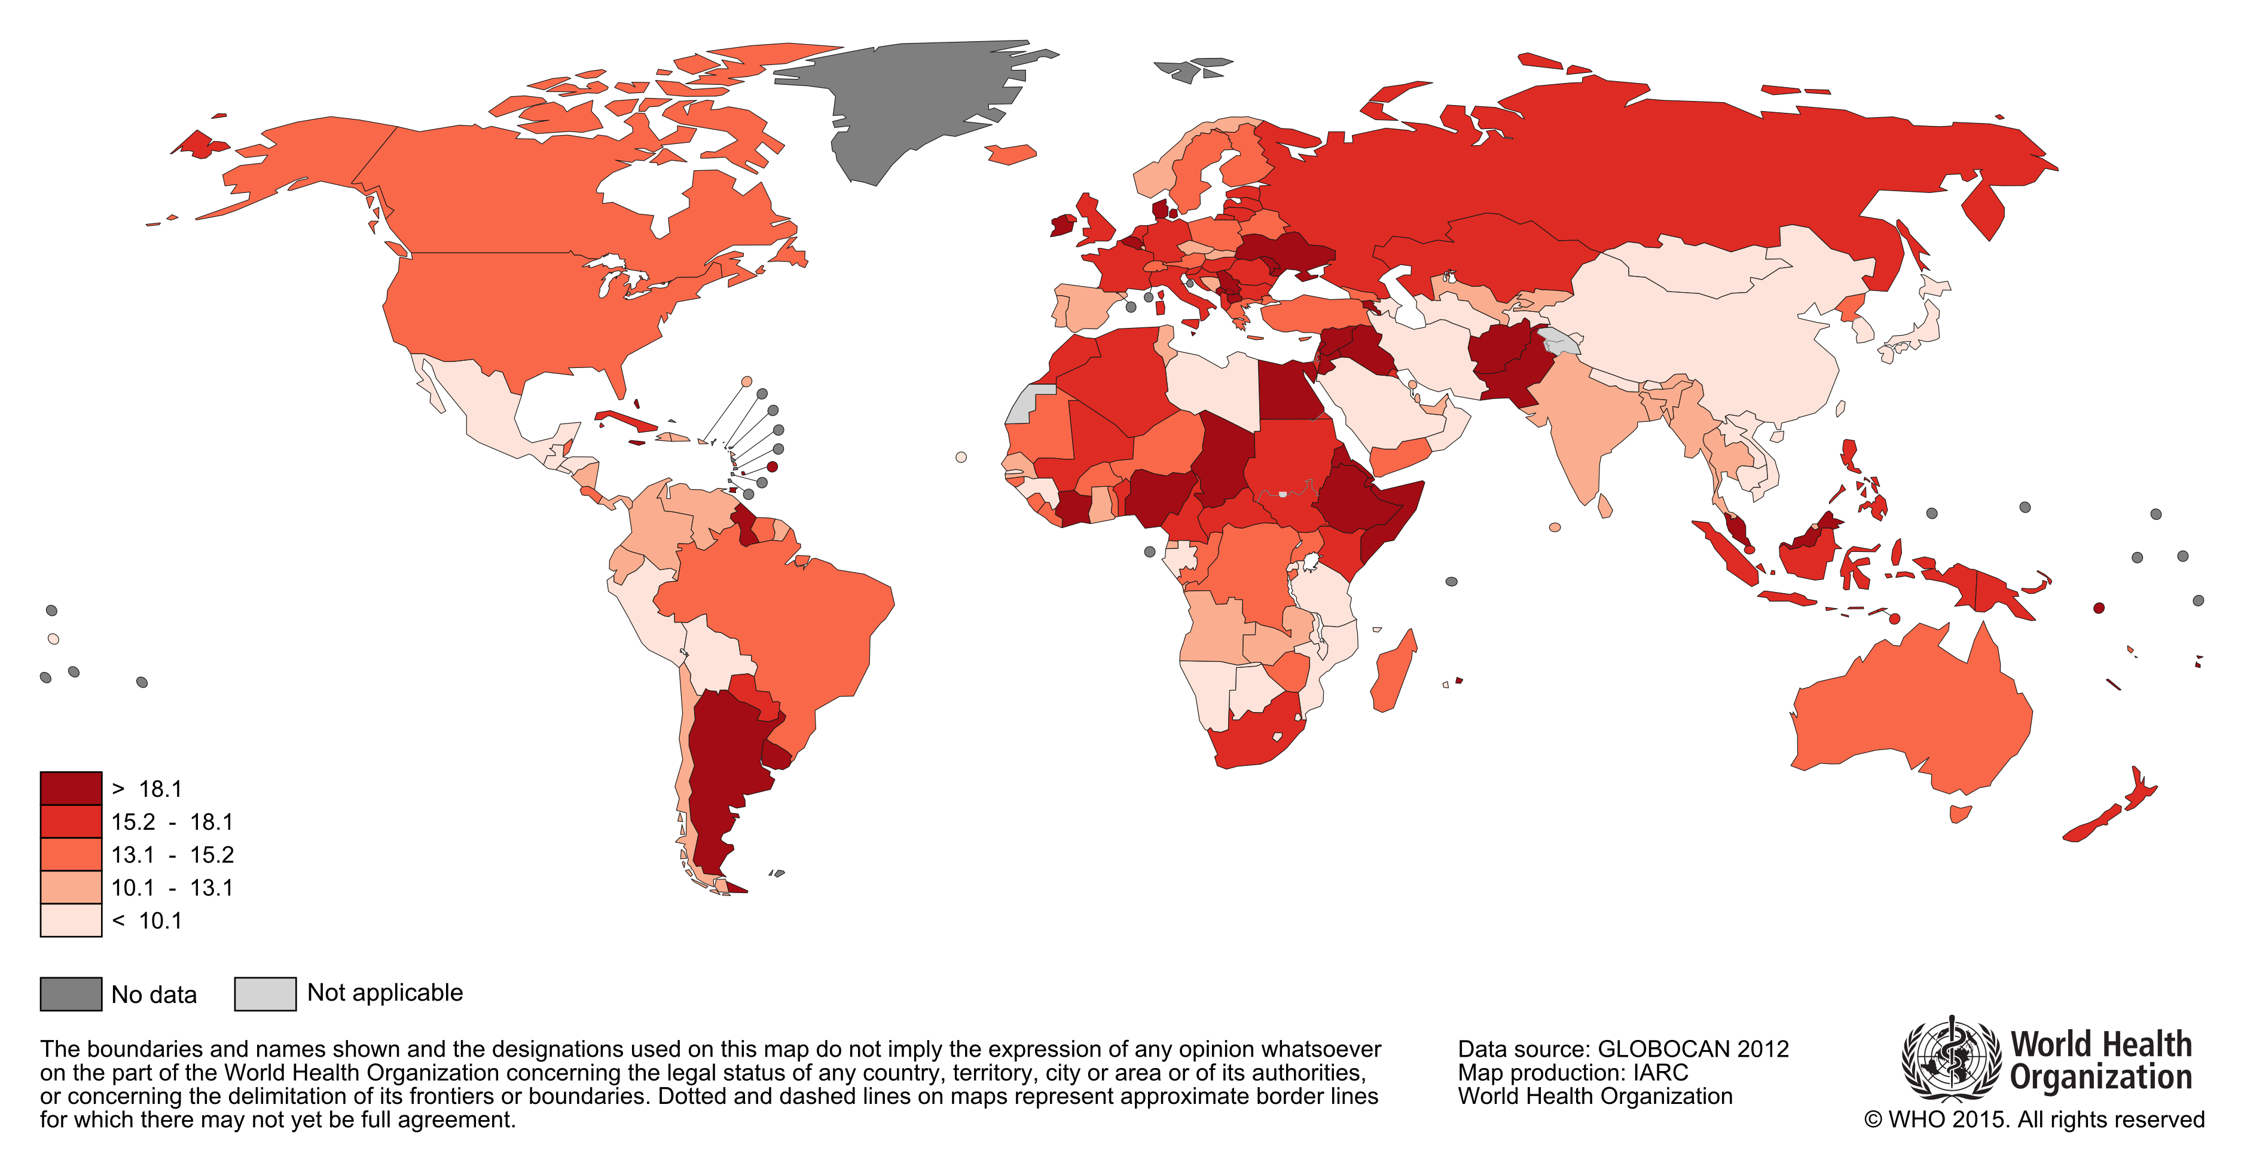
Chemotherapy induced polyneuropathy
Incidence cancer 485/100,000, deaths 171/100,000, prevalence ~ 4900/100,000
20% receive chemotherapy, primarily in breast, colon, pelvic
40-50% of chemotherapy patients develop small fiber neuropathy
SFN burden ~1.2 million

Slide 23
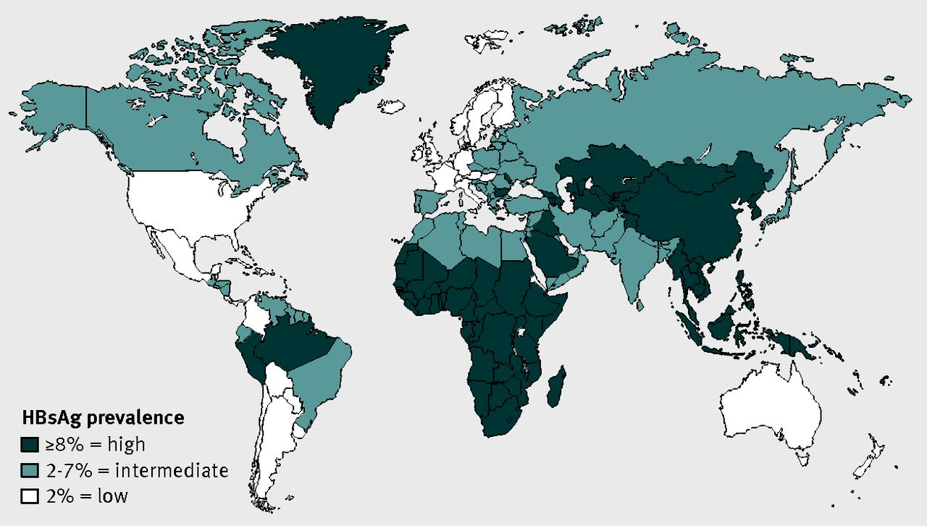
Hepatitis neuropathy
Prevalence of hepatitis B 300/100,000 in US
SFN in ~25%
Burden of illness 229,000
Kim WR. Hepatology, 2009

Slide 24
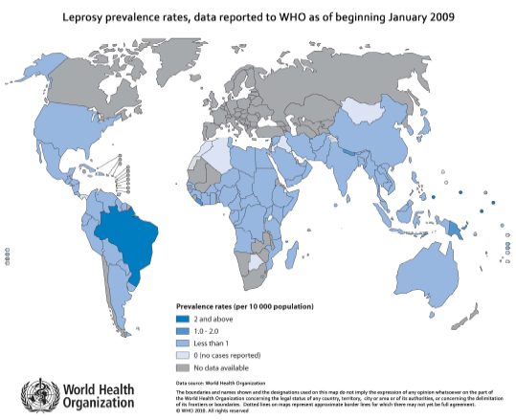
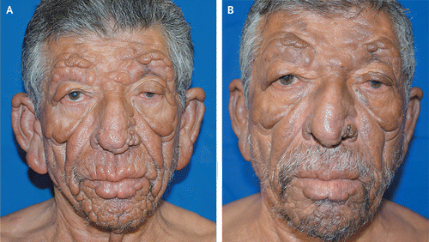
Leprosy
200,000 new cases yearly worldwide
Prevalence 10-20/100,000
  70 % in India, Indonesia, Myanmar
  US cases rare
    75-85% of these brought by immigrants
    International travel
    Rarely- nine-banded armadillo exposure
https://openi.nlm.nih.gov/detailedresult.php?img=PMC3284349_tropmed-86-382-g002&req=4

Slide 25
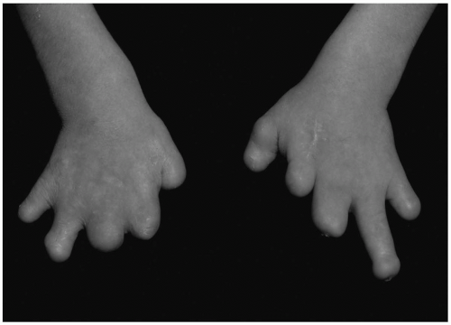
Hereditary sensory and autonomic neuropathies (HSANs)
  HSAN Type I
    Distal symmetric small > large fiber neuropathies
    Prominent acromutilation - Charcot joints, painless ulcers
  HSAN Type III (Riley-Day)
    Infantile onset
    Small fiber neuropathy - pain insensitivity and abnormal warm/cold sensation
    Autonomic crises - HTN, tachycardia, hyperhidrosis, irritability
    Other
      No lacrimation
      Absent lingual fungiform papillae
      Absent skin flare with intradermal histamine
  HSAN Type IV
    Congenital insensitivity to pain
    Anhidrosis
    Skin wheal in response to histamine
Self mutilation in a 12-year-old boy with hereditary sensory and autonomic neuropathy (HSAN) II attributed to loss of pain sensation, neglect of injury, excessive surgery,. (From Weingarten TN, Sprung J, Ackerman JD, et al. Anesthesia and patients with congenital hyposensitivity to pain. Anesthesiology. 2006;105:338-345.
https://aneskey.com/do-patients-with-congenital-insensitivity-to-pain-need-anesthetics-and-postoperative-opioids/
Notes:
Prognosis
HSAN Type I = most types slowly progressive
HSAN Type III = 50% die before 30-40yo
HSAN Type IV = 20% die early from hyperpyrexia
Other causes of death = sepsis from poor wound healing

Slide 26
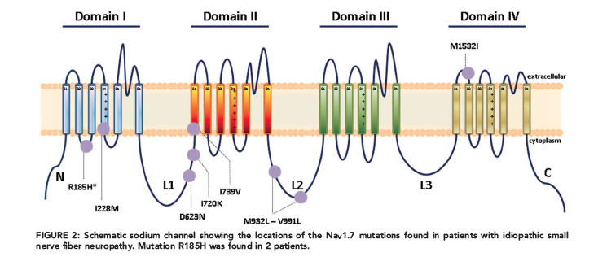
Na channelopathy neuropathies
SCN9a codes Nav 1.7
Gain-of-function mutations- rare inherited erythromelalgia and paroxysmal extreme pain disorder
Loss-of-function mutation- rare AR insensitivity to pain
2012- 8/28 patients with confirmed idiopathic pure small fiber neuropathy found to have SCN9a GOF mutations for Nav1.7
Faber C. et al. Annals Neurology, 2012

Slide 27
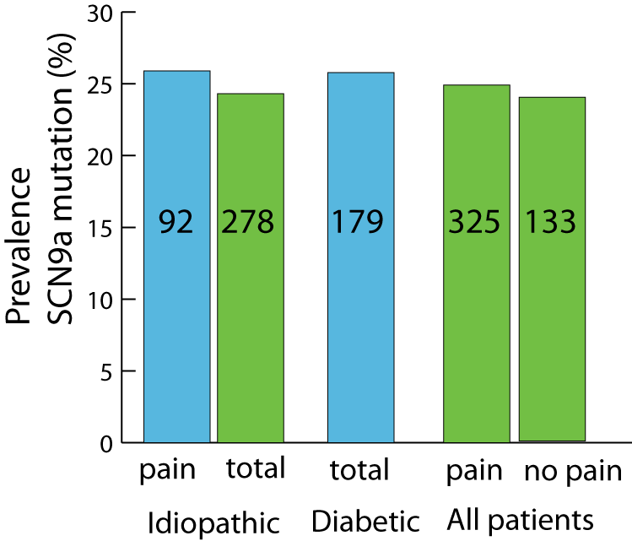
Na channelopathy neuropathies
2014- evaluation of 345 patients with possible SFN found SCN11a GOF mutations (for NAv 9) in 12 patients
2017- evaluation of 457 patients with neuropathy from the Peripheral Neuropathy Research Registry consortium:
No SCN9, 10, 11 missense allele frequencies or GOF mutation were not more common in painful than nonpainful neuropathy.
Nav1.7
Huang, Waxman. et al. Brain, 2014
Wadhawan, Bristow. et al. Neurol Genet, 2017

Slide 28
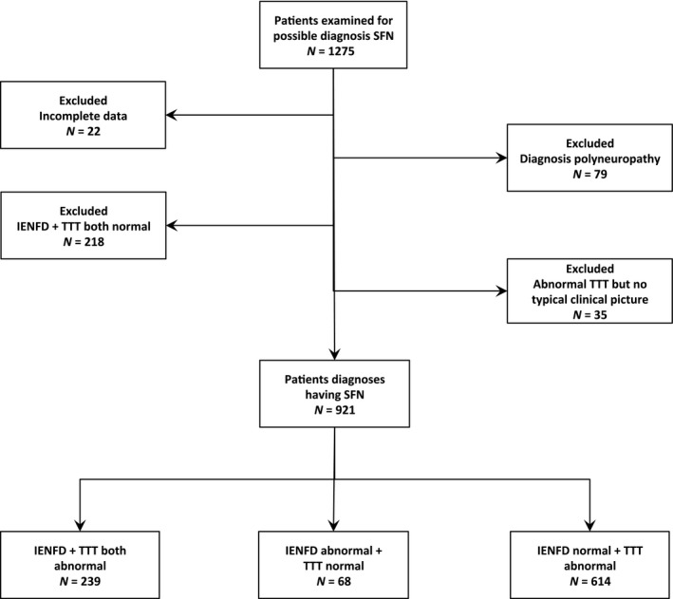
Pure small fiber neuropathy evaluation
Xray,
GTT, lipids, LFTs, BMT, TSH
B1, B6, B12
ENA, ANA, soluble IL2, SPEP
B burgdorf Ig HIV
Alpha galactosidase A SCN9A, SCN10A, SCN11A
NOT- HSAN genes, hepatitis serology
deGreef, Faber, Merkies et al, Eur J Neurol 2018
Notes:
Evaluations of small fiber neuropathy may be contaminated by referral bias. This group published a distribution of SFN in 88
Patients from 2005-2009 and found more nearly half had

Slide 29
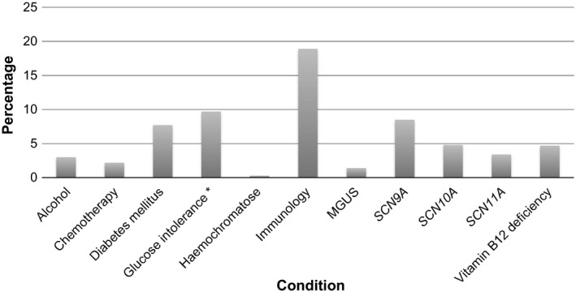
Pure small fiber neuropathy evaluation
Associated conditions in 921 patients with SFN defined by abnormal IENFD or temperature threshold testing
53% remained idiopathic after standardized workup
deGreef Faber Merkies et al, Eur J Neurol 2018
Notes:
Evaluations of small fiber neuropathy may be contaminated by referral bias. Merkies group published a distribution of SFN in 88
Patients from 2005-2009 and found sarcoidosis as the most common cause of SFN, ahead of diabetes

Slide 30
SFN differential diagnosis
Disease associated with neuropathy | Reported prevalence per 100,000 USA | SFN frequency % | Neuropathy burden in USA
Type 2 diabetes | 14,000 | 25 | 7,900,000
Metabolic syndrome | 21,000 | 8 | 5,124,000
Type 1 diabetes | 410 | 30 | 1,200,000
CIPN | 4900 | 8 | 1,200,000
HIV | 800 | 20 | 488,000
Sjogrens | 1200 | 11 | 402,600
HepatitisB, C | 300 | 25 | 229,000
Gammopathy | 3200 | 16 | 61,400
Fabry disease | 21 | 50 | 32,000
Leprosy | 10 | 90 | 27,000
Sarcoidosis | 20 | 15 | 9,150

Slide 31
Take Home Points, Challenges
Prevalence of SFN depends on definition of neuropathy and of SFN
Metabolic causes (greatly) outnumber other etiologies in disease burden
True prevalence of idiopathic SFN neuropathy remains poorly defined
Need population-based epidemiology of idiopathic neuropathy unbiased by referral patterns
Need prospective studies in common neuropathies to distinguish relative prognosis of painful vs. nonpainful, or SFN vs mixed fiber neuropathy using standardized measures
Need additional studies of burden of neuropathy produced by Na channelopathies and other as-yet unrecognized genetic predispositions

Slide 32
Disclosure Statement
No relevant financial disclosures.

Slide 33
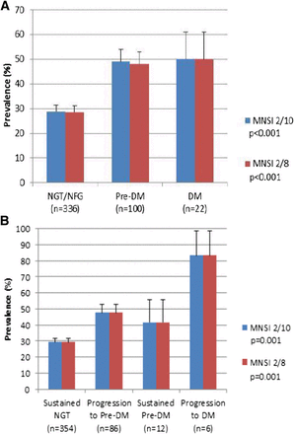
Neuropathy is associated with prediabetes
497 members of the Prospective Pancreatic Metabolism and Islet Cell Evaluation (PROMISE) cohort who had 3 year follow-up.
Neuropathy symptoms based on MNSI of 2 (or 3) of 10 questions.
Neuroesthesiometer use to measure vibration sensation threshold.
Lee, Perkins et al Diabetes Care, 2015
Notes:
No increase in prevalence in neuropathy in prediabetes compared to normoglycemia
No small fiber measure of neuropathy on exam, NCS
Suggests that if you have diabetes, additional metabolic features add risk for neuropathy

Slide 34
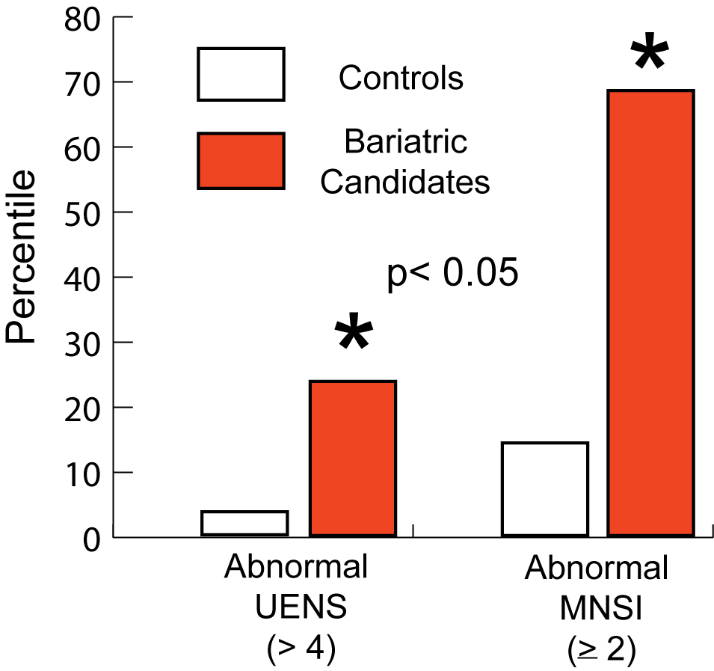
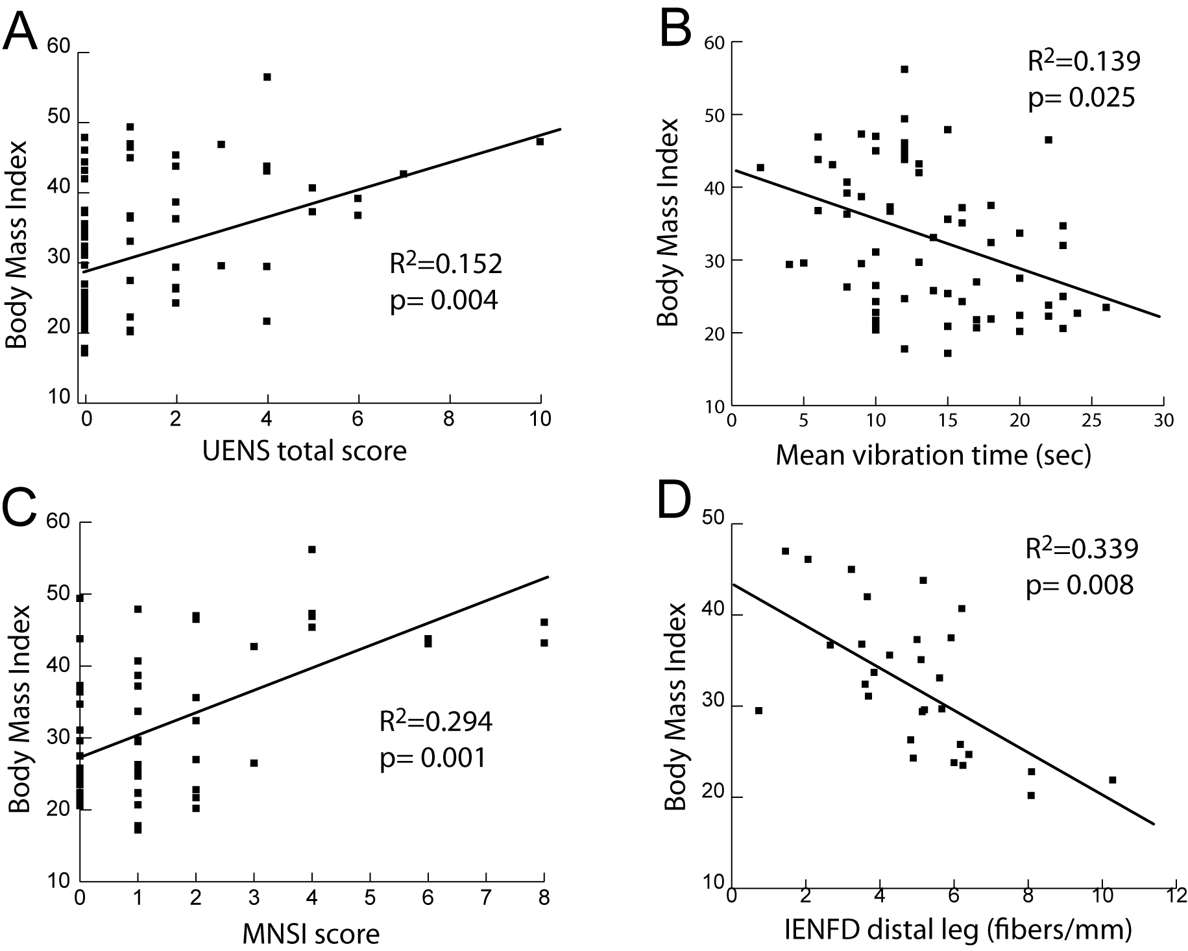
Bariatric candidates are more likely to meet symptomatic and exam thresholds of neuropathy
Body mass index correlates with features of distal peripheral axonal injury

