Slide 1
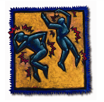
Diagnostic criteria for idiopathic SFN: Where we are now?
A systematic literature review
Simon Haroutounian, PhD
Chief of Clinical Research, Washington University Pain Center
Department of Anesthesiology, Washington University School of Medicine, St. Louis, MO
sharout@wustl.edu

Slide 2
Small fiber neuropathy (SFN)
SFN is a subgroup of peripheral neuropathies mainly characterized by A-δ and C-fiber abnormalities
Patients with SFN usually present with distal symmetric (acral) sensory symptoms, often accompanied by pain
Among the commonly reported etiologies of SFN are
Diabetes Mellitus (DM) and other metabolic disorders
HIV infection
Sjӧgren’s syndrome
Hypothyroidism
Alcoholic neuropathy
The etiology of SFN still remains unclear in about 50% of the cases, and they are currently termed
idiopathic SFN (iSFN).
The diagnostic criteria for and clinical characterization of idiopathic SFN are currently not well-developed.
Devigili et al., 2008; Üçeyler et al., 2010, Lauria et al., 2012

Slide 3
Objective
Our objective was to:
Systematically review and summarize the published literature on the assessment of and diagnostic criteria for idiopathic small fiber neuropathy
2. Provide evidence to support an expert consensus on revised clinical characterization and diagnostic criteria for painful iSFN.

Slide 4
Approach
A systematic literature search was performed (July 10, 2017)
Keywords:
Small fiber neuropathy, SFN, Distal symmetric polyneuropathy, DSP, painful polyneuropathy, idiopathic neuropathy, cryptogenic neuropathy.
MeSH terms:
Small Fiber Neuropathy
Polyneuropathies
Diabetic Neuropathies
Alcoholic neuropathy
Hereditary Sensory and Autonomic Neuropathies
Neuropathy, painful
Without limiting to types of studies: 43,860 papers

Slide 5
Approach
After limiting to: Human studies, Reviews/meta-analyses, and English language studies
("pain"[MeSH Terms] OR "pain"[All Fields]) AND (("Small Fiber Neuropathy"[Mesh] OR ("Polyneuropathies"[Mesh] OR "Alcoholic Neuropathy"[Mesh] OR "Diabetic Neuropathies"[Mesh])) OR "Hereditary Sensory and Autonomic Neuropathies"[Mesh]) OR "Neuropathy, Painful"[Supplementary Concept] AND ((Case Reports[ptyp] OR Clinical Study[ptyp] OR Clinical Trial[ptyp] OR Clinical Trial, Phase I[ptyp] OR Clinical Trial, Phase III[ptyp] OR Clinical Trial, Phase II[ptyp] OR Clinical Trial, Phase IV[ptyp] OR Comparative Study[ptyp] OR Controlled Clinical Trial[ptyp] OR Meta-Analysis[ptyp] OR Multicenter Study[ptyp] OR Observational Study[ptyp] OR Practice Guideline[ptyp] OR Pragmatic Clinical Trial[ptyp] OR Randomized Controlled Trial[ptyp] OR Review[ptyp] OR systematic[sb] OR Validation Studies[ptyp]) AND "humans"[MeSH Terms] AND English[lang]) OR ("small fiber neuropathy"[MeSH Terms] OR ("small"[All Fields] AND "fiber"[All Fields] AND "neuropathy"[All Fields]) OR "small fiber neuropathy"[All Fields]) OR SFN[All Fields] OR (Distal[All Fields] AND symmetric[All Fields] AND ("polyneuropathies"[MeSH Terms] OR "polyneuropathies"[All Fields] OR "polyneuropathy"[All Fields])) OR ("Int Conf Digit Signal Process Proc"[Journal] OR "dsp"[All Fields]) OR (("pain"[MeSH Terms] OR "pain"[All Fields] OR "painful"[All Fields]) AND ("polyneuropathies"[MeSH Terms] OR "polyneuropathies"[All Fields] OR "polyneuropathy"[All Fields])) OR (idiopathic[All Fields] AND neuropathy[All Fields]) OR (cryptogenic[All Fields] AND neuropathy[All Fields]) AND ("humans"[MeSH Terms] AND English[lang])
6,460 results

Slide 6
Criteria for screening/inclusion
Obtain full text, if | Clinical study (epidemiological, observational or interventional) OR Review/guidelines AND Patient population includes small fiber neuropathy (or distal polyneuropathy) that is Termed “idiopathic” or Is of unclear/mixed etiology.
Exclude, if | Animal study In-vitro / ex-vivo study Clinical studies dealing with polyneuropathy of well-defined etiology – i.e. DPN, HIV-SN, CIPN, and other axonal or demyelinating neuropathies.

Slide 7
Approach
Each abstract was independently screened by two investigators
Mathias Leinders (Washington University)
Marta Campagnolo (Harvard)
Color coded as follows:
MAYBE INCLUDE
EXCLUDE
(other well-defined etiology)
EXCLUDE (Irrelevant)
INCLUDE

Slide 8
Records identified through literature search (n=6460)
Abstracts independently screened by 2 investigators for inclusion criteria, and color-coded
Excluded (n=5867)
Additional papers identified from references (n=11)
Full text obtained and color-coded for inclusion in
data extraction database (n=594)
Disagreements solved by discussion
REDCap database exclusion criteria:
- Non-human study
- Clear other etiology (e.g. DPN)
- N < 10 subjects (e.g. case-reports)
Excluded (n=482)
Data extracted and included in analysis
iSFN / mSFN
(n= 123)
Record overview:
iSFN (n=11) mSFN (n=74) Reviews/Guidelines (n=38)
SFN= small fiber neuropathy
iSFN= pure idiopathic SFN
mSFN= mixed cases of SFN

Slide 9
Records extracted to REDCap;
REDCap extraction details:
1. Characteristics of included record:
Subject demographics, single/multicenter, study arms
2. SFN details/ Study Methodology:
Type/cause SFN, NCS?, SFN defined? SFN Criteria? Pain cut-off?
3. Results:
Symptoms, descriptors, questionnaires
Morphology (biopsy site, details), sensory assessment (site, details), functional assessments (QSART, etc)
- Comorbidities, QoL?
Potential risk of bias/ comments
Other patient-centered outcomes
Final Records included for analysis
(n=123)
iSFN: (n=11)
mSFN: (n=74)
Mixed cased: (n=60)
Fabry: (n=4)
Hereditary: (n=2)
Sarcoidosis: (n=2)
Sepsis: (n=1)
Amyloidosis: (n=1)
Other: (n=4)
Data Mapping
Direction of change
Expected
No. difference
Opposite
Unclear/mixed
Abnormal vs. HC
Abnormal vs. other
Reviews: (n=38)
SFN diagn. criteria: (n=15)
SFN guidelines: (n=3)
SFN methods: (n=8)
SFN epidem: (n=2)
SFN other etiol: (n=4)
PSN diagnosis: (n=3)
DSP guidelines: (n=3)

Slide 10
Guidelines and Reviews
Guidelines and Reviews - criteria for SFN (n=38)
 | Sensory symptoms in LE (length-dependent) (burning pain, paresthesia, numbness) | Abnormal pinprick in length dependent fashion in LE | Abnormal quantitative sudomotor axon reflex (QSART) | Abnormal thermal perception and/or pain thresholds | Abnormal autonomic symptoms | Abnormal skin biopsy (reduced IENFD) | Normal NCS | Ewing battery | Laboratory tests (Differential diagnosis)
Count | 33 | 16 | 9 | 25 | 15 | 32 | 27 | 5 | 9
Percentage of total | 87% | 42% | 24% | 66% | 39% | 84% | 71% | 13% | 24%
The Ewing battery: 1) HR response to the Valsalva manoeuvre; 2) HR response to standing up;
3) HR response to deep breathing; 4) BP response to standing up; 5) BP response to sustained handgrip.
Not included in this summary:
Other biopsy findings 7/38 (e.g. swellings); CCM 4/38; CHEPs 1/38; LEPs 3/38, microneurography 4/38…

Slide 11
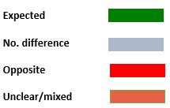
Included studies – iSFN, n=11
Idiopathic
 | Skin biopsy |  |  | Cornea | Quantitative sensory testing |  |  |  |  |  |  |  |  |  |  |  |  |  | Nerve conduction studies |  |  | Add-on tests |  |  |  |  |  |  | Cardio vascular testing
 | Distal | Proxi-mal | other | CCM | CDT | WDT | TSL | PHS | CPT | HPT | MDT | MPS | DMA | WUR | VDT | PPT | Pin-prick | TTT | Mo-tor | Sensory | other | LDI flare to heat | SSR | Skin wrinkling | Q-SART | CHEPs | LEPs | Histamine skin flare | HR with deep breathing | Valsalva | Orth. Hypo | other
Dabby, R 2007
Ebadi, H 2012
Faber, CG 2012
Gibbons, CH 2006
Shukla, G 2005
Teoh, HL 2008
Tobin, K 1999
Ueceyler, N 2010
Walk, D 2007
Ebadi, 2015
Holland, 1997
TTT=temperature threshold testing
SSR= sympathetic skin response

Slide 12
Included studies – iSFN, n=11
Skin Biopsy
Nerve Conduction

Slide 13
Included studies – iSFN, n=11
Quantitative sensory testing

Slide 14
Included studies – iSFN, n=11
Add-on tests
Not included in this summary:
Other biopsy findings 2/11 (e.g. swellings); CCM 0/11; TTT 1/11

Slide 15
Included studies – mSFN, n=74
Mixed | Skin biopsy |  |  | Cornea | Quantitative sensory testing |  |  |  |  |  |  |  |  |  |  |  |  |  | Nerve conduction studies |  |  |  | Add-on tests |  |  |  |  |  | Cardio vascular testing
 | Distal | Proximal | other | CCM | CDT | WDT | TSL | PHS | CPT | HPT | MDT | MPS | DMA | WUR | VDT | PPT | pinprick | TTT | Motor | Sensory | other | LDI flare | SSR | Skin wrink. | QSART | CHEPs | LEPs | Histamine skin flare | HR with db | Valsalva | orth. Hypo | other | DTR
Atherthon 2007
Axer, 2016
Bakkers, 2014
Bakkers, 2009
Bakkers, 2015
Bednarik, 2009
Bickel, 2002
Boruchow, 2013
Bucher, 2015
Casanova-Molla, 2012 (JPNS)
Casanova-Molla, 2011 (JNM) | .
Casanova-Molla, 2012 (Pain)
Casanova-Molla, 2011 (Pain)
deGreef, 2016
Devigili, 2008
Doppler, 2012
Doppler, 2015
Dori, 2015
Gemignani, 2009
Gemignani, 2010 |  |  |  |  |  |  |  |  |  |  |  |  |  |  |  |  |  |  |  |  |  |  |  |  |  |  | `
Gorson, 2008
Herrmann, 2004
Hoitsma, 2011
Holland, 1997
Hsieh, 2015
Karlsson, 2013 JPNS
Karlsson, 2013
Khan, 2012
Khoshnoodi, 2016
Koskinen, 2005
Lagerburg, 2015
Lauria, 2011
Lauria, 2015
Lefaucheur, 2015
Liguori, 2011
Lopate, 2013
Low, 2006
Magda, 2002
Martinelli-Boneschi, 2017
Medici, 2013
Nebuchennykh, 2009
Nolano, 2015
Oaklander, 2013
Rousseau, 2016
Saperstein, 2013
Schuller, 2000
Sharma, 2007
Stewart, 1992
Tavakoli, 2012
Tavakoli, 2010
Thaisetthawatkul, 2013
Thaisetthawatkul, 2014
Uceyler, 2013
Uceyler, 2011
Uceyler, 2016
Uluc, 2008
Vas, 2014
Datema, 2012
Killian, 2011
Scherens, 2009
Periquet, 1999
McArthur, 1998
Orstavik, 2006
Zhou, 2011
Brenaut, 2015
Herrmann, 1999
Jamal, 1987
Lang, 2016
Sumner, 2003
Tanislav, 2011
Treister, 2015
Singer, 2004
deSousa, 2006
Samuelsson, 2014

Slide 16
Included studies – mSFN, n=74
Skin Biopsy
Nerve Conduction

Slide 17
Included studies – mSFN, n=74
Quantitative sensory testing

Slide 18
Included studies – mSFN, n=74
Add-on tests
SSR=sympathetic skin response

Slide 19
Therapeutic Clinical Trials in SFN
Author, year | Journal
de Graaf 2016 | Trials
Ho 2009 | Pain
Dworkin 2007 | J Pain (overview of studies)
Herrmann 2005 | Pain Med
Windebank 2004 | JPNS
Weintraub 2004 | Neurorehabil Neural Repair
Sumner 2003 | Neurology (IGT testing)
Dyck 2017 | Muscle&Nerve
Holbech 2015 | Pain
Raber 2014 | Acta Neurol Belg
Demant 2014 | Pain
Lohse-Busch 2014 | NeuroRehab
Liu 2014 | Acta Neurol Scand
Maihofner 2013 | Curr Med Res Opinion
Jann 2012 | Pain Med
Sindrup 2011 | EJP
Brasch-Andersen 2011 | Eur J Clin Pharm
Otto 2008 | Pain
Holbech 2011 | EJP
Otto 2007 | EJP (overview of studies)
Schattschneider 2006 | J Neurol (NE iontophoresis)
Otto 2004 | Neurology
Sindrup 2003 | Neurology
Sindrup 2001 | Pain
Devers 2000 | Clin J pain
Sindrup 1999 | Clin Pharmacol Ther.
Low 1995 | Pain
A separate search for clinical trials:
Idiopathic AND painful AND neuropathy (N=19)
Cryptogenic AND painful AND neuropathy (N=0)
Idiopathic sensory polyneuropathy (N=11)
Idiopathic sensory neuropathy (n=15)
Painful and Polyneuropathy (N=198)
After screening and removing duplicates: N=27

Slide 20
Therapeutic Clinical Trials in SFN
SFN criteria for inclusion into trial (n=27)
 | Relevant Symptoms | Pain severity cut-off (avg ≥4) | SFN confirmation by skin biopsy | SFN confirmed by QST | SFN confirmed by normal NCS | Exclusion of other predisposing factors | SFN characteri-zation by add-on tests
Count | 24 | 19 | 6 | 9 | 14 | 10 | 7
Percentage of total | 89% | 70% | 22% | 33% | 52% | 37% | 26%

Slide 21
Summary of findings (1/4)
This semi-quantitative presentation of findings suggest
Among therapeutic clinical trials in SFN (n=27), inclusion criteria were primarily based on:
Neuropathy symptoms in appropriate distribution (89% of studies)
Pain severity cut-off (70% studies)
SFN confirmed by normal NCS (52% of studies)
Exclusion of other predisposing factors (37% of studies)
Confirmation by QST (33% of studies)
Confirmation by skin biopsy / IENFD (22% of studies)

Slide 22
Summary of findings (1/4)
This semi-quantitative presentation of findings suggest
Among therapeutic clinical trials in SFN (n=27), inclusion criteria were primarily based on:
Neuropathy symptoms in appropriate distribution (89% of studies)
Pain severity cut-off (70% studies)
SFN confirmed by normal NCS (52% of studies)
Exclusion of other predisposing factors (37% of studies)
Confirmation by QST (33% of studies)
Confirmation by skin biopsy / IENFD (22% of studies)

Slide 23
Summary of findings (2/4)
Among guidelines and reviews (n=38), the diagnostic criteria for SFN are primarily based on:
Sensory symptoms in appropriate distribution (87%)
Abnormal skin biopsy findings / reduced IENFD (84%)
Normal NCS (71%)
Abnormal thermal perception (66%)
Abnormal pinprick - length-dependent (42%)
Abnormal QSART (24%)
Abnormal autonomic symptoms (39%)

Slide 24
Summary of findings (2/4)
Among guidelines and reviews (n=38), the diagnostic criteria for SFN are primarily based on:
Sensory symptoms in appropriate distribution (87%)
Abnormal skin biopsy findings / reduced IENFD (84%)
Normal NCS (71%)
Abnormal thermal perception (66%)
Abnormal pinprick - length-dependent (42%)
Abnormal QSART (24%)
Abnormal autonomic symptoms (39%)

Slide 25
Summary of findings (3/4)
Among “pure” iSFN studies (n=11), the findings are:
73% used distal skin biopsies – all with results as expected
27% used proximal skin biopsies - all with results as expected
18% used EMG – all with results as expected
36% used NCV – 3/4 with results as expected
73% tested CDT – 5/8 with results as expected
45% tested WDT – 4/5 with results as expected
36% tested HPT – only in 1/4 the results as expected
55% tested VDT – in 4/6 results as expected
18% tested pinprick sensation – all mixed/unclear results
The rest of QST tests only in a limited number of studies
Additional tests (flare/SSR) and autonomic testing – only in a limited amount of studies

Slide 26
Summary of findings (3/4)
Among “pure” iSFN studies (n=11), the findings are:
73% used distal skin biopsies – all with results as expected
27% used proximal skin biopsies - all with results as expected
18% used EMG – all with results as expected
36% used NCV – 3/4 with results as expected
73% tested CDT – 5/8 with results as expected
45% tested WDT – 4/5 with results as expected
36% tested HPT – only in 1/4 the results as expected
55% tested VDT – in 4/6 results as expected
18% tested pinprick sensation – all mixed/unclear results
The rest of QST tests only in a limited number of studies
Additional tests (flare/SSR) and autonomic testing – only in a limited amount of studies

Slide 27
Summary of findings (4/4)
Among “mixed” SFN studies (n=74), the findings are:
78% used distal skin biopsies – 46/58 with results as expected
38% used proximal skin biopsies – 20/27 with results as expected
7% used CCM – all 5 studies with results as expected
47% used EMG – 20/35 with results ax expected
74% used NCV – 35/55 with results as expected
47% tested CDT – in 16/34 the results were as expected
45% tested WDT – 17/33 results as expected
32% tested HPT – only in 8/24 the results as expected
19% tested CPT – no difference vs controls
49% tested VDT – in 16/36 results as expected
36% tested pinprick sensation – in 15/27 results as expected
The rest of QST tests only in a limited number of studies
Additional tests (flare/SSR) and autonomic testing – only in a limited amount of studies, but CHEPs, LEPs, Histamine flare – all results as expected

Slide 28
Summary of findings (4/4)
Among “mixed” SFN studies (n=74), the findings are:
78% used distal skin biopsies – 46/58 with results as expected
38% used proximal skin biopsies – 20/27 with results as expected
7% used CCM – all 5 studies with results as expected
47% used EMG – 20/35 with results as expected
74% used NCV – 35/55 with results as expected
47% tested CDT – in 16/34 the results were as expected
45% tested WDT – 17/33 results as expected
32% tested HPT – only in 8/24 the results as expected
19% tested CPT – no difference vs controls
49% tested VDT – in 16/36 results as expected
36% tested pinprick sensation – in 15/27 results as expected
The rest of QST tests only in a limited number of studies
Additional tests (flare/SSR) and autonomic testing – only in a limited amount of studies, but CHEPs, LEPs, Histamine flare – all results as expected

Slide 29
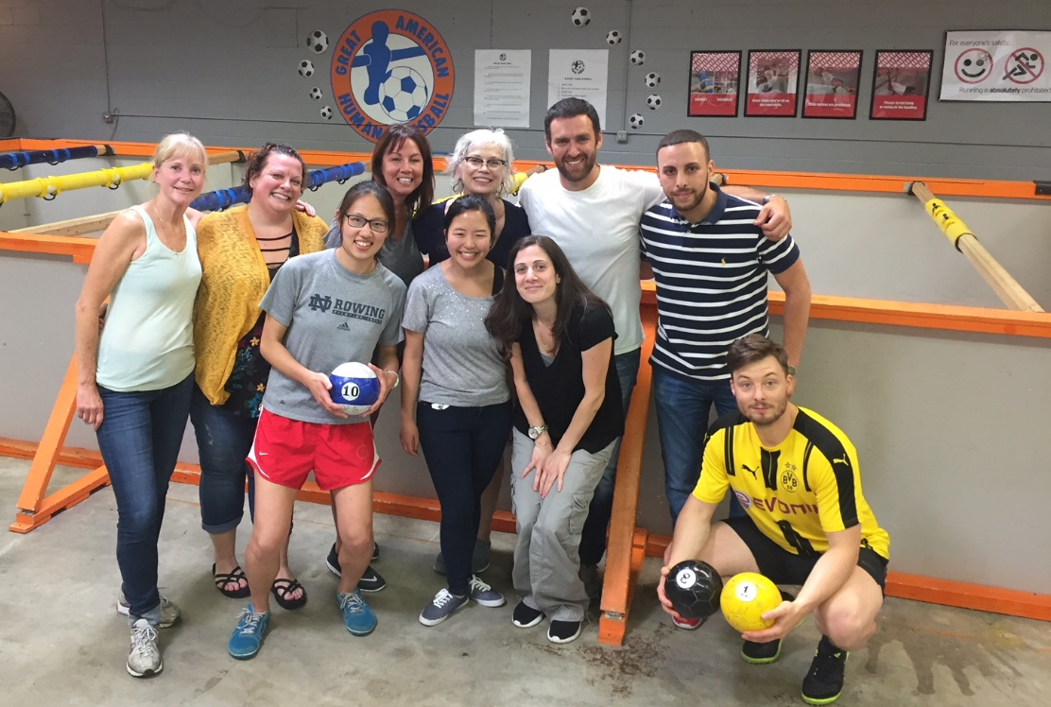
Acknowledgements
Mathias Leinders
Marta Campagnolo
Bob Dworkin
Roy Freeman

