Slide 1
Small Fiber Neuropathy
Diagnostic Instruments
Christopher Gibbons

Slide 2
Disclosures
I may have the most boring topic on the agenda, I will intentionally try to be a bit provocative…
I do not have a small fiber neuropathy instrument named after me
I am not developing a small fiber neuropathy instrument

Slide 3
Diagnostic Instruments
Review of existing patient and clinician oriented questionnaires
  Questionnaires specifically developed for use in neuropathic pain, but not specific for neuropathy (or SFN) may be mentioned but not discussed in detail
Review of examination criteria for diagnosis of small fiber neuropathy
Compare and contrast – with editorial comments…

Slide 4
Questionnaires
Questionnaire | Domain Sensory | Domain: Autonomic | Physician Developed Q’s | Patient Developed Q’s | Internal Consistency Testing | Test-Retest Reliability | Construct Validity
Survey of Aut Symptoms (Zillox) |  | Y | Y |  | Y | Y | Y
SFN-RODS© | ? | ? | Y | Y | Y | Y | Y
SFN-SIQ© | Y | Y | Y |  | Y | Y | Y
SFPN (Treister) | Y | Y | Y | Y | Y | Y | Y
NTSS-6 | Y |  | Y |  | Y | Y | Y
NPS | Y/? |  | Y |  | Y | Y | Y
mCOMPASS |  | Y | Y |  | Y | Y | Y

Slide 5
Questionnaires
Questionnaire | Controls | Disease | SFN Diagnosis | Exclusion
SAS- Survey of Aut Symptoms (Zillox) | 30 (18 F, 12 M) | 62 (38 F, 25 M) (neuropathy and IGT or newly diagnosed DM | Signs and symptoms of peripheral neuropathy, and (1) abnormal NCS, QST, QSART or IENFD | Other causes of neuropathy
SFN-RODS© |  | 238 (131 F, 107 M) | 2 symptoms of SFN, and either reduced IENFD or abnormal temperature threshold testing | No evidence of large fiber dysfunction or central nervous system disorders
SFN-SIQ© |  | 238 (131 F, 107 M) | 2 symptoms of SFN, and either reduced IENFD or abnormal temperature threshold testing | No evidence of large fiber dysfunction or central nervous system disorders
SFPN (Treister) | 17 | 162 | Either abnormal biopsy or autonomic function testing | Neuropathy from other cause
NTSS-6 |  | 205 | Impaired VDT, abnormal NCS, and had diabetes | Need for insulin initiation, neuropathy from other cause
NPS | 105 | 91 (Sarcoid) | SFN symptoms | No central nervous system involvement, no large fiber neuropathy
mCOMPASS | 105 | 91 (Sarcoid) | SFN symptoms | No central nervous system involvement, no large fiber neuropathy

Slide 6
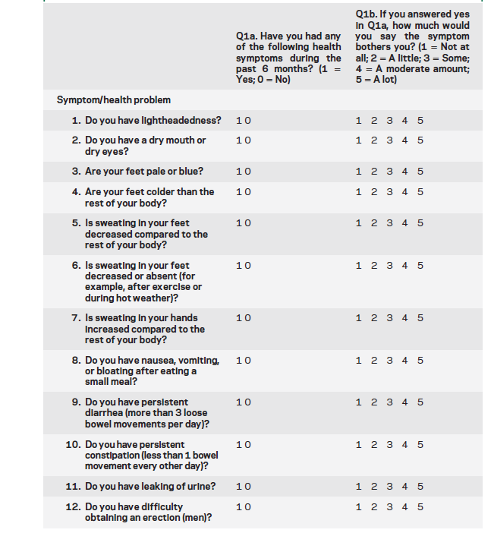
Survey of Autonomic Symptoms
12 Questions in 2 parts
YES/NO followed by
1-5 scale
Zilliox et al. Neurology 2011

Slide 7
SFN-RODS
32 Question Scale
0-2 rating
Brouwer et al. JPNS 2015

Slide 8
SFN-RODS
Brouwer et al. JPNS 2015

Slide 9
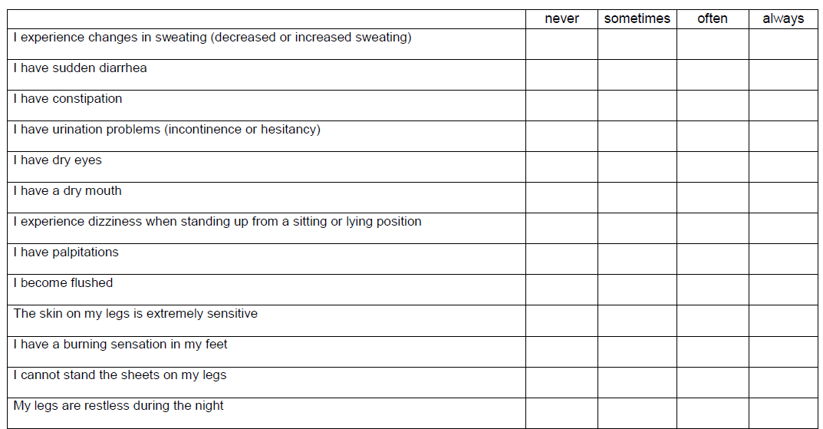
SFN-SIQ
13 item questionnaire
4 point scale
Brouwer et al. JPNS 2015

Slide 10
MGH: SSS-SFPN

Slide 11
NTSS-6
1. Aching pain: "Do you experience a deep, aching, tightness, boring, pulling, or squeezing pain in your feet or legs?"
2. Allodynia: "Do you experience unusual sensitivity or tenderness when your feet are touched or are used in activities such as walking?"
3. Burning pain: "Do you experience burning pain in your feet or legs?"
4. Lancinating pain: "Do you experience sharp, stabbing, or shooting pain, electrical shock-like pain, or surges of pain that last seconds to minutes in your feet or legs?"
5. Numbness: "Do you experience numbness, lost sensation, or a 'dead feeling' like an anesthetic, without prickling in your feet or legs?"
6. Prickling sensation: "Do you experience a prickling or tingling feeling, with or without an 'asleep' feeling, in your feet or legs?"
Grading assessed by:
Frequency (Never, Occasional, Often, Continuous)
Intensity (Not present, Mild, Moderate, Severe)

Slide 12
Strengths
Large numbers of subjects studied, some with large number of controls as well
Good internal consistency
Excellent test-retest reliability
Content validity evaluated using many different previously published tools

Slide 13
Weaknesses
Gold standards?
SFN defined by:
  1) Abnormal test result (IENFD, autonomic function)
  2) Abnormal symptoms
  3) Abnormal signs
  4) Combinations
SFN studied in a single disease
  Are questionnaires therefore only relevant in that disease or more broadly applicable?

Slide 14

Weaknesses
Are small fiber sensory neuropathies and autonomic neuropathies the same disease?
  Is the patient with a severe isolated autonomic neuropathy the same as a patient with a severe isolated small fiber sensory neuropathy?

Slide 15
Weaknesses
Do we need to define the role of the questionnaires more carefully?
  Small Fiber Sensory Questionnaire
  Small Fiber Autonomic Questionnaire
  Small Fiber Sensory and Autonomic Questionnaires

Slide 16
Weaknesses
Not all questionnaires are publically available
  If not accessible in the public domain, we will continue to see growth of individualized questionnaires that may, or may not, be compatible with existing questionnaires
Some questionnaires cannot be analyzed without support (psychometrics may place a barrier to more widespread use)
  Can some repository of information be made available to assist investigations in SFN?
Use of disease control subjects?

Slide 17
Internal Conflict / Bias
Do these questionnaires reflect the patients that I see that have SFN?

Slide 18
Examinations

Slide 19
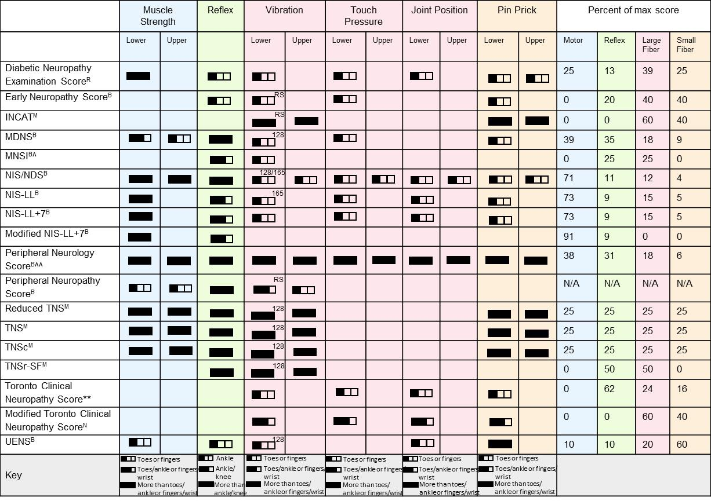

Slide 20
UENS
Publically available
Easy to understand and simple to complete
Clarity counts!

Slide 21
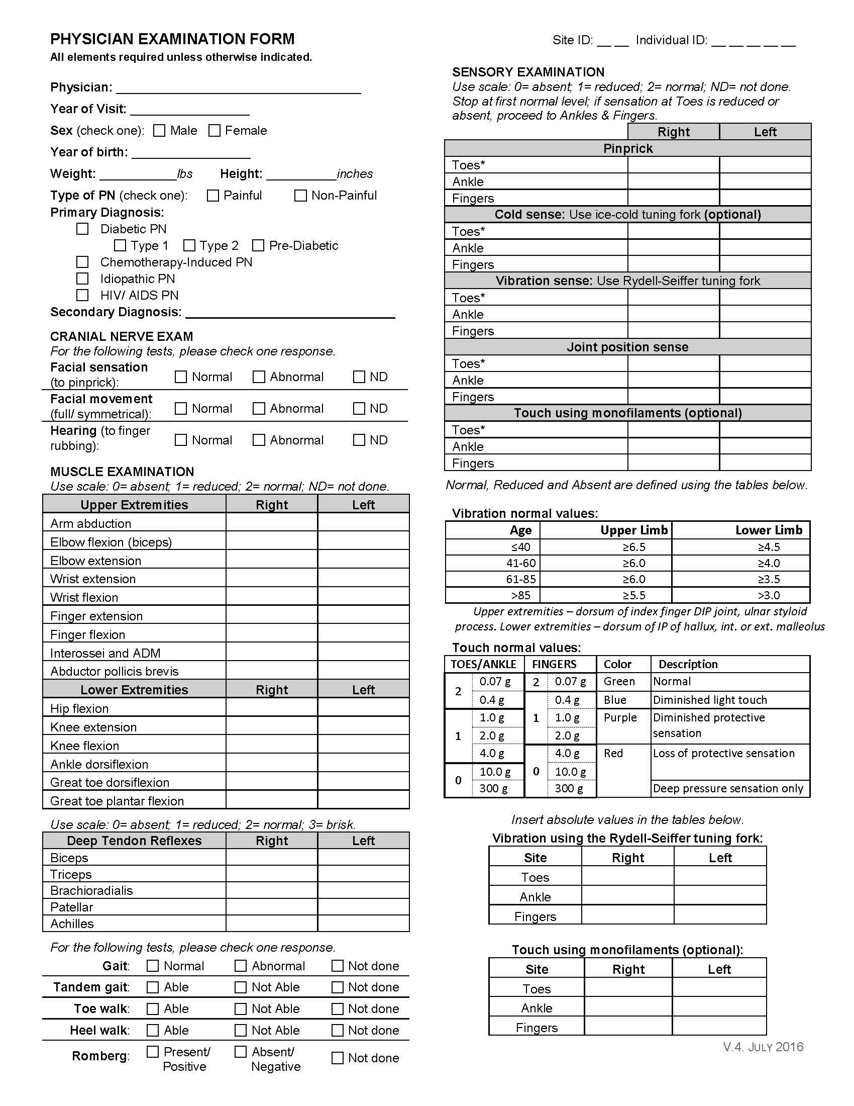
PNRR
Not focused on small fiber neuropathy
Tries to be adaptive to different types of neuropathy
Is comprehensive, but clear
Is not validated or publically available

Slide 22
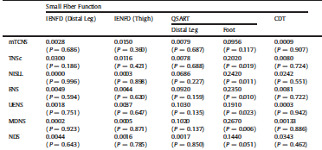
Compared examination scores in early neuropathy due to IGT
Zilliox et al Journal of Diabetes and it Complications 2015

Slide 23
Compared examination scores in early neuropathy due to IGT
All of the scales were terrible in correlating with test of structure or function
mTNS correlated best with diagnosis of neuropathy…
The caveat of course is in the details
The definition of neuropathy was symptoms for less than 2 years without requiring any signs of neuropathy or other corroborative testing
Zilliox et al Journal of Diabetes and it Complications 2015

Slide 24
Many Steps…
Agreement by disease type/subtype
Clarity to defining disease
Test/Questionnaire availability
Test/Questionnaire simplicity

Slide 25
Questions?

