Slide 1
NCI: Programmatic Overview of CIPN Portfolio March, 2017
Ann O’Mara, PhD, RN, FAAN
Head, Palliative Care Research
Division of Cancer Prevention

Slide 2
Objectives
Provide an overview of the NCI Community Oncology Research Program (NCORP)
Discuss CIPN studies conducted within NCORP and the NIH grant portfolio
Discuss NCI perspectives on today’s meeting objectives

Slide 3
NCORP: A Single Community-Based National Network
3 components: Community Sites, Minority/Underserved Community Sites, and Research Bases
Clinical Trials: prevention, symptom/toxicity management, health-related quality of life, comparative effectiveness, and screening
Cancer care delivery research: patient-provider and organization-level influences on cancer outcomes
Incorporation of cancer disparities research into clinical trials and cancer care delivery research
Accrual to National Clinical Trials Network (NCTN) treatment and imaging trials
Community/academic partnerships

Slide 4
NCORP’s Three Components
Research Bases (Scientific Engine)
Design and conduct multi-center trials in cancer prevention, control, screening and post-treatment surveillance clinical trials and cancer care delivery studies
Provide scientific and statistical leadership
Data management, administration, regulatory compliance
Community Sites (Accrual Engine)
Accrue participants to NCORP trials/studies (may include providers, organizations) and to NCTN treatment and imaging trials
Minority/Underserved Community Sites (Accrual Engine)
Accrue participants to NCORP trials/studies (may include providers, organizations) and to NCTN treatment and imaging trials
Communities are composed of 30% Minority/Underserved

Slide 5
NCORP Network Characteristics
12 Research Bases
46 sites (34 community; 12 MU community)
947 Components and Subcomponents
Health Care Systems Kaiser, Essentia, Aurora, Catholic Health Initiatives, Geisinger, Sanford & Nemours
7 Merged Community Programs
300+ CCDR Components within 46 Programs

Slide 6
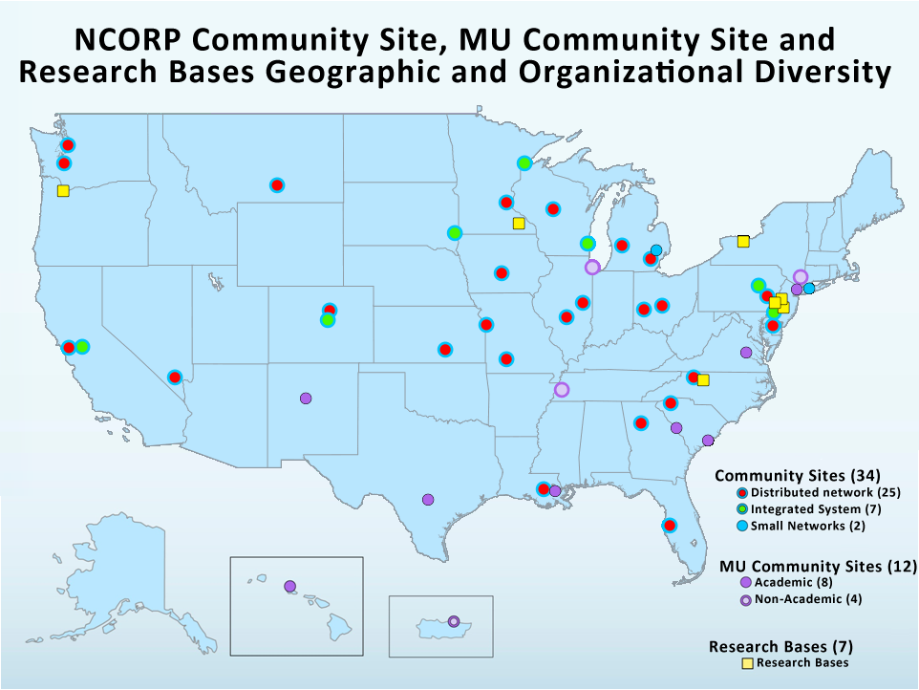
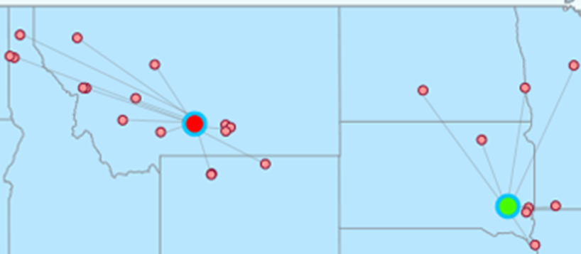

Slide 7
CCOP/NCORP CIPN Clinical Trials
14 clinical trials; 1 natural history study (acute and chronic paclitaxel induced neuropathies)
All pharmacologic interventions (topical amitriptyline/ketamine, nortriptyline, amifostine, gabapentin, acetyl L-carnitine, levetiracetam, alpha-lipoic acid, lamotrigine, vitamin E, topical baclofen, amitriptyline HCl, and ketamine (BAK), glutathione, calcium/magnesium, duloxetine)
4 trials included different chemotherapies; others-targeted specific chemotherapies (taxanes, cisplatinum, oxaliplatin)
Prevention (7); established CIPN (7)
All studies negative except for duloxetine; acetyl L-carnitine worsened CIPN
Majithia et al, Support Care Cancer, 2016 March, 24(3)

Slide 8
CCOP/NCORP CIPN Studies (2006-2011)
Title | Research Base
Assessment of Topical Treatment Response with Amitriptyline and Ketamine: Combination Trial in Chemotherapy Peripheral Neuropathy (ATTRACT-CPN) | URCC
Phase II Trial of Subcutaneous Amifostine for Reversal of Persistent Paclitaxel-Induced Peripheral Neuropathy. | MDA
The Efficacy of Gabapentin in the Management of Chemotherapy-induced Peripheral Neuropathy: A Phase III Randomized, Double-Blind, Placebo-Controlled, Cross-Over Trial | NCCTG
Randomized Placebo-Controlled Trial Of Acetyl L-Carnitine For The Prevention Of Taxane Induced Neuropathy | SWOG
A Randomized Phase III Trial of Amifostine vs. No Treatment for Platinum Induced Peripheral Neuropathy | GOG
A Randomized, Double-Blind, Placebo Controlled Trial Using Acetyl-l-Carnitine (ALCAR) for the Prevention of Chemotherapy-Induced Peripheral Neuropathy in Patients with Recurrent Ovarian, Primary Peritoneal or Fallopian Tube Cancer | GOG
The Efficacy of Levetiracetam in the Management of Chemotherapy-Induced Peripheral Neuropathy: A Phase III Randomized, Double-Blind, Placebo-Controlled, Clinical Trial | NCCTG

Slide 9
CCOP/NCORP CIPN Studies (2006-2011)
Title | Research Base
Prevention of Cisplatin or Oxaliplatin-Induced Peripheral Neuropathy with Alpha-Lipoic Acid: A Placebo-Controlled Phase III Trial | MDA
The Efficacy of Lamotrigine in the Management of Chemotherapy-Induced Peripheral Neuropathy: A Phase III Randomized, Double Blind, Placebo-Controlled Trial | NCCTG
The Use of Vitamin E for Prevention of Chemotherapy Induced Peripheral Neuropathy: A Phase III Double-Blind Placebo Controlled Study | NCCTG
The Use of Topical Baclofen, Amitriptyline HCl, and Ketamine (BAK) in a PLO Gel vs. Placebo for the Treatment of Chemotherapy Induced Peripheral Neuropathy: A Phase III Randomized Double-Blind Placebo Controlled Study | NCCTG
Use of Topical Amitriptyline, Baclofen, and Ketamine in a PLO Gel for the Treatment of Chemotherapy Induced Peripheral Neuropathy: A Phase III Double-Blind Placebo Controlled Study | NCCTG

Slide 10
NIH Portfolio
2011-2016

Slide 11
Funding Opportunity Announcements
Active
NCI Clinical and Translational Exploratory/Developmental Studies (PAR-16-176, R21)
Mechanisms of Cancer and Treatment-related Symptoms and Toxicities (PA-16-258, R21)
Improving Outcomes in Cancer Treatment-Related Cardiotoxicity (PA-16-035, R01), (PA-16-036, R21)
Mechanisms, Models, Measurement, & Management in Pain Research (PA-16-187, R21), (PA-16-188, R-01)
Expired
PQ –9 What are the molecular and/or cellular mechanisms that underlie the development of cancer therapy-induced severe adverse sequelae?
Biomechanisms of Peripheral Nerve Damage by Anti-Cancer Therapy (R01)

Slide 12
NIH Funded Grants in CIPN (2011-2016) (AI, AT, CA, DA, DE, GM, HD, NR, NS)
61 grants among 81 researchers totaling $23,493,341
35 pre-clinical grants
Biomarkers and pathways: cannabinoid receptors, NMDA receptor pathways, cytokine expression and mRNA levels, apoptotic pathways (Bclw, SARM1), epidural nerve innervation and axon structure, mitochondrial mechanisms and toll-like receptors (TLRs)
2 grants involved research in both animal models and cancer patients
Biomarkers and pathways: cytokine expression, epidermal nerve density and TLR levels
Only 4 (11%) of the 37 grants used tumor-bearing animals
Biomarkers assessed typically at only one time point

Slide 13
NIH Funded Grants in CIPN (2011-2016) (AI, AT, CA, DA, DE, GM, HD, NR, NS)
26 Clinical grants
Cohort/Longitudinal (n=20)
Trajectory of CIPN
Genetic discovery
Development/testing of new assays/test
Clinical Trials (n=6)
Acupuncture
Exercise
Photon therapy
Nicotinamide Riboside

Slide 14
NCI’s Interest in Mechanistic Studies
30 year history of funding cancer control/symptom science within the community oncology program (CCOP, NCORP)
Historically, studies based on empiric data & anecdotal evidence
Repurposing of pharmacologic agents
Majority of studies negative-not mechanistically based
High interest in understanding:
mechanisms of symptom development to develop targeted interventions
the natural history of symptoms
the ability to predict who is at risk to develop certain symptoms

Slide 15
Conclusion of Literature Review and Grant Review
Pre-clinical and clinical CIPN researchers operating in 2 different research planes.
Pre-clinical researchers investigating a variety of biomarkers and pathways
Clinical researchers examining many potential treatment methods
Researcher groups seem to rarely collaborate, leading to pre-clinical discoveries that are typically not adopted and adapted for clinical research in a timely manner, if they are discovered at all.
Collaboration, or at least frequent communication, should expedite clinically-relevant yet biologically-sound research
Establishing CIPN research teams with researchers from both groups could also serve this field well.
Robert Korycinski
Scientific Program Analyst
NCI

