Slide 1
Striking the Balance: FDA Oncology’s Regulatory Perspective on Development of Agents for CIPN
Lynn Howie, MD, Medical Officer, DOP1

Slide 2
Supportive Care is Crucial for Cancer Treatment
Antiemetics
Growth factors
Bone health agents
Agents to reduce mucositis
Anti-diarrheals
Supportive care therapies reduce symptoms and side effects allowing for improved delivery of chemotherapy agents, many of which are given with curative intent
(e.g. adjuvant chemotherapy, stem cell transplant,
and treatment of leukemia/lymphoma)
Notes:
For example, improvements in antiemetic regimens led to an increased ability to deliver cisplatinum and increased the numbers of patients willing to take curative chemotherapy (previous estimates were that as many as 20% of patients would forego curative chemotherapy for fear of nausea)
Growth factors such as filgrastim and peg-filgrastim allow for increased ability to deliver chemotherapy and reduce the incidence of infection
Agents such as palifermin have been approved to reduce the incidence and duration of severe mucositis in patients undergoing high dose chemotherapy with stem cell transplant in hematological malignancies
Drugs are being developed for chemotherapies associated with severe diarrhea

Slide 3
CIPN: Scope of the Problem
Incidence: approximately 40%
Variable based on anti-cancer agent and method of assessment
Oxaliplatin, an agent widely used for treatment of CRC, may have an incidence as high as 90%
Symptoms can lead to chemotherapy dose reductions, delays and/or early discontinuation
Hershman, D. L., et al. (2014). "Prevention and management of chemotherapy-induced peripheral neuropathy in survivors of adult cancers: American Society of Clinical Oncology clinical practice guideline." J Clin Oncol 32(18): 1941-1967.
Attal, N., et al. (2009). "Thermal hyperalgesia as a marker of oxaliplatin neurotoxicity: a prospective quantified sensory assessment study." Pain 144(3): 245-252.
Notes:
Oxaliplatin, an agent widely used for treatment of CRC, this number has been reported as high as 90%

Slide 4
CIPN: Scope of the Problem
Manifestations of CIPN:
Pain, numbness
Difficulty with proprioception/balance
Motor symptoms
Autonomic symptoms
Chronic neuropathy can be detrimental to function and quality of life
Hershman, D. L., et al. (2011). "Association between patient reported outcomes and quantitative sensory tests for measuring long-term neurotoxicity in breast cancer survivors treated with adjuvant paclitaxel chemotherapy." Breast Cancer Res Treat 125(3): 767-774.

Slide 5
Paucity of Evidence
Multiple agents for prevention of CIPN have been studied, but none have been approved based on review of the clinical data provided to support the indication
As a practicing physician, I have few evidence- based options for preventing or treating CIPN making this an unmet medical need
Notes:
Only drug with some evidence of efficacy for the treatment of chronic CIPN is duloxetine, but this agent is not approved for this indication

Slide 6
What is important to FDA Oncology?
Evidence that supportive therapies do not attenuate or interfere with anti-cancer therapies
Awareness of the variability of chemotherapy agents used that cause CIPN
Trial design and patient selection
Notes:
The first bullet is essential in agents that are to be administered at the same time as chemotherapy treatment
The last bullet is crucial so that the effect of the drug on CIPN can be detected
Minimize variables that may confound the understanding of the effect of the CIPN therapy vs. other factors

Slide 7
What is important to FDA Oncology?
Different agents have different mechanisms of neurotoxicity
Approval with one chemotherapy or chemotherapy regimen does not automatically mean approval for use with all chemotherapies/ chemotherapy regimens
Development should be focused on agents that prevent and/or treat peripheral neuropathy for commonly used chemotherapies in common malignancies
Notes:
Within a class of drugs, there can be differences in mechanism and manifestation of neurotoxicity
Common malignancies include breast cancer and colon cancer

Slide 8
Agents Associated with CIPN
Class | Examples | Diseases Treated
Microtubule inhibitors (taxanes, eribulin) | Paclitaxel, docetaxel, eribulin | Breast, ovarian, uterine, gastric, lung, head and neck (H&N), esophageal cancer, sarcoma
Platinum agents | Cisplatin, carboplatin, oxaliplatin | Ovarian, uterine, H&N, gastric, lung, esophageal, testicular, bladder, colorectal cancers
Proteasome inhibitors | Bortezomib, carfilzomib | Multiple myeloma, mantle cell lymphoma
Vinca alkaloids | vincristine, vinorelbine, vinblastine | Lymphoma, breast cancer, acute lymphocytic leukemia (ALL)
Immunomodulators | Ipilimumab, pembrolizumab, nivolumab, atezolizumab | Melanoma, lymphoma, lung, H&N, bladder cancer
Notes:
Taxanes are widely used in curative intent (adjuvant) therapies for breast and lung cancer.
Platinums widely used for curative intent therapy for H&N, testicular cancer, and colorectal cancer. Of this subcategory, Oxaliplatin>Cisplatin>Carboplatin with respect to incidence of CIPN
Vinca alkaloids are used in a wide variety of cancers including Hodgkin’s and Non-Hodgkin’s lymphoma and ALL, both of which are in curative setting.

Slide 9
Chemotherapy and Neurotoxicity Symptoms
Drug | Manifestations of CIPN | Possible Mechanism of Action
Oxaliplatin | Acute neurosensory neuropathy associated with cold (transient) Cumulative Sensory Polyneuropathy (chronic) Sensory loss and ataxia | Thought to be interaction with sodium (Na+) gated voltage channels
Cisplatin | Peripheral neuropathy Ototoxicity Tremor Loss of position sense | Thought to be related to neuronal apoptosis related to mitochondrial dyusfunction
Carboplatin Least incidence of platinum agents—most dose dependent | Peripheral neuropathy | Thought to be related to neuronal apoptosis
Notes:
Two of the most common classes of drugs that cause CIPN are platinums and taxanes.
Within the platinums themselves, there are differences by drug in both the manifestations/symptoms of CIPN and also their likely mechanism of action
The acute sensory neuropathy of oxaliplatin can lead to perioral and distal paresthesias and dysesthesias…1-2% report difficulty breathing

Slide 10
Chemotherapy and Neurotoxicity Symptoms
Drug | Manifestations of CIPN | Possible Mechanism of Action
Paclitaxel | Acute neuropathy manifested as pain syndrome with myalgias and arthralgias—dose dependent Chronic neuropathy characterized by numbness/tingling rather than pain | Microtubule inhibition Possibly the Cremophor-ethanol drug vehicle
Docetaxel | Generally less neurotoxic than paclitaxel Generally parasthesias, numbness or pain in hands/feet | Microtubule inhibition
Notes:
My point is there are intraclass variabilities and minimizing these in trial design will help to better understand the effect of the supportive therapy.

Slide 11
Risk Factors for Development of CIPN
Age ≥65
Diabetes mellitus
Prior Chemotherapy
Obesity
Smoking history
Vitamin deficiencies
Decreased creatinine clearance
Notes:
Now I want to talk about the patient specific factors associated with the risk of development of CIPN
These include increased age, diabetes mellitus, especially poorly controlled
Optimal trial design will work to minimize these factors in order to better understand treatment effect. These confound risk.

Slide 12
Pre-clinical Drug Development
Preclinical evidence the drug does not interfere with anti-tumor activity of chemotherapy:
Data characterizing the mechanism of action of the drug and a scientific rationale which supports the postulate there is no interference with the mechanism of action of the investigation product and the chemotherapy agents used
Pharmacology studies with the investigational agent in combination with chemotherapy (e.g., in vitro proliferation, murine xenograft models) demonstrating no impairment of chemotherapy-related antitumor activity
Notes:
This is important for agents that are to be simultaneously administered with chemotherapy treatment.
Take for example palifermin, a keratinocyte growth factor. As this was thought to have theoretical risk of tumor promotion in solid tumors of epithelial origin as the KGF receptor is on many of these tumors. Due to this theoretical risk, there has not been significant development outside of hematological malignancies which do not express the receptor that would respond to KGF.

Slide 13
Clinical Studies
Initial trials must be performed in patients with metastatic disease as the outcome on tumor related endpoints (i.e. survival, PFS) is unknown
Important to consider comorbidities with increased risk of neuropathy in the trial design
Well-designed, randomized, placebo controlled trials with a homogeneous patient population (same tumor type, same stage of disease, same treatment) and with appropriate endpoints
Symptom assessment and severity
Objective measure(s) of functional loss
More than one trial necessary to confirm safety and efficacy
Notes:
In addition to pain, need to evaluate sensation (numbness/tingling), function (buttoning, dropping objects, and

Slide 14
Clinical Studies: Additional Caveats
Efficacy: Symptom and functional assessment are required
Seek early advice from FDA Clinical Outcomes Assessment group regarding appropriate measures
Safety: Evaluation of adverse events (CTCAE) and demonstration there is no decrement in tumor-related outcomes (i.e. overall survival, PFS)
Balance of safety and efficacy is key for successful development
Notes:
Go back and figure out how to clean up this slide to say same thing

Slide 15
Symptom-Measurement Scales
The symptom(s) which are selected for study must be validated using the chemotherapy regimen in the disease studied
Focus group(s) of patients (same disease and stage, same chemotherapy) to determine the most bothersome symptoms
Testing symptom assessment in a new larger group (same disease, same chemotherapy)
Demonstrate that symptoms selected occur at a frequency that allows study
Demonstrate that scales used detect the severity of the symptoms can be validated statistically
Notes:
Symptom identification and measurement is the most difficult part of the development

Slide 16
Functional Evaluation
Objective measure of the impact on the functional impairment
Measure(s) have to be sensitive enough to detect differences between arms
Functional assessment must be validated
Challenge is to develop a group of functional assessments that can be used in clinical trials with different chemotherapies or across different classes of chemotherapy drugs

Slide 17
Trial Design: Other Considerations
Trial duration
Long enough to detect the onset, the progression, and the possible improvement in the chronic neuropathy
Long enough to ensure adequate information about tumor-related endpoints (i.e. safety) is available
Functional and symptom assessments should be validated in cancer population
Given lack of clarity of relationship between acute neuropathic syndromes and chronic syndromes, targeting acute neuropathic syndromes is not clear surrogate for clinical benefit

Slide 18
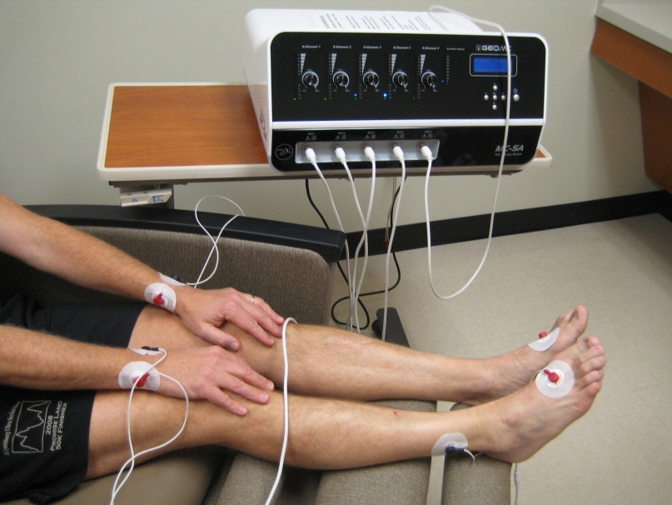
Non-Drug Modalities
Neurofeedback
Scrambler Device
We encourage early work with the
Center for Devices and Radiologic Health (CDRH) for the development of devices for CIPN
Neurofeedback: (Das 2017); Scrambler: http://nationalpainreport.com/scrambler-therapy-%E2%88%92-a-new-way-to-treat-chronic-pain-without-drugs-or-invasive-devices-8827467.html
Notes:
This month, Prinsloo and colleagues reported a randomized study in patients with persistent grade 3 peripheral neuropathy (>3 months out of treatment) for neurofeedback techniques in reducing the primary endpoint of worst pain by the clinically meaningful difference of 2 points on the Brief Pain Inventory (BPI). They used a wait list control so as to try to minimize the effects of improvement with time.

Slide 19
Take Home Messages
Safety
Evidence agents do not attenuate anti-cancer therapy and do not negatively effect tumor-related outcomes
Population
Endpoints
Measure symptoms
Same anti-cancer therapy
Same underlying malignancy
Measure change in function
Minimize patients with comorbidities with ↑risk
Notes:
There are multiple factors at play to consider:
Dose reductions for chemotherapy for non CIPN related reasons (e.g. myelosuppression) may affect study results
Differential progression (and hence differential duration of exposure to chemotherapy)
Also, endpoints should be appropriate for this population. For example, don’t use a rheumatology pain scale to try to capture CIPN associated pain
Come to us early in your development plan as we are

Slide 20
Acknowledgements
ACTTION
Jennifer Gewandter, PhD
Roy Freeman, MD
FDA DOP 1
Geoffrey Kim, MD
Laleh Amiri-Kordestani, MD
Julia Beaver, MD
Genevieve Schechter, MD
Todd Palmby, PhD
FDA OCE PFDD
Paul Kluetz, MD
FDA COA
Selena Daniels, PharmD
Elektra Papadopoulos, MD, MPH
Notes:
Thank ACCTTION for inviting me

