Slide 1
CIPN: Considerations for Drug Development
Pamela Horn, MD
Clinical Reviewer
DAAAP

Slide 2
Outline
Patient Perspective from PFDD Public Meeting
Drug Approval Standards
Approved Therapies
Possible CIPN Indications
FDA Review Division Roles
Study Design Issues Raised by Sponsors
Population
Dose and Dosing
Concomitant and Rescue Medication Use
Outcome Measures
Endpoints
Safety Assessment

Slide 3
Patient-Focused Drug Development Meeting on Peripheral Neuropathy
FDA held a public meeting attended by patients caregivers and advocates on June 10, 2016
37 patients attended in-person and 54 participants contributed through live webcast
CIPN well-represented
Summary report posted February 2017 at https://www.fda.gov/downloads/ForIndustry/UserFees/PrescriptionDrugUserFee/UCM542169.pdf

Slide 4
Summary of Patient Symptoms and Impact
Pain sensations most commonly described as numbness, tingling, burning, and stabbing particularly in hands and feet
In addition to painful sensations, numbness identified as having high impact due to functional consequences (e.g. loss of balance and falls)
Participants described impact as daily on activities, work, and relationships
Not well-managed currently for nearly all
Notes:
CIPN patients noted hands and feet as most affected, Some CIPN patients said that they had recovered sensation after a couple years

Slide 5
Summary of Treatment Discussion
Pregabalin and gabapentin, wide range of effectiveness reported, adverse reactions noted frequently were dizziness, somnolence, dry mouth, edema, blurred vision, weight gain, difficulty with concentration/attention
NSAIDS, opioids, drugs by epidural and topical ROA also reported
Massage, PT, acupuncture, vitamin supplements
Diet, exercise
Notes:
One CIPN patient reported Lyrica to be very helpful

Slide 6
Drug Approval Standards
Approval requires:
Substantial evidence of efficacy
Two adequate and well-controlled trials or equivalent for a specific peripheral neuropathic pain indication
Three successful trials in three separate neuropathic pain conditions for a general peripheral neuropathic pain indication
Adequate assessment of safety in a sufficient number of individuals for an adequate duration of exposure
Favorable risk-benefit balance
Notes:
Basic requirements for approval still apply in this condition

Slide 7
Approved Drugs for Peripheral Neuropathic Pain
Diabetic Peripheral Neuropathy (DPN):
Nucynta ER (Tapentadol)
Lyrica (Pregabalin)
Cymbalta (Duloxetine)
Postherpetic Neuralgia (PHN):
Lyrica (Pregabalin)
Neurontin (Gabapentin)
Transdermal lidocaine
Capsaicin 8% patch
Trigeminal Neuralgia:
Tegretol (Carbamazepine)
Notes:
There are no approved drugs that include an indication for CIPN or for non-painful aspects or manifestations for any peripheral neuropathy

Slide 8
Division roles
DAAAP reviews and provides advice pertaining to development of drugs for the treatment of pain and peripheral neuropathies, including CIPN
DAAAP consults
DOP1 to gain input on clinical considerations in studying oncology patients and managing possible impact of interventions on cancer treatment
COA regarding validity and testing of PRO instruments

Slide 9
Possible CIPN Indications
Prevention
Treatment
Chemotherapy
CIPN: pain, other symptoms or signs
Symptoms appear with first dose
Symptoms appear after last dose

Slide 10
Population
Number of different chemotherapy agents to include in one study
Single agent
Single class (taxane, platinum)
Multiple classes
Entry criteria for prevention
Cancer diagnosis (e.g. colon cancer), and life expectancy (e.g. 12 weeks)
Planned chemotherapy regimen(s)
Entry criteria for treatment
Baseline pain (avg NRS 5-9, > 4)
NCI CTCAE (e.g. > Grade I)
Clinical diagnosis of CIPN based on symptoms and neurological signs
Completed or concurrent chemotherapy regimen

Slide 11
Dose and Dosing
Dose selection
Dose same as dosing for chemotherapy treatment
Dose selection based on Phase 2 work in a pain or neuropathy endpoint
Placebo control
Double-blind
Fixed dosing interval
Fixed and flexible dosing
Patient-administered and clinician-administered

Slide 12
Concomitant and Rescue Medication Use
Allow standardized concurrent use of stable dose of analgesics
Allow limited rescue medications

Slide 13
Outcome Measures
Pain only (11-point NPRS/ BPI-SF)
PRO with composite/ multiple manifestations of disease in one instrument (EORTC QLQ-CIPN20, FACT/GOG-Ntx-4)
Novel PRO
Clinician-reported (Sanofi-NCI)
Notes:
QLQ is a quality of life questionnaire with 3 subscales: a sensory, motor, and autonomic subscale
No objective measures have been proposed

Slide 14
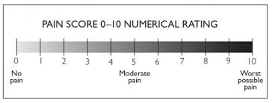
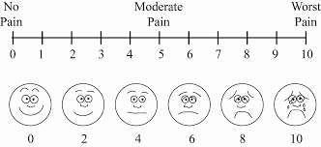
11-point NPRS
Source: http://www.physio-pedia.com/Numeric_Pain_Rating_Scale
http://www.wikidoc.org/index.php/Pain_physical_examination

Slide 15
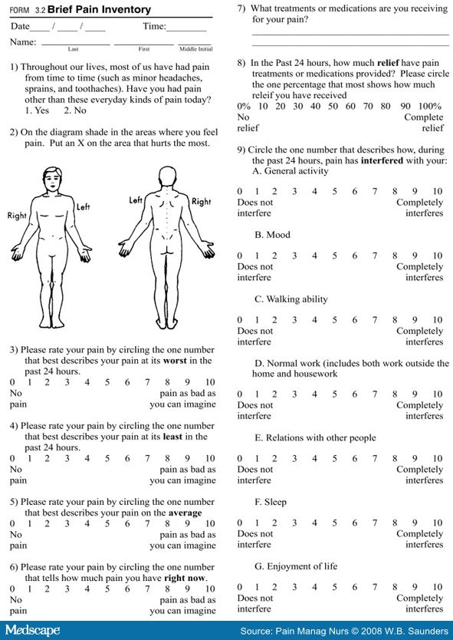
BPI SF

Slide 16
FACT/GOG-Ntx-4
Source: www.facit.org/LiteratureRetrieve.aspx?ID=42412

Slide 17
Sanofi-NCI
Source: Eloxatin Prescribing Information

Slide 18
Summary
CIPN not adequately managed with available therapies for many patients; efficacious prevention and treatment options are needed
Range of proposals have been made
CIPN is a distinct peripheral neuropathy and there are study design issues unique to CIPN

