Slide 1
Comments on Methodological Challenges in Clinical Trials for CIPN Scott Evans, PhD, MS Harvard University
ACTTION, 2017

Slide 2
Building on Mike’s comments which are excellent…

Slide 3
Should we disentangle PN and cancer outcomes?
Chemo affects PN
PN management may affect cancer outcome
Failure of chemo therapy may be a down-stream consequence to failure of PN management
Change in chemo again affects PN…
Difficult problem…

Slide 4
Question 1
Suppose you measure the duration of PN
Or an AUC of PN (TNS) representing a total disease burden based on duration and severity
Shorter duration is better … or is it?
The faster that a patient withdraws chemo, the shorter the duration. The faster the patient dies, the shorter the duration.
Interpretation of AUC needs clinical context of other (cancer) outcomes for the same patient

Slide 5
Question 2
Suppose the person that you care about the most, has just been diagnosed with cancer requiring chemotherapy
You are selecting a treatment for CIPN
3 treatment options: A, B, and C
2 outcomes
PN: binary
Chemo outcome: binary

Slide 6
RCT Comparing A, B, and C Analysis of Endpoints
A (N=100)
B (N=100)
C (N=100)

Slide 7
RCT Comparing A, B, and C Analysis of Endpoints
A (N=100)
PN: 50%
B (N=100)
PN: 50%
C (N=100)
PN: 50%

Slide 8
RCT Comparing A, B, and C Analysis of Endpoints
A (N=100)
PN: 50%
Chemo fail: 40%
B (N=100)
PN: 50%
Chemo fail: 50%
C (N=100)
PN: 50%
Chemo fail: 50%

Slide 9
RCT Comparing A, B, and C Analysis of Endpoints
A (N=100)
PN: 50%
Chemo fail: 40%
B (N=100)
PN: 50%
Chemo fail: 50%
C (N=100)
PN: 50%
Chemo fail: 50%
Which treatment would you choose?

Slide 10
RCT Comparing A, B, and C Analysis of Endpoints
A (N=100)
PN: 50%
Chemo fail: 40%
B (N=100)
PN: 50%
Chemo fail: 50%
C (N=100)
PN: 50%
Chemo fail: 50%
Which treatment would you choose?
They all have the same PN rate.

Slide 11
RCT Comparing A, B, and C Analysis of Endpoints
A (N=100)
PN: 50%
Chemo fail: 40%
B (N=100)
PN: 50%
Chemo fail: 50%
C (N=100)
PN: 50%
Chemo fail: 50%
Which treatment would you choose?
They all have the same PN rate.
A has lower chemo failure.

Slide 12
RCT Comparing A, B, and C Analysis of Endpoints
A (N=100)
PN: 50%
Chemo fail: 40%
B (N=100)
PN: 50%
Chemo fail: 50%
C (N=100)
PN: 50%
Chemo fail: 50%
Which treatment would you choose?
They all have the same PN rate.
A has lower chemo failure.
B and C are indistinguishable.

Slide 13
Analysis of Patients: 4 Possible Outcomes
A (N=100)
PN: 50%
Chemo fail: 40%
B (N=100)
PN: 50%
Chemo fail: 50%
C (N=100)
PN: 50%
Chemo fail: 50%
PN
+ -
PN
+ -
PN
+ -
C S
F
30 | 30
20 | 20
50 | 0
0 | 50
0 | 50
50 | 0

Slide 14
Analysis of Patients: 4 Possible Outcomes
A (N=100)
PN: 50%
Chemo fail: 40%
B (N=100)
PN: 50%
Chemo fail: 50%
C (N=100)
PN: 50%
Chemo fail: 50%
PN
+ -
PN
+ -
PN
+ -
C S
F
30 | 30
20 | 20
50 | 0
0 | 50
0 | 50
50 | 0
Rate of chemo success without PN
30% 0% 50%

Slide 15
Our culture is to use patients
to analyze the endpoints.

Slide 16
Our culture is to use patients
to analyze the endpoints.
Shouldn’t we use endpoints
to analyze the patients?

Slide 17
Scott’s father (a math teacher) to his confused son many years ago:
“The order of operations is important…”

Slide 18
Question 3
During analyses of a clinical trial, we define analysis populations
Efficacy analysis: efficacy population (e.g., ITT)
Safety analysis: safety population (e.g., those > 1 dose)
Efficacy population ≠ safety population
We then combine these analyses into a benefit:risk analysis
To whom does this benefit:risk analysis apply?

Slide 19
Vision for the Future of Clinical Trials
Today |  | Tomorrow
Few (usually 1) | Treatment Effects | Many (stratified medicine)
 | Endpoints

Slide 20
Vision for the Future of Clinical Trials
Today |  | Tomorrow
Few (usually 1) | Treatment Effects | Many (stratified medicine)
Many (efficacy, toxicity, QOL) | Endpoints | Few (overall patient outcome)

Slide 21
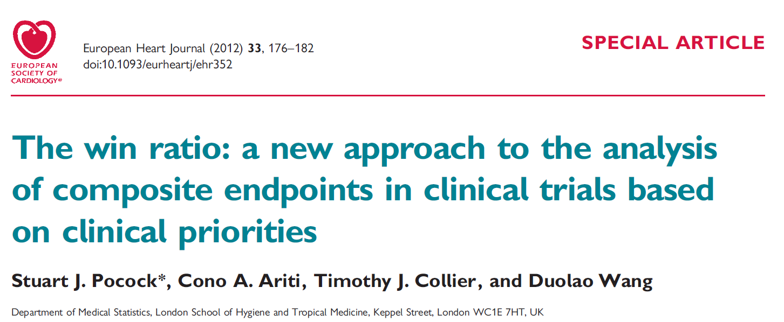
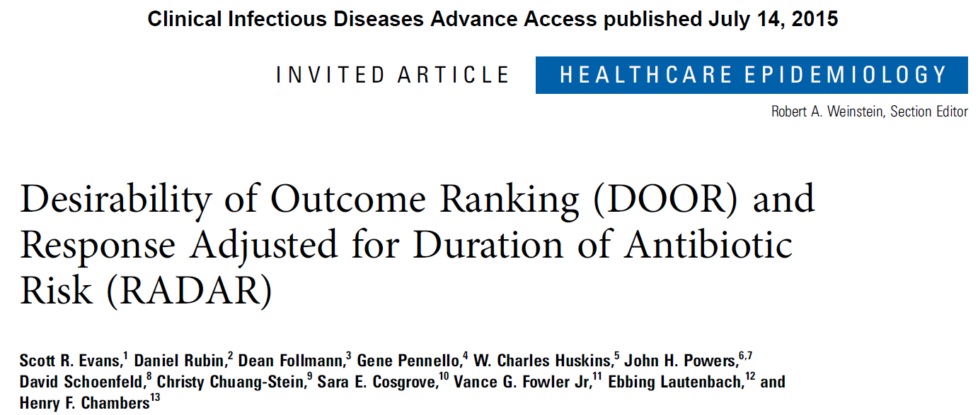

Slide 22
“Treat the patient, not the disease.”
David Clifford, MD
What if we evaluate interventions by how well they treat the patient?
Focus on:
Systematic evaluation of benefits and harms
Pragmatism

Slide 23
Desirability of Outcome Ranking (DOOR)
Positive chemo response with small PN AUC
Positive chemo response with large PN AUC
Negative chemo response with small PN AUC
Negative chemo response with large PN AUC
Death
Finer gradations possible

Slide 24
DOOR
DOOR Category | Control | Test Intervention
1 | n1
2 | n2
3 | n3
4 | n4
5 | n5
Northward migration of proportions of patients
relative to control?

Slide 25
Analyses
Via pairwise comparisons
DOOR probability: Probability that a randomly selected patient in Arm A has a more desirable outcome than a patient in the control arm (+ half credit for ties)
Win ratio: #wins / #losses
Partial credit

Slide 26
Partial Credit Example: 4 Categories
 | Arm A | Control | Score
Survived with good cancer and PN outcomes | # | # | 100
Survived with modest cancer and PN outcomes | # | # | Partial credit
Survived with poor cancer and PN outcomes | # | # | Partial credit
Death | # | # | 0
For transparency and pre-specification, partial credit can be surveyed from experts or obtained from patients
Can we allow for patient/clinician preferences?

Slide 27
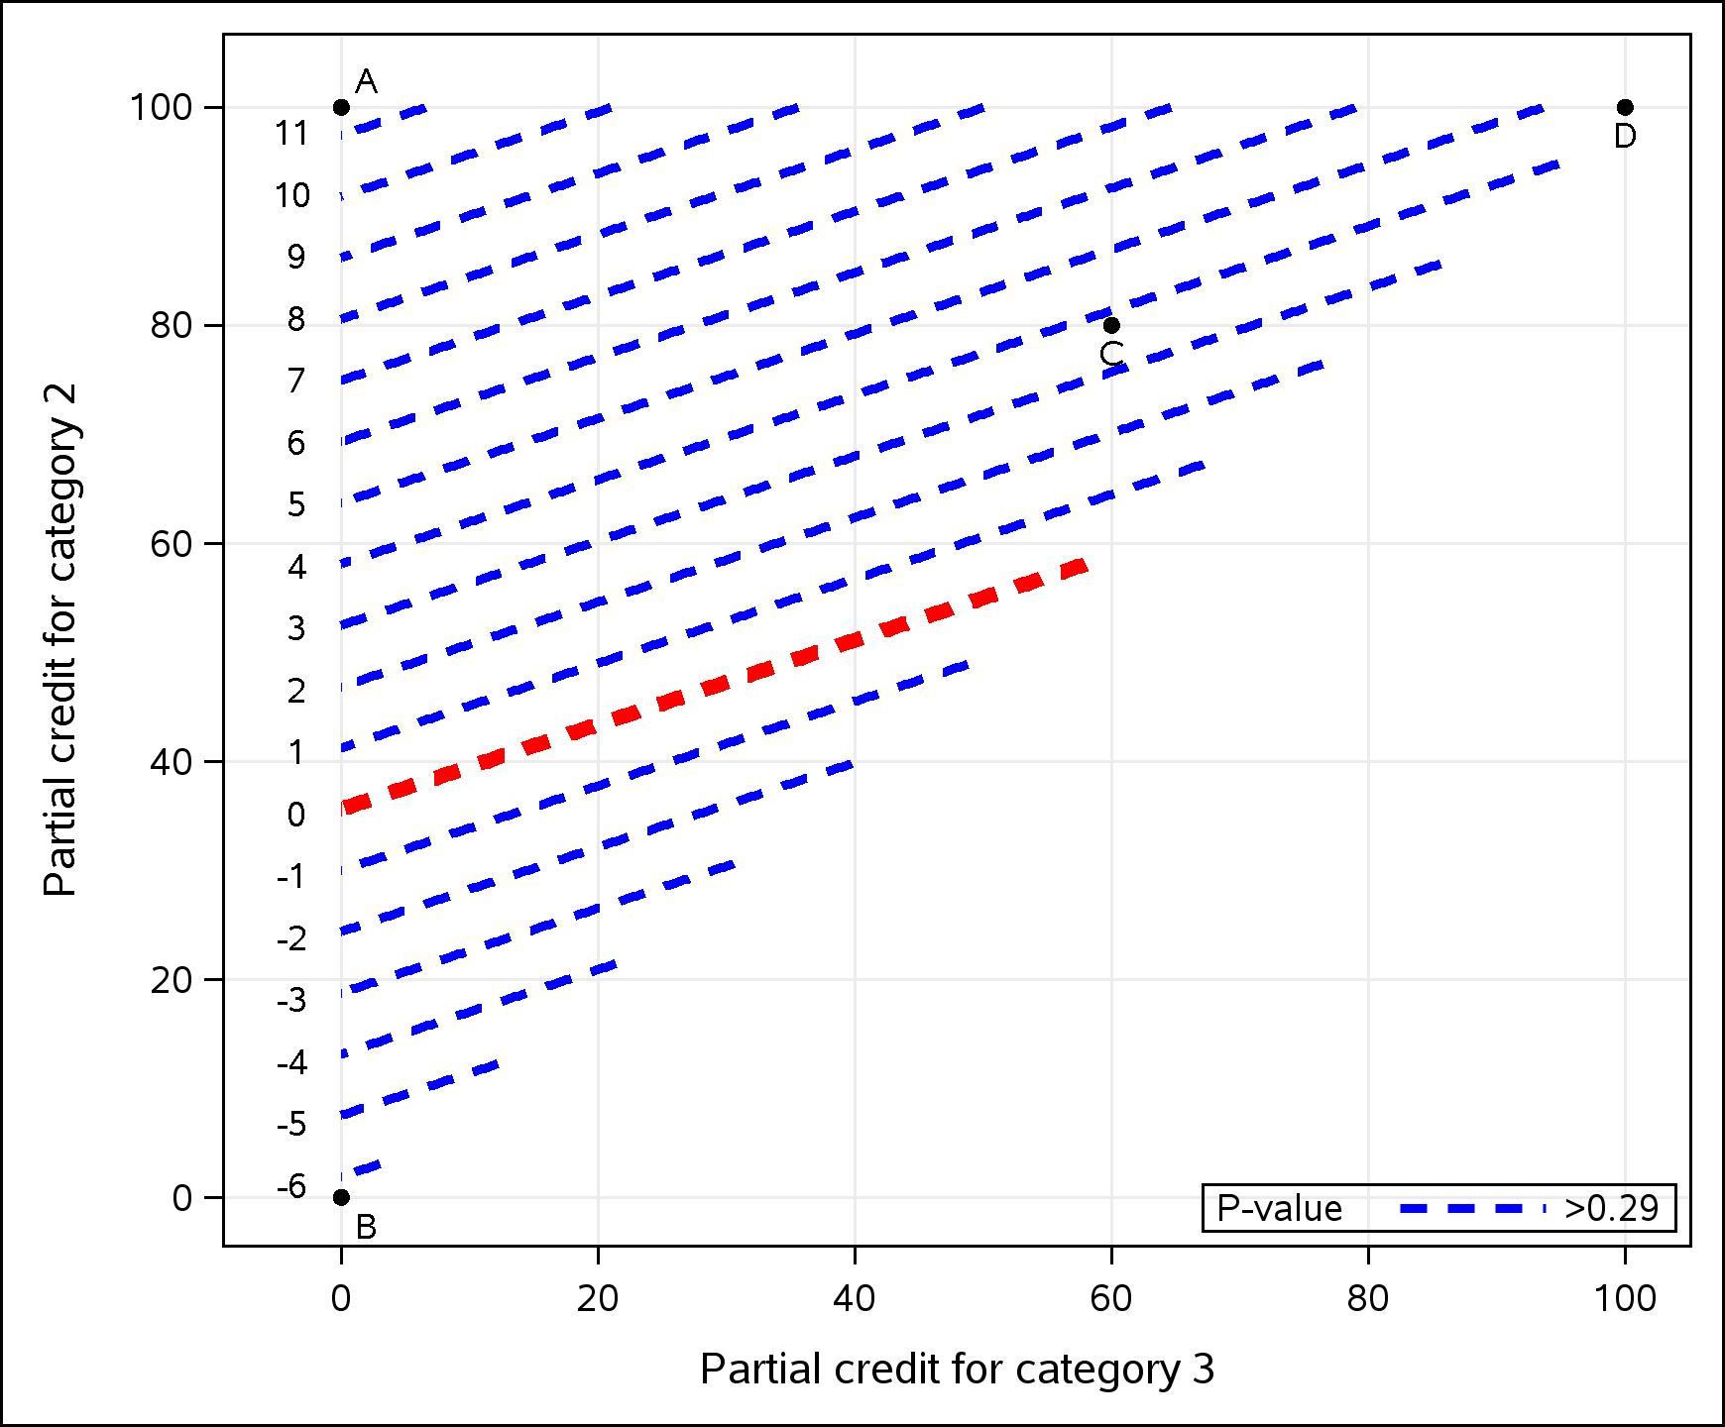
Plot: Contours of effects as partial credit varies. Allows for personal preference decisions.
 | Score
Survived with good cancer and PN outcomes | 100
Survived with modest cancer and PN outcomes | Partial credit
Survived with poor cancer and PN outcomes | Partial credit
Death | 0

Slide 28
Only survival matters
 | Score
Survived with good cancer and PN outcomes | 100
Survived with modest cancer and PN outcomes | 100
Survived with poor cancer and PN outcomes | 100
Death | 0
Result: 5 point advantage for new treatment

Slide 29
Only surviving with good cancer and PN outcomes matter
 | Score
Survived with good cancer and PN outcomes | 100
Survived with modest cancer and PN outcomes | 0
Survived with poor cancer and PN outcomes | 0
Death | 0
Result: 6 point advantage for control

Slide 30
Only surviving with modest cancer and PN outcomes matter
 | Score
Survived with good cancer and PN outcomes | 100
Survived with modest cancer and PN outcomes | 100
Survived with poor cancer and PN outcomes | 0
Death | 0
Result: 11 point advantage for new treatment

Slide 31
Compromise
 | Score
Survived with good cancer and PN outcomes | 100
Survived with modest cancer and PN outcomes | 80
Survived with poor cancer and PN outcomes | 60
Death | 0
Result: 4 point advantage for new treatment

Slide 32
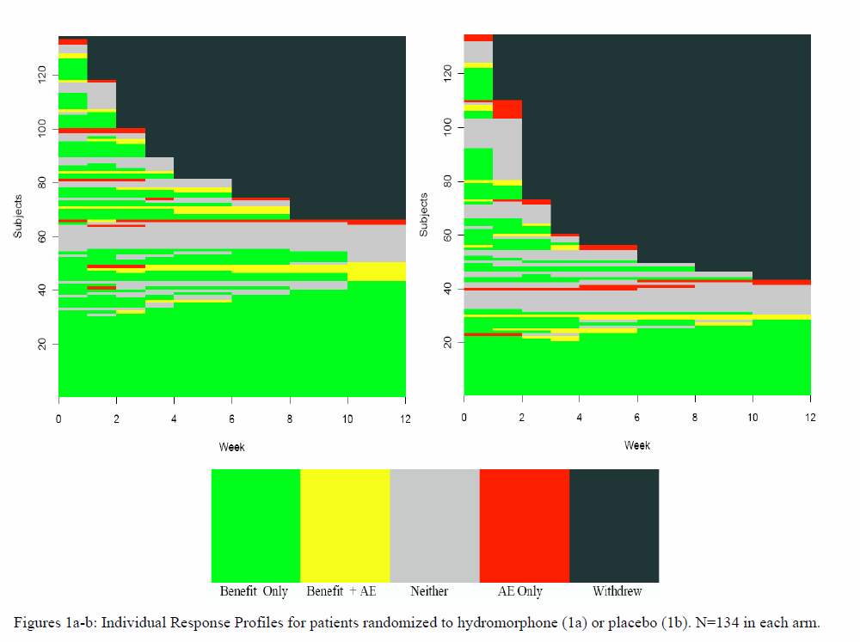
AUC: Longitudinal States of PN

Slide 33
As you can see dear colleagues, this is intuitively obvious
to even the most casual of observers…
or the ramblings of a lunatic.
Thank you.

