Slide 1
ANALGESIC, ANESTHETIC, AND ADDICTION CLINICAL TRIAL TRANSLATIONS, INNOVATIONS, OPPORTUNITIES, AND NETWORKS (ACTTION) Public-Private Partnership WITH THE FDA
Robert H. Dworkin, PhD
Professor of Anesthesiology, Neurology, and Psychiatry
Professor in the Center for Human Experimental Therapeutics
University of Rochester School of Medicine and Dentistry

Slide 2
“The science base necessary to evaluate and predict safety and efficacy … is different from the science that generates the new idea for a drug, biologic or device.
In general, the National Institutes of Health and academia do not perform research in this area, indicating the need to develop mechanisms and incentives to foster research directed at improving the scientific base for the critical path, for example, for analgesic drug development.”
Woodcock J, et al. Nature Reviews Drug Discovery 2007;6:703-710

Slide 3
Mission of ACTTION
To identify, prioritize, sponsor, coordinate, and promote innovative activities — with a special interest in optimizing clinical trials — that will expedite the discovery and development of improved analgesic, anesthetic, addiction, and peripheral neuropathy treatments for the benefit of the public health.

Slide 4
Consortia and Collaborations
Consortia
Consortium for Addiction Research on Efficacy and Safety (CARES)
Consortium on Clinical Endpoints and Procedures for Peripheral Neuropathy Trials (CONCEPPT)
Sedation Consortium on Endpoints and Procedures for Treatment, Education, and Research (SCEPTER)
Collaborations
ACTTION-American Pain Society Pain Taxonomy (AAPT) — Chronic Pain
ACTTION-American Pain Society-American Academy of Pain Medicine Pain Taxonomy (AAAPT) — Acute Pain

Slide 5
Working Groups
Abuse Liability Evaluation for Research , Treatment, and Training (ALERTT)
Analgesic Comparative Effectiveness and Pragmatic Trials (ACEPT)
Community Patient Awareness About Clinical Trials (COMPAACT)
Pain-Related Outcomes Training and Evaluation for Conducting Clinical Trials (PROTECCT)
Public Relations and Other Communication and Education Strategies (PROCESS)
Repository of Registered Analgesic Clinical Trials (RReACT)
Resource for Evaluating Procedures and Outcomes of Randomized Trials (REPORT)
Retrospective Evaluation of Patient-Level Information from Controlled Analgesic Trials of Efficacy (REPLICATE)
Safety and Benefit-Risk Reporting and Evaluation (SABRRE)
Standardized Analgesic Database for Research, Discovery, and Submissions (STANDARDS)

Slide 6
Major Research Objective
Develop an evidence-based approach to the design, execution, analysis, and interpretation of clinical trials of analgesic, addiction, sedation, and peripheral neuropathy clinical trials

Slide 7
Partners – Professional & Research Societies
American Academy of Neurology
American Academy of Pain Medicine
American College of Rheumatology
American Pain Society
American Society of Anesthesiologists
Europain
German Research Network on Neuropathic Pain
International Association for the Study of Pain
Osteoarthritis Research Society International
Outcome Measures in Rheumatology

Slide 8
Partners – US Government Agencies
Food and Drug Administration
Department of Veteran Affairs
National Institutes of Health
Department of Defense

Slide 9
Industry Partners – CONCEPPT

Slide 10
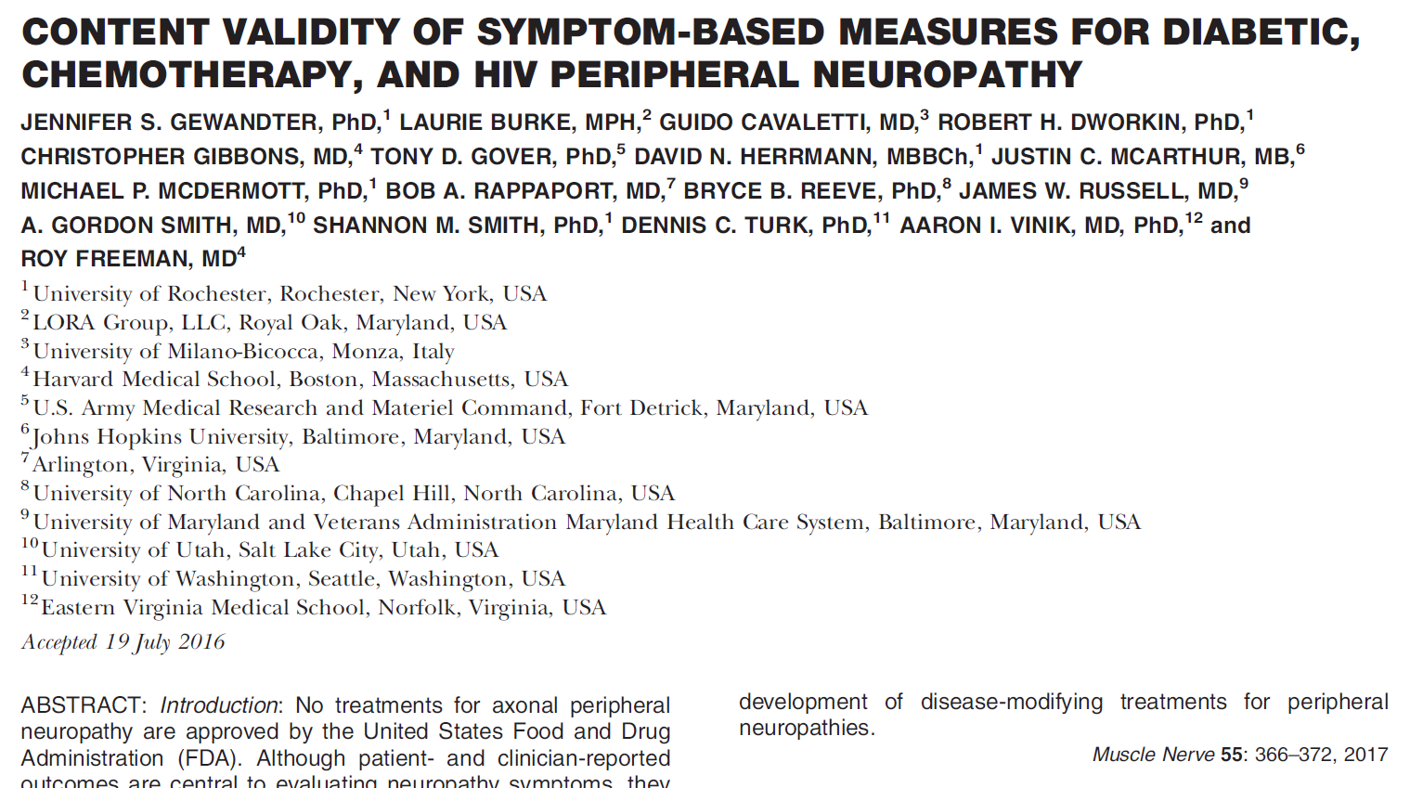
CONCEPPT Publication (others in the pipeline)

Slide 11
www.acttion.org

Slide 12
ANALGESIC, ANESTHETIC, AND ADDICTION CLINICAL TRIAL TRANSLATIONS, INNOVATIONS, OPPORTUNITIES, AND NETWORKS (ACTTION) Public-Private Partnership WITH THE FDA

Slide 13
INTRODUCTION

Slide 14
Background
Consequence of success
Number of cancer survivors
Change of focus - quality of survival
CIPN
Substantial prevalence, disability, reduced QOL even years after treatment
Dose reduction or discontinuation of chemotherapy with possible effects on survival

Slide 15
Background
Challenges
Goals
1. to evaluate disease modification of CIPN
2. to evaluate symptomatic treatment of CIPN
3. to evaluate chemotherapy disruption due to CIPN
4. to define a research agenda for the unknowns

