Slide 1



Patient-reported Symptom Outcome Measures of CIPN
Guido Cavaletti
University of Milano-Bicocca
Monza - Italy

Slide 2
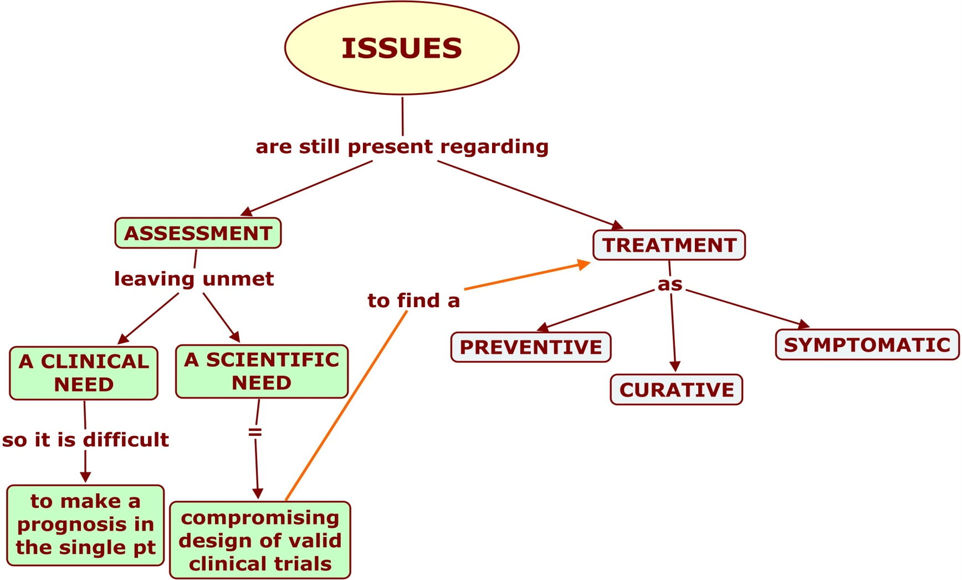

Slide 3
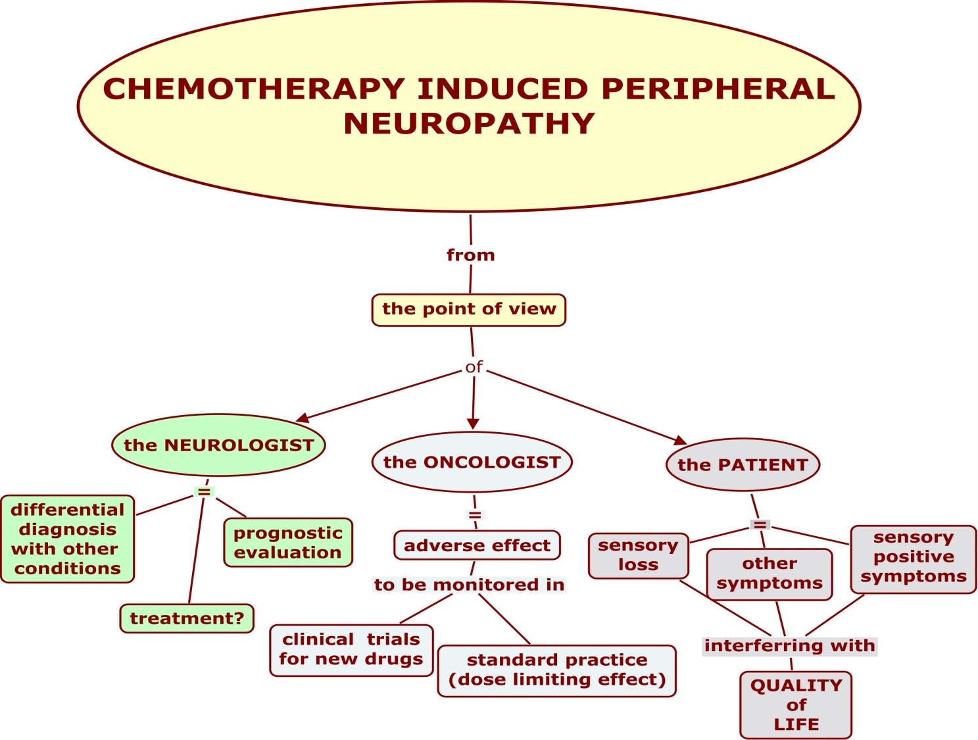


Slide 4
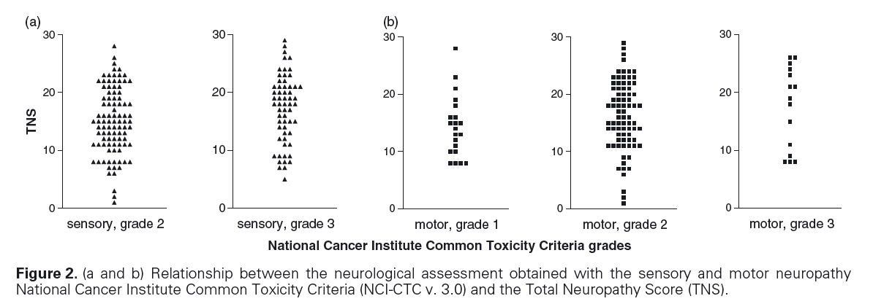
.
…….
.
.
…….
.
.
…….
.
.
…….
.
.
…….
.

Slide 5
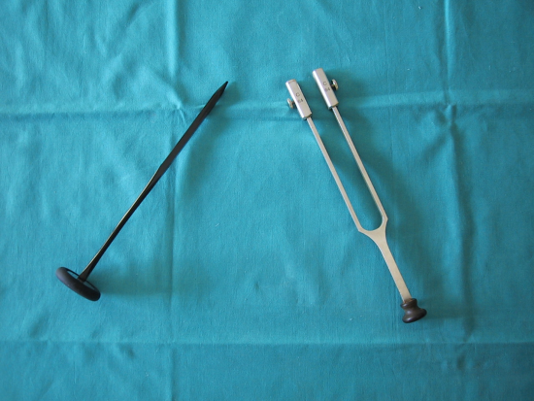
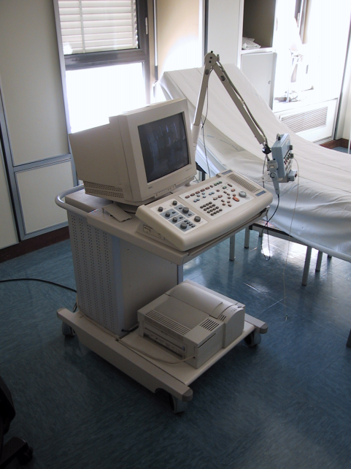
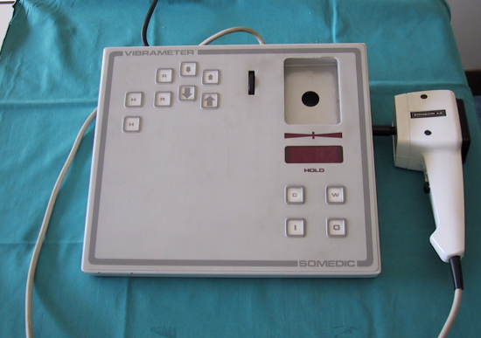
Outcome measures
Clinical?
Neurophysiological?
QST?
CTC?
Composite scales?
PRO?
???

Slide 6

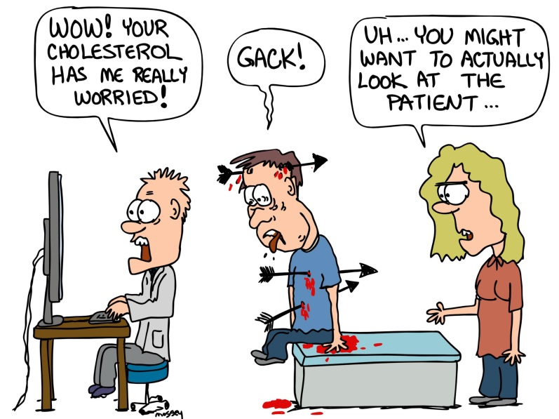

Slide 7
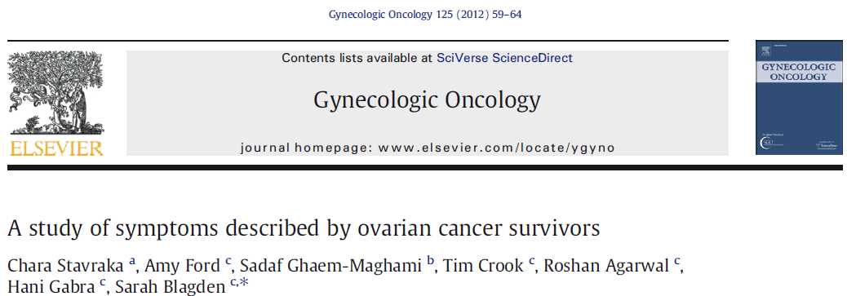
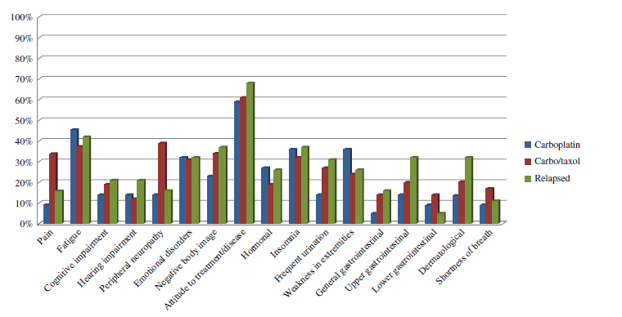

Slide 8
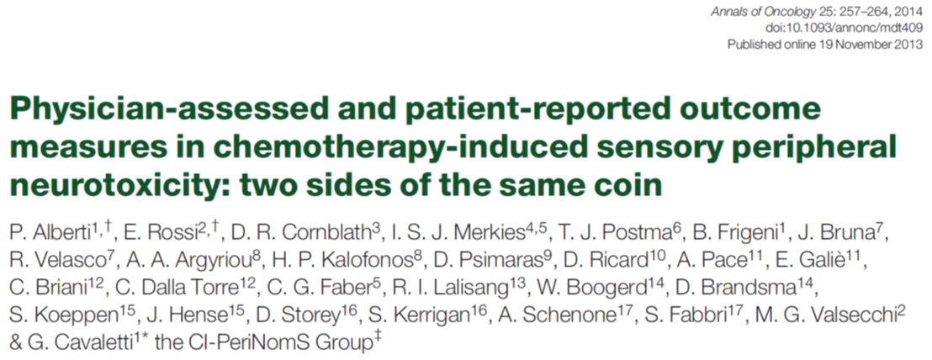
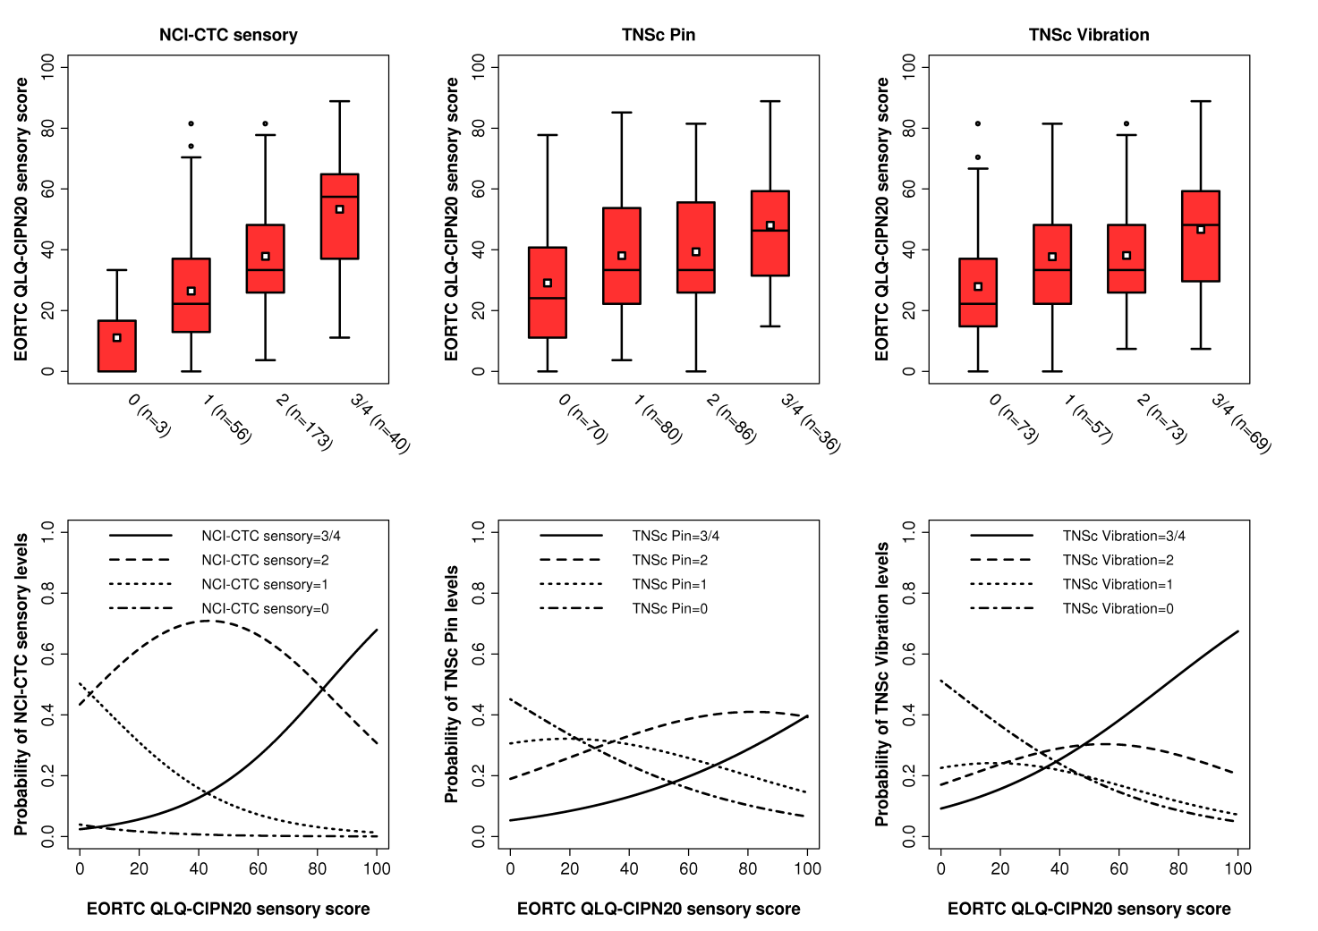

Slide 11
Drug-specific PROMs

Slide 13
Clinical Studies
Initial trials must be performed in patients with metastatic disease as the outcome on tumor related endpoints (i.e. survival, PFS) is unknown
Important to consider comorbidities with increased risk of neuropathy in the trial design
Well-designed, randomized, placebo controlled trials with a homogeneous patient population (same tumor type, same stage of disease, same treatment) and with appropriate endpoints
  Symptom assessment and severity
  Objective measure(s) of functional loss
More than one trial necessary to confirm safety and efficacy
Courtesy of Lynn Howie
Notes:
In addition to pain, need to evaluate sensation (numbness/tingling), function (buttoning, dropping objects, and

Slide 14
Symptom-Measurement Scales
The symptom(s) which are selected for study must be validated using the chemotherapy regimen in the disease studied
  Focus group(s) of patients (same disease and stage, same chemotherapy) to determine the most bothersome symptoms
  Testing symptom assessment in a new larger group (same disease, same chemotherapy)
    Demonstrate that symptoms selected occur at a frequency that allows study
    Demonstrate that scales used detect the severity of the symptoms can be validated statistically
Courtesy of Lynn Howie
Notes:
Symptom identification and measurement is the most difficult part of the development

Slide 15
Functional Evaluation
Objective measure of the impact on the functional impairment
Measure(s) have to be sensitive enough to detect differences between arms
Functional assessment must be validated
Challenge is to develop a group of functional assessments that can be used in clinical trials with different chemotherapies or across different classes of chemotherapy drugs
Courtesy of Lynn Howie

Slide 16
Trial Design: Other Considerations
Trial duration
  Long enough to detect the onset, the progression, and the possible improvement in the chronic neuropathy
  Long enough to ensure adequate information about tumor-related endpoints (i.e. safety) is available
Functional and symptom assessments should be validated in cancer population
Given lack of clarity of relationship between acute neuropathic syndromes and chronic syndromes, targeting acute neuropathic syndromes is not clear surrogate for clinical benefit
Courtesy of Lynn Howie

Slide 17


Slide 18
Develpoment of a PRO instrument

Slide 19




Slide 21
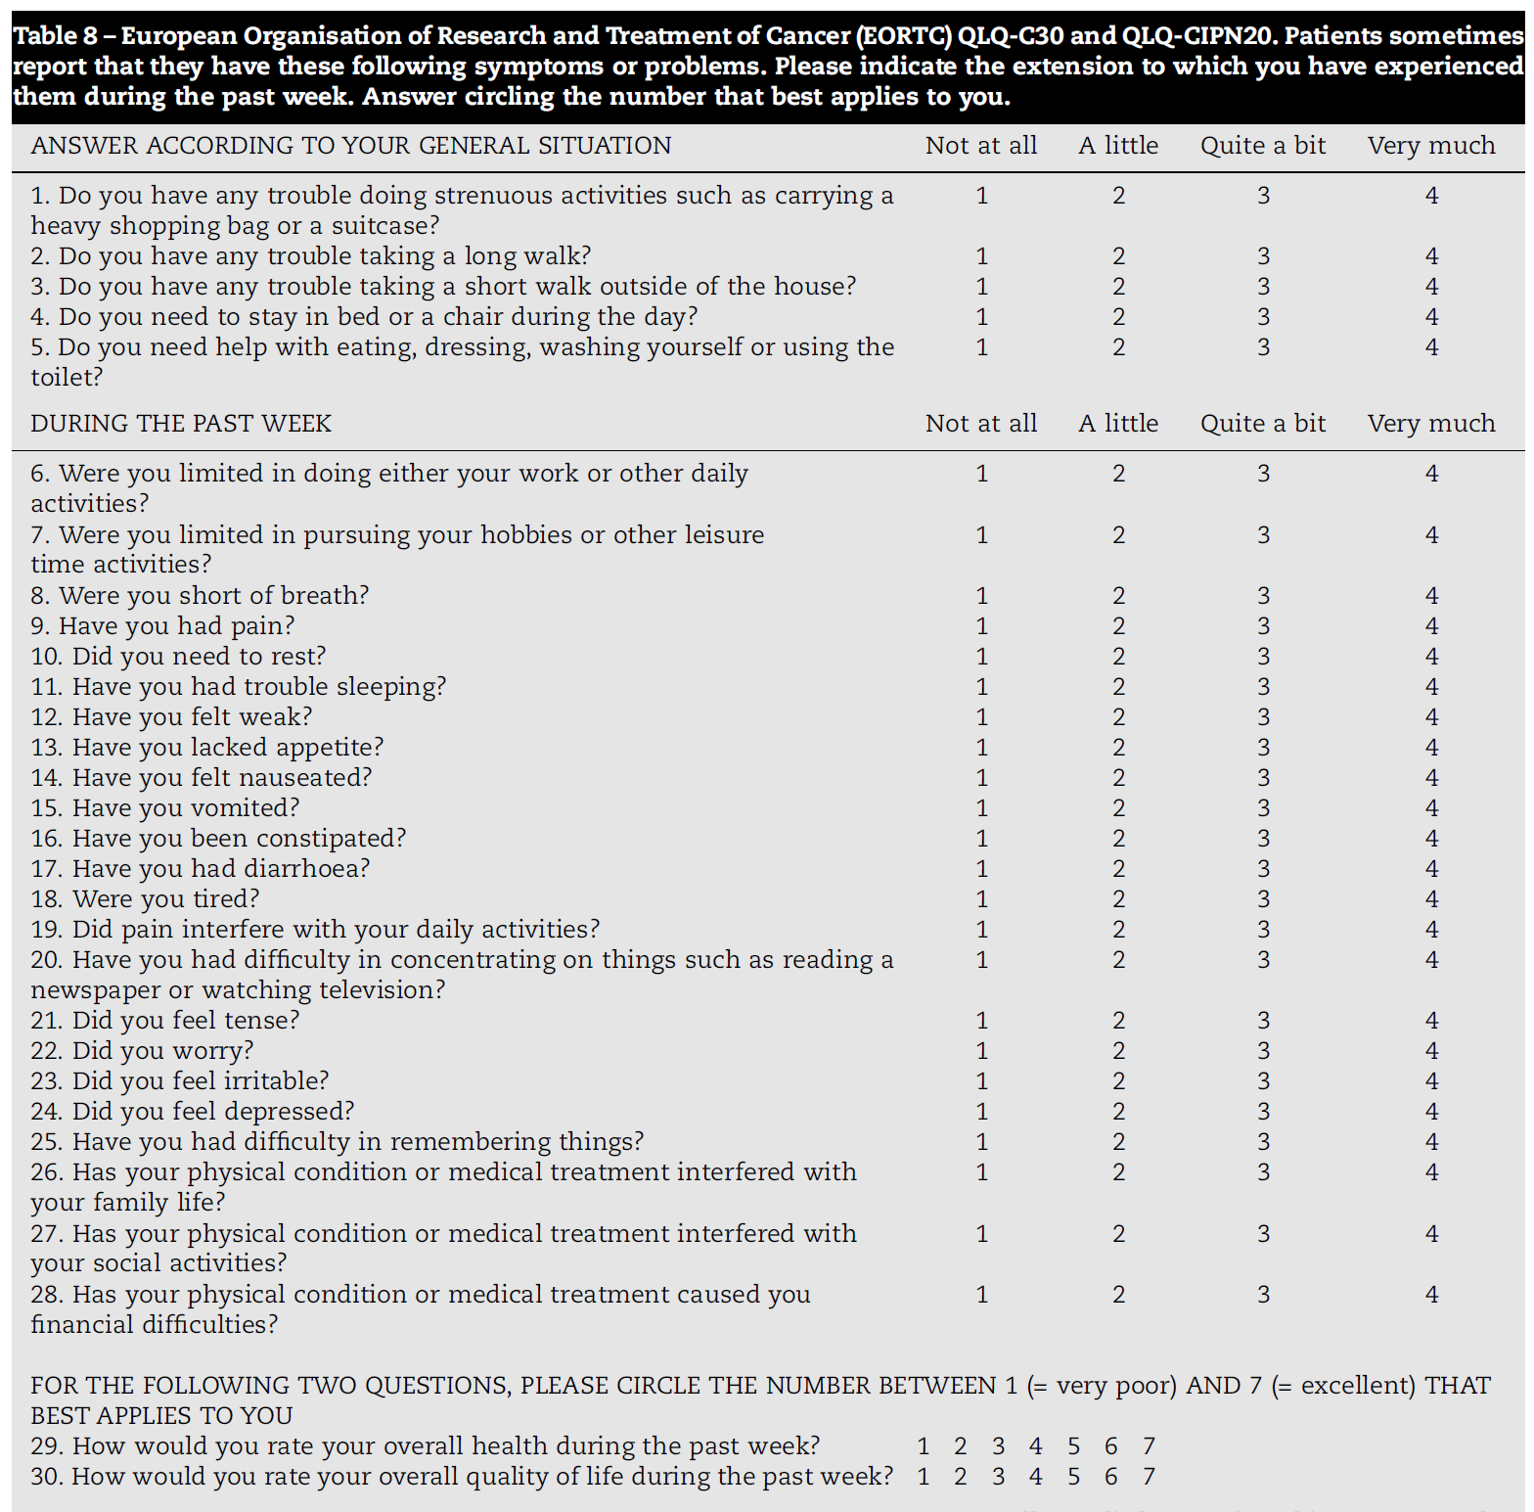

Slide 23
S
M
A

Slide 25
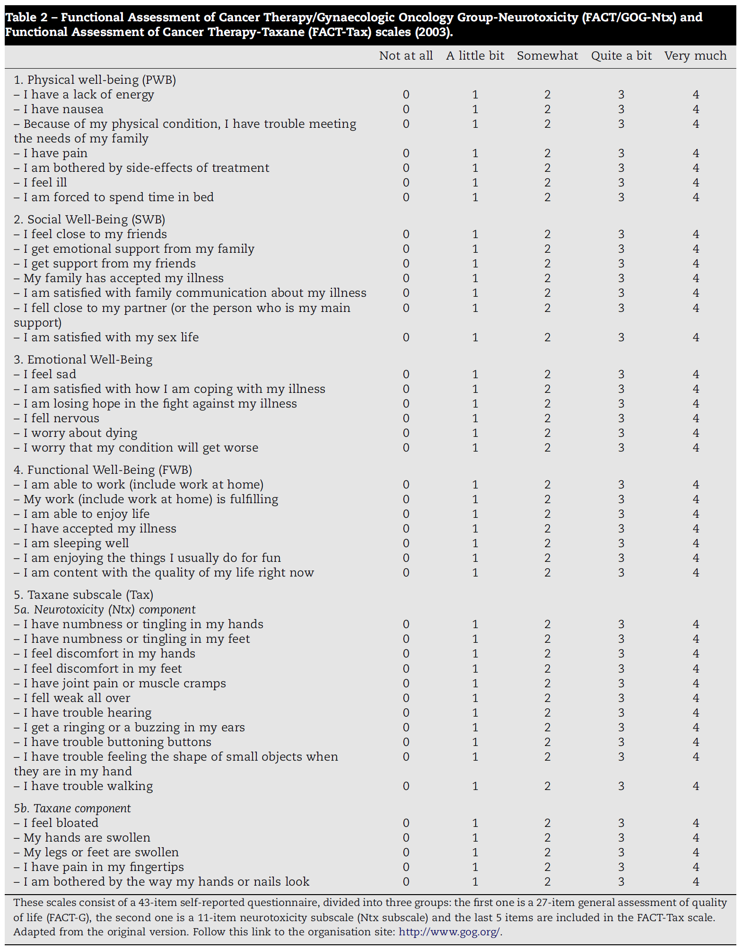

Slide 32


Slide 33

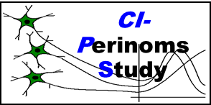



Kick-off meeting, Pomezia 2007
New Partners are WELCOME!!

Slide 34
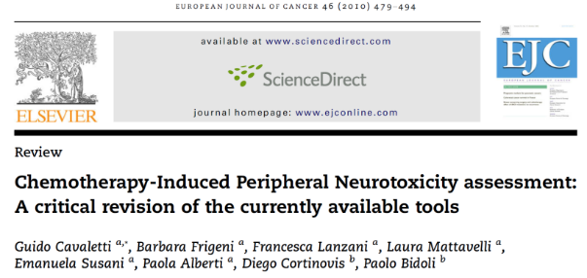
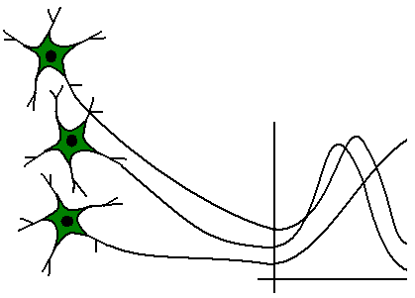
CIPN assessment
CI-Perinoms
Study
Current physician-based measures are inadequate:
  Mix of disability and Quality of Life items
  Items not unambiguously described
  Lack of clinimetric evaluation.

Slide 35
Classical Test Theory (CTT)
CI-Perinoms
Study
  Biggest disadvantage : Classical Test Theory (CTT)
  Recruit items arbitrarily
  Complete all items
  Sumscores
    Equal relevance and weight of all items?
    Difference in sumscore?
  Lack of linearity: ordinal scale
Devellis, Med Care 2006

Slide 36
Classical Test Theory (CTT)
CI-Perinoms
Study
Ordinal scales: lack linearity
Impossible 0 | Very difficult 1 | Difficult 2 | Easy 3
Ordinal scales
?
?
?
5 cm
10 cm
Linearity

Slide 37

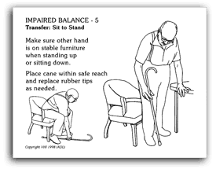

RASCH Theory:
1. transform ordinal to interval scale
2. the patient’s response to an item depends on the ability of the patient and the difficulty of the item
Less active
patients
More active
patients
-6
-5
-4
-3
-2
-1
0
1
2
3
4
5
6
1 logit
1 logit
Easiest items
Most difficult
items

Slide 38
CI-PeriNomS
Study
CI-PeriNomS Study
Investigators meeting
12 November 2011, Monza
Rasch-built Overall Disability Scale for patients with chemotherapy-induced peripheral neuropathy (R-ODS-CIPN)
Davide Binda, Guido Cavaletti, Catharina G. Faber, Els Vanhoutte, David R. Cornblath, Tjeerd Postma, Ingemar S.J. Merkies
on behalf of CI-PeriNomS study group*

Slide 39
CI-PeriNoms Study questionnaire development
CI-Perinoms
Study
Item generation: Literature review - WHO ICF
Pre-phase Rasch-built Overall Disability Scale: 146 activity and participation items
Pre-phase R-ODS was assessed twice (test-retest)
Rasch unidimensional measurement model (RUMM 2030)
Notes:
International Classification of Functioning, Disability and Health

Slide 41
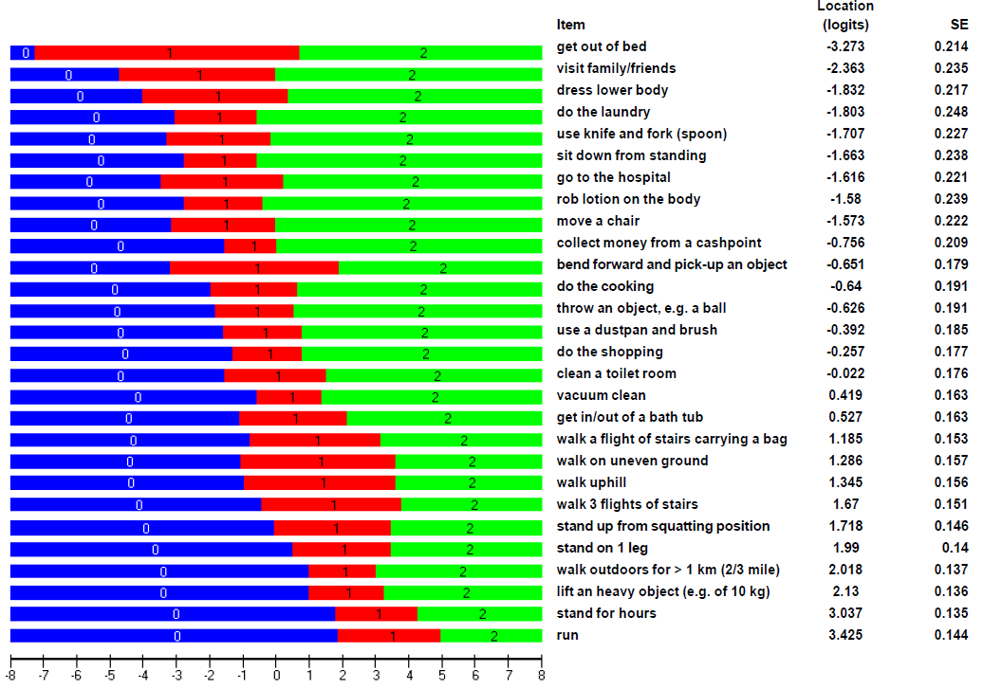

Slide 42
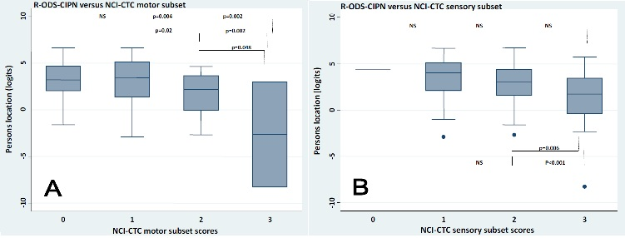
RODS-CIPN
Reliability
CI-Perinoms
Study
Validity
RODS-CIPN vs NCI-CTC motor and sensory subscore

Slide 43
RODS-CIPN
CI-Perinoms
Study
Easy to be completed and communicable
Valid and reliable disability outcome measure
Responsiveness needs to be evaluated (ongoing!)
Disability is a generic terms:
  RODS-CIPN for activity limitations and participation restrictions level
  Total Neuropaty Score for impairment level

Slide 44


Slide 45
Clinical Studies: Additional Caveats
Efficacy: Symptom and functional assessment are required
  Seek early advice from FDA Clinical Outcomes Assessment group regarding appropriate measures
Safety: Evaluation of adverse events (CTCAE) and demonstration there is no decrement in tumor-related outcomes (i.e. overall survival, PFS)
Balance of safety and efficacy is key for successful development
Courtesy of Lynn Howie
Notes:
Go back and figure out how to clean up this slide to say same thing

Slide 47
EORTC CIPN20

Slide 49
«In the final PRO guidance, the elimination of MID is accompanied by an emphasis on establishing meaningful change in PRO measures at the individual level (i.e., defining a responder) versus at the treatment group level.
This new focus is demonstrated by the definition provided for a responder in the final PRO guidance as being “a score change in a measure, experienced by an individual patient over a predetermined time period that has been demonstrated in the target population to have a significant treatment benefit”»

Slide 50


Slide 51


