Slide 1
Overview of Chemotherapy-Induced Peripheral Neuropathy over 55 years of neuropathic toxicity: if not now, when do we take aaacttion
Joanna M Brell, MD
Clinical Associate Professor of medicine
Case Western Reserve University
Associate Director Cancer Center for clinical research
MetroHealth Cancer Center
March 23, 2017

Slide 2
outline
Incidence and diagnosis
Case report
Significance
American Society Clinical Oncology approach

Slide 3
definition Chemotherapy-induced peripheral neuropathy (CIPN)
You know it when you see it……
Symptoms predominantly of sensory neuropathy – distal extremity numbness, paresthesias, burning pain, cramping, weakness, imbalance/proprioception – within a usual time frame from receipt certain cancer therapies
Onset and symptoms prescripted by anti-cancer therapy
Range of symptoms: sensory vs pain vs both

Slide 4
Peripheral nerves: different morphology and functions http://www.emeraldinsight.com/books.htm?chapterid=1775219&show=html

Slide 5
CIPN description
Most common Dose-Limiting Toxicity (DLT) as N&V, neutropenia more preventable
No FDA-approved treatments or prevention
Further translational data to inform development of treatments
Unmet clinical need
Need definition of heterogenous, complex condition

Slide 6
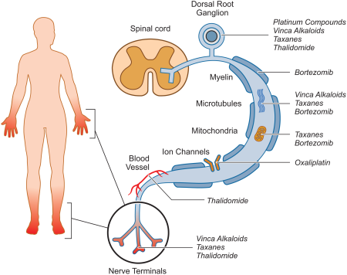
Chemotherapy‐induced peripheral neurotoxicity: mechanisms
Axonal degeneration
Mitochondrial dysfunction
Sodium channel abnormalities
Central sensitization
CA: A Cancer Journal for Clinicians Volume 63, Issue 6, pages 419-437, 11 NOV 2013 DOI: 10.3322/caac.21204 http://onlinelibrary.wiley.com/doi/10.3322/caac.21204/full#caac21204-fig-0001
Notes:
Depiction of the Typical “Glove‐and‐Stocking” Distribution of Chemotherapy‐Induced Peripheral Neuropathy (CIPN) Symptoms With Putative Targets for CIPN Toxicity in the Peripheral Nervous System Depicted From the Dorsal Root Ganglion to Axon and Axonal Components (Myelin, Microtubules, Mitochondria, Ion Channels, and Vascular Network) and the Distal Nerve Terminals.

Slide 7
Difficult to enumerate
Best estimates – sensory or motor or autonomic +/- pain
Differs for each implicated therapy: rate from 25-90%
Dependent:
on stage of cancer
national guidelines; clinical trials
dose, route of administration, infusion rate
host risk factors
Consensus: under reported without tools to diagnosis

Slide 8
2017 USA cancer incidence Seigel RL, et al ca: ca j clin January 2017

Slide 9
Incidence CIPN
57% of expected top 10 cancers 2017 could potentially be treated with CIPN-inducing agents = almost one million patients
Estimates of 30-40% of patients will develop CIPN at least 300,000 – 400,000 new cases annually
Approximately 40,000 – 64,000 patients/year with colorectal cancer (stages II some, III, IV) will develop CIPN

Slide 10
diagnosis of cipn vital for clinical trial eligibility
Anti-cancer therapy type - known
Patient report - varied
Clinical exam – DTR, pinprick, vibration
Neurologic test – QST, sural nerve amplitude
Serum biomarkers - none
Imaging – none
Tissue – intraepidermal nerve fiber density (IENFD)
Germline mutations – not yet

Slide 11
Anti-cancer therapies associated with cipn
CLASS/MECHANISM of ACTION | DRUGS
Platinums | cisplatin, oxaliplatin, carboplatin
Vinca alkyloids | vincristine, vinblastine, vinorelbine
Taxanes Microtubular inhibitors | Eribulin, paclitaxel, docetaxel, nano- particle paclitaxel
Epothilones | ixabepilone
Proteasome inhibitors NF-kB inhibitor | bortezomib, ixazomib
Immunomodulators/ Angiogenesis inhibitors | interferonα-2b, thalidomide, lenolidamide
Experimental | PI3K inhibitors, JAK2 inhibitors
Targeted therapies | crizotinib
Others | procarbazine, cytarabine, etoposide

Slide 12
Patient reported outcomes (pro) in cipn for diagnosis
Allodynia, hyperesthesias, numbness or neuropathic pain, etc
NRS 0-10
FACT/GOG-Ntx - Functional Assessment of Cancer Therapy/ Gynecologic Oncology Group-Neurotoxicity
EORTC QLQ CIPN-20 - sensory (9), motor (8), autonomic (3
Functional Assessment of Cancer Therapy– Taxane (FACT-Taxane) scales
Peripheral Neuropathy Questionnaire (PNQ)
Oxaliplatin-Specific Neurotoxicity Scale (ONS)
Some PROS suffer from lack of validation

Slide 13
pro in cipn for diagnosis
++++++ strengths | ---------weaknesses
Individually experienced sensations | Patient confusion about questions, scales
Patients are direct source | Cannot discern between numbness/paresthesias vs pain
Peripheral neuropathy clinical assessments not always specific and sensitive | Expectations influence reports Observed = Reported
Easily obtained in clinic | Few validated instrument encompassing potential symptoms

Slide 14
Clinicians assessment
NCI common terminology criteria for adverse events (CTCAE v4)
Created for adverse event reporting, however utilized as diagnostic and outcomes tool
5 grades: mild/asymptomatic changes grade 1
moderate/symptoms/intervention/iADLs grade 2
severe/hospitalization/ADLs grade 3
life-threatening/urgent intervention grade 4
death grade 5
The association between clinician-based common terminology criteria for adverse events (CTCAE) and patient-reported outcomes (PRO): a systematic review. Atkinson TM, et al supp care 2016;24:3669

Slide 15
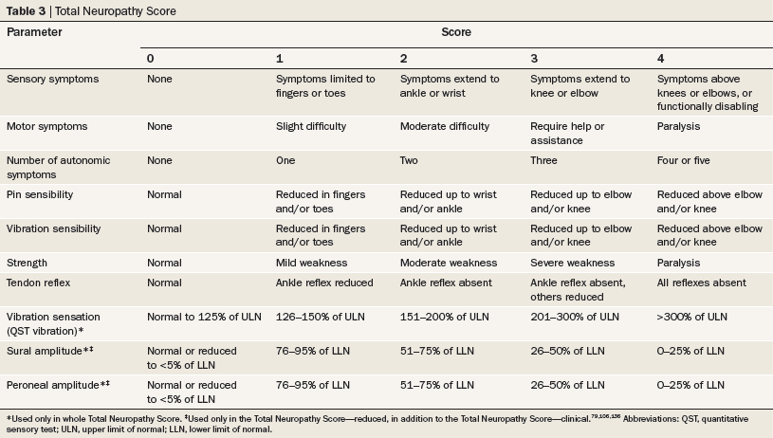
Cavaletti, G. & Marmiroli, P. (2010) Chemotherapy-induced peripheral neurotoxicity
Nat. Rev. Neurol. doi:10.1038/nrneurol.2010.160
Table 3 Total Neuropathy score
– several versions

Slide 16
Clinical case study for patient impact
69 y/o African-American female
type II diabetes x 8 years, no insulin (? hgbA1c), BMI 31
works part time seamstress but sedentary, lives alone
Adenocarcinoma colon  hemicolectomy:
Stage IIIB (T3N1bM0) 2 poor prognostic features
5 year overall survival ~ 50%
Priority is longer life  adjuvant therapy to decrease risk:
FOLFOX oxaliplatin 85 mg/m2 IV every 2 weeks
12 cycles/ ~ 6 months

Slide 17
Clinical course
cycle 1: before leaving cancer center c/o SOB, laryngospasm, perioral sensations – decadron IV
cycle 1: couple hrs cold-induced perioral and pharyngolaryngeal dysesthesias and paresthesias fingers last 1-2 days – glass
cycle 4: cold induced symptoms last 7-9 days after chemo; mild paresthesias in toes

Slide 18
Clinical course
cycle 5: in addition numbness in fingers and toes but still mild per patient (grade 1)
cycle 7: dropping objects, cramping hands, cannot pick up needles off counter (grade 2) but all other ADLs
cycle 7: 20% dose reduction oxaliplatin
No symptomatic treatments desired as denies any pain – no disease modifying agents

Slide 19
Clinical course
cycle 8-10: “stable” or “improved” symptoms - patient not reporting ?
cycle 11-12: “stable” later admits did not report worsening
6 weeks later abrupt worsening of symptoms
4 months later fingers and toes numb, no return to work
6 months later diabetic foot ulcer1st digit

Slide 20
Clinical course
Risk factors:female, increasing age, African American, diabetes, obesity
Acute oxaliplatin neurologic symptoms experienced by almost all immediately or within several hours of infusion (reaction? ion channel dysfunction?: cold-induced perioral paresthesias, pharyngolaryngeal dysesthesia, SOB without hypoxia, jaw stiffness, muscle cramps)
Chronic sensory PN can be predicted by acute symptoms, early paresthesias?
Burning pain uncommon with oxaliplatin
Patients may not report accurately, under report, have high tolerance
Coasting often forgotten

Slide 21
Survivor Consequences of CIPN – urgency for discoveries ~15.5 million cancer survivors 2016
5 year overall survival rate of all USA cancers 67%
2/3 survivors > 5 years out from initial diagnosis
Living cancer-free:
after treatment for the remainder of life
after treatment for many years but experiencing one or more serious, late or chronic complications of treatment
after treatment for many years, but dying after a late recurrence
after the first cancer is treated, but developing a second cancer
Living with intermittent periods of active disease requiring treatment
Living with cancer continuously, with or without treatment

Slide 22
Consequences of CIPN - physical
Anti-cancer therapy dose reduced or discontinued
No information regarding potential influence on survival outcomes
Functional status diminished
Daily activities altered: fine skills with hands, keyboarding, cooking
Difficulty ambulating
Chronic pain
More dependent on friends and family

Slide 23
Consequences of CIPN - QOL
Chemotherapy-induced neuropathy and its association with quality of life among 2- to 11-year colorectal cancer survivors: results from the population-based PROFILES registry. Mols F, et al J Clin Oncol 2013;20(21):2699-707
The trajectory of neurotoxic side effects’ impact on daily life: a qualitative study. Drott J, et al. Supp care ca 2016 DOI 10.1007/s00520-016-3179-1
Spiritual pain from persistent chemotherapy-induced peripheral neuropathy in colon cancer patients in Japan. Kyota A, et al Ann Ca Res 2016;7:3

Slide 24
Consequences of CIPN – financial Toxicity
Often unable to return to workforce or societal roles as caregivers, students
Caregivers for the patients have lost productivity
If patient is caregiver, replacement needed
Costs of healthcare
2010 estimated $2 billion/yr USA
one million outpatient visits for CIPN at $4900/patient¹
2012 estimated $17,344/patient/yr (~$5.2 billion/yr USA)
CIPN in breast, ovarian, head/neck, or NSCLC patients with increased healthcare utilization/costs/work loss compared to diabetics and controls – all health spending
$8,092/yr outpatient²
1 IMS Health data Lema, et al Oncologist; 2010
2 Administrative claims database CT Pike, et al Chemother Res Pract; 2012

Slide 25
Prevention and Management of Chemotherapy-Induced Peripheral Neuropathy in Survivors of Adult Cancers: American Society of Clinical Oncology (ASCO) Clinical Practice Guideline Hershman et al JCO 2014 32(18) 1941-1967
Determine prevention and treatment approaches for CIPN in adult cancer survivors
48 eligible RCTs from 1990 – 2013 with CIPN outcome of interest
Small sample size
Heterogeneous in eligibility criteria, populations
Multiple different outcomes, measurements, instruments
Different time points for primary objective
No recommendations for prevention strategies

Slide 26
AGENT/ Chemotherapy | N | INCIDENCE | SEVERITY | NEURO PHYSIOLOGY | PRO/QoL
Duloxetine/ taxane or platinum | 231 | NR | 30% - 50% pain ↓ P=0.003 | NR | BPI-SF FACT GOG-Ntx
Gabapentin/ taxane, vinca, platinum | 115 | NR | NR | NR | PRO pain, neuropathy
Lamotrigine/ taxane, vinca, platinum | 131 | NR | Symptom reduction ECOG pain scale | NR | ECOG pain scale
Nortriptyline/ cisplatin | 51 | NR | NR | NR | VAS
Amitriptyline/ taxane, vinca, platinum | 44 | NR | NCN-CTCAE | NR | Diary data QoL
Topical BAK/ thalidomide taxane, vinca, platinum | 208 | NR | EORTC CIPN-20 | NR | BPI Profile of mood
Treatment
RCT

Slide 27
American Society of Clinical Oncology Clinical Practice Guideline 2014 recommendations
Develop comprehensive and standardized approach to assessment of CIPN
to ensure the reliable and valid acquisition of data
allow clinicians to better recognize, understand, and respond to CIPN
RESEARCH AGENDA:
Investigate the efficacy of high-dose capsaicin preparations for severe CIPN, topical menthol, BAK
Another phase III trial of gabapentin or pregabalin
RCT for efficacy of electrocutaneous nerve stimulation on going
Other complementary or alternative medicine modalities are ongoing

Slide 28
National Cancer Institute community oncology research program (NCI NCORP)
NCORP peer-reviewed grants to cancer centers/cooperative groups to perform large phase II-III clinical trials in community
Community medical oncologists with time and resource constraints
Competing interests:
Patients with multiple adverse events
Attend to “treatable” side effects
Less time for neurologic assessment
Not best environment for complex clinical studies
Notes:
Pain (trigeminal neuralgia)
Inherited (Charcot-Marie-Tooth disease)
Trauma
Systemic conditions (diabetes, infection, chronic inflammation, autoimmune, cancer)

Slide 29
NCI investment in CIPN mainly via Ncorp
CIPN Clinical Trials Planning Meeting March 2009
Reviewed clinical research, knowledge gaps
CIPN Workshop June 2011
Sponsored by NCI-DCP, NCI-DCCPS, NINDS
Mechanistic research recommendations
Lead to Funding Opportunity PA-12-082, 083
CIPN Clinical Trials Planning Meeting March 2017
Developing novel trials informed by translational science

Slide 30
CIPN Clinical Trials Planning Meeting March 2017 Developing novel trials informed by translational science
NCORP members, community oncologists, academic neurologists, PhD researchers, advocates
Longitudinal study recommendations:
Work with SWOG database – not certain of exact data to be recorded; recommended cancer type, treatments with doses, drug levels, phenotype, PRO, neurologic assessments, ? biospecimens
Interventional study recommendations:
Phase II studies ~ 60 pts of promising new drugs (not yet available), exercise, duloxetine as prevention (mechanism?)

Slide 31
Summary CIPN
Chronic, debilitating problem touching receipt of cancer therapy, survivors, and society
No expectation incidence will decrease (Oxaliplatin 6 vs 12 cycles)
Increasing interest – multidisciplinary
Vincristine FDA approved 55 years ago
2017 is the year for AAACTTION

