Slide 1
Focal Entrapment Neuropathies in Diabetes
Vera Bril
Professor of medicine (Neurology)
The Ellen and Martin Prosserman Centre for Neuromuscular Diseases
University Health Network
University of Toronto

Slide 2
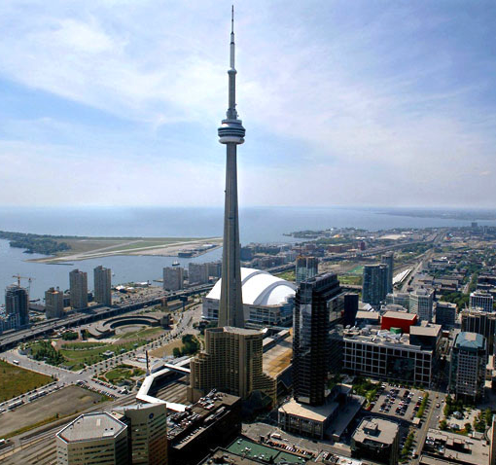
Disclosures
Consultant for Grifols, Octapharma, Baxalta, CSL, Bionevia, UCB, Argenx
Research support: Grifols, Octapharma, Baxalta, CSL, Bionevia
Guidelines process CDA, AAN/AANEM/AAPMR
Acknowledgements to Dr. Tayir Alon who reviewed the topic and summarized the literature.

Slide 3
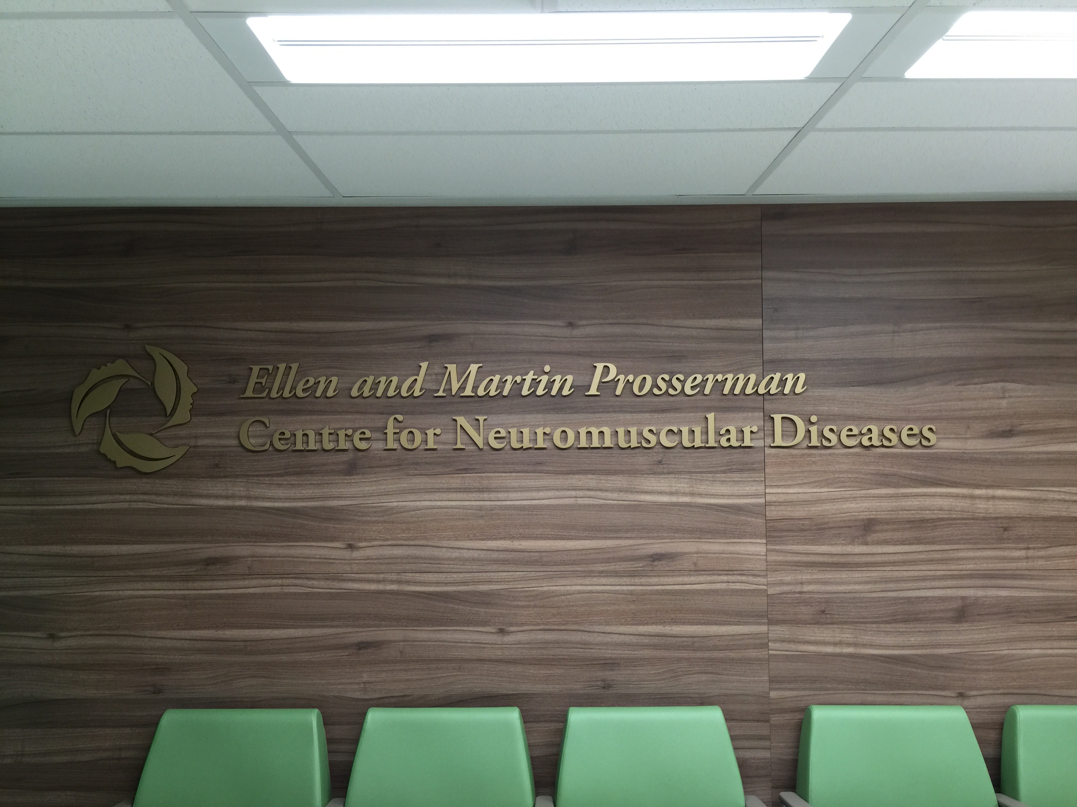

Slide 4
Mononeuropathies
Acute/chronic repetitive external pressure – compressive
Chronic distortion or angulation from internal source – entrapment
Focal nerve lesions
Motor findings in muscles supplied by the nerve distal to the lesion
Sensory findings less reliable
NCS
EMG

Slide 5
Differential Diagnosis
Mononeuropathy
DSP
CIDP
B12 deficiency
Hypothyroidism
Uremia
Ethanol
Familial
Paraprotein
CA
Toxic
Cranial nerves 3, 4, 6, 7
Median, ulnar, radial, peroneal
LSRPN: femoral amyotrophy
Nerve entrapments
Aneurysms
Spinal Stenosis
CIDP variants

Slide 6
Peroneal Nerve
Prevalence, incidence uncertain
Trauma to knee/hip, compression at knee (kneeling, surgery), intrinsic lesions (cyst, ganglion)
Fairly common

Slide 7
Peroneal Neuropathy
2 small case series:
5-30% of peroneal nerve entrapment at head of fibula found in patients with diabetes (Stamboulis 2005, Garland 1952)
642 patients reviewed: 7/23 with peroneal nerve palsy had DM (30%)
(Greece: 1994-1999)

Slide 8
Peroneal: Anterior Tarsal Tunnel Syndrome
Entrapment of the deep peroneal nerve at the ankle
Pain on the dorsum of the foot + sensory deficits in the web area between toes 1 & 2
Observational studies on peroneal nerve release as treatment for diabetic neuropathy
Based on Tinel’s sign at sites of potential entrapment, not on NCS
AAN 2006
Tannemaat 2016
No definitive proof

Slide 9
Ulnar Neuropathy
Compression at retroepicondylar groove, at aponeurotic arcade joining 2 heads of FCU, at arcade of Struthers more proximally or more distally at exit from FCU
Repeated trauma at retroepicondylar groove, pressure in surgery, accessory anconeus muscle, spontaneous hemorrhage, gouty tophus, low BMI
Standardized yearly incidence of 20.9 per 100,000 (Mondelli, 2005)

Slide 10
Ulnar Neuropathy
642 patients reviewed: 5/41 with ulnar nerve palsy had DM (12%) (Stamboulis 2005)
About 6% of patients with UN at the elbow, UNE, have diabetes
Small study: 19% of UNW patients have DM (Murata 2003; 31 subjects retrospective)
Controversial whether DM is a risk factor for UNE

Slide 11
Ulnar Neuropathy
Rota 2014, 64 consecutive DM patients
DX of UNE:
decreased SNCV as well as SNAP of the ulnar nerve
absolute slowing of ulnar motor conduction velocity (CV) across the elbow <50 m/s (<46 m/s for subjects aged 65 or over)
differential slowing of more than 10 m/s of the CV across the groove compared to the forearm segment
conduction block, i.e. a reduction of compound muscle action potential (CMAP) area/amplitude of at least 20% comparing above and below the elbow.

Slide 12
Ulnar Neuropathy
UNE found in 22 patients (34%)
-recording from the ADM muscle in 16 patients
-recording from the FDI in 14
-and from both in 8.
18/22 patients with UNE (82%) had polyneuropathy
Only 2 subjects (6%) in the UNE group complained of sensory symptoms and showed clinical signs consistent with clinical UNE.

Slide 13
Ulnar Neuropathy
Dx UNW
distal motor latencies to FDI of >4.5 ms
distal motor latencies comparing FDI to ADM > a 2 ms difference
distal motor latencies comparing FDI to contralateral FDI > a 1.3 ms difference
distal motor latencies comparing ulnar interosseus to second lumbrical of >0.4 ms difference.

Slide 14
Ulnar Neuropathy
UNW found in 7 patients (11%)
100% had polyneuropathy
Only 2 subjects (6%) in the UNE group complained of sensory symptoms and showed clinical signs consistent with clinical UNE.

Slide 15
Ulnar Neuropathy
Jang 2014
105 DM patients without clinical Ulnar neuropathy
Criteria:
absolute MCV from above elbow (AE) to below elbow (BE) of less than 50 m/s (AANEM1)
an AE to BE segment greater than 10 m/s slower than the BE to the wrist segment (AANEM2)
inching test, with 0.4 ms as the upper normal limit of latency difference per 1 cm segment
41% had one of these criteria of UNE
41% had at least 1 abnormality

Slide 16
Ulnar Nerve Treatment
Failure of surgery related/unrelated presence of DM depending on report
Poor results in up to 30% with revision in 3%, independent of DM (1987, 2016)

Slide 17
Carpal Tunnel Syndrome
Most common
Lifetime risk about 10%
Risk: basic anatomy, limited longitudinal sliding of nerve, higher BMI, greater AP diameter, small hand, presence of palmaris longus and fifth flexor digitorum superficialis, anomalous artery, ganglion cysts
Idiopathic: enlarged nerve, women, age, dominant hand, cane
642 patients reviewed: 40/522 with carpal tunnel syndrome had DM (7.7%)
(Greece: 1994-1999)
Pourmemari, 2016: review: risk of CTS in DM increased by 1.97 or 1.67 in case control studies

Slide 18
CTS
What is the diagnosis?
NCS or clinical syndrome?
Albers 1996: 95/414 participants (23%) fulfilled criteria for MM, independent of diabetes type. (excluded subjects with “greater than mild symptoms of carpal tunnel syndrome”, or absent lower limb sural/peroneal responses)

Slide 19
CTS
Perkins 2002
478 subjects – prevalence of clinical CTS
Reference subjects – 2%
DM without DSP – 14%
DM with mild, moderate and severe DSP – 30%
Diagnosis:
The presence of any four of the following six criteria established a diagnosis of CTS: history of paresthesia in hands and/or marked preponderance of sensory symptoms in the hands, nocturnal hand symptoms awakening patient, symptoms precipitated by activities such as holding a newspaper or driving a car and relieved by hand shaking, predilection for radial digits, weak thenar muscles, or upper-limb sensory loss solely within the distribution of the median nerve.

Slide 20
CTS
NCS
DMML, DMSL, DMMA, DMSA, and DMSCV. The PMSL, PMSCV and motor conduction velocity.
Median, ulnar, sural NCS
DMML-to-DUML, DMSL-to-DUSL, DMMA-to-DUMA, DMSA-to-DUSA, DMSCV-to-DUSCV, PMSCV-to-DMSCV, DMSL-to-SL, DMSA-to-SA, DMSCV-to-SCV, DMML-to-SL, and DMMA-to-SA.
None could distinguish CTS from non-CTS patients with DM.

Slide 21
CTS
Ultrasound
Different results in different studies on ability to show CTS in those with DM

Slide 22
CTS Treatment
Ozkul 2002
22 DM and 25 non-DM up to 1 year post-op
Electrodiagnostic parameters and global symptom score improved in both groups, but less in those with DM
Gulabi 2014
Prospective study
27 DM and 42 non-DM
All improved immediately
Followed up to 10 years; those with DM did not do as well

