Slide 1
Psychedelics: Current General Approaches for Studying as Therapeutic Agents
Roland R. Griffiths
Center for Psychedelic and Consciousness Research
Behavioral Pharmacology Research Unit
Department of Psychiatry and Behavioral Sciences
Johns Hopkins University School of Medicine

Slide 2
Acknowledgements and Disclosures
Support has been provided by grants from several different sources including the Heffter Research Institute, the Riverstyx Foundation, the Steven and Alexandra Cohen Foundation and Tim Ferriss, Matt Mullenweg, Craig Nerenberg, Blake Mycoskie
Roland Griffiths is on the Board of Directors of the Heffter Research Institute and he is site PI of a multi-site clinical trial funded by the Usona Institute to evaluate psilocybin as a treatment for Major Depressive Disorder

Slide 3
Background
The classic psychedelics are 5-HT_{2A} serotonin receptor agonists that produce a unique profile of changes in thoughts, perceptions and emotions. Classic psychedelics include psilocybin (from Psilocybe mushrooms), mescaline (from peyote cactus), DMT (in ayahuasca), and, LSD.
Historically, considerable human research was conducted with psilocybin and other psychedelics in the 1950s and 1960s
Subsequently, human research with these compounds went dormant for about 3 decades because of safety concerns raised in response to the widespread non-medical use of these compounds in the 1960s, exacerbated by the antics of Timothy Leary which undermined a scientific approach to studying these compounds

Slide 4
Abuse and risks of psilocybin
Psilocybin is classified as Schedule I (no medical use)
Psilocybin is not considered to be a drug of “addiction” because it does not produce compulsive drug-seeking behavior
Medical emergencies from psilocybin use are very rare
Concern about potential adverse effects, including panic reactions and possible precipitation of enduring psychiatric conditions
We documented the validity of these concerns in an in a survey of ≈2000 individuals who reported adverse experiences after taking psilocybin. 11% put themselves or others at risk of physical harm; and 10% reported enduring adverse psychological symptoms lasting ≥1 year. Such effects are very uncommon in laboratory studies.

Slide 5
Psilocybin research at Johns Hopkins
1999 – initiated development of our first study in healthy volunteers
Completed and ongoing studies:
psychedelic naïve healthy participants
psychedelic experienced healthy participants
novice and long-term meditators
religious professionals (i.e. clergy)
depressed and anxious cancer patients
participants with major depression
addicted cigarette smokers
To date: >370 participants in >700 psilocybin sessions

Slide 6
Studies in healthy participants
Rigorous double-blind experimental designs
Participants were medically and psychiatrically healthy, and most were without histories of psychedelic use
Participants met with the session monitors on several occasions before the first session to develop rapport and trust to minimize the risk of adverse reactions to psilocybin
Experimental conditions were designed to minimize expectancy bias

Slide 8
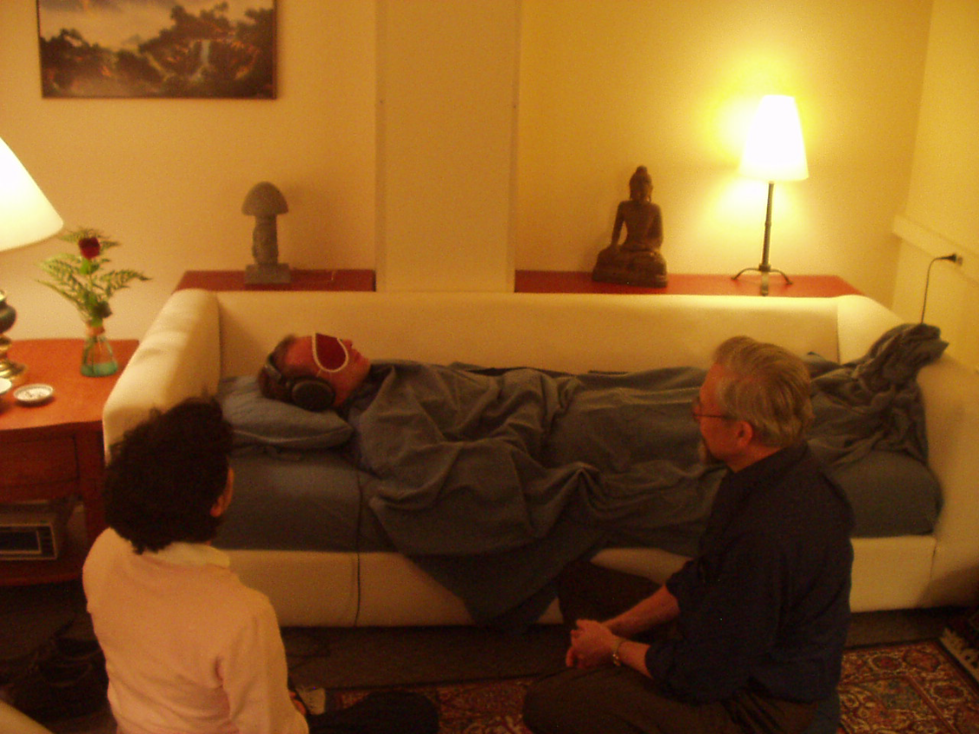

Slide 9
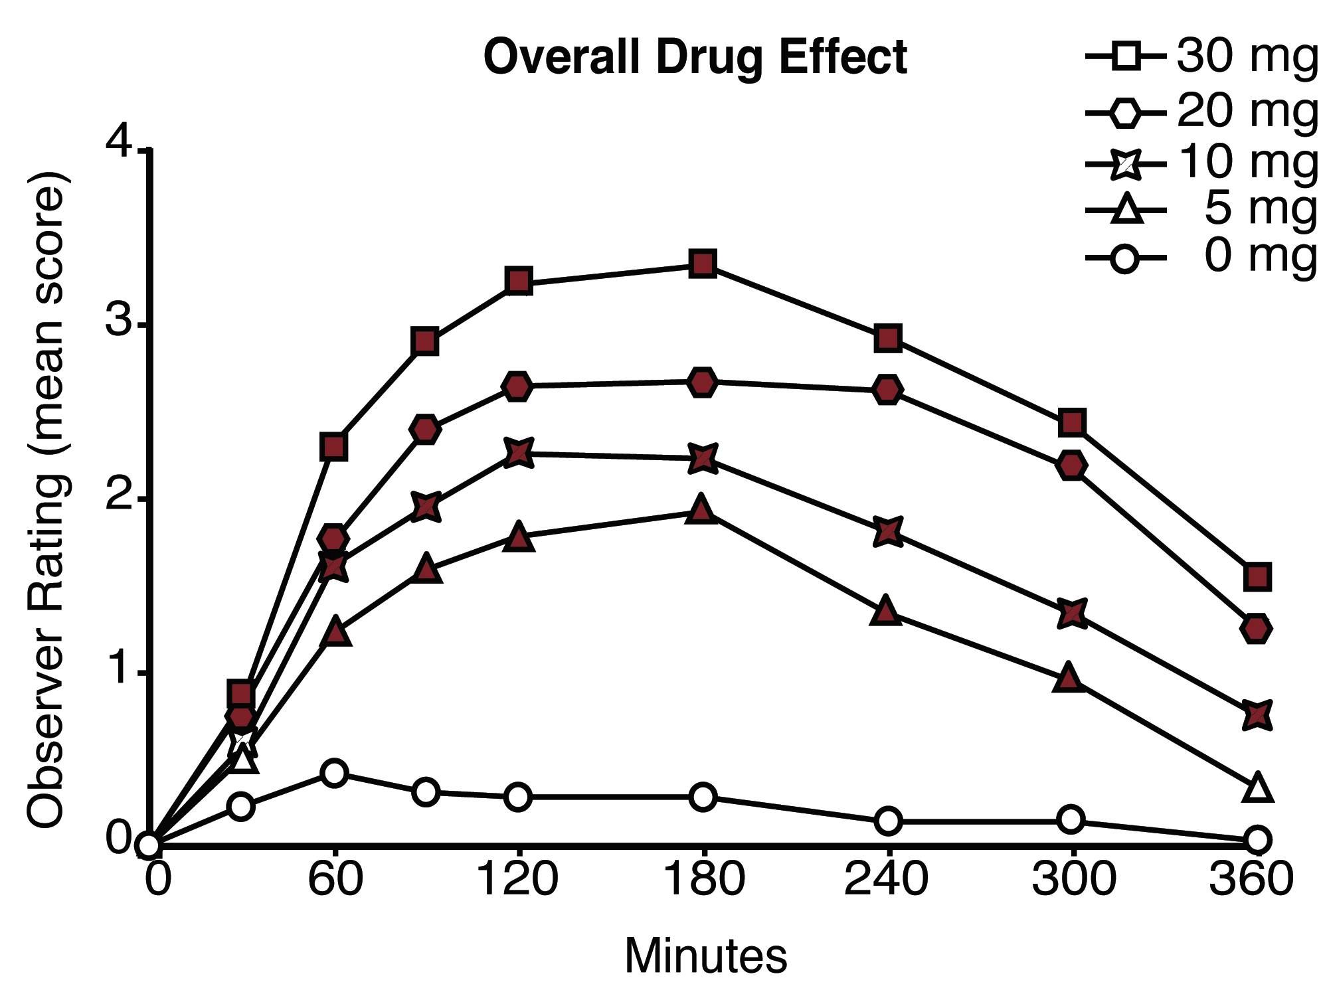
Time-course of monitor ratings

Slide 10
Post-session ratings of mystical- and psychologically insightful- types of experience
10

Slide 11
1 Month after the high dose sessions
≈ 80% -- among the top five most personally meaningful experiences of their life
≈ 90% -- increased sense of life satisfaction and positive behavior change
Positive attributions are sustained at least 14 months after sessions and confirmed by ratings from community observers (e.g. friends and family members)

Slide 12
Psilocybin treatment of depression and anxiety in patients with a life-threatening cancer diagnosis (2016)
51 cancer patients
Randomized, double-blind, cross-over design with two sessions about 5 weeks apart comparing a moderate-high psilocybin dose with a very low (placebo-like) dose

Slide 13
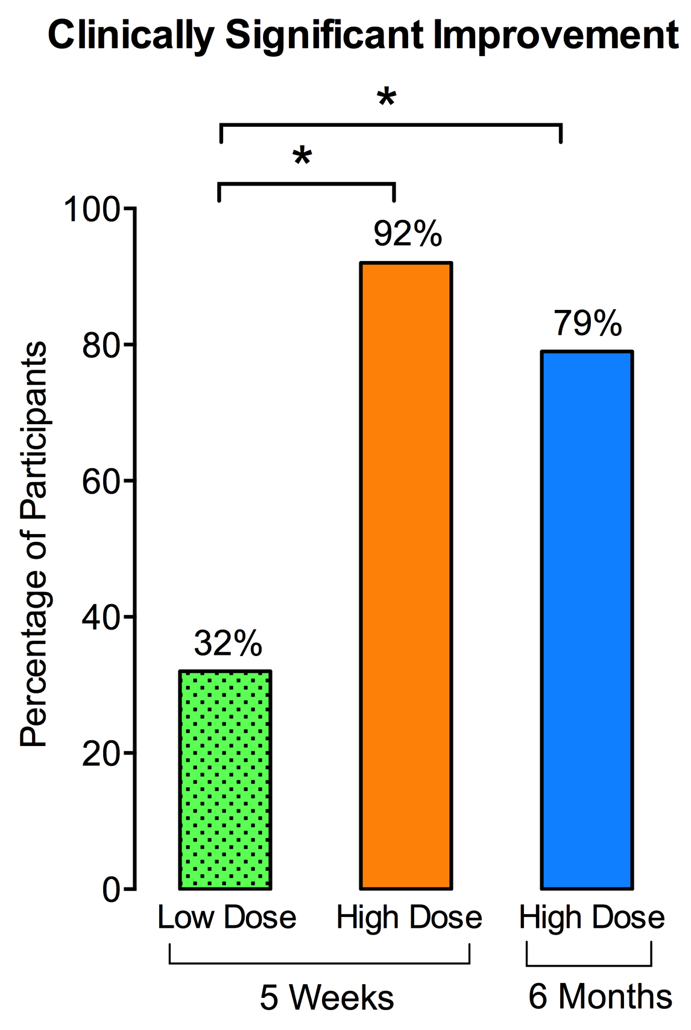
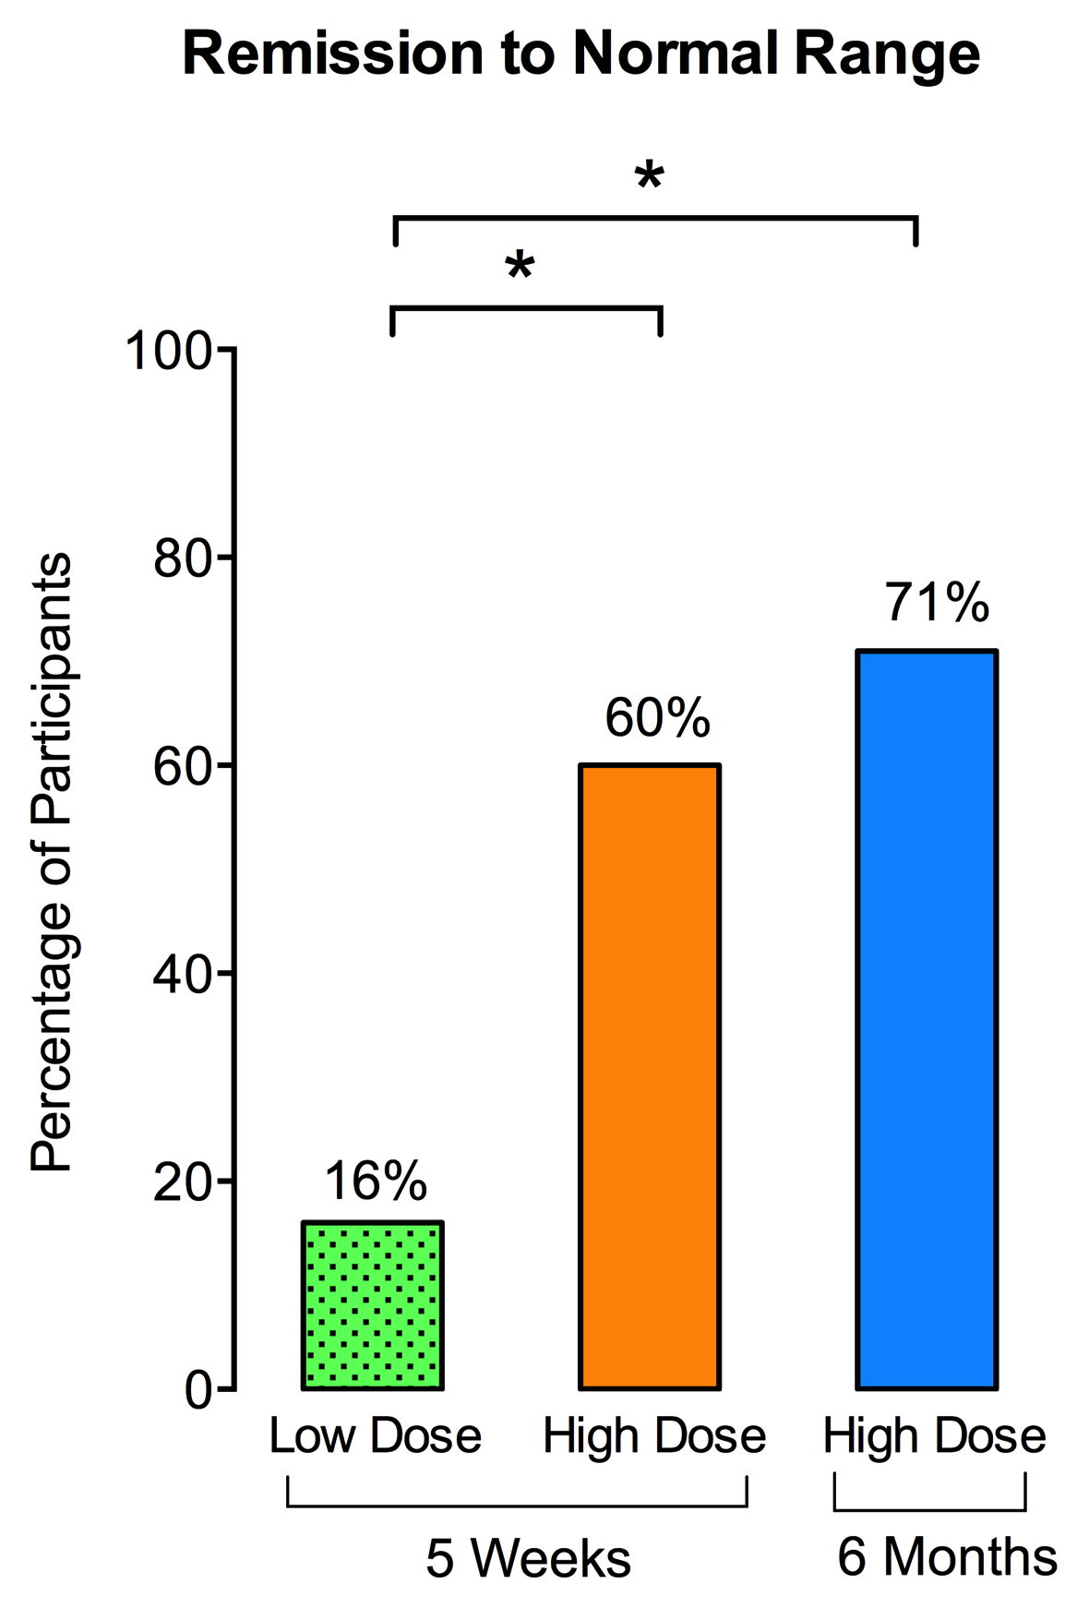
Depressed mood – HAM-D

Slide 14
Psilocybin treatment of Major Depressive Disorder (2019, unpublished)
Randomized delayed treatment (wait list) control trial examining efficacy of two psilocybin sessions (20 and 30 mg/70 kg respectively) under psychologically supported conditions
Notes:
Excluded bipolar illness
Selected individuals with some religious orientation
--psilocybin has been used sacramentally so this was a possible effect
--reduce variability by not allowing this to be random (it would be interesting to examine atheists or those not religiously inclined)
--also considered the possibility that if the study occasioned a profound possibly disorienting experience, interaction with those in a spiritual community might be helpful to the participant in interpreting or understanding the effect

Slide 15
Conclusion / Implication
Psilocybin occasioned discrete experiences have marked similarities to classic mystical- and insightful-type experiences. These experiences are associated with enduring positive trait changes in attitudes, mood, and behavior.
Data suggest possible efficacy in depression (MDD and depression associated with a life-threatening cancer diagnosis. Two companies are pursuing FDA compliant registration trials and FDA has given the Breakthrough Therapy Designation to the trial focusing on treatment resistant depression.
It is plausible that the therapeutic efficacy of psychedelics will have transdiagnositic generalitiy. Matt Johnson will present data suggesting such efficacy in treatment of various Drug Use Disorders.
Notes:
The present study represents an important extension of the Pahnke study using
--better blinding and comparison control procedures,
-- assessment of effects in individual participants unconfounded by group interactions,
-- the use of empirically validated measures of mystical
--assessment of effects by community volunteers.
In particular, it seems plausible that the religious or spiritual interest of the participants may have increased the likelihood that the psilocybin experience would be interpreted as having substantial spiritual significance and personal meaning. It is also unknown how the hallucinogen-naïve status of the participants affected either the intensity or qualitative interpretation of the experience. Recruiting volunteers without histories of use avoided the problem of participant selection bias in which individuals who had previously had positive experiences with hallucinogens would have been most likely to participate. However, it is also possible that the novelty of the experience in hallucinogen-naïve individuals enhanced both the intensity and the personal and spiritual significance of the experience.
The ability to prospectively occasion mystical experiences should permit rigorous scientific investigations about their causes and consequences, providing insights into underlying pharmacological and brain mechanisms, nonmedical use and abuse of psilocybin and similar compounds, as well as the short-term and persisting effects of such experiences.

